Slide 1
Chapter Goals
Demonstrate an appreciation for fishes and an interest in ichthyology.
Discuss the diversity of fishes and demonstrate familiarity with the different groups of fishes.
Understand the relationships among various groups of fishes.
Demonstrate knowledge about the general characteristics of the major groups of fishes.
Discuss basic principles of fish behavior, physiology, and ecology and relate these principles to environmental adaptations.
Fishes are the most numerous vertebrates on the planet.
Estimates between 25,000 and 40,000 species

Slide 2
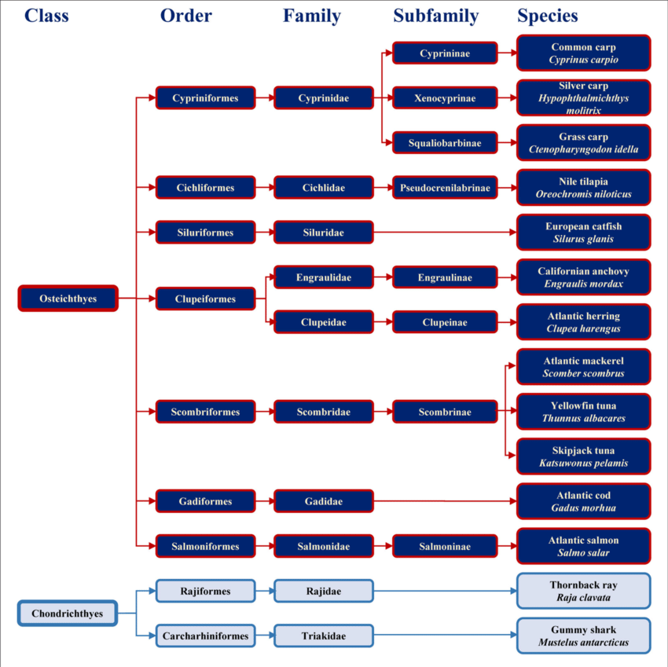

Slide 3
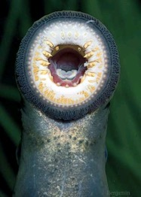
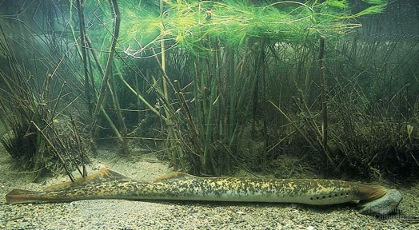
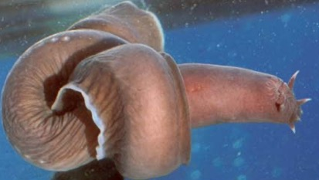
Superclass Agnatha
“without jaws”
Lack paired appendages
Most primitive of living fishes
Lampreys
Round mouth with rasping tongue; feed on tissue and blood of prey
Most, but not all, live as larvae in freshwater streams and migrate to sea as adults
Hagfishes
Mainly scavengers; lack rasping mouthparts; eyespots only
Lack a larval stage and live entirely in salt water.

Slide 4
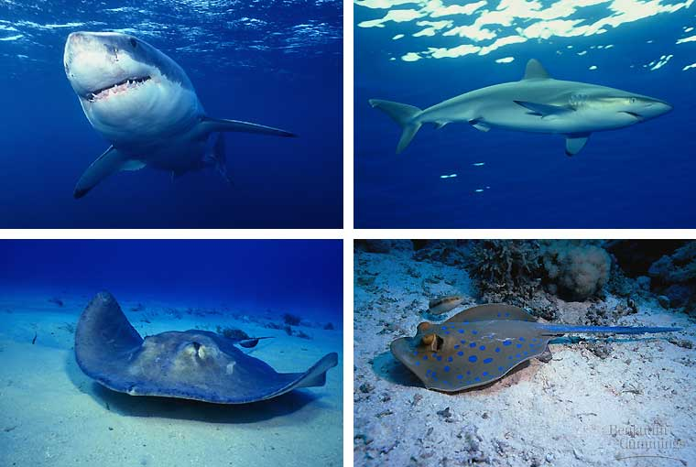
Class Chondrichthyes
Includes sharks, rays, and their relatives
Jaws and paired fins are well developed
Skeleton made of cartilage
Most are marine. There are about 1,000 living species.
Fossil shark teeth are quite common in USA

Slide 5
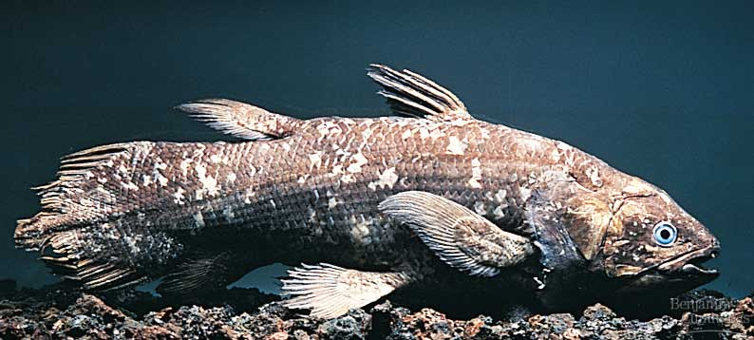
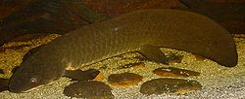
Class Osteichthyes
Bony Fishes
Lobe-finned Fishes
Lobe-finned Fishes are the ancestors of amphibians and all tetrapods
Modern lobe-finned fishes include lungfishes and coelacanths
All are freshwater. Lungfishes are found in Africa, South America, and Australia

Slide 6
Class Osteichthyes
Ray-finned Fishes
Fins are supported mainly by long, flexible rays. Modified for maneuvering, defense, and other functions.
Include the fish most familiar to USA. Bass, trout, perch, catfish, tuna, herring, etc.
Most numerous of all vertebrate classes. Number about 24,000 species
Occur in all habitats where fishes occur. Range from approximately 3 miles above sea level to 7 miles beneath it.

Slide 7
Bony Fish Characteristics
Endoskeleton made of bone
Breathe by drawing water across gills
Skin covered by scales
Glands in the skin secrete mucus that reduces drag during swimming
Swim bladder controls buoyancy of fish
Possess a lateral line system

Slide 8
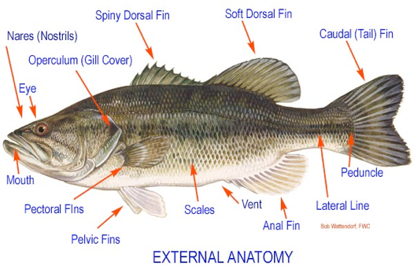
Parts of a Fish and Their Function
Fins: Fins move, stabilize and sometimes protect the fish. A fish may have paired fins (pectoral and pelvic fins), and unpaired fins (anal, caudal, and dorsal fins). Some fish do not have all of these fins, and their placement shows great variability.
The pelvic and pectoral fins are like the arms and legs of mammals. When they extend outward like oars (sunfish), the fish uses them for small maneuvers and in offsetting the propulsion effects of water going over the gills. When they extend outward like stubby wings, they may be used to prop the fish on the bottom or to hold on in strong currents
The position of the pectoral and pelvic fins provides an important means of identifying major groups of fish.

