Slide 1
Minimization of Circuits

Slide 2
The main purpose for this lesson is to introduce the following:
How can use the sum-of-products expansion of a circuit to find a set of logic gates.
Finding minimization of the Boolean function.
Karnaugh Maps (K-map).

Slide 3
Introduction
We can always use the sum-of-products expansion of a circuit to find a set of logic gates that will implement this circuit.
The sum-of products expansion may contain many more terms than are necessary.
Terms in a sum-of products expansion that differ in just one variable, so that in one term this variable occurs and in the other term the complement of this variable occurs, can be combined.

Slide 4
Example :
consider the circuit that has output 1 if and only if x = y = z = 1 or x = z = 1 and y = 0. The sum-of-products expansion of this circuit is
The two products in this expansion differ in exactly one variable, namely, y. They can be combined as
Hence, x z is a Boolean expression with fewer operators that represents the circuit in Figure 1 .

Slide 5
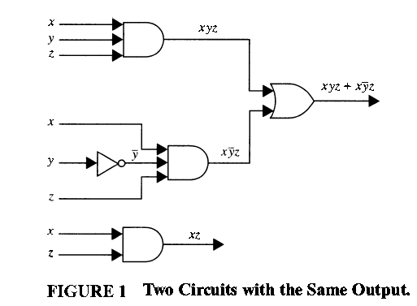
The second circuit uses only one gate, whereas the first circuit uses three gates and an inverter. Finding such a sum of products is called minimization of the Boolean function. Minimizing a Boolean function makes it possible to construct a circuit for this function that uses the fewest gates and
fewest inputs to the AND gates and OR gates in the circuit.

Slide 6
Karnaugh Maps (K-map)
There are four possible minterms in the sum-of-products expansion of a Boolean function in the two variables x and y. A K-map for a Boolean function in these two variables consists of four cells, where a 1 is placed in the cell representing a minterm if this minterm is present in the expansion.

Slide 7
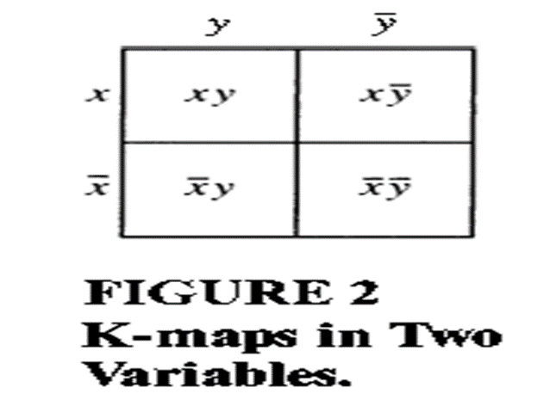
Cells are said to be adjacent if the minterms that they represent differ in exactly one literal. For instance, the cell representing $\overline{x}$y is adjacent to the cells representing xy and $\overline{x}\overline{y}$. The four cells and the terms that they represent are shown in Figure 2.

Slide 8
EXAMPLE 1
Find the K-maps for:

Slide 9
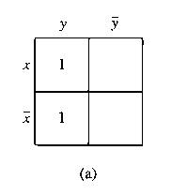
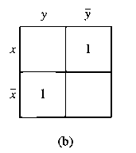
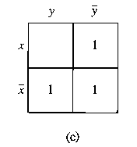
Solution:

Slide 10
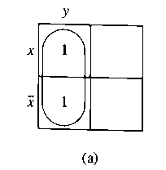
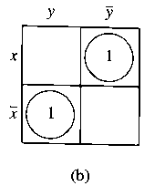
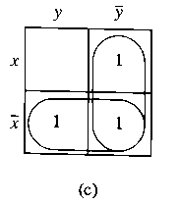
EXAMPLE 2
Simplify the sum-of-products expansions given in Example 1 .
Solution:

Slide 11
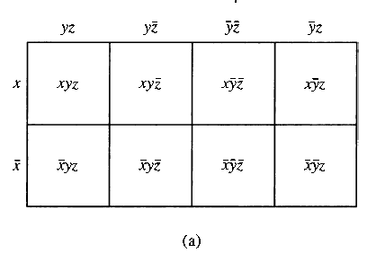
K-map in three variables
A K-map in three variables is a rectangle divided into eight cells. The cells represent the eight possible minterms in three variables. Two cells are said to be adjacent if the minterms that they represent differ in exactly one literal. One of the ways to form a K-map in three variables is shown in Figure 5(a).

Slide 12
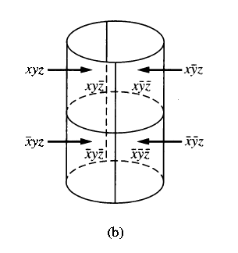
K-map in three variables
This K-map can be thought of as lying on a cylinder, as shown in Figure 5(b). On the cylinder, two cells have a common border if and only if they are adjacent.

Slide 13
Simplify a sum-of-products in 3 variables
To simplify a sum-of-products expansion in three variables, we use the K-map to identify blocks of minterms that can be combined. Blocks of two adjacent cells represent pairs of minterms that can be combined into a product of two literals; 2 x 2 and 4 x 1 blocks of cells represent minterms that can be combined into a single literal; and the block of all eight cells represents a product of no literals, namely, the function 1 .

Slide 14
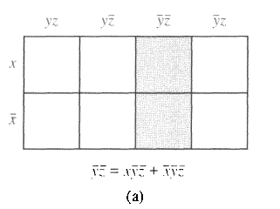
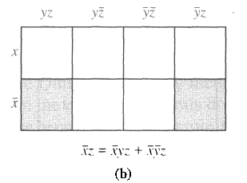
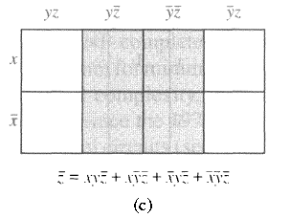
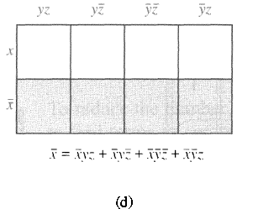
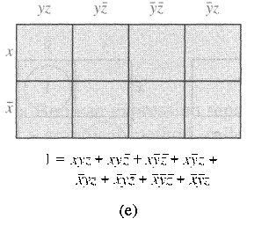
Simplify a sum-of-products in 3 variables
1 x 2 block
2 x 1 block
2 x 2 block
4 x 1 block
4 x 2 block

Slide 15
EXAMPLE 3
Use K-maps to minimize these sum-of-products expansions.

Slide 16
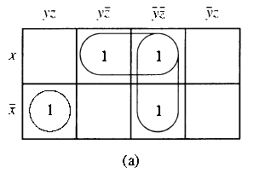
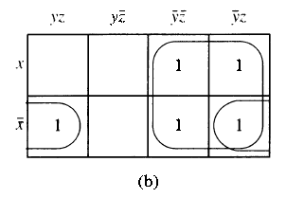
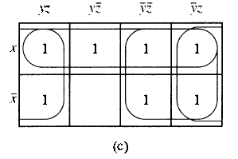
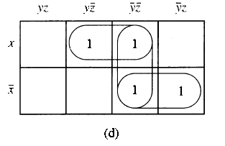
Solution:

Slide 17
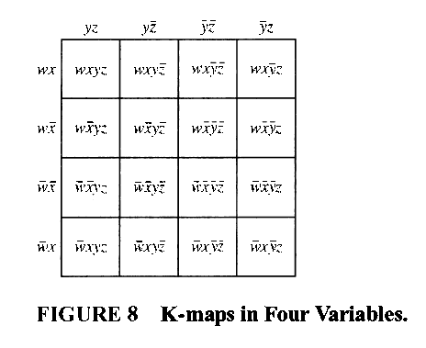
K-map in 4 variables
A K-map in four variables is a square that is divided into 16 cells. The cells represent the 16 possible minterms in four variables. One of the ways to form a K-map in four variables is shown in Figure 8.

Slide 18
Simplify a sum-of-products in 4 variables
The simplification of a sum-of-products expansion in four variables is carried out by identifying those blocks of 2, 4, 8, or 1 6 cells that represent minterms that can be combined.

Slide 19
EXAMPLE 4
Use K-maps to simplify these sum-of-products expansions:

Slide 20
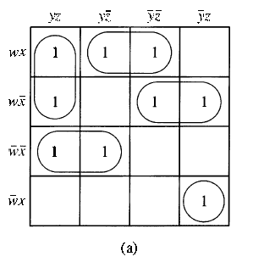
Solution:

Slide 21
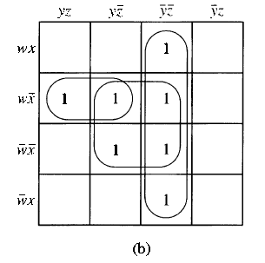

Slide 22
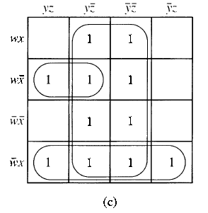

Slide 23
Homework
Page 841/842
1 (b)
2 (c)
3 (a,b,c)
5 (a,b)
7 (a,b).

