Slide 1
(Line Encoding )
Data Transmission And Digital Communication
Lecture 6– 2019/1440
By: Elham Sunbu

Slide 2
OUTLINE
What is line coding?
Line coding schemes.
- Unipolar encoding; NRZ
- Polar encoding; (NRZ, NR, Manchester, Differential Manchester)
Line coding examples.

Slide 3
Digital Transmission
Digital transmission is the sending of information over a communications media in the form of digital signals.
Digital signals are a sequence of voltage pulses.
They can propagate analog and digital data.
They offer better noise immunity, are cheaper to implement in hardware, more secure and also allow data compression, thereby optimally utilizing the transmission link.

Slide 4
Digital Signal Transmission
Digital Data transmitted as Digital Signals
Analog Data transmitted as Digital Signals
✔

Slide 5
Digital Data Transmitted as Digital Signals
To convert digital data into digital signals. It can be done in two ways, line coding and block coding.
For all communications, line coding is necessary whereas block coding is optional.
Here digital data is first encoded into a binary stream. These binary streams are then converted into digital signals by line coding techniques.
Notes:
Digital data → like for examples Alphabets
It first converted to 0s and 1s
However, as digital information cannot be sent directly in the form of 0s and 1s, it must be encoded in the form of a signal with two states, for example:
two voltage levels with respect to earth
the difference in voltage between two wires
the presence/absence of current in a wire
the presence/absence of light
...

Slide 6
What is Line Coding?
- is the process of converting binary data (a sequence of bits) to a digital signal.
- Different line codes have different attributes.
- Best line code has to be selected for a given application and channel condition.

Slide 7
Line Coding

Slide 9
Unipolar Encoding
Unipolar encoding uses only single voltage level to represent data.
It is also called Unipolar-Non-return-to-zero, because there is no rest condition
In this case, to represent binary 1, high voltage is transmitted and to represent 0, no voltage is transmitted
Notes:
It is also called Unipolar-Non-return-to-zero, because there is no rest condition i.e. it either represents 1 or 0.

Slide 10
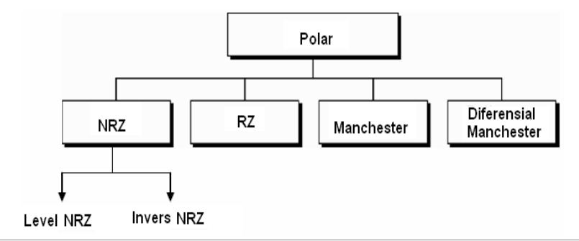
Polar Encoding
Polar encoding uses two voltage levels (positive and negative).
Polar encodings is available in four types:

Slide 11
Polar Encoding
1.1- Polar NRZL (Non Return to Zero) Level
- Bit 0 is mapped to a negative amplitude.
Bit 1 is mapped to a positive amplitude.

Slide 12
Polar Encoding
1.2- Polar NRZI (Non Return to Zero Inverted)
- Bit 0 mapped to no signal level transition.
- Bit 1 is mapped to signal level transition at the beginning of the bit interval.
Assumption:
- The signal level to the left of the bit is high – Fig. A and Fig. C
- The signal level to the left of the bit is low – Fig. B and Fig. D

Slide 13
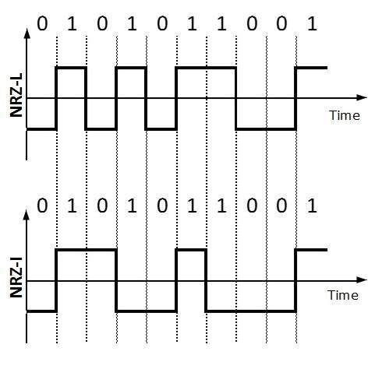
NRZ-L changes voltage level at when a different bit is encountered whereas NRZ-I changes voltage when a 1 is encountered.
Notes:
Problem with NRZ is that the receiver cannot conclude when a bit ended and when the next bit is started, in case when sender and receiver’s clock are not synchronized.

Slide 14
Polar Encoding
2- Polar RZ (Return to Zero)
- Bit 0 is mapped to a negative amplitude - A for the first half of the symbol duration followed by a zero amplitude for the second half of the symbol duration.
- Bit 1 is mapped to a positive amplitude +A for the first half of the bit duration followed by a zero amplitude for the second half of the bit duration.

Slide 15
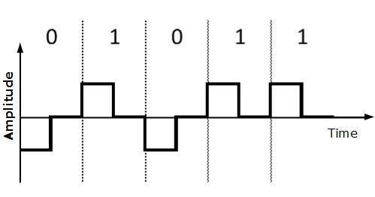

Slide 16
Polar Encoding
3- Polar Manchester Coding
- Bit 0 is sent by having a mid-bit transition from high to low.
- Bit 1 is sent by having a mid-bit transition from low to high.
Notes:
This encoding scheme is a combination of RZ and NRZ-L. Bit time is divided into two halves. It transits in the middle of the bit and changes phase when a different bit is encountered.

Slide 17
Polar Encoding
4- Polar Differential Manchester Coding
- Bit 0 is mapped to signal level transition at the beginning of the bit interval.
- Bit 1 is mapped to absence of signal level transition at the beginning of the bit interval.
Assumption:
The signal level to the left of the bit is high – Fig. A and Fig. C
The signal level to the left of the bit is low – Fig. B and Fig. D
Notes:
This encoding scheme is a combination of RZ and NRZ-I. It also transit at the middle of the bit but changes phase only when 1 is encountered.

Slide 18
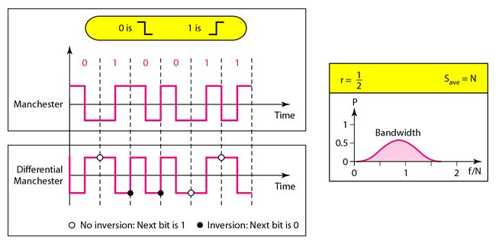

Slide 19
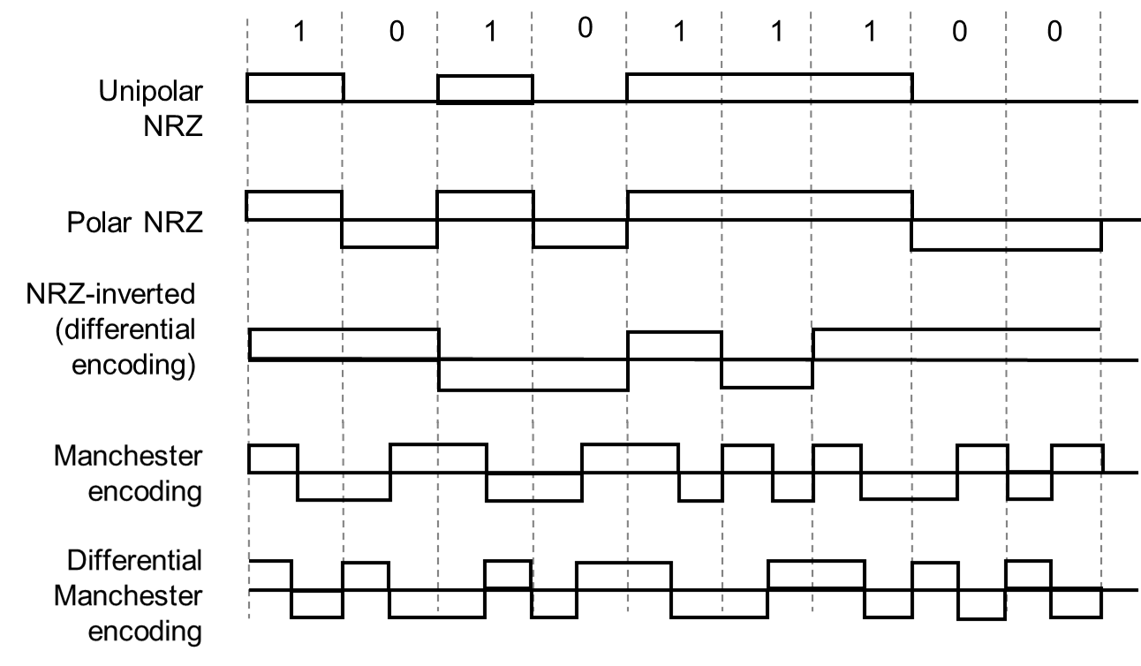
Line Coding Examples

Slide 20
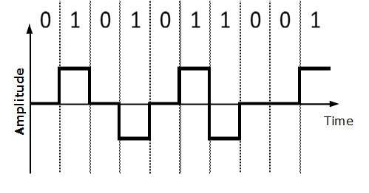
Bipolar Encoding
Bipolar encoding uses three voltage levels, positive, negative and zero. Zero voltage represents binary 0 and bit 1 is represented by altering positive and negative voltages.

Slide 21
Any Question?

Slide 22
Thank You

