Slide 1
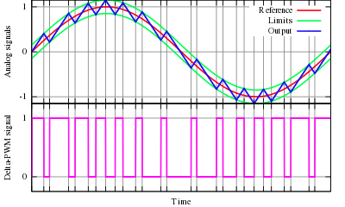
Lecture 3
Delta Modulation
1st semester 1440 - 2018

Slide 2
Outline
- Introduction.
- Basic Operation.
Delta Modulation.

Slide 3
Introduction
Delta modulation (DM) is an analog-to-digital signal conversion technique used for transmission of voice information where quality is not of primary importance.
PCM finds the value of the signal amplitude for each sample; DM finds the change from the previous sample.

Slide 4
Basic Operation
The operation of a delta modulator is:
to periodically sample the input message,
to make a comparison of the current sample with that preceding it,
and to output a single bit which indicates the sign of the difference between the two samples

Slide 5
Delta Modulation
In Delta Modulation, only one bit is transmitted per sample
That bit is a 1 if the current sample is more positive than the previous sample, and a 0 if it is more negative
Since so little information is transmitted, delta modulation requires higher sampling rates than PCM for equal quality of reproduction

Slide 6
Delta Modulation
1- A staircase approximation of the message signal is derived
The analog signal is approximated with a series of segments ( staircase approximation signal)
Each segment of the approximated signal is compared to the message signal:
If the approximation fall below the signal at any sampling epoch → the segment is increased by ∆.
If the approximation lies above the signal at any sampling epoch → the segment is diminished by ∆.
So, the time and amplitude axes are quantized.

Slide 7
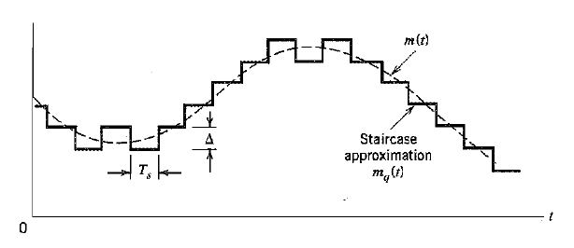

Slide 8
Delta Modulation
2- encoding
This scheme sends only one bit each segment.
if the segment at time t_{n+1} is higher in amplitude value than the segment at time t_{n}, → then a bit “1” is used to indicate the positive value.
If the segment is lower in value → resulting in a negative value, a “0” is used.

Slide 9
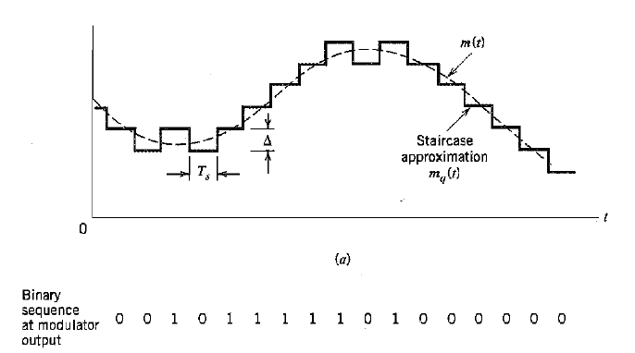
This scheme works well for small changes in signal values between samples.
If changes in amplitude are large, this will result in large errors.

Slide 10
Any Question?

