Slide 1
Lecture 2
Pulse Code Modulation (PCM)
1st semester 1440 - 2018

Slide 2
Outline
- Analogue to Digital conversion.
- Sampling (PCM).
- Pulse Code Modulation Advantages.
- Pulse Code Demodulation.

Slide 3
Analog to Digital Conversion
A digital signal is superior to an analog signal.
Digital is less prone to noise and distortion.
We can’t use analog signals for long distance (lose their strength, which means amplifiers are needed to amplify signal. However the amplifier creates distortion in the signal and adds some noise).
The tendency today is to change an analog signal (such as audio ,voice and music) to digital data.
Pulse Code Modulation (PCM) is a technique to convert analog data to digital signal.

Slide 4
Analog to Digital Conversion
The idea of digitizing analog signal started with telephone companies, to provide long distance services; They digitized the analog signal at the sender; The signal is converted back to analog at the receiver.
- Pulse Code Modulation (PCM):
1- Sampling (PAM).
2- Quantization.
3- Binary encoding.
4- Line or block coding.

Slide 5
1. Sampling (PAM)
The first step in PCM is sampling.
The analog signal is sampled at equal interval, every T_{s} s (sample interval)
The inverse of sampling interval is sampling rate or sampling frequency.
f_{s}= 1/T_{s}
Sampling rate: number of samples per second.

Slide 6
1. Sampling PAM (Pulse Amplitude Modulation)

Slide 7
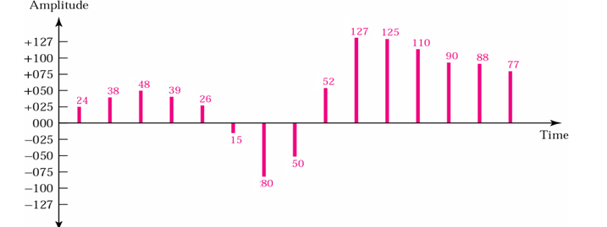
2. Quantized PAM Signal
The result of PAM is a series of pulses with amplitude values between the maximum and minimum amplitudes of the signal with real values.
Quantization: is a method of assigning integer values in a specific range to sampled instances.

Slide 8
3. Binary Encoding
Each quantized samples is translated into equivalent binary codes .

Slide 9
4. Line Encoding
- The binary digits are then transformed to a digital signal using one of the line encoding.

Slide 10
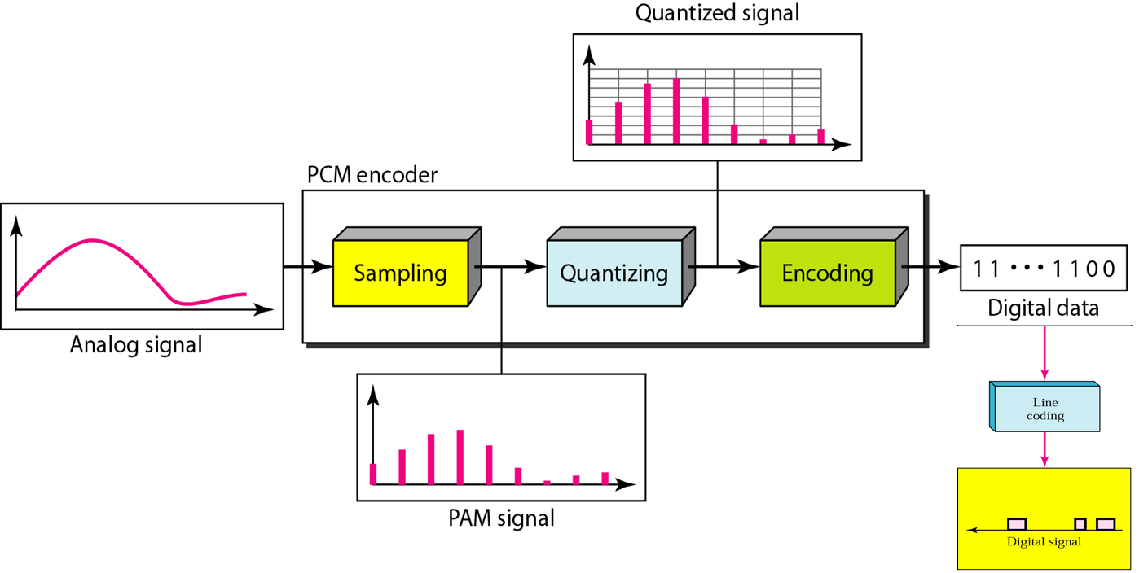
Components of PCM Encoder

Slide 11
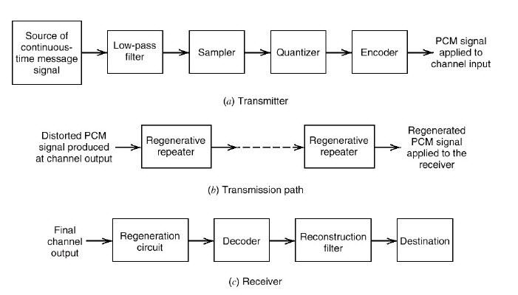
PCM Block
The basic elements of a PCM system

Slide 12
Pulse Code Modulation Advantages
Analog signal can be transmitted over a high speed digital communication system.
Probability of occurring error will reduce by the use of appropriate coding methods.
PCM is used in Telkom system, digital audio recording, digitized video special effects, digital video, voice mail.
PCM is also used in Radio control units as transmitter and also receiver for remote controlled cars, boats, planes.
The PCM signal is more resistant to interference than normal signal.

Slide 13
Pulse Code Demodulation
Pulse Code Demodulation: will be doing the same modulation process in reverse.
Demodulation starts with decoding process
During transmission the PCM signal will effected by the noise interference.

Slide 14
Any Question?

