Slide 1
KINGDOOM OF SAUDI ARABIA
King Saud University
College of Sciences - Department Botany & Microbiology
Plant Physiology
BIO 323
Dr. Abdulrahman Al-hashimi

Slide 2
Lecture 6
Photosynthesis in Plants
1- Light reactions
2- Carbon reactions
3- Physiological and ecological considerations

Slide 3
Introduction
The life on the earth depends mainly on the energy derived from the sun.
The Photosynthesis is the only process of biological importance that can harvest this energy.
The term Photosynthesis means “synthesis using light.”
Photosynthetic organisms use the solar energy to synthesize carbon compounds that cannot be formed without the energy.

Slide 4
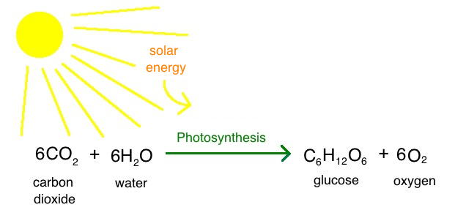
Introduction
Photosynthesis converts light energy to chemical energy.
The light energy drives the synthesis of carbohydrates from carbon dioxide and water with the generation of oxygen:

Slide 5
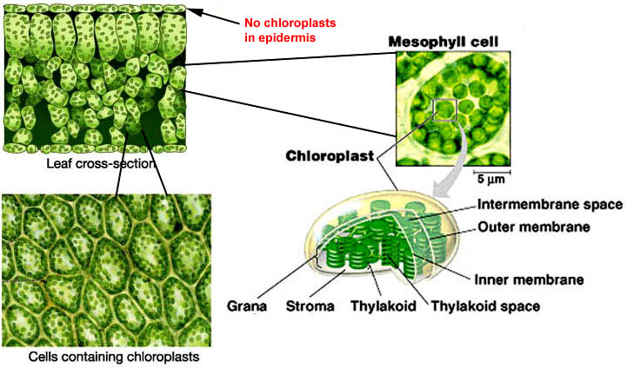
Introduction
The active photosynthetic tissue in plants is mesophyll of leaves.
Mesophyll cells have many chloroplasts, sites of photosynthesis.

Slide 6
Introduction
In the photosynthesis, the plant uses the solar energy to oxidize water (releasing oxygen), and to reduce carbon dioxide (forming large carbon compounds, sugars).
The complex series of photosynthesis reactions include:
Light-dependent reactions (light reactions),
(also known as thylakoid reactions ).
Light-independent reactions (dark reactions),
(also known as Carbon fixation reactions).

Slide 7
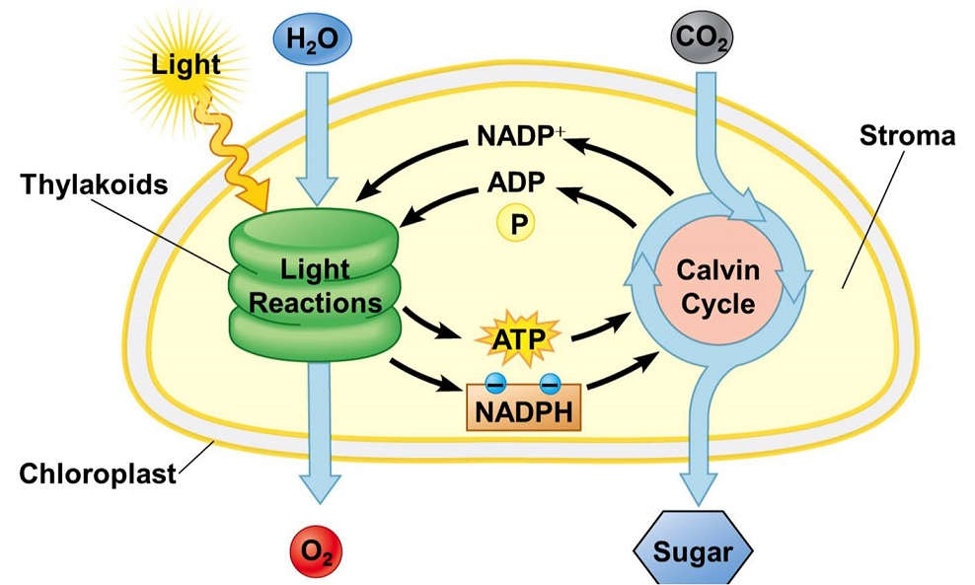
Introduction
Both stages of photosynthesis take place in chloroplasts.
Light reactions take place in thylakoid membranes.
Dark reactions (Calvin Cycle) take place in stroma.

Slide 8
Light reactions
The photosynthesis process begins with the absorption of light by specialized organic molecules, called pigments.
The thylakoid membranes contain photosynthetic pigments involved in the light reactions of photosynthesis.
The end products of the light reactions are two molecules needed for the next stage of photosynthesis ;
The energy storage molecule (ATP)
The electron carrier (NADPH)

Slide 9
Light reactions
In the chloroplast, the light energy is converted into chemical energy by two different functional units called Photosystems, found in the thylakoid membranes.
Photosystems are pigment-protein complexes involved in photosynthesis mainly for the absorption of light and transfer of energy and electrons.
The absorbed light energy is used to power the transfer of electrons through a series of compounds that act as electron donors and electron acceptors.

Slide 10
Light reactions
The Electromagnetic Spectrum is the range of all possible wavelengths of the Electromagnetic Radiation given by the Sun, ranging from high energy Gamma rays through Visible light and down to low energy radio waves.
The Sunlight is a portion of the electromagnetic radiation, in particular infrared, visible, and ultraviolet light.
The Visible light is a small fraction of the electromagnetic spectrum between Infrared (IR) and Ultraviolet rays (UV).

Slide 11
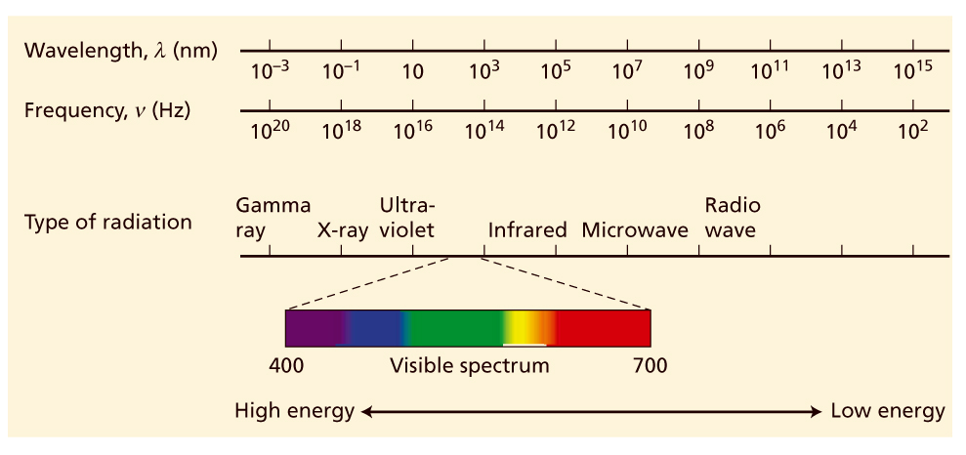
Light reactions
Electromagnetic Spectrum
Human eyes can see only a narrow range of wavelengths, visible region, extends from about 400 nm, nanometres (violet) to about 700 nm (red). Short-wavelength (high-frequency) light has a high energy and long wavelength (low-frequency) light has a low energy.

Slide 12
Light reactions
The energy of sunlight is first absorbed by plants pigments.
All pigments active in photosynthesis, such as chlorophylls and carotenoids are found in the chloroplast.
Plant pigments absorb specific wavelengths of the light.
Chlorophylls absorb the red (long wavelength) and the blue (short wavelength) regions of the visible light spectrum, while reflect the green light, making the plant appear green.
Carotenoids absorb light in blue-green and violet regions and reflect yellow, red, and orange wavelengths.

Slide 13
Light reactions
Plant leaves usually appear green because the large amount of chlorophylls may mask the appearance of other pigments.
Some plants have red leaves, in this situation the higher amounts of red pigment masks the chlorophylls.
There are various types of chlorophylls;
Chlorophyll a and Chlorophyll b are found in green plants.
Chlorophyll c and Chlorophyll d are found in cyanobacteria.

Slide 14
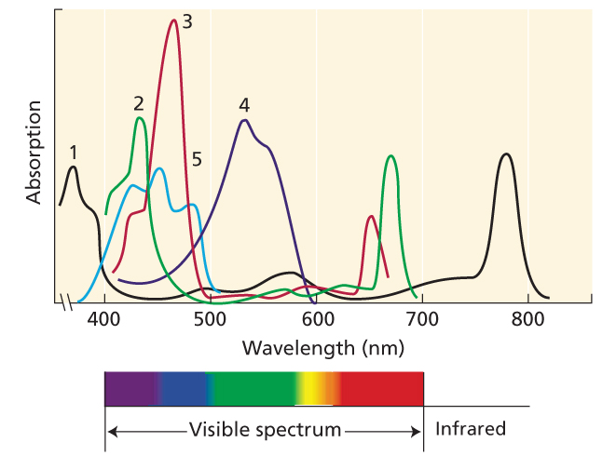
Light reactions
Absorption spectra of some photosynthetic pigments
Curve 1: Bacteriochlorophyll
Curve 2: Chlorophyll a
Curve 3: Chlorophyll b
Curve 4: Phycoerythrobilin
Curve 5: β-carotene.

Slide 15
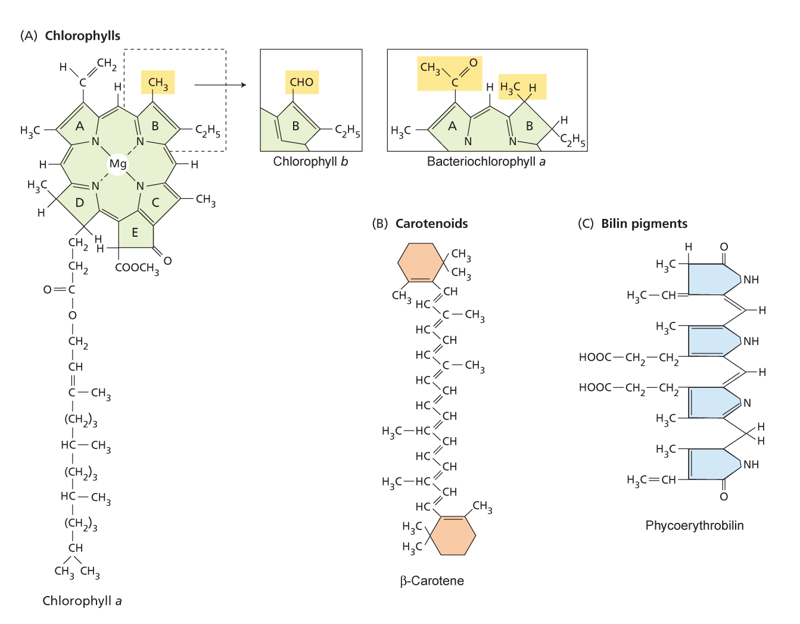
Light reactions
Molecular structure of some photosynthetic pigments

Slide 16
Light reactions
The chlorophylls (found in plants) and bacteriochlorophylls (found in certain bacteria) are the typical pigments of photosynthesis, but all organisms contain a mixture of more than one kind of pigment, each serving a specific function.
The carotenoids are found in all photosynthetic organisms.
The light absorbed by the carotenoids is transferred to chlorophyll for photosynthesis; because of this role they are called accessory pigments.

Slide 17
Light reactions
A portion of the light energy absorbed by pigments is stored as chemical energy by the formation of chemical bonds.
This conversion of energy from one form to another is a complex process that depends on cooperation between many pigment molecules and a group of electron transfer proteins.
The majority of the pigments serve as an antenna complex, collecting light and transferring the energy to the reaction center complex, where the chemical oxidation and reduction reactions leading to long-term energy storage.

Slide 18
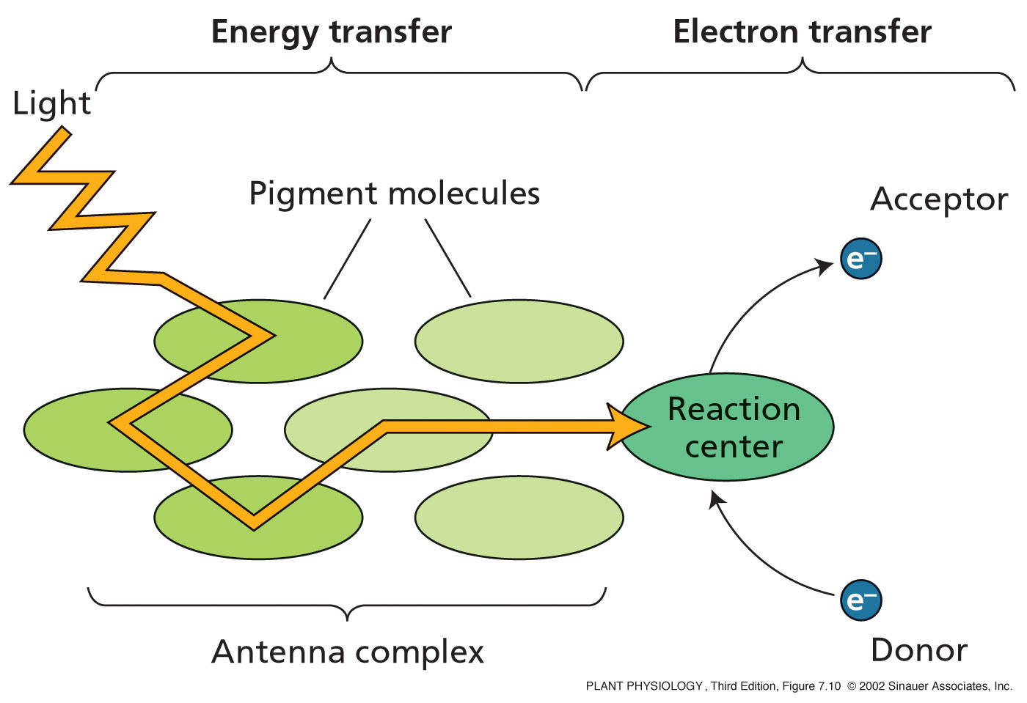
Light reactions
Basic concept of energy transfer during photosynthesis
Many pigments together serve as an antenna, collecting light and transferring its energy to the reaction center, where chemical reactions store some of the energy by transferring electrons from a chlorophyll pigment to an electron acceptor molecule. An electron donor then reduces the chlorophyll again.

Slide 19
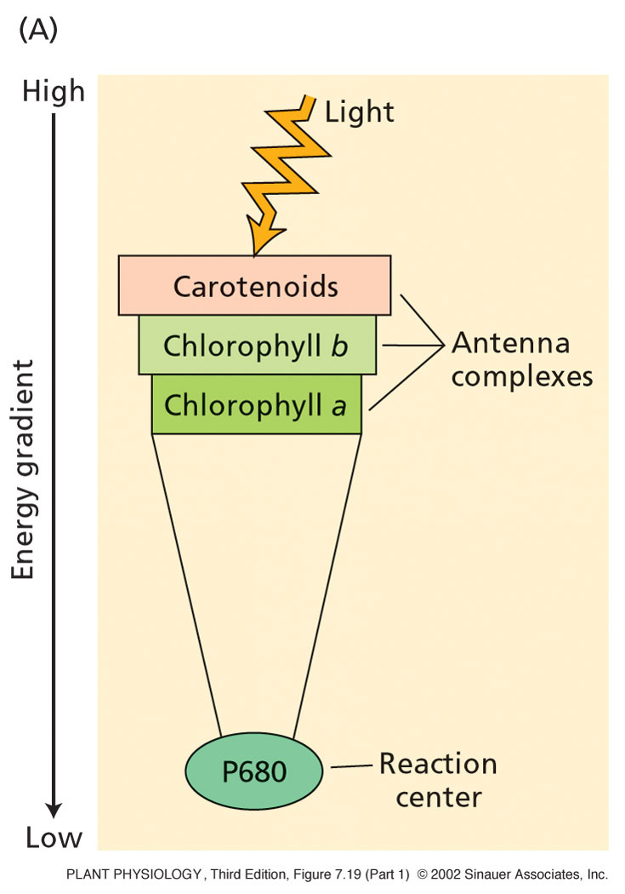
Light reactions
Light energy moves down an energy gradient
towards the reaction center
The energy of different pigments increases with the distance from the reaction center,
Pigments closer to the reaction center are lower in energy than those farther from the reaction center.

Slide 20
Light reactions
Antennal pigment/reaction center complexes are also referred to as photosystems.
There are 2 photosystems;
Photosystem I (PSI) absorbs far-red light of wavelengths greater than 680 nm, and produces a strong reductant capable of reducing NADP⁺ to NADPH.
Photosystem II (PSII) absorbs red light of 680 nm, and produces a very strong oxidant capable of oxidizing water (releasing oxygen).

Slide 21
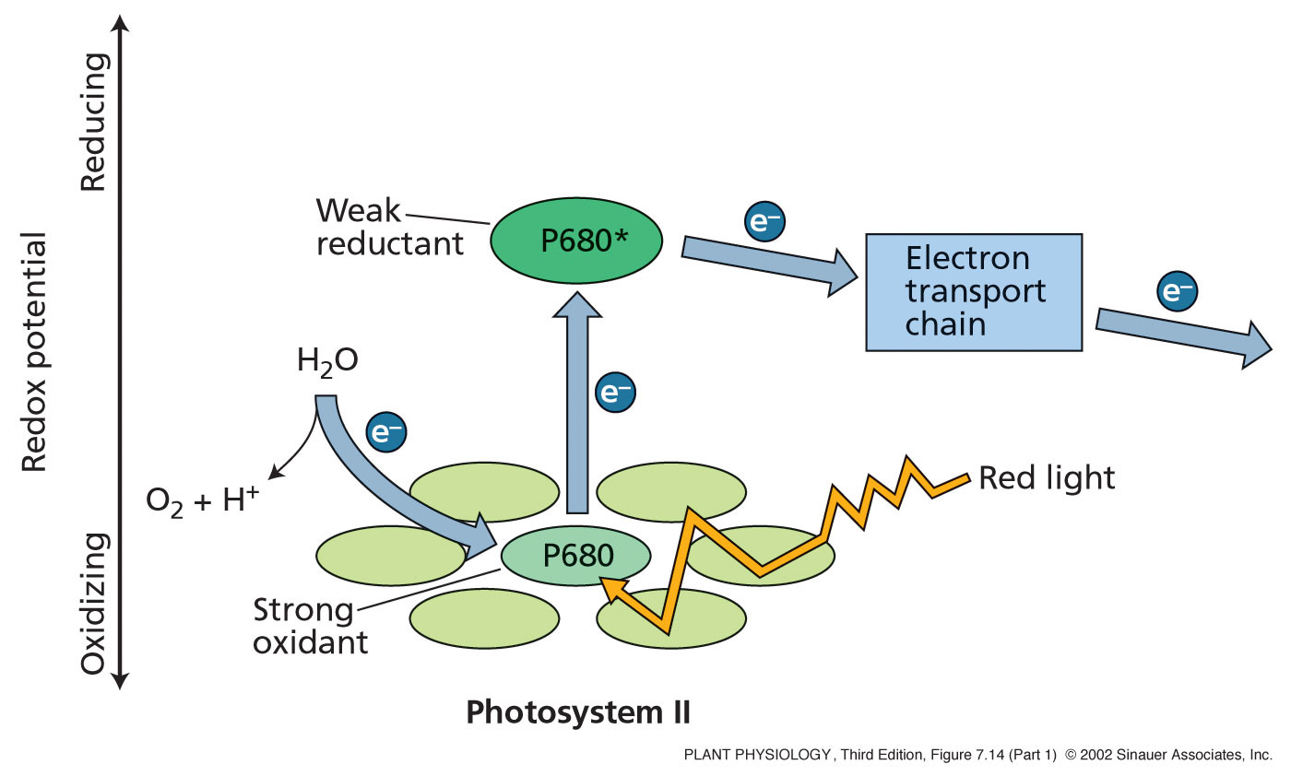
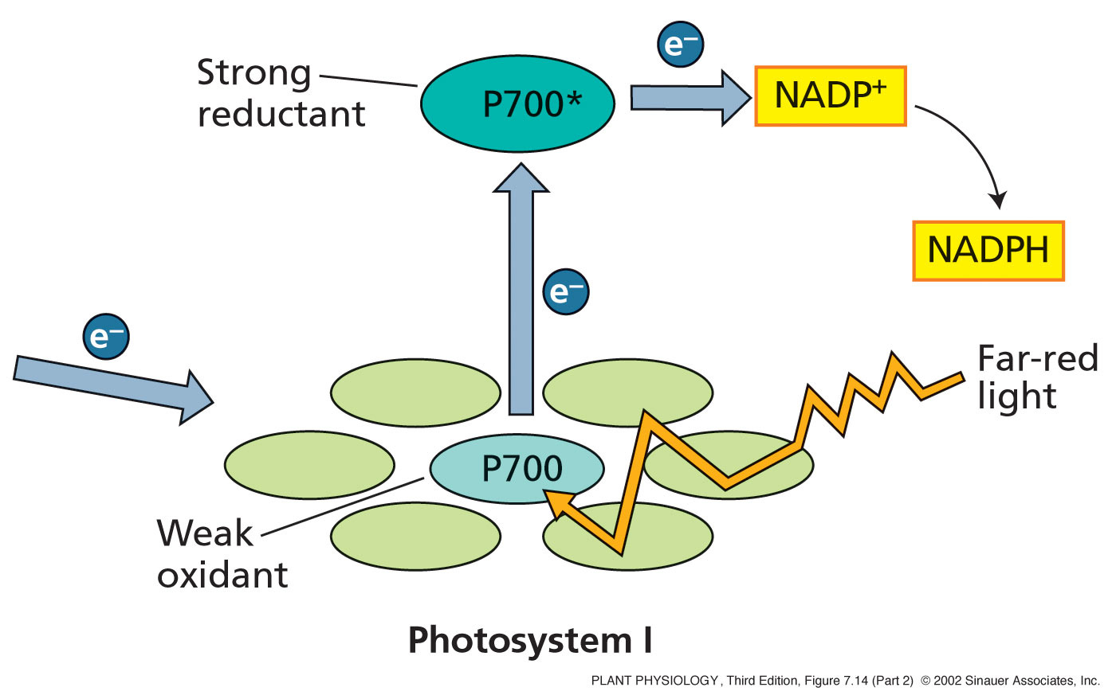
Light reactions
Electrons ejected from the Chlorophyll travel through
a series of electron carriers organized in the “ Z Scheme ”

Slide 22
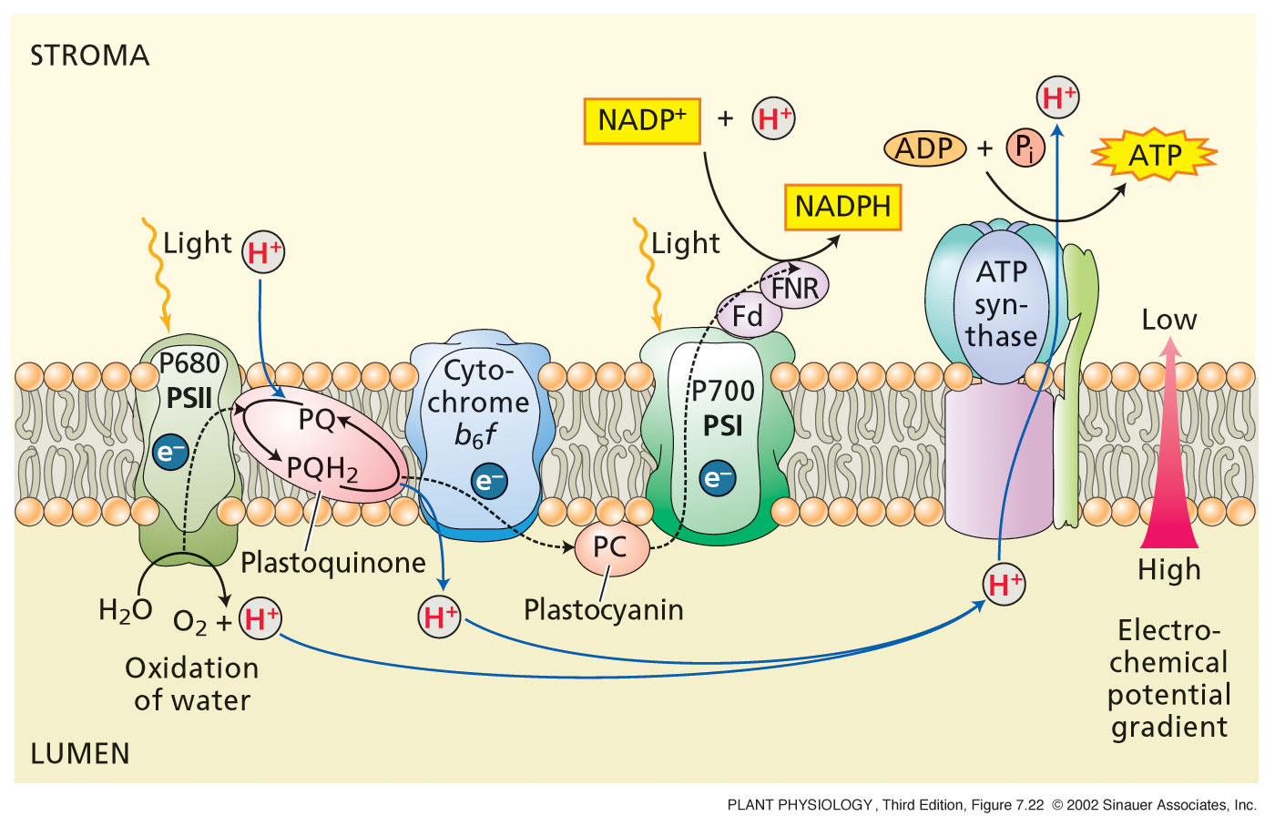
Light reactions
Four protein complexes in the thylakoid are involved in light reactions
PSII oxidizes water to O₂ and protons are released. PSI reduces NADP⁺ to NADPH.
Cytochrome b₆ f transports Protons. ATP synthase enzyme synthesize ATP

Slide 23
Light reactions
Chloroplasts contain DNA and encode and synthesize some of the proteins that are essential for photosynthesis.
Additional proteins are encoded by nuclear DNA, synthesized in the cytosol, and imported into the chloroplast.
Chlorophylls are synthesized in a biosynthetic pathway involving several steps, each is very carefully regulated.
Once the Chlorophylls are synthesized, proteins and pigments are assembled into the thylakoid membrane.

Slide 24
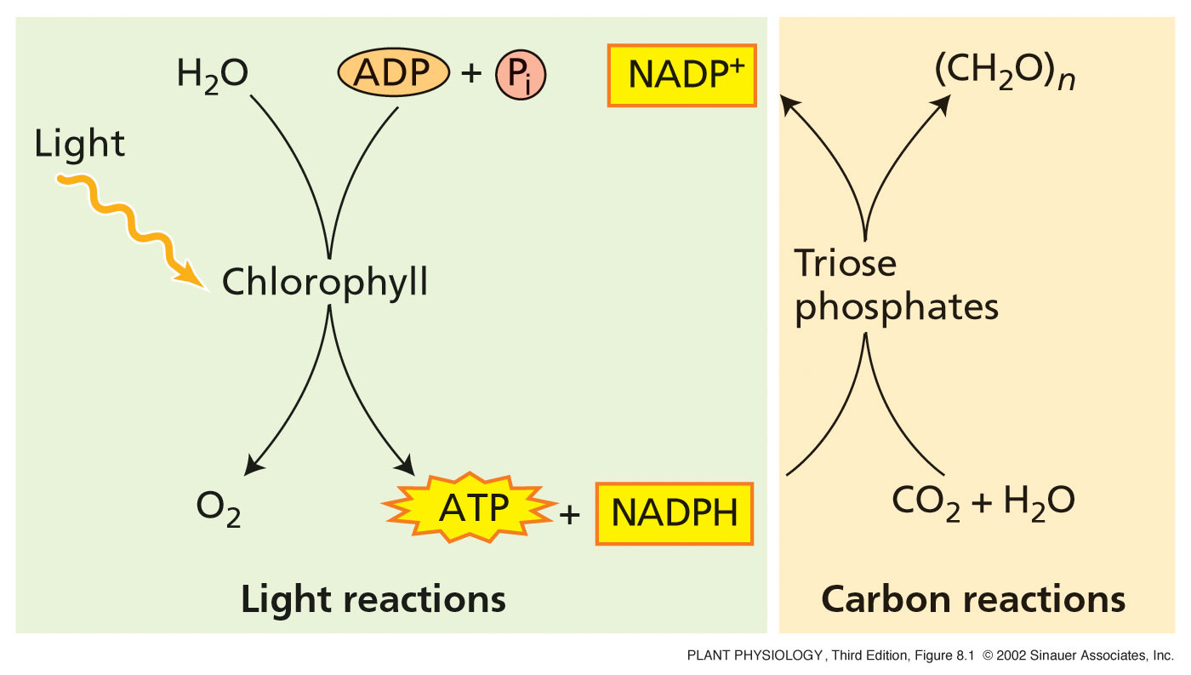
Carbon reactions
ATP and NADPH produced from the light reactions are used for the synthesis of sugars in the carbon fixation reactions.

Slide 25
Carbon reactions
The carbon reactions are independent of light, and so they also known as dark reactions.
The reduction of CO₂ to carbohydrate are coupled to the consumption of NADPH and ATP by enzymes found in the stroma, the soluble phase of chloroplasts.
All photosynthetic eukaryotes, from alga to higher plants, reduce CO₂ to carbohydrate by the same basic mechanism.

Slide 26
Carbon reactions
The photosynthetic carbon reduction cycle originally described for C₃ plants and is known as Calvin cycle.
The Calvin cycle was explained as a result of a series of experiments conducted by Melvin Calvin and his colleagues in the 1950s, for which a Nobel Prize was awarded in 1961.
Other metabolic pathways associated with photosynthetic fixation of CO₂, such as C₄ photosynthetic carbon assimilation cycle is also dependent on the basic Calvin cycle.

Slide 27
The Calvin Cycle
The Calvin cycle proceeds in three stages :
Carboxylation of CO₂ acceptor (ribulose-1,5-bisphosphate), by the enzyme ribulose bisphosphate carboxylase/oxygenase (rubisco), forming two molecules of 3-phosphoglycerate, the first stable intermediate of the Calvin cycle.
Reduction of 3-phosphoglycerate, forming glyceraldehyde-3-phosphate (a carbohydrate).
Regeneration of the CO₂ acceptor ribulose-1,5-bisphosphate from glyceraldehyde-3-phosphate.

Slide 28
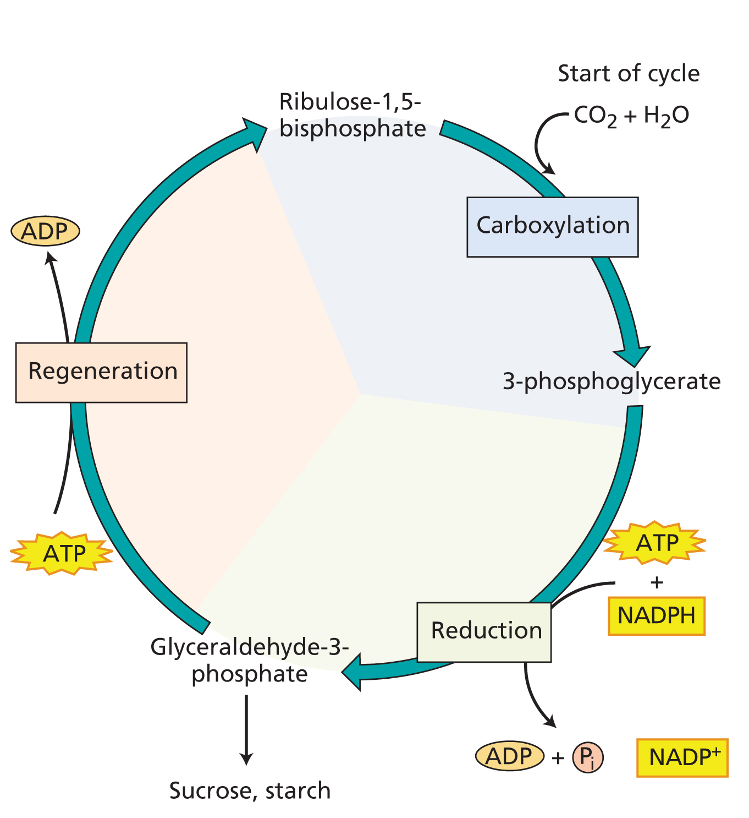
The Calvin Cycle

Slide 29
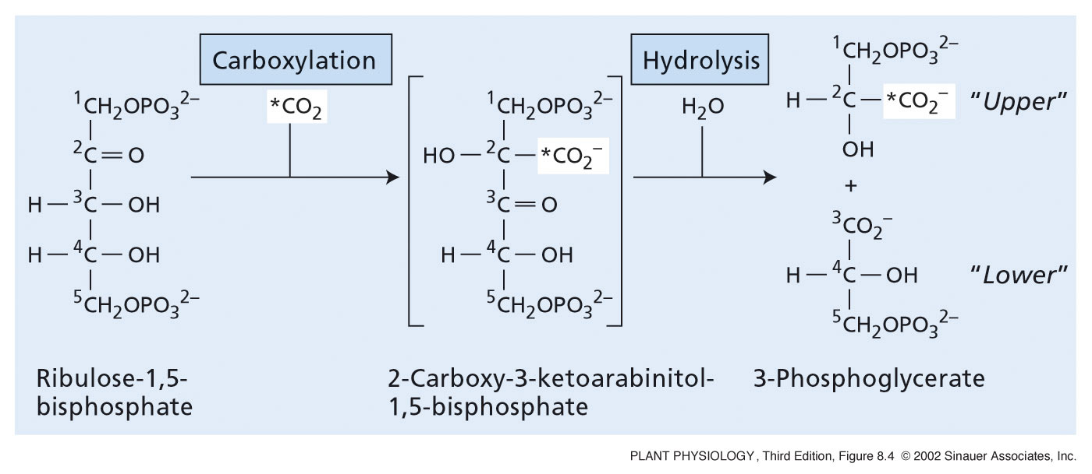
The Calvin Cycle
The carboxylation of ribulose-1,5-bisphosphate Rubisco

Slide 30
The Calvin Cycle
The Carbon in CO₂ is the most oxidized form found in the nature (+4).
The carbon of the first stable intermediate;
3-phosphoglycerate, is more reduced (+3).
It is further reduced in the glyceraldehyde-3-phosphate (+1).
The reactions of the Calvin cycle complete the reduction of atmospheric carbon, and consequently facilitate its incorporation into organic compounds.

Slide 31
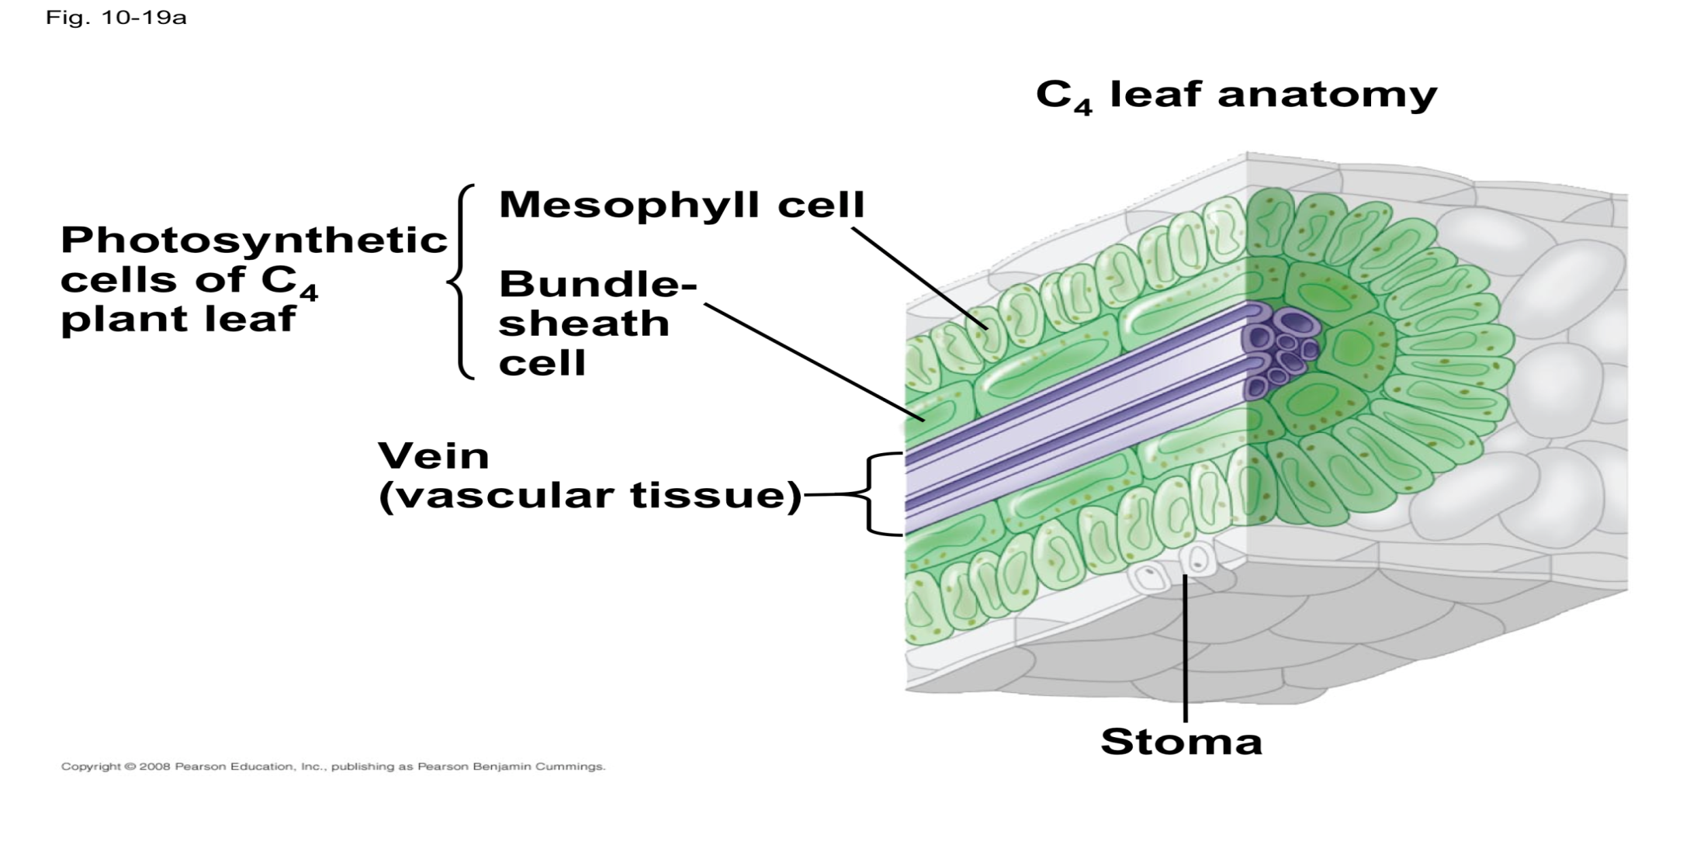
The C₄ photosynthetic carbon cycle
The basic C₄ photosynthetic carbon cycle involves four stages in two different cell types; Mysophyl cells and Bundle sheath cells.
Transport of metabolites between mesophyll and bundle sheath cells is driven by diffusion gradients along numerous plasmodesmata.

Slide 32
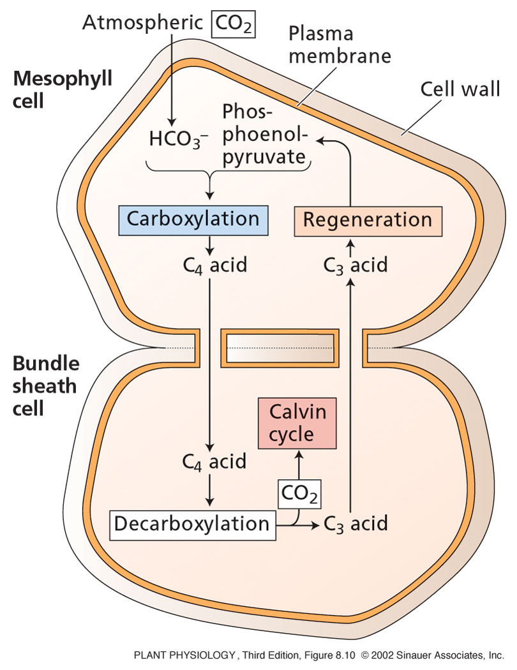
The C₄ photosynthetic carbon cycle
Four stages in two different cell types:
(1) Fixation of CO₂ by the carboxylation of phosphoenolpyruvate in mesophyll cells to form a C₄ acid.
(2) Transport of the C₄ acids to the bundle sheath cells;
(3) Decarboxylation of the C₄ acids within the bundle sheath cells and generation of CO₂, which is then reduced to carbohydrate via Calvin cycle
(4) Transport of the C₃ acid that is formed by the decarboxylation step back to mesophyll cells and regeneration of the CO₂ acceptor phosphoenolpyruvate
Low
[CO₂]
High
[CO₂]

Slide 33
C₃ Plants versus C₄ plants
The C₃ in C₃ photosynthesis refers to the first stable molecule formed (3-carbon) from an enzyme catalyzed CO₂ fixation.
In the C₄ photosynthesis, the first stable molecule formed from the fixation of CO₂ is a 4-carbon organic acid.
In C₃ plants, the CO₂ fixation takes place only at one place.
In C₄ plants, the CO₂ fixation takes place twice in two cells connected via plasmodesmata (one in a mesophyll cell, second in a bundle sheath cell).

Slide 34
C₃ Plants versus C₄ plants
C₃ plants: such as wheat, rice, potatoes, sugar beet, beans).
C₄ plants: such as corn, sugarcane, sorghum)
The C₃ plants are favored in the environments where the water is abundant, temperature and light levels are moderate (temperate climates).
The C₄ plants are favored in the environments where the water is limiting and light and temperatures are high (tropical/subtropical habitats).

Slide 35
Synthesis of Starch and Sucrose
Carbohydrates synthesized by the Calvin cycle are converted into storage forms of energy and carbon (sucrose & starch).
In most plants, the sucrose is the principal form of carbohydrate translocated throughout the plant phloem.
The sucrose is synthesized in the cytosol, and its synthesis is regulated by phosphorylation of sucrose phosphate synthase.
The starch is is synthesized in the chloroplast.
The synthesis of the starch during the day can be separated from its breakdown, to provide energy to the plant at night.

Slide 36
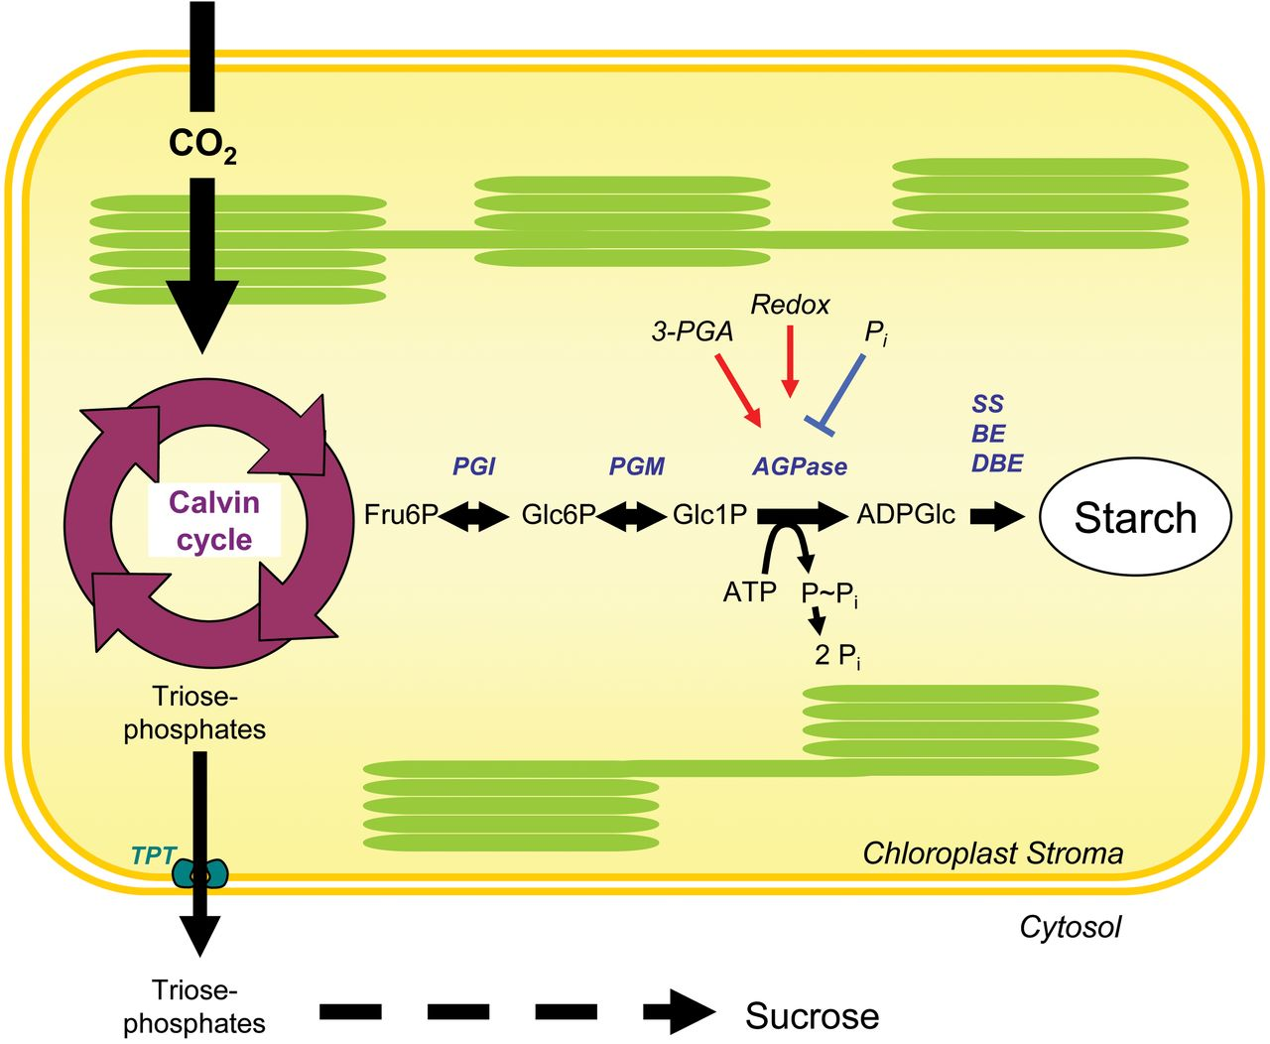
Synthesis of Starch and Sucrose

Slide 37
Physiological and Ecological Considerations
The impact of the environment on photosynthesis is of interest to both plant physiologists and agronomists.
From a physiological point of view, it is of great importance to understand how photosynthesis responds to different environmental factors such as light, ambient CO₂ concentrations, and temperature.
The dependence of photosynthetic processes on environment is also important to agronomists because plant productivity depends strongly on the photosynthetic rates.

Slide 38
Physiological and Ecological Considerations
Three major metabolic steps have been identified as important for optimal photosynthetic performance:
Rubisco activity
Regeneration of ribulose bisphosphate (RuBP)
Metabolism of the triose phosphates
The first two steps (Rubisco activity and RuBP regeneration) are the most prevalent under natural conditions.
Different environmental factors can limit photosynthetic rates.

Slide 39
Physiological and Ecological Considerations
Effects of light and CO₂ on Photosynthesis
Both the amount of light and the amount of CO₂ determine the photosynthetic response of leaves.
In some situations, photosynthesis is limited by an inadequate supply of light or CO₂. In other situations, absorption of too much light can cause severe problems.

Slide 40
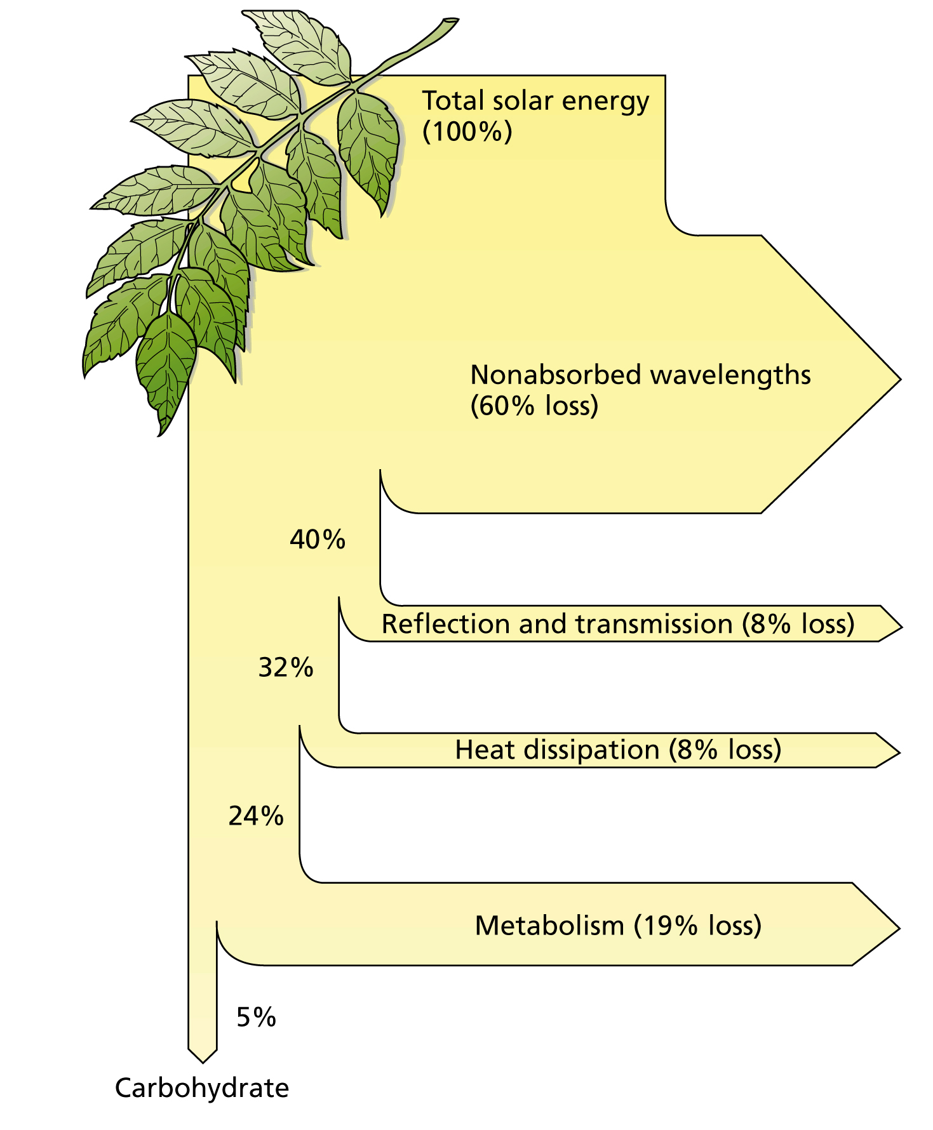
Physiological and Ecological Considerations
Of the total energy, only 5% is converted into carbohydrates

Slide 41
Physiological and Ecological Considerations
Plant adaptation to Sun and Shade
Some plants have enough developmental plasticity to adapt to a range of light regimes, such as leaf movement (orientation) in sun-tracking plants.
(A)
(B)
(A) Initial leaf orientation in the lupine.
(B) Leaf orientation 4 hours after exposure to oblique light,
to maximize light absorption.

Slide 42
Physiological and Ecological Considerations
Effect of heat load on the leaf
Sunlight imposes a substantial heat load on the leaf, which is dissipated back into the air by long-wavelength radiation (Heat dissipation).
The absorption and dissipation of energy from sunlight by the leaf.
The imposed heat load must be dissipated in order to avoid damage to the leaf. The heat load is dissipated by emission of long-wavelength radiation, by sensible heat loss to the air surrounding the leaf, and by the evaporative cooling by transpiration.

Slide 43
Any
QUESTIONS ?

