Slide 1
The OSI Model and the TCP/IP Protocol Suite
Outline:
Protocol Layers
OSI Model
TCP/IP Model
Addressing

Slide 2
Application Layer
This layer relates to the services that enable the user to access the network.
It provide user interfaces and support user applications or services, such as software for file transfers, database access, WWW, Sand e-mail.
In other words, it serves as a window through which application processes can access network services.
This would be the layer that a programmer uses to allow his application to access a network service, such as linking into a database.
The major duties of this layer: mail services, file transfer and access, remote log-in, accessing WWW.

Slide 3
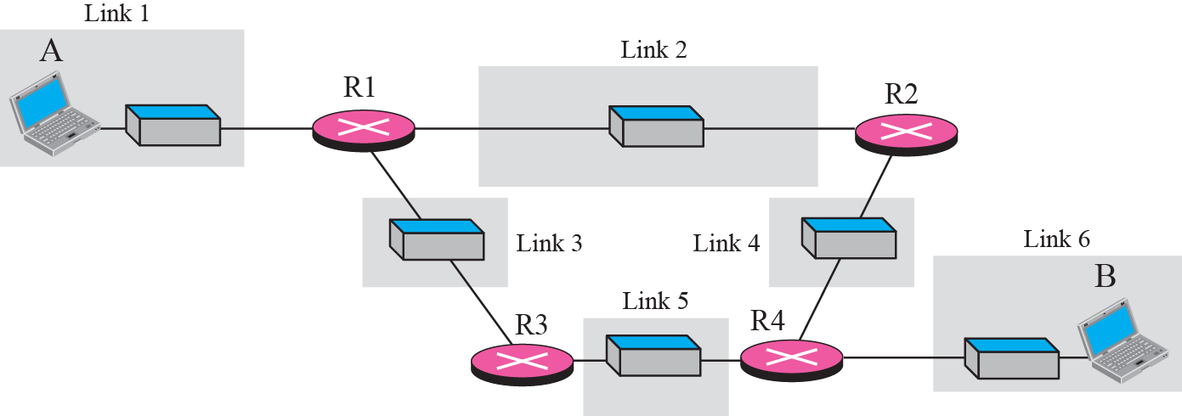
Communication at application layer

Slide 4
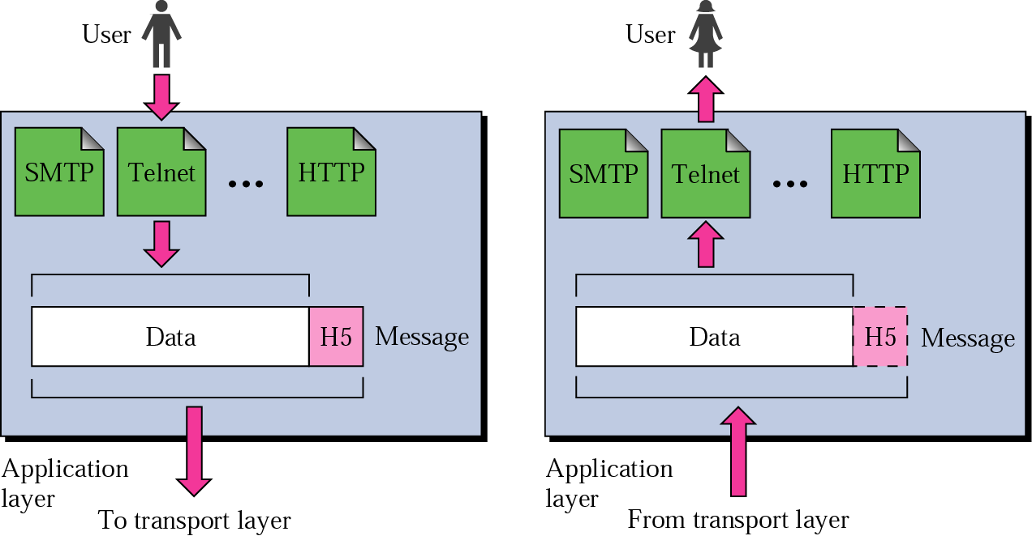
Note
The unit of communication at the application layer is a message.

Slide 5
Presentation Layer
It is a layer in the OSI model.
The presentation layer is responsible for translation, compression, and encryption.
Deals with the actual formatting of the data.
For example, data might be converted from EBCDIC to ASCII formatting so that the receiving node can understand it.

Slide 6
Session Layer
It is a layer in the OSI model.
the session layer, allows two applications on different computers to open, use, and close a connection called a session.
(A session is a highly structured dialog between two workstations.)
Functions:
Dialog control
It also makes sure the session is orderly establishing, which node transmits first, how long it can transmit, and what to do in case of an error.
It performs name-recognition and other functions, such as security, that are needed to allow two applications to communicate over the network.
Synchronization
The session layer synchronizes user tasks by placing checkpoints in the data stream.
The checkpoints break the data into smaller groups for error detection. It allows information of different streams, perhaps originating from different sources, to be properly combined or synchronized.
An example application is web conferencing, in which the streams of audio and video must be synchronous to avoid so-called lip synch problems. It ensures that the person displayed on screen is the current speaker.

Slide 7
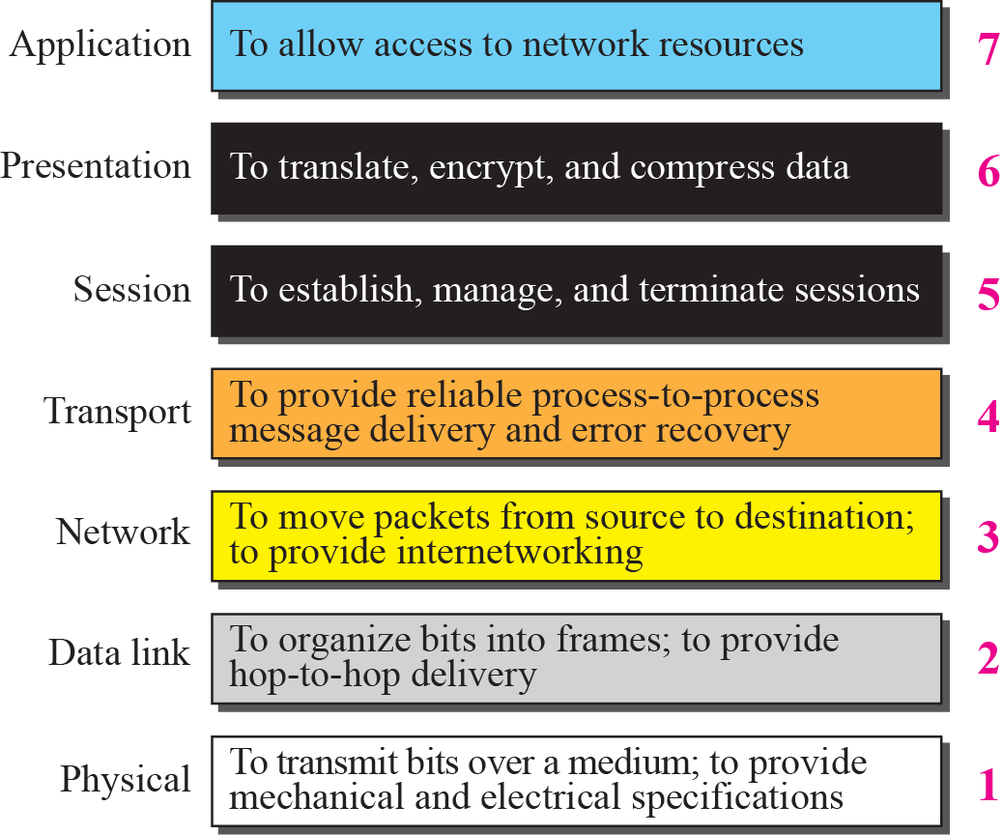
Summery of OSI Layers

Slide 8
ADDRESSING
Four levels of addresses are used in an internet employing the TCP/IP protocols:
physical address
logical address
port address
application-specific address.
Each address is related to a one layer in the TCP/IP architecture

Slide 9
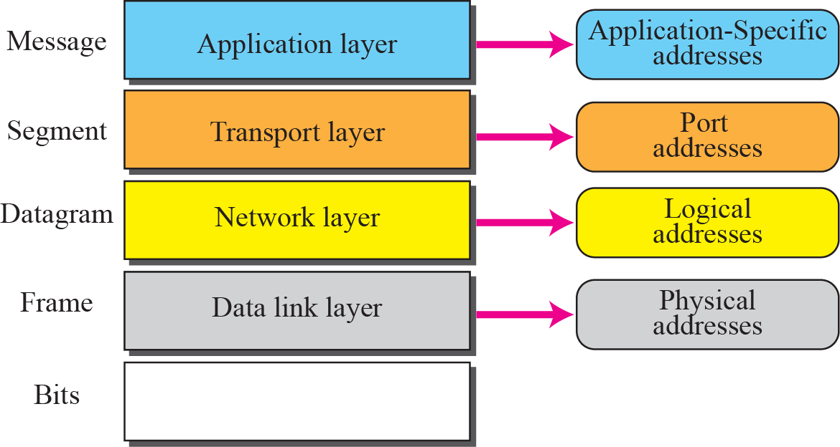

Slide 10
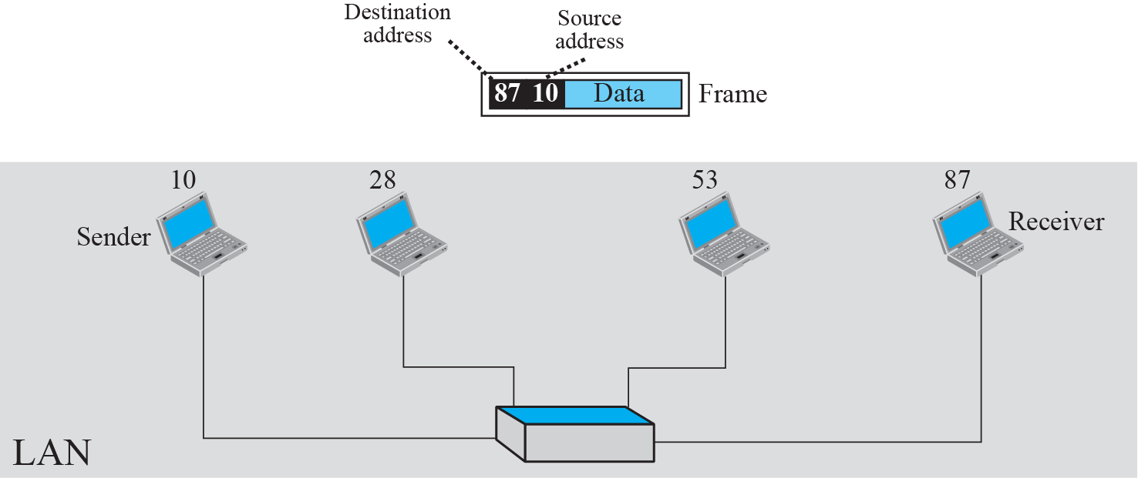
Example 1: physical addresses

Slide 11
Example 1: physical addresses
In the previous figure a node with physical address 10 sends a frame to a node with physical address 87. The two nodes are connected by a link (a LAN). At the data link layer, this frame contains physical (link) addresses in the header. These are the only addresses needed. The rest of the header contains other information needed at this level. As the figure shows, the computer with physical address 10 is the sender, and the computer with physical address 87 is the receiver. The data link layer at the sender receives data from an upper layer. It encapsulates the data in a frame. The frame is propagated through the LAN. Each station with a physical address other than 87 drops the frame because the destination address in the frame does not match its own physical address. The intended destination computer, however, finds a match between the destination address in the frame and its own physical address.

Slide 12
Physical Address
As we will see later, most local area networks use a 48-bit (6-byte) physical address written as 12 hexadecimal digits; every byte (2 hexadecimal digits) is separated by a colon, as shown below:
07:01:02:01:2C:4B
A 6-byte (12 hexadecimal digits) physical address

Slide 13
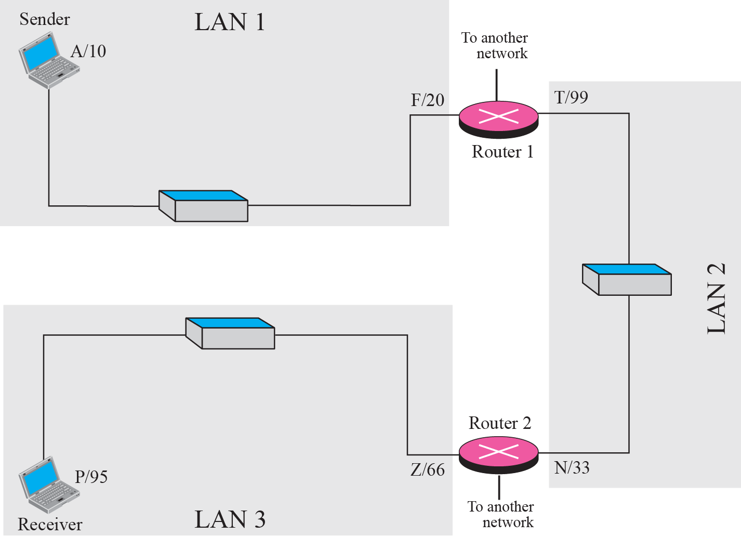
Example 2: logical addresses
Notes:
Figure 2.17 shows a part of an internet with two routers connecting three LANs. Each device (computer or router) has a pair of addresses (logical and physical) for each connection. In this case, each computer is connected to only one link and therefore has only one pair of addresses. Each router, however, is connected to three networks. So each router has three pairs of addresses, one for each connection. Although it may be obvious that each router must have a separate physical address for each connection, it may not be obvious why it needs a logical address for each connection. We discuss these issues in Chapters 11 and 12 when we discuss routing. The computer with logical address A and physical address 10 needs to send a packet to the computer with logical address P and physical address 95. We use letters to show the logical addresses and numbers for physical addresses, but note that both are actually numbers, as we will see in later chapters.

Slide 14
Example 2: logical addresses
The previous figure shows a part of an internet with two routers connecting three LANs. Each device (computer or router) has a pair of addresses (logical and physical) for each connection. In this case, each computer is connected to only one link and therefore has only one pair of addresses. Each router, however, is connected to three networks. So each router has three pairs of addresses, one for each connection.
The computer with logical address A and physical address 10 needs to send a packet to the computer with logical address P and physical address 95. We use letters to show the logical addresses and numbers for physical addresses, but note that both are actually numbers, as we will see in later chapters.

Slide 15
Note
The physical addresses will change from hop to hop, but the logical addresses remain the same.

Slide 16
Port address
the purpose of ports is to uniquely identify different applications or processes running on a single computer and thereby enable them to share a single physical connection to a packet-switched network like the Internet.
As we will see later, a port address is a 16-bit address represented by one decimal number as shown.
753
A 16-bit port address represented as one single number

Slide 17
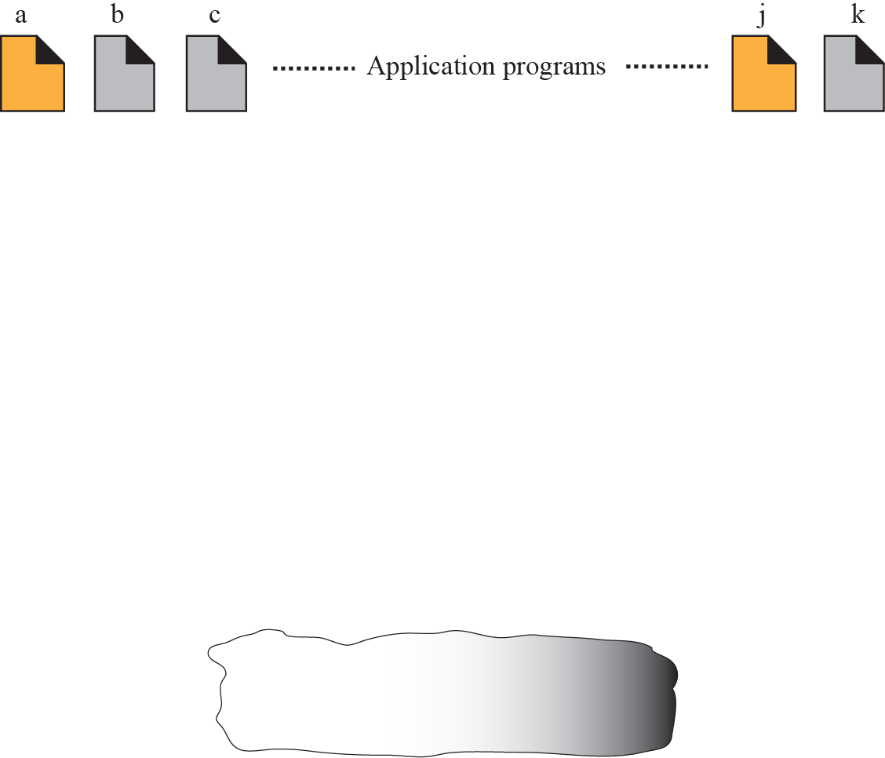
Example 3: port address
Notes:
Figure 2.18 shows two computers communicating via the Internet. The sending computer is running three processes at this time with port addresses a, b, and c. The receiving computer is running two processes at this time with port addresses j and k. Process a in the sending computer needs to communicate with process j in the receiving computer. Note that although both computers are using the same application, FTP, for example, the port addresses are different because one is a client program and the other is a server program, as we will see in Chapter 17.

Slide 18
Example 3: port address
The previous figure shows two computers communicating via the Internet. The sending computer is running three processes at this time with port addresses a, b, and c. The receiving computer is running two processes at this time with port addresses j and k. Process a in the sending computer needs to communicate with process j in the receiving computer.
Note that although both computers are using the same application, FTP, for example, the port addresses are different because one is a client program and the other is a server program.

Slide 19
Note
The physical addresses change from hop to hop, but the logical and port addresses usually remain the same.

Slide 20
References
http://pluto.ksi.edu/~cyh/cis370/ebook/ch05b.htm
CSC 1202 2012-2013 Lecture Notes.
Chapter 2 in TCP/IP Protocol Suite , 4th ed, Behrouz A. Forouzan

