Slide 1
Introduction to Networks

Slide 2
What is a network ?
A number of nodes connected together.
They share information and resources.
Examples:
Roads, Telephones , Computers

Slide 3
What is a computer network?
A computer network is computers and devices connected together.
The capabilities of a computer are increased when connected with other devices to form a computer network.

Slide 4
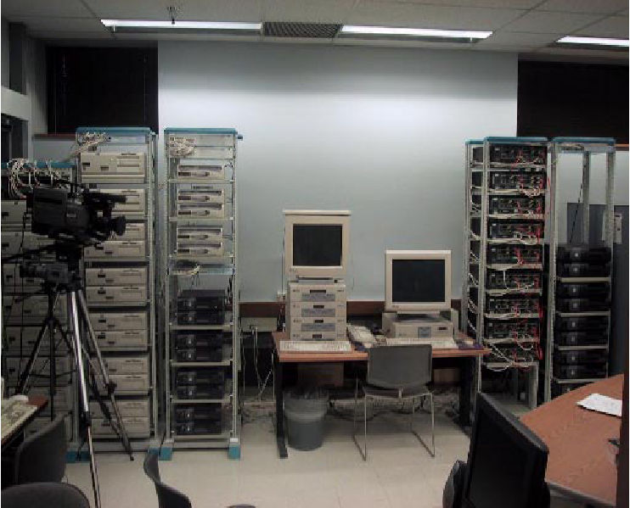
Physical Network

Slide 5
Computer Network Components
Computer with NIC (PCs, laptops, handhelds)
routers & switches (IP router, Ethernet switch)
Links” Transmission media” (wired, wireless)
protocols (IP,TCP,CSMA/CD,CSMA/CA)
applications (network services) i.e. Network Operating System (NOS)
humans and service agents

Slide 6
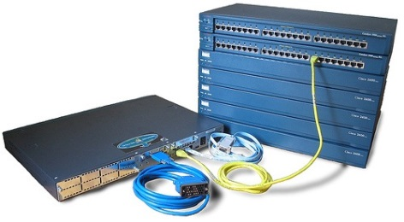
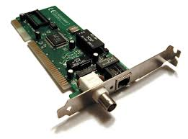
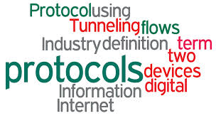
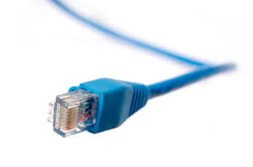

Slide 7
Purpose of a Computer Network
Summarized in a single word: sharing.
Individual computers are isolated.
Networked computers can share resources.
Networks also make computer management easier.
Three types of resources can be shared (Software ,data and hardware)

Slide 8
Share Software and Data
Application and utility software:
can be shared by all users across the network.
This requires only a single software copy to be purchased and maintained.
Data files:
Can also be shared. This makes data more accessible and maintains integrity.

Slide 9
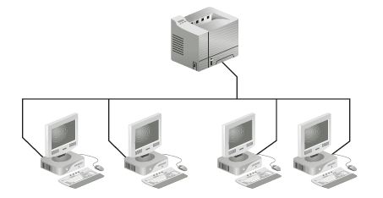
Share Hardware
Sharing is an essential feature of a computer network.
This reduces costs and the work of support staff.
Printers, fax modems, scanners, hard drives, CD-ROMs, and DVDs can all be shared.

Slide 10
Improve Communications
Communication is essential in today’s businesses.
Computer networks can help in improved communications through groupware.
E-mail, electronic calendars, and video conferencing are available.

Slide 11
Centralize Management
Computer networks allow computers to be managed from one central location.
Software updates can be “pushed” to users’ computers.
Problems can be diagnosed over the network.
Training can be done over the network.

Slide 12
Network Communications
Source
Message
Channel
Receiver
Noise
Feedback
Context

Slide 13
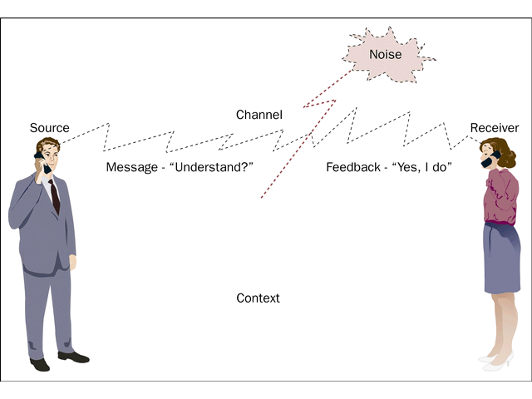
Network Communications

Slide 14
Types of Networks
Two types of network classifications:
Classified by device that controls network
Classified by distance between devices

Slide 15
Network Classified by device
Peer-to-Peer
Server based

Slide 16
I. Peer-to-Peer Network
No single computer controls the network.
Each computer is the same (a peer) to all others.
It is suitable for small offices.
Called “ work group”.
Each user controls the access to his own computer ( read only , hide files).
Its suitable when :
10 or less computers.
All computers in the same place.
Security is not an issue.
No network upgrading plans.

Slide 17
I. Peer-to-Peer Network
Advantages :
Limited cost.
No software needed.
No powerful computers needed.
Easy to install and setup.
Disadvantages:
Not suitable for large networks

Slide 18
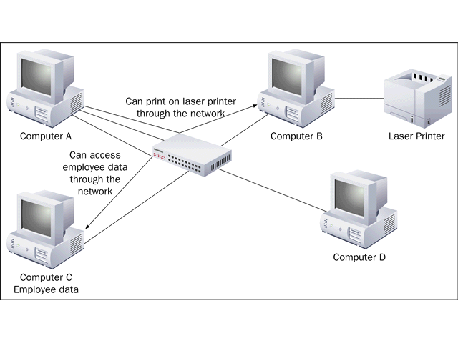
I. Peer-to-Peer Network

Slide 19
II. Server-Based Network
The network is controlled by a special high-powered server.
The server is dedicated to running the network.
The server never work as a client.
If the number of computers connected together is large , another server is used.
Types:
Print and file servers
Application servers
Communication servers
Directory service servers

Slide 20
II. Server-Based Network
Advantages:
Scheduled Backup
Data is safe
Thousands of users
Any type of computers can be connected.
Easy to access and manage data.
Security ( to have an administrator)

Slide 21
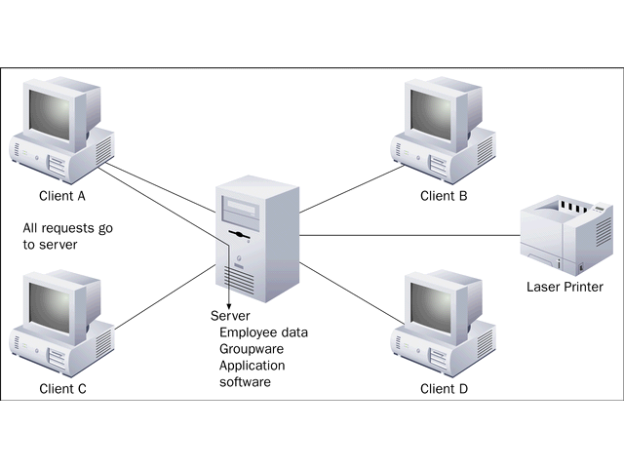
II. Server-Based Network

Slide 22
Network Classified by distance
LAN
Local Area Network
MAN
Metropolitan Area Network
WAN
Wide Area Network

Slide 23
I. Local Area Network
Network computers are located relatively close to each other.
They are generally limited to buildings owned by one organization.
They operate at high speeds (10-1000 mbps)
They are low-cost networks.

Slide 24
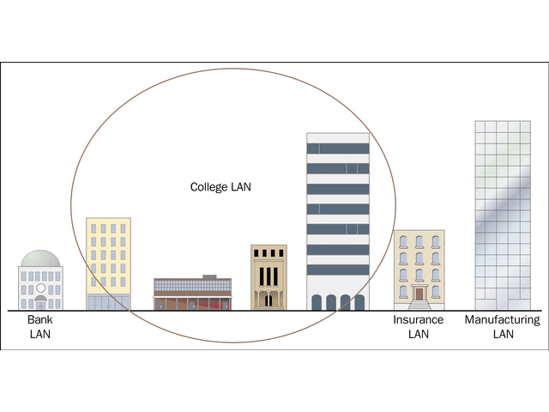
I. Local Area Network

Slide 25
II. Metropolitan Area Network
A very fast LAN.
Uses fiber optics as a media.
Covers an area from 20 to 100 meters.

Slide 26
III. Wide Area Network
Network computers are spread out over a larger area.
They are often managed by public carriers.
They operate at lower speeds.
They are a higher-cost network.

Slide 27
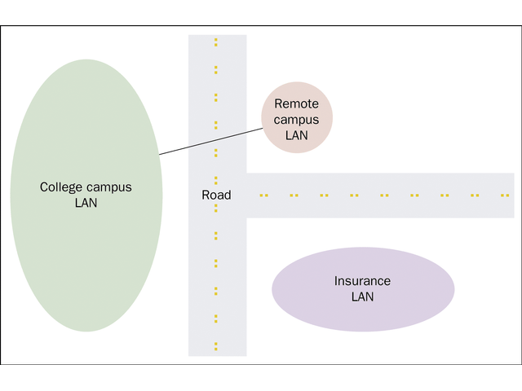
III. Wide Area Network

