Slide 1
Error Detection and Control
2nd semester 1438-1439
NET 205: Data Transmission and Digital Communication

Slide 2
205NET CLO
1-Introduction to Communication Systems and Networks architecture OSI Reference Model.
2- Data Transmission Principles
3- Transmission medias
4- Data modulation and encoding
5- Multiplexing
6- Spreading technique
7- Synchronize and asynchronize transmission
8- Error Detection and control

Slide 3
Outline
Types of Error
Detection Versus Corrections
Redundancy
Detection Methods
Parity Check
  Simple Parity Check
  Two-Dimensional Parity Check
Cyclic Redundancy Check (CRC)
  The CRC Generator

Slide 4
Introduction
Networks must be able to transfer data from one device to another with acceptable accuracy.
Data can be corrupted during transmission.
Some applications require that errors be detected and corrected.
Notes:
Some applications can tolerate a small level of error. For example, random errors
in audio or video transmissions may be tolerable, but when we transfer text, we expect
a very high level of accuracy.

Slide 5
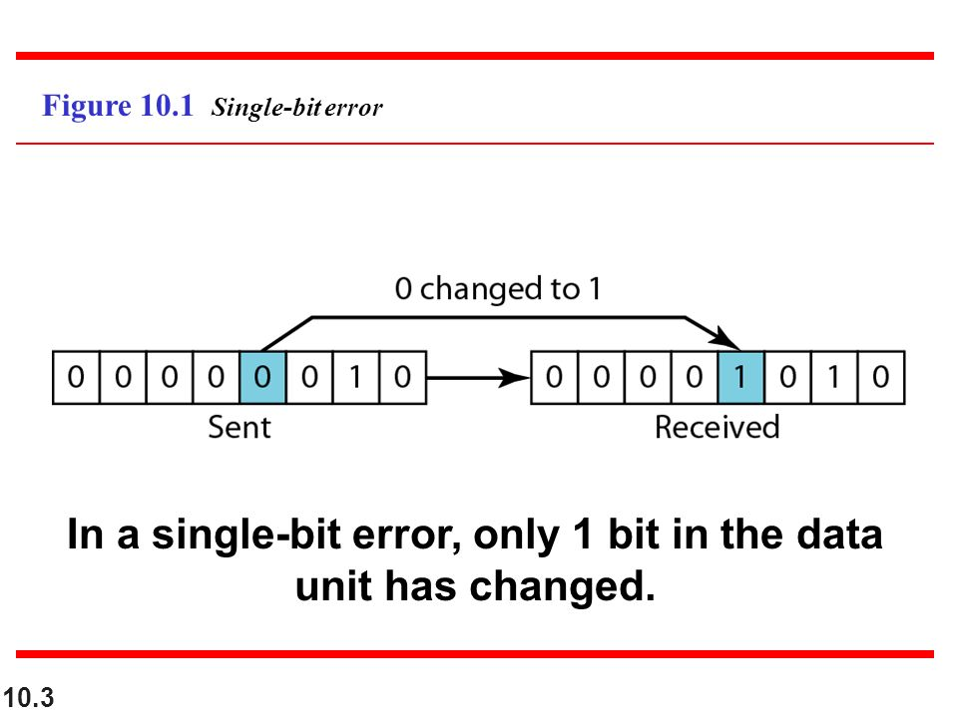
Types of Errors
Single-Bit Error
only 1 bit in the data unit (such as a byte, character, or packet) has changed.
Single-bit errors are the least likely type of error in serial data transmission

Slide 6
Types of Errors
Burst Error
A burst error means that 2 or more bits in the data unit have changed.
Note that a burst error does not necessarily mean that the errors occur in consecutive bits.
The length of the burst is measured from the first corrupted bit to the last corrupted bit.
Notes:
The length of the burst is measured from the first corrupted bit to the last corrupted bit. Some bits in
between may not have been corrupted.

Slide 7
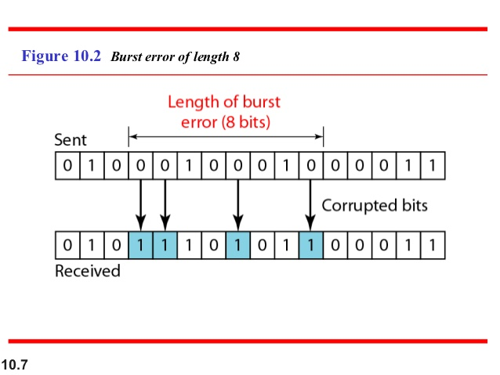

Slide 8
Detection Versus Correction
In error detection, we are looking only to see if any error has occurred → The answer is a simple yes or no
In error correction, we need to know the exact number of bits that are corrupted and more importantly, their location in the message.
Notes:
The answer is a simple yes or no. We are
not even interested in the number of errors. A single-bit error is the same for us as a
burst error.
The number of the errors and the size of
the message are important factors.

Slide 9
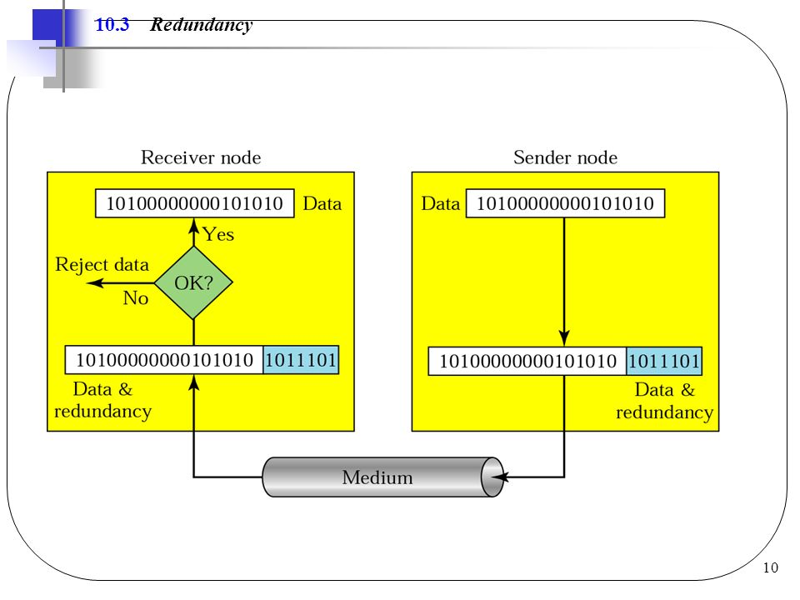
Redundancy
One error detection mechanism is including extra information in the transmission for error detection.
  A group of bits is appended to the end of each unit.
  This technique called redundancy.
  These redundant bits are added by the sender and removed by the receiver.

Slide 10
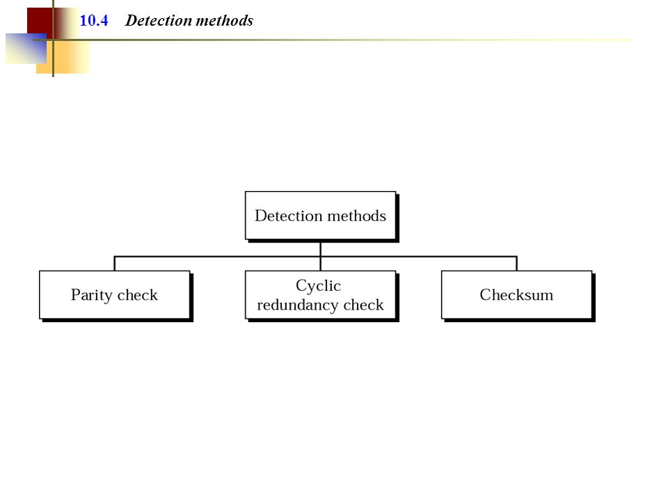
Detection Methods

Slide 11
Parity Check
The most common and least expensive mechanism.
Parity checking can be simple or two-dimensional

Slide 12
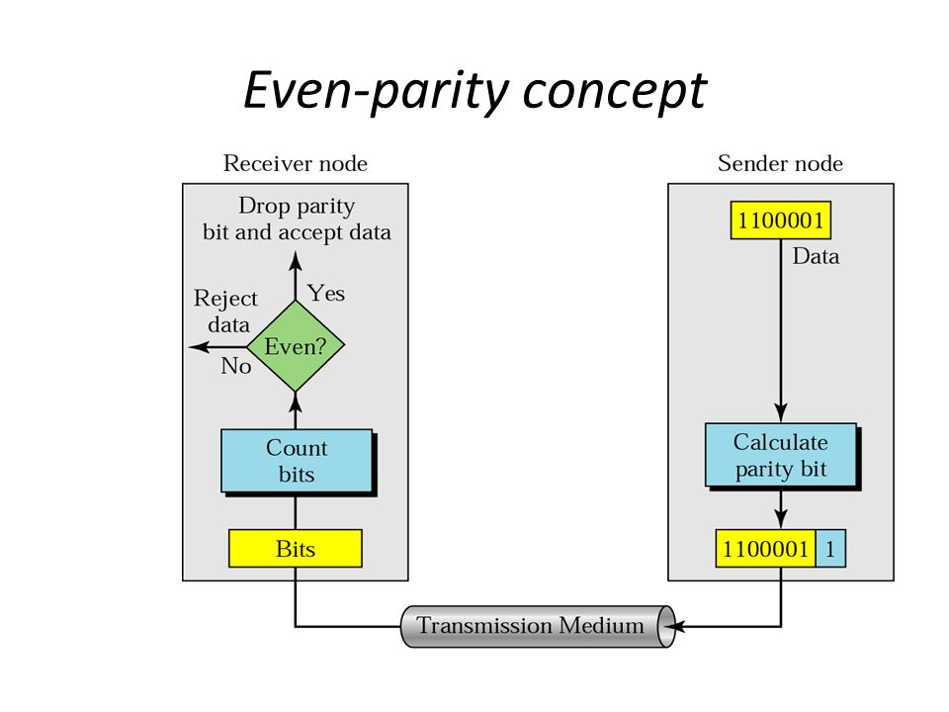
Simple Parity Check
A redundant bit called a parity bit is added to every data unit so the total number of 1s in the unit (including the parity bit) become even (or odd)

Slide 13
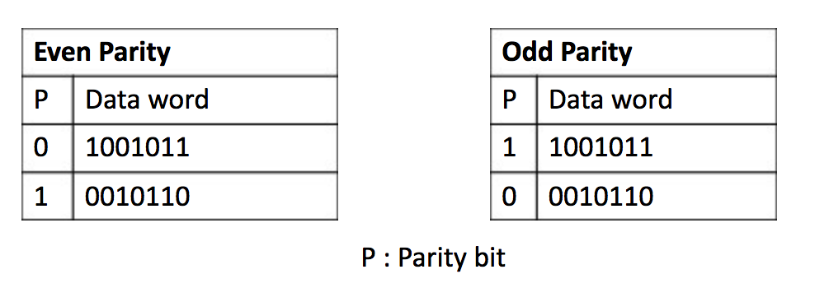
Simple Parity Check

Slide 14
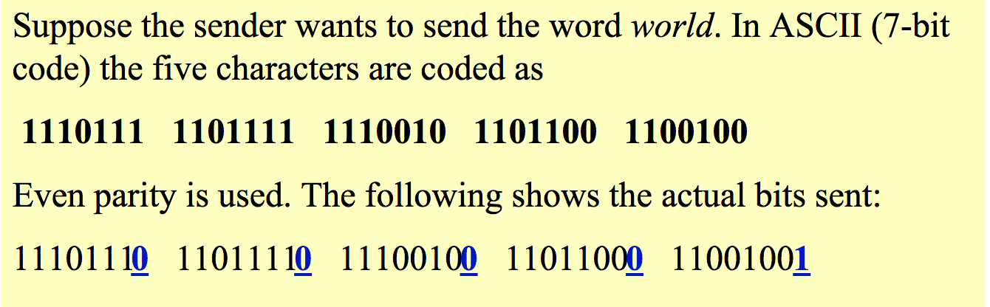
Example

Slide 15
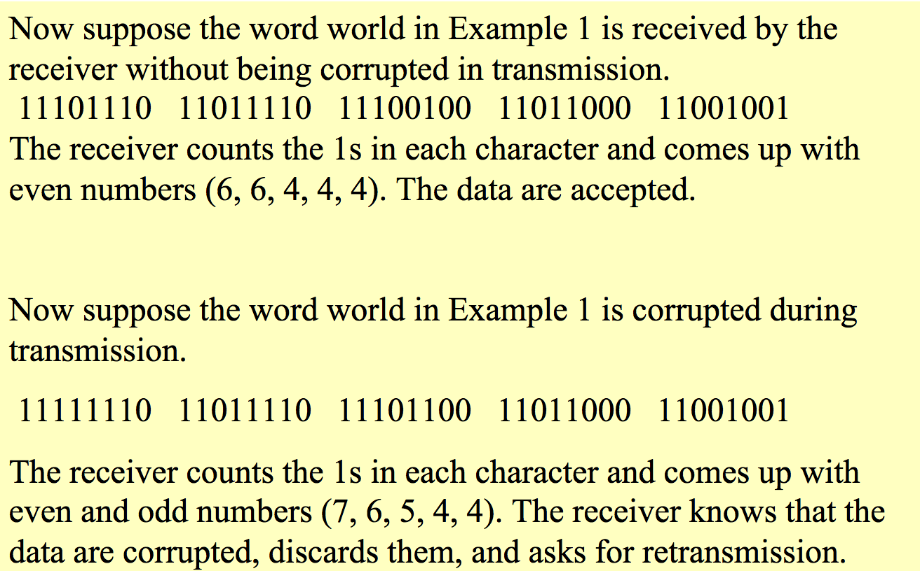
Example

Slide 16
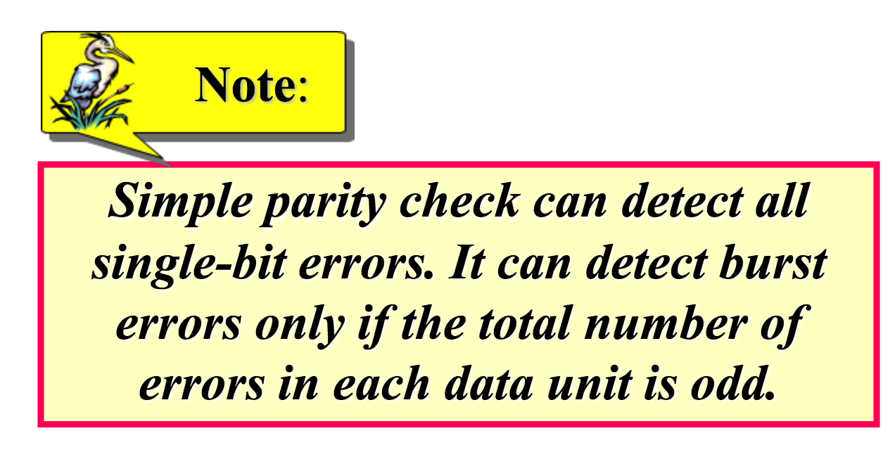
Performance

Slide 17
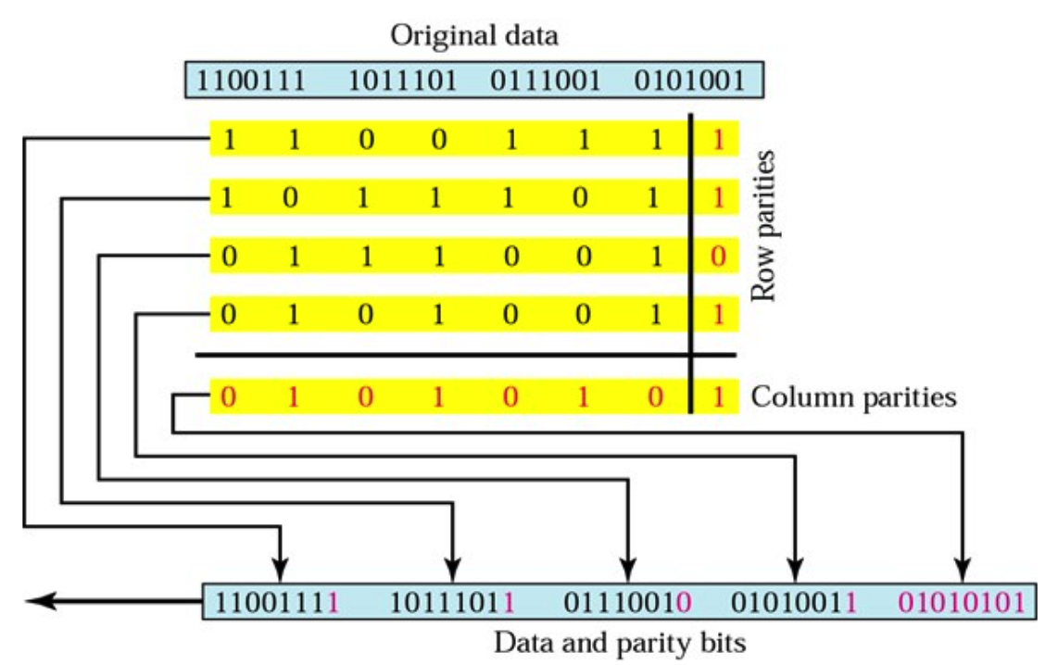
Two-Dimensional Parity Check
In two-dimensional parity check, a block of bits is organized in a table (rows and columns)
  calculate the parity bit for each data unit.
  calculate the parity bit for each column and create a new row of 8 bits.

Slide 18
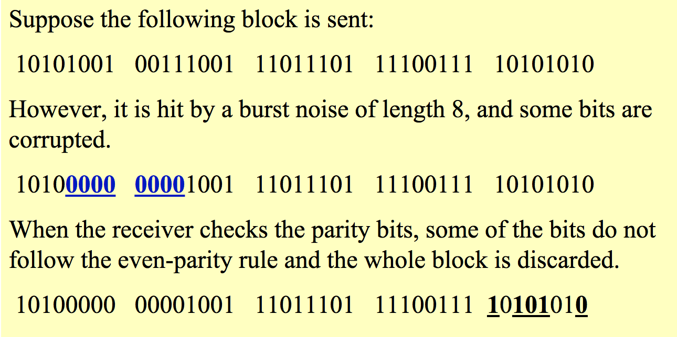
Example

Slide 19
Performance
Two-dimensional parity check increase the likelihood of detecting burst errors.
A redundancy of n bits can easily detect a burst error of n bits.
a burst error of more than n bits is also detected with a very high probability
If 2 bits in one data unit are damaged and 2 bits in exactly the same positions in another data unit are also damaged, the checker will not detect an error.

Slide 20
Cyclic Redundancy Check (CRC)
Cyclic Redundancy Check (CRC) is based on binary division.
In CRC, a sequence of redundant bits called the CRC is appended to the end of data unit so that the resulting data unit become exactly divisible by a second predetermined binary number.
At destination, the incoming data unit is divided by the same number, If:
  There is no reminder → the data unit assumed to be intact
  There is a reminder → the data unit assumed to be damaged

Slide 21
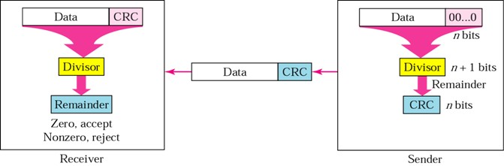
Cyclic Redundancy Check (CRC)

Slide 22
Cyclic Redundancy Check (CRC)
At the sender:
A string of n 0s is appended to the data unit. The number n is 1 less than the number of bits in the predetermined divisor, which is n+1.
The data unit then divided by the divisor, using a process called binary division. The resulted reminder is the CRC.
The CRC n bits replaces the appended 0s at the end of the data unit. (CRC may consist of all 0s)

Slide 23
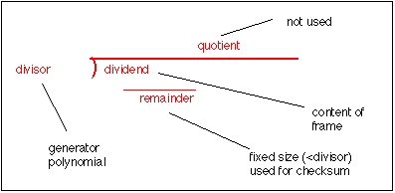
The CRC Generator
The CRC are derived by dividing the data unit by a predetermined divisor, the reminder is the CRC

Slide 24
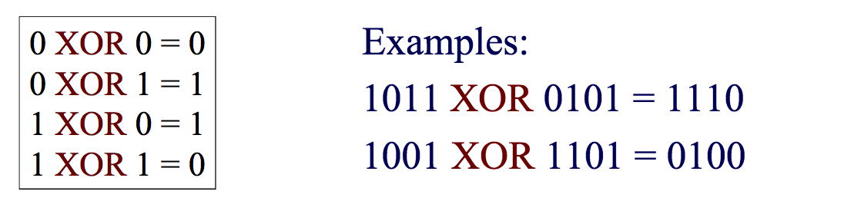
Module 2 Arithmetic
In module 2 arithmetic, addition and substruction are identical to Exclusive OR (XOR) operation.
Multiplication and division are the same as in base-10 arithmetic without carries in addition or borrows in subtraction

Slide 25
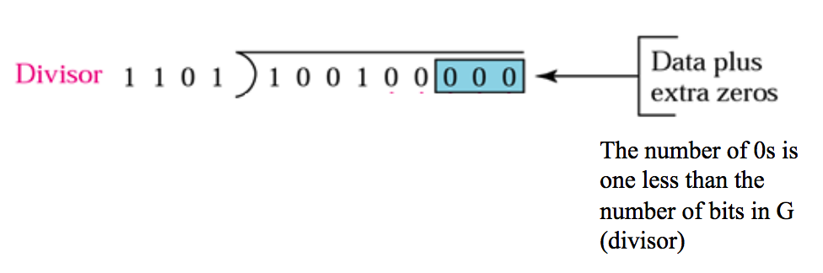
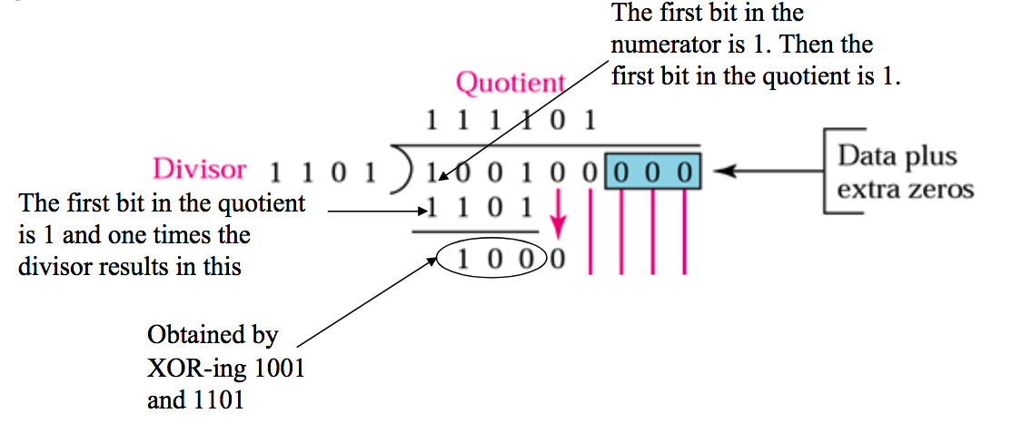
The CRC Generator

Slide 26
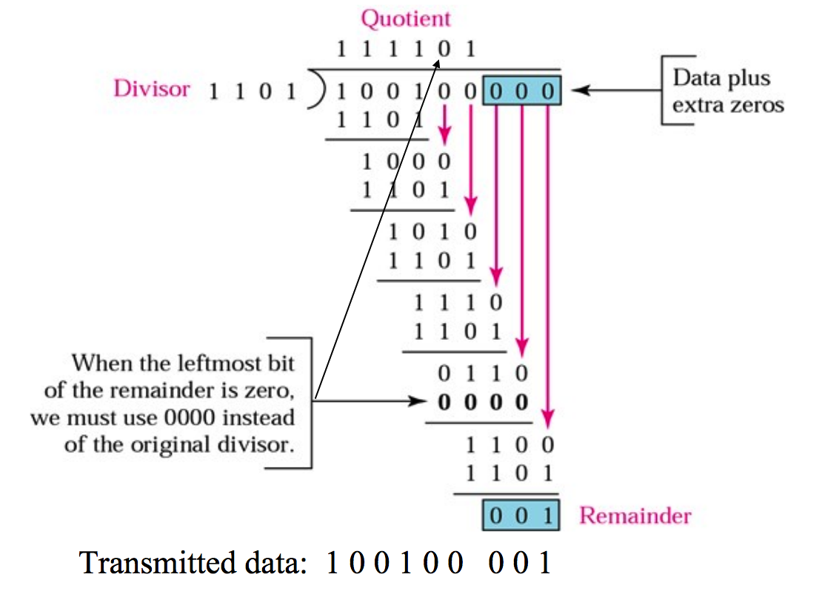
The CRC Generator

Slide 27
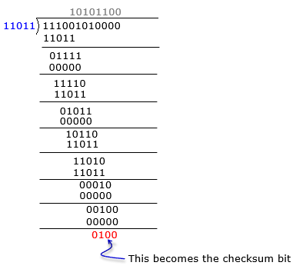
Example

Slide 28
The CRC Checker
A CRC checker functions exactly as the generator does.
After receiving the data appended with CRC, it does the same module-2 division.
  If the reminder is all 0s, the CRC is dropped and the data are accepted.
  Otherwise, the received stream of bits is discarded and data are resent.

Slide 29
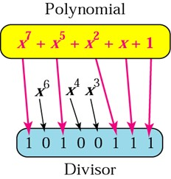
Polynomials
The divisor in the CRC generator is most often represented not as a string of 1s and 0s, but as an algebraic polynomial.

Slide 30
Performance
CRC is very effective error detection method.
CRC can detect all burst errors that effect an odd number of bits.
CRC can detect all burst errors of length less than or equal to the degree of the polynomial.
CRC can detect, with a very high probability, burst errors of length greater than the degree of the polynomial.

Slide 31
Any Questions ?

