Slide 1
Bandwidth Utilization: Spreading + Transmission Modes
2nd semester 1438-1439
NET 205: Data Transmission and Digital Communication

Slide 2
205NET CLO
1-Introduction to Communication Systems and Networks architecture OSI Reference Model.
2- Data Transmission Principles
3- Transmission medias
4- Data modulation and encoding
5- Multiplexing
6- Spreading technique
7- Synchronize and asynchronize transmission

Slide 3
Outline
SPREAD SPECTRUM
Frequency Hopping Spread Spectrum
Direct Sequence Spread Spectrum
TRANSMISSION MODES
Parallel transmission
Serial transmission
asynchronous,
synchronous,
isochronous

Slide 4
SPREAD SPECTRUM

Slide 5
Introduction
Multiplexing combines signals from several sources to achieve bandwidth efficiency.
In spread spectrum, we also combine signals from different sources to fit into a larger bandwidth, but our goals are somewhat different
Spread spectrum is designed to be used in wireless applications
In these types of applications, stations must be able to share the medium without interception and without jamming .
Notes:
To achieve these goals, spread spectrum techniques add redundancy; they spread the original spectrum needed for each station.
if the required bandwidth for each station is B, spread spectrum expands it to B_{ss} such that B_{ss} >> B.
The expanded bandwidth allows the source to wrap its message for a more secure transmission.
An analogy is the sending of a delicate, expensive gift. We can insert the gift in a special box to prevent it from being damaged during transportation, and we can use a
superior delivery service to guarantee the safety of the package.

Slide 6
Spread Spectrum
Spread spectrum achieves its goals through two principles:
The bandwidth allocated to each station needs to be, by far, larger than what is needed. This allows redundancy.
The expanding of the bandwidth must be done by a process that is independent of the original signal. In other words, the spreading process occurs after the signal is created by the source.
Notes:
After the signal is created by the source, the spreading process uses a spreading code and spreads the bandwidth. The figure shows the original bandwidth B and the
spreaded bandwidth Bss. The spreading code is a series of numbers that look random, but are actually a pattern.

Slide 7
Spread Spectrum Techniques
There are two techniques to spread the bandwidth:
frequency hopping spread spectrum (FHSS)
direct sequence spread spectrum (DSSS)

Slide 8
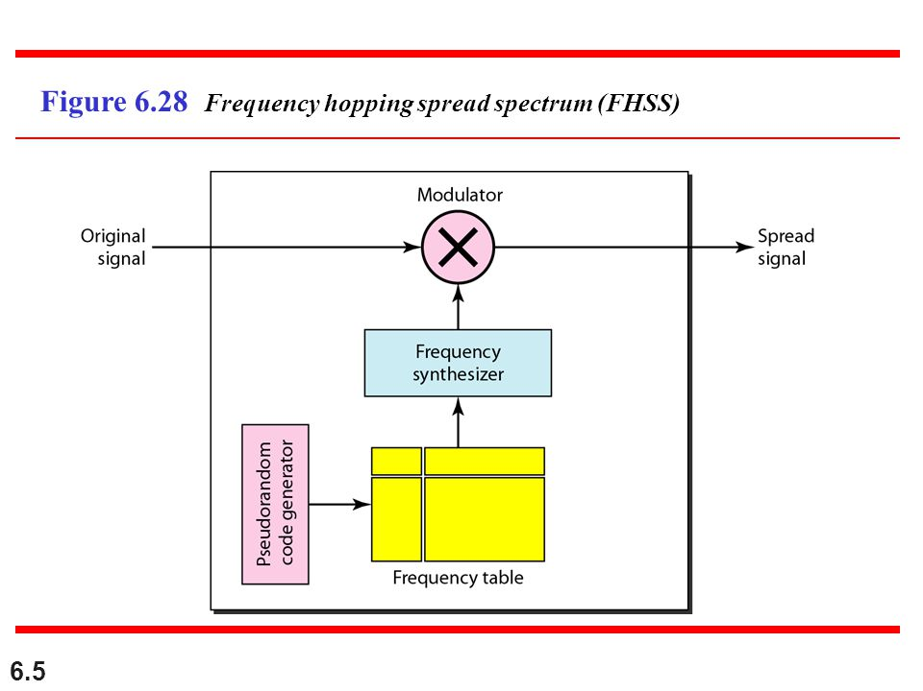
Frequency Hopping Spread Spectrum
The frequency hopping spread spectrum (FHSS) technique uses M different carrier frequencies that are modulated by the source signal.
At one moment, the signal modulates one carrier frequency.
At the next moment, the signal modulates another carrier frequency. .. etc
creates a k-bit pattern
Notes:
Although the modulation is done using one carrier frequency at a time,
M frequencies are used in the long run. The bandwidth occupied by a source after
spreading is BpHSS »B.
Figure 6.28 shows the general layout for FHSS. A pseudorandom code generator,
called pseudorandom noise (PN), creates a k-bit pattern for every hopping period Th•
The frequency table uses the pattern to find the frequency to be used for this hopping
period and passes it to the frequency synthesizer. The frequency synthesizer creates a
carrier signal of that frequency, and the source signal modulates the carrier signal.

Slide 9
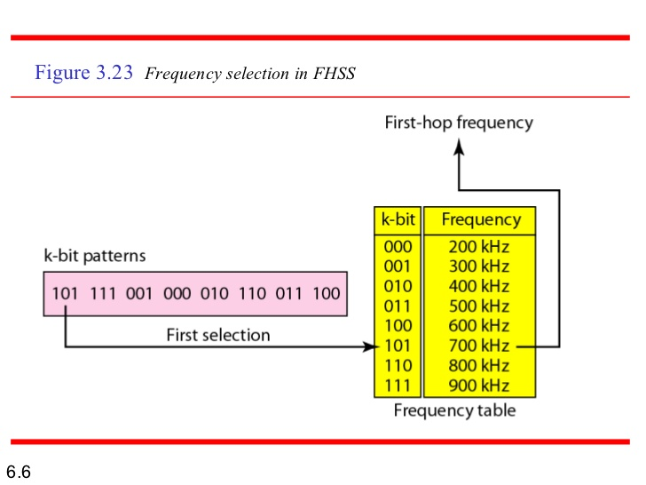
Example
Suppose we have decided to have eight hopping frequencies.
M is 8 →k is 3 ( k= log₂ M).
The pseudorandom code generator will create eight different 3-bit patterns. These are mapped to eight different frequencies in the frequency table
Notes:
Suppose we have decided to have eight hopping frequencies. This is extremely low
for real applications and is just for illustration.
The pattern for this station is 101, 111, 001, 000, 010, all, 100. Note that the pattern is pseudorandom it is repeated after eight hoppings. This means that at hopping
period 1, the pattern is 101. The frequency selected is 700 kHz; the source signal modulates this carrier frequency. The second k-bit pattern selected is 111, which selects the
900-kHz carrier; the eighth pattern is 100, the frequency is 600 kHz. After eight hoppings,
the pattern repeats, starting from 101 again

Slide 10
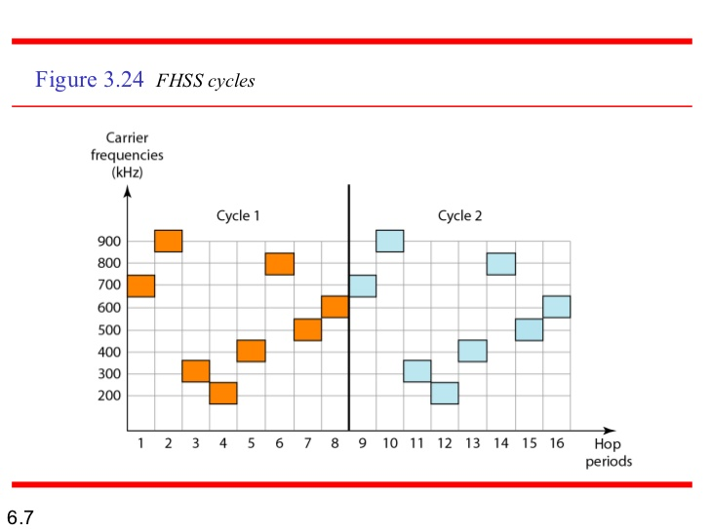
Example
The figure shows how the signal hops around from carrier to carrier. ( assuming the required bandwidth of the original signal is 100 kHz).
Notes:
Figure 6.30 shows how the signal hops around from carrier to carrier. We assume the required bandwidth of the original signal is 100 kHz.
It can be shown that this scheme can accomplish the previously mentioned goals.
If there are many k-bit patterns and the hopping period is short, a sender and receiver
can have privacy. If an intruder tries to intercept the transmitted signal, she can only
access a small piece of data because she does not know the spreading sequence to
quickly adapt herself to the next hop. The scheme has also an antijamming effect. A
malicious sender may be able to send noise to jam the signal for one hopping period
(randomly), but not for the whole period

Slide 11
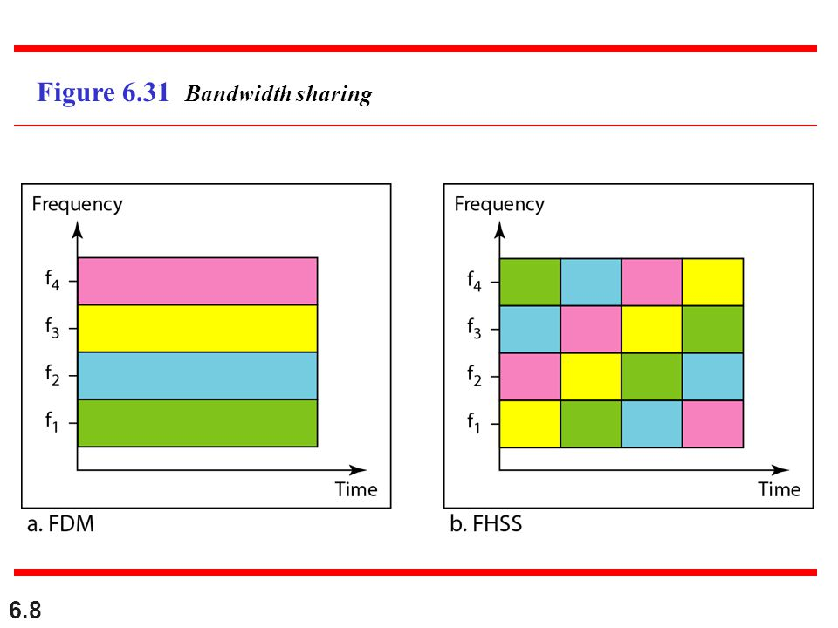
Bandwidth Sharing
If the number of hopping frequencies is M, we can multiplex M channels into one by using the same B_{ss} bandwidth.
M different stations can use the same Bss if an appropriate modulation technique such as multiple FSK (MFSK) is used.
Notes:
This is possible because a station uses just one frequency in each hopping period; M - 1 other frequencies can be used by other M - 1 stations.
FHSS is similar to FDM, as shown in Figure 6.31.
Figure 6.31 shows an example of four channels using FDM and four channels using FHSS. In FDM, each station uses 11M of the bandwidth, but the allocation is
fixed; in FHSS, each station uses 11M of the bandwidth, but the allocation changes hop to hop.
Figure 6.31 shows an example of four channels using FDM and four channels
using FHSS. In FDM, each station uses 11M of the bandwidth, but the allocation is
fixed; in FHSS, each station uses 11M of the bandwidth, but the allocation changes hop
to hop.

Slide 12
Direct Sequence Spread Spectrum
In direct sequence spread spectrum (DSSS), we replace each data bit with n bits using a spreading code.
each bit is assigned a code of n bits, called chips, where the chip rate is n times that of the data bit.

Slide 13
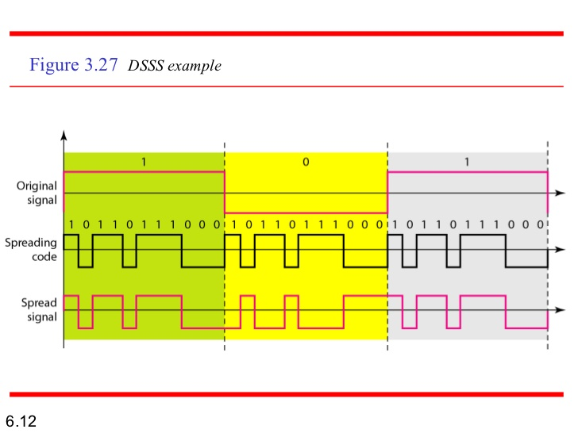
Example
Notes:
As an example, let us consider the sequence used in a wireless LAN, the famous
Barker sequence where 11 is 11. We assume that the original signal and the chips in the
chip generator use polar NRZ encoding. Figure 6.33 shows the chips and the result of
multiplying the original data by the chips to get the spread signal.
In Figure 6.33, the spreading code is 11 chips having the pattern 10110111000 (in
this case). If the original signal rate is N, the rate of the spread signal is nN. This
means that the required bandwidth for the spread signal is 11 times larger than the
bandwidth of the original signal. The spread signal can provide privacy if the intruder
does not know the code. It can also provide immunity against interference if each station
uses a different code.

Slide 14
Bandwidth Sharing
We can share the bandwidth, if we use a special type of sequence code that allows the combining and separating of spread signals.
Notes:
Can we share a bandwidth in DSSS as we did in FHSS? The answer is no and yes. If we
use a spreading code that spreads signals (from different stations) that cannot be combined
and separated, we cannot share a bandwidth. For example, as we will see in Chapter 14,
some wireless LANs use DSSS and the spread bandwidth cannot be shared. However, if
we use a special type of sequence code that allows the combining and separating of spread
signals, we can share the bandwidth. As we will see in Chapter 16, a special spreading code
allows us to use DSSS in cellular telephony and share a bandwidth between several users.

Slide 15
TRANSMISSION MODES

Slide 16
Introduction
The transmission of binary data across a link can be accomplished in either parallel or serial mode.
In parallel mode, multiple bits are sent with each clock tick.
In serial mode, 1 bit is sent with each clock tick.
Notes:
Of primary concern when we are considering the transmission of data from one device to another is the wiring, and of primary concern when we are considering the wiring is
the data stream. Do we send 1 bit at a time; or do we group bits into larger groups and,
if so, how?
While there is only one way to send parallel data, there are three subclasses of serial transmission: asynchronous, synchronous, and isochronous

Slide 17
Parallel Transmission
In parallel transmission, the binary data ( 1s and 0s) organized into groups of n bits each and then send data n bits at a time instead of 1.
Notes:
Computers produce and consume data in groups of bits much as we conceive of and use spoken language in the form of words rather than letters.
The mechanism for parallel transmission is a conceptually simple one: Use n wires
to send n bits at one time. That way each bit has its own wire, and all n bits of one
group can be transmitted with each clock tick from one device to another.
Figure 4.32 shows how parallel transmission works for n =8. Typically, the eight wires are bundled in a cable with a connector at each end.

Slide 18
Advantage and Disadvantage
The advantage of parallel transmission is speed
All else being equal, parallel transmission can increase the transfer speed by a factor of n over serial transmission.
The significant disadvantage: cost.
Parallel transmission requires n communication lines (wires) just to transmit the data stream.
Because this is expensive, parallel transmission is usually limited to short distances

Slide 19
Serial Transmission
In serial transmission one bit follows another.
so we need only one communication channel rather than n to transmit data between two communicating devices
Notes:
Since communication within devices is parallel, conversion devices are required at
the interface between the sender and the line (parallel-to-serial) and between the line and the receiver (serial-to-parallel).

Slide 20
Serial Transmission
The advantage of serial is that it reduces the cost of transmission over parallel by roughly a factor of n.
Serial transmission occurs in one of three ways:
asynchronous,
synchronous,
isochronous.
Notes:
The advantage of serial over parallel transmission is that with only one communication channel, serial transmission reduces the cost of transmission over parallel by
roughly a factor of n.

Slide 21
Asynchronous Transmission
In asynchronous transmission:
the timing of a signal is unimportant
It depends on using patterns
Patterns are based on grouping the bit stream into bytes.
Notes:
Figure 4.34 is a schematic illustration of asynchronous transmission. In this example, the start bits are 0s, the stop bits are 1s, and the gap is represented by an idle line
rather than by additional stop bits.
Asynchronous transmission is so named because the timing of a signal is unimportant.
Instead, information is received and translated by agreed upon patterns. As long as those
patterns are followed, the receiving device can retrieve the information without regard
to the rhythm in which it is sent. Patterns are based on grouping the bit stream into
bytes. Each group, usually 8 bits, is sent along the link as a unit. The sending system
handles each group independently, relaying it to the link whenever ready, without regard
to a timer.
Without synchronization, the receiver cannot use timing to predict when the next
group will arrive. To alert the receiver to the arrival of a new group, therefore, an extra
bit is added to the beginning of each byte. This bit, usually a 0, is called the start bit.
To let the receiver know that the byte is finished, 1 or more additional bits are appended
to the end of the byte. These bits, usually I s, are called stop bits. By this method, each
byte is increased in size to at least 10 bits, of which 8 bits is information and 2 bits or
more are signals to the receiver. In addition, the transmission of each byte may then be
followed by a gap of varying duration. This gap can be represented either by an idle
channel or by a stream of additional stop bits.

Slide 22
Asynchronous Transmission
An example of a pattern:
An extra bit (usually a 0) called the start bit is added to the beginning of each byte → to alert the receiver to the arrival of a new group.
1 or more additional bits (usually 1 s) called stop bits are appended to the end of the byte → to let the receiver know that the byte is finished.
By this method, each byte is increased in size to at least 10 bits ( data + synchronization bits).
the transmission of each byte may then be followed by a gap of varying duration. This gap can be represented either by an idle channel or by a stream of additional stop bits.
Notes:
The start and stop bits and the gap alert the receiver to the beginning and end of
each byte and allow it to synchronize with the data stream. This mechanism is called
asynchronous because, at the byte level, the sender and receiver do not have to be synchronized.
But within each byte, the receiver must still be synchronized with the
incoming bit stream. That is, some synchronization is required, but only for the duration
of a single byte. The receiving device resynchronizes at the onset of each new byte.
When the receiver detects a start bit, it sets a timer and begins counting bits as they
come in. After n bits, the receiver looks for a stop bit. As soon as it detects the stop bit,
it waits until it detects the next start bit.
Asynchronous here means "asynchronous at the byte level;'
but the bits are still synchronized; their durations are the same

Slide 23
Advantage and Disadvantage
Slow:
The addition of stop and start bits and the insertion of gaps into the bit stream make asynchronous transmission slower than forms of transmission that can operate without the addition of control information.
cheap and effective:
two advantages that make it an attractive choice for situations such as low-speed communication
Notes:
For example, the connection of a keyboard to a computer is a natural application for
asynchronous transmission. A user types only one character at a time, types extremely
slowly in data processing terms, and leaves unpredictable gaps of time between each
character.

Slide 24
Synchronous Transmission
In synchronous transmission, we send bits one after another without start or stop bits or gaps. It is the responsibility of the receiver to group the bits.
Notes:
In other words, data are transmitted as an
unbroken string of 1s and Os, and the receiver separates that string into the bytes, or
characters, it needs to reconstruct the information.
Figure 4.35 gives a schematic illustration of synchronous transmission. We have
drawn in the divisions between bytes. In reality, those divisions do not exist; the sender
puts its data onto the line as one long string. If the sender wishes to send data in separate
bursts, the gaps between bursts must be filled with a special sequence of Os and Is that
means idle. The receiver counts the bits as they arrive and groups them in 8-bit units.

Slide 25
Synchronous Transmission
The bit stream is combined into longer "frames," which may contain multiple bytes.
Bytes is sent sequentially without a gap between it.
there may be uneven gaps between frames
The receiver is responsible for separating the bit stream into bytes for decoding purposes.
There is no built-in mechanism for bit synchronization midstream →Timing is very important.
The accuracy of the received information is completely dependent on the receiver.
Notes:
Without gaps and start and stop bits, there is no built-in mechanism to help the
receiving device adjust its bit synchronization midstream. Timing becomes very important,
therefore, because the accuracy of the received information is completely dependent
on the ability of the receiving device to keep an accurate count of the bits as they come in.

Slide 26
Advantage
The advantage of synchronous transmission is speed:
no extra bits or gaps to introduce at the sending end and remove at the receiving end, and fewer bits move across the link
So it is more useful for high-speed applications such as the transmission of data from one computer to another.

Slide 27
Isochronous
In real-time audio and video, in which uneven delays between frames are not acceptable, synchronous transmission fails.
For this type of application, synchronization between characters is not enough; the entire stream of bits must be synchronized.
The isochronous transmission guarantees that the data arrive at a fixed rate.
Notes:
For example, TV images are broadcast at the rate of 30 images per second; they must be viewed at the same rate. If each image is sent by using one or more frames, there should be no delays between frames.

Slide 28
Any Questions ?

