Slide 1
Lec#5 part 1
Packetizing
Error Detection

Slide 2
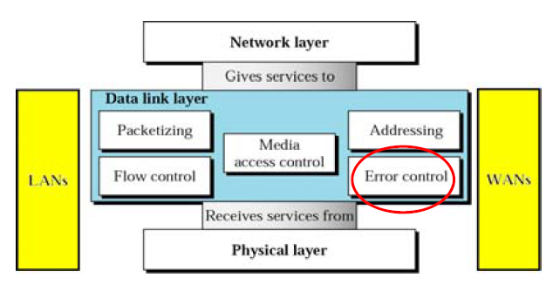
The Data Link Layer
Data link layer is responsible for carrying a packet ( called frame) from one hop to the next hop.
Specific responsibilities of the data link layer include framing, addressing, flow control, error control, and media access control.

Slide 3
Packetizing

Slide 4
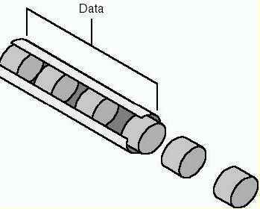
How Networks Send Data
To send data over a network, the data is broken down into small, manageable packets , each wrapped with the essential information needed to get it from its source to the correct destination .
In the sender, data is disassembled in small chunks.
Then it reassemble in the proper order when it reaches its destination.

Slide 5
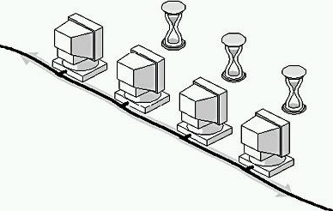
The Function of Packets in Network Communications
Networks cannot operate if computers put large amounts of data on the cable at the same time.
Notes:
As you see in the figure, a computer sending large amounts of data causes other computers to wait (increasing the frustration of the other users) while the data is being moved. This is not called "sharing"; it is called "monopolizing the network.“
In order for many users at once to transmit data quickly and easily across the network, the data must be broken into small, manageable chunks. This way, users each get their share of access to the network. These chunks are called packets, or frames

Slide 6
The Function of Packets in Network Communications
There are two reasons why putting large chunks of data on the cable at one time slows down the network:
  Large amounts of data sent as one large unit tie up the network and make timely interaction and communications impossible because one computer is flooding the cable with data.
  The impact of retransmitting large units of data further multiplies network traffic.
These effects are minimized when the large data units are reformatted into smaller packages for better management of error correction in transmission.
Notes:
This way, only a small section of data is affected, and, therefore, only a small amount of data must be retransmitted, making it relatively easy to recover
from the error.
.

Slide 7
Components of Packets
  Packets contents are based on the protocol used , but they basically contain:
  Source address
  Destination address
  Data to be sent ( files & messages)
  Other information like:
    Giving instructions to the network on how to send data
    Telling the receiving computer how to collect and arrange packets.
    Checking data from errors (determine the need to resend the data)

Slide 8
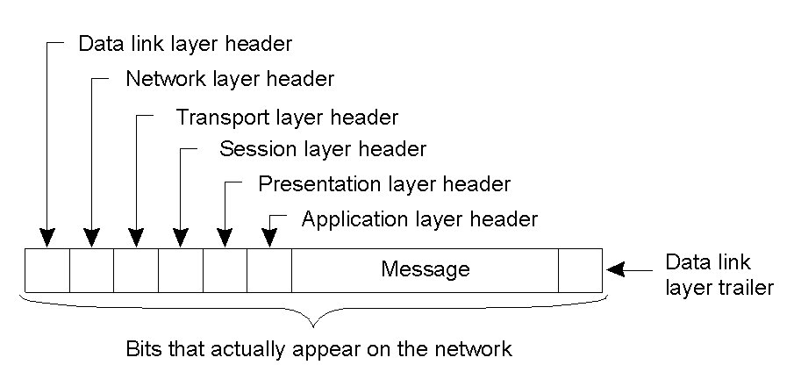
A Typical data packet on the Network
error-checking component

Slide 9
Error Detection

Slide 10
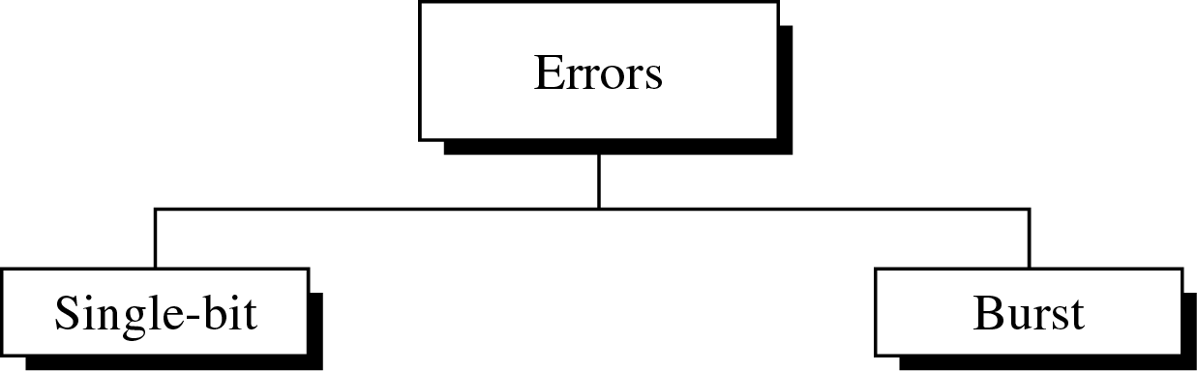
Accuracy of the Transmitted Data
Data can be corrupted during transmission.
For reliable communication, errors must be detected and corrected.

Slide 11
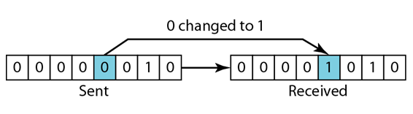
Single-Bit Error
  In a single-bit error, only one bit in the data unit has changed. (0 → 1 or 1 → 0)

Slide 12
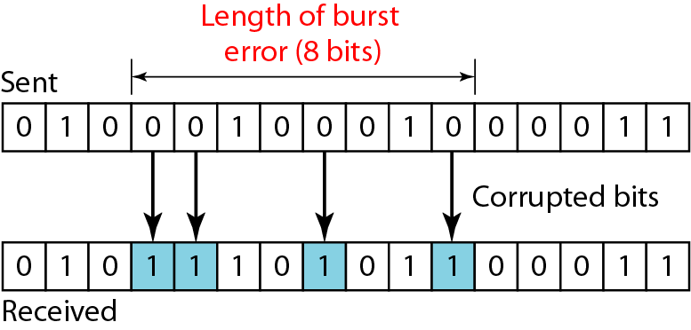
Burst Error
Two or more bits in the data unit have changed
Burst error does not necessarily mean that the errors occur in consecutive bits
Corrupted Bits = 4 bits

Slide 13
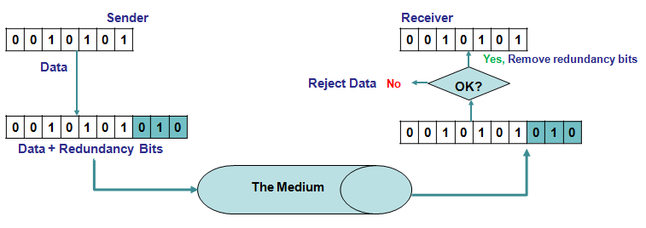
Error Detection
Error detection uses the concept of redundancy, which means adding extra (redundant) bits for detecting errors at the destination
Notes:
Redundancy is achieved through various coding schemes. The sender adds redundant
bits through a process that creates a relationship between the redundant bits and the
actual data bits. The receiver checks the relationships between the two sets of bits to
detect or correct the errors

Slide 14
Error Detection Methods
Three types of redundancy checks:
Parity Check
Cycle Redundancy Check
Checksum
Error Detection Methods

Slide 15
Parity Check
The most common and least expensive
a parity bit (extra bit)is added to every data unit so that the total number of 1’s is even or odd.
Simple parity check can detect single bit errors.
It can detect burst errors only if the total number of errors in each data unit is odd.

Slide 16
Even/odd parity
Computers can sometimes make errors when they transmit data.
Even/odd parity:
  is basic method for detecting if an odd number of bits has been switched by accident.
Odd parity:
  The number of 1-bit must add up to an odd number
Even parity:
  The number of 1-bit must add up to an even number

Slide 17
Even/odd parity
The computer knows which parity it is using
If it uses an even parity:
  If the number of of 1-bit add up to an odd number then it knows there was an error:
If it uses an odd:
  If the number of of 1-bit add up to an even number then it knows there was an error:
However, If an even number of 1-bit is flipped the parity will still be the same. But an error occurs
  The even/parity can’t this detect this error.

Slide 18
Even/odd parity
It is useful when an odd number of 1-bits is flipped.
Suppose we have an 7-bit binary word (7-digits).
  If you need to change the parity you need to add 1 (parity bit) to the binary word.
  You now have 8 digit word.
  However, the computer knows that the added bit is a parity bit and therefore ignore it.

Slide 19
Example (1)
Suppose you receive a binary bit word “0101” and you know you are using an odd parity.
Is there any error?
The answer is yes:
    There are 2 1-bit, which is an even number
    We are using an odd parity
    So there must have an error.

Slide 20
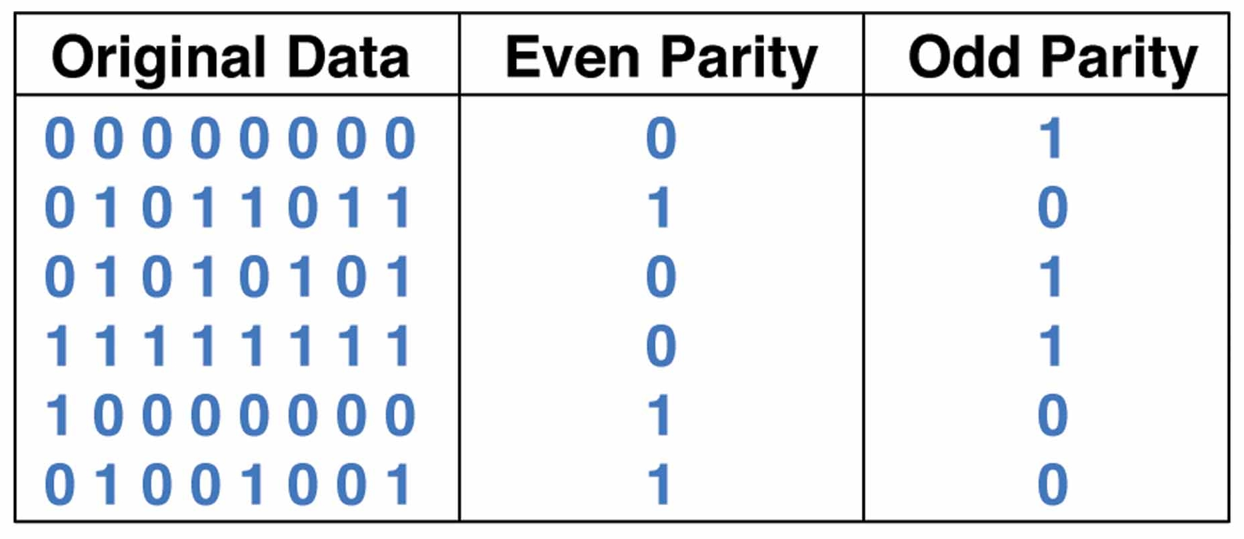
Parity Bit
A single bit is appended to each data chunk
  makes the number of 1 bits even/odd

Slide 21
Parity Checking
Assume we are using even parity with 7-bit ASCII.
The letter V in 7-bit ASCII is encoded as 0110101.
How will the letter V be transmitted?
  Because there are four 1s (an even number), parity is set to zero.
  This would be transmitted as: 01101010.
If we are using an odd parity:
  The letter V will be transmitted as 01101011

Slide 22
Exercise 1
Suppose you are using an odd parity. What should the binary word “1010” look like after you add the parity bit?
Answer:
  There is an even number of 1-bits.
  So we need to add another 1-bit
  Our new word will look like “10101”.

Slide 23
Exercise 2
Suppose you are using an even parity. What should the binary word “1010” look like after you add a parity bit?
Answer:
  There is an even number of 1’s.
  So we need to add another 0
  Our new word will look like “10100”.

Slide 24
Parity Check
Sender
Receiver
1 | 0 | 1 | 0 | 1 | 0 | 0
Data
1 | 0 | 1 | 0 | 1 | 0 | 0
Yes , Drop parity bit & accept data
Reject Data
No
Even?
Calculate Parity bit
Count bits
1 | 1 | 0 | 1 | 0 | 1 | 0 | 0
1 | 1 | 0 | 1 | 0 | 1 | 0 | 0
Data + Redundancy Bits
The Medium

Slide 25
Cyclic Redundancy Check (CRC)
Used for error checking
Unlike the parity check which is based on addition, CRC is based on binary division.
Before sending data ,some calculation are done on the data packets to generate a CRC number
The CRC is calculated so the packet ( data + CRC ) becomes exactly divisible by a predetermined number.
When data is received , the packet is divided by the number.

Slide 26
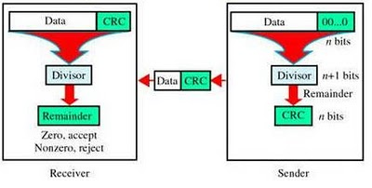
Cyclic Redundancy Check (CRC)
If the reminder “0” : data is correct
If the reminder “1” : data has a problem and need to be sent again.
CRC Can detect single bit & burst errors.
Notes:
0505247709

Slide 27
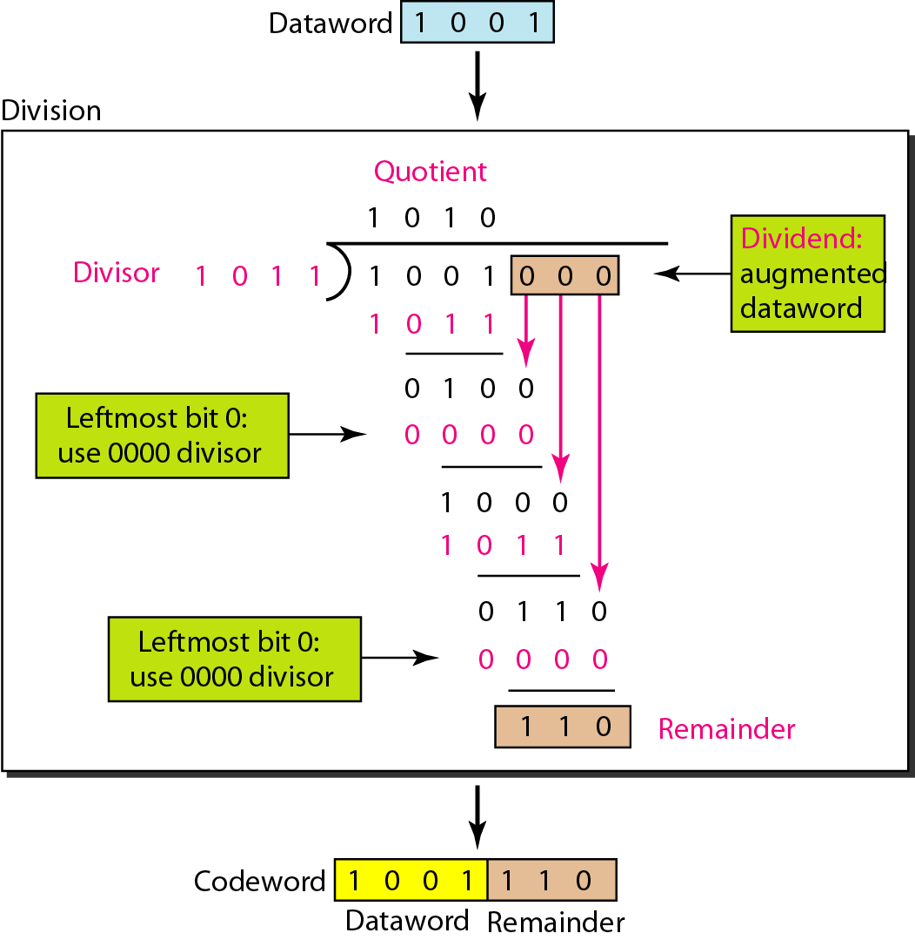
Division in CRC encoder

Slide 28
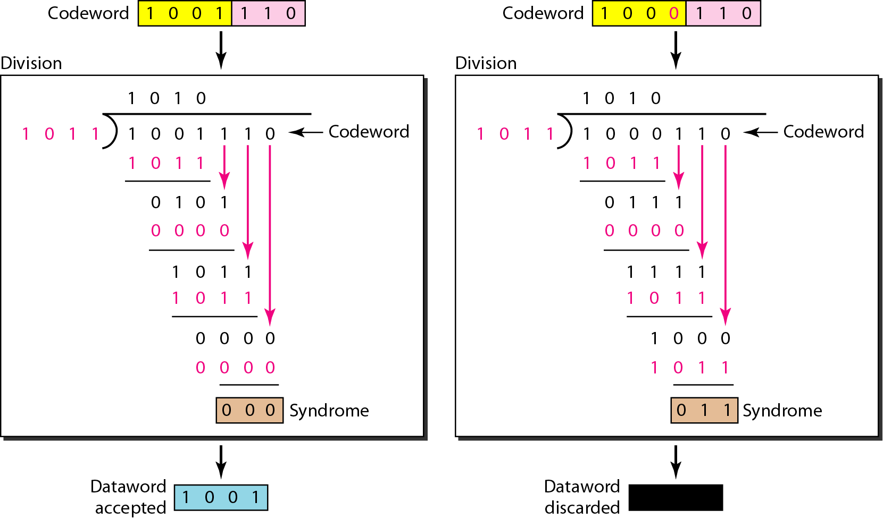
Division in the CRC decoder for two cases

Slide 29
Checksum
A checksum “adds” together “chunks” of data.
  A match between receiver checksum and transmitted checksum indicates good data.
  A mismatch indicates an error has occurred.
Capable of detecting single or burst errors.
It is simple to implement in either hardware or software.

Slide 30
Checksum idea
Suppose our data is a list of five 4-bit numbers that we want to send to a destination. In addition to sending these numbers, we send the sum of the numbers. For example, if the set of numbers is (7, 11, 12, 0, 6), we send (7, 11, 12, 0, 6, 36), where 36 is the sum of the original numbers. The receiver adds the five numbers and compares the result with the sum. If the two are the same, the receiver assumes no error, accepts the five numbers, and discards the sum. Otherwise, there is an error somewhere and the data are not accepted.

Slide 31
We can make the job of the receiver easier if we send the negative (complement) of the sum, called the checksum. In this case, we send (7, 11, 12, 0, 6, −36). The receiver can add all the numbers received (including the checksum). If the result is 0, it assumes no error; otherwise, there is an error.

