Slide 1
Analog Transmission
NET 205: Data Transmission and Digital Communication
2nd semester 1439-1440

Slide 2
205NET CLO
1-Introduction to Communication Systems and Networks architecture OSI Reference Model.
2- Data Transmission Principles
3- Transmission medias
4- Data modulation and encoding

Slide 3
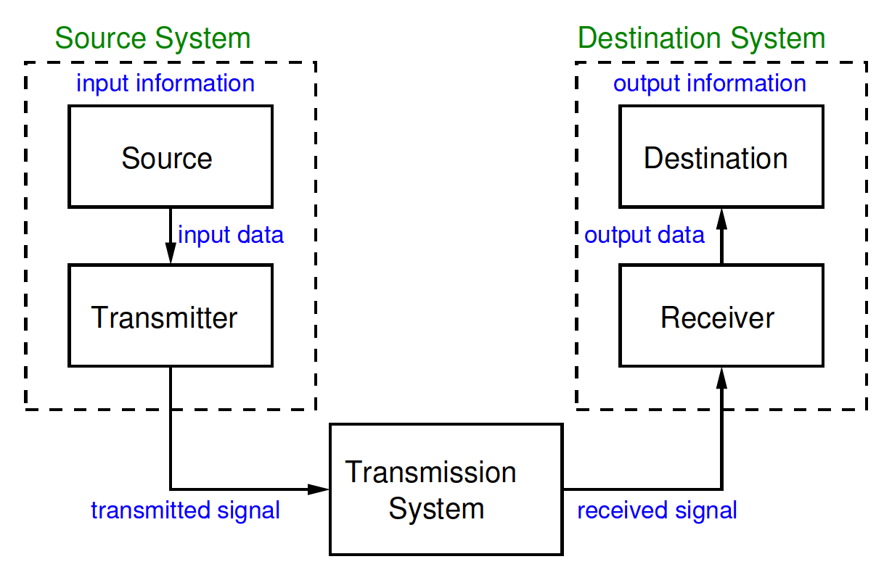
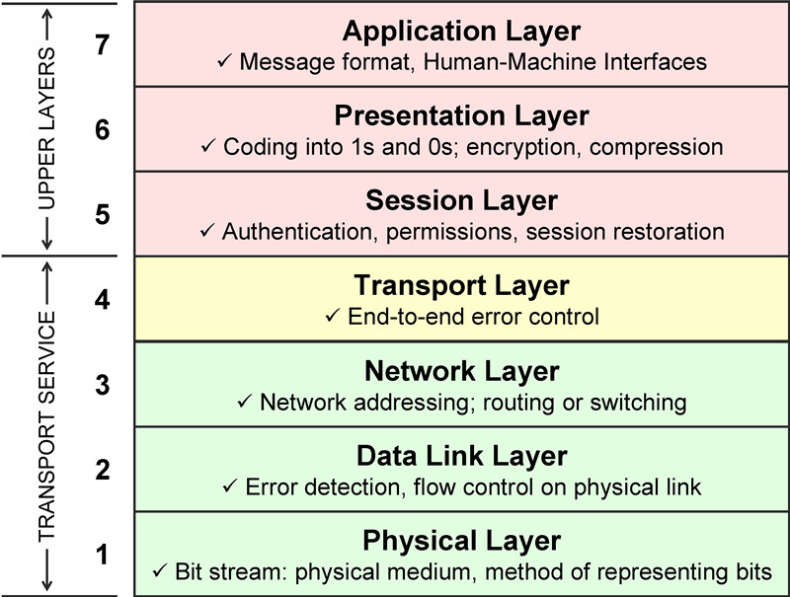
Data Modulation And Encoding

Slide 4
Outline
Introduction
Modulation of Digital Data
Amplitude Shift Keying
Frequency Shift Keying
Phase Shift Keying
Quadrature Amplitude Modulation
Modulation of Analog Data
Amplitude Modulation
Frequency Modulation
Phase Modulation

Slide 5
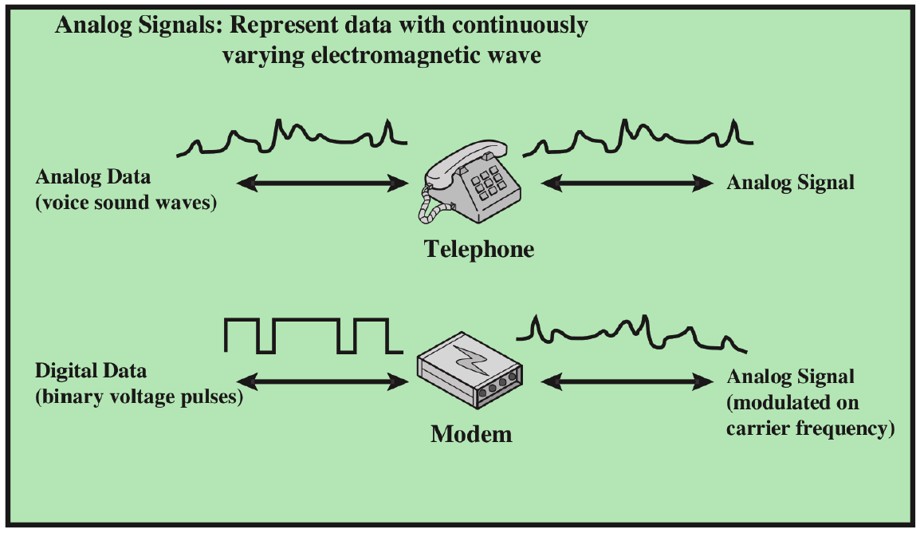
Introduction
Notes:
Converting digital data or low-pass analog signal to a band-pass analog signal is traditionally called modulation.
If the available channel is a bandpass channel~we cannot send the digital signal directly to
the channel; we need to convert the digital signal to an analog signal before transmission.

Slide 6
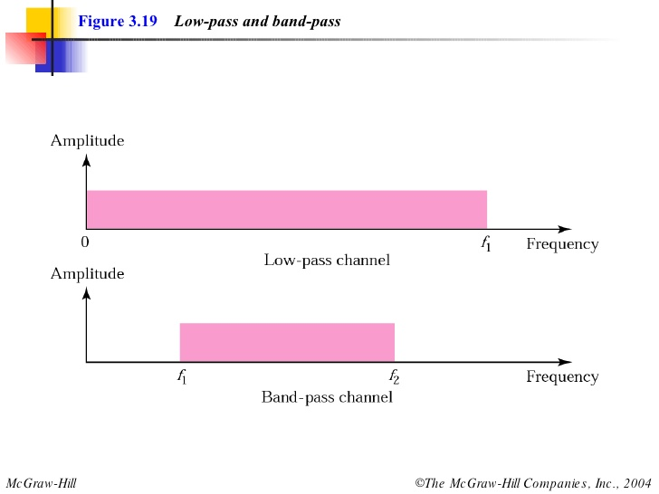
Channel Properties
A communication channel only operates at a certain frequency range.
Channels are either be
low-pass
band-pass channels.
Notes:
A low-pass channel has a bandwidth with frequencies between 0 and 𝒇.
A band-pass channel has a bandwidth with frequency between 𝒇1 and 𝒇2

Slide 7
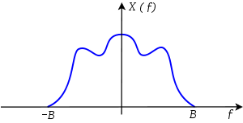
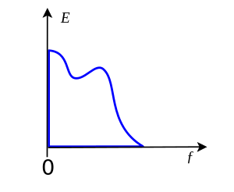
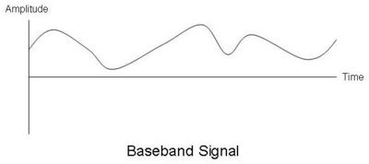
Analog → Analog
The source typically produces a low frequency signal ,referred to as the “baseband signal”.
The baseband signals are not suitable for direct transmission over band-pass channels.
Notes:
A baseband signal or low frequency signal is a signal whose spectrum is positioned close to dc (ω=0) ( e.g. speech signals → spectrum 0 to 3.5 kHz and video signals →spectrum 0 to 4.3 kHz.

Slide 8
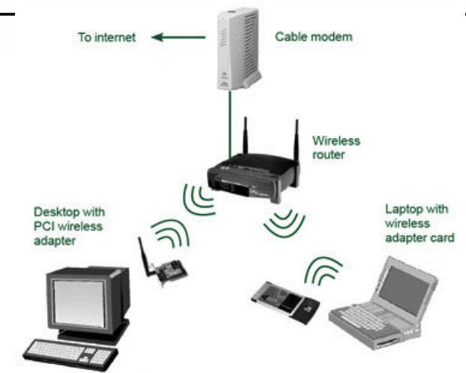
Digital → Analog
1) The channel is band-pass, and/or
2) Multiple users need to share the medium – microwave systems.

Slide 9
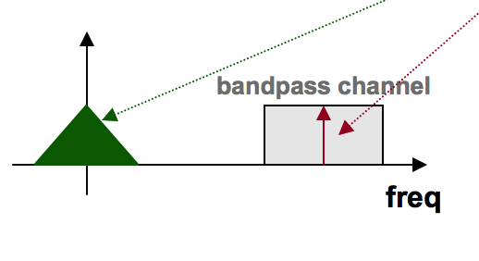
Modulation
It is the process of converting digital data or a low-pass analog to band-pass (higher-frequency) analog signal

Slide 10
Carrier Signal
Carrier Signal: is a high frequency signal that acts as a basis for the information signal

Slide 11
Modulation translates a signal from its baseband to the operating
range of the channel

Slide 12
Outline
Introduction
Modulation of Digital Data
Amplitude Shift Keying
Frequency Shift Keying
Phase Shift Keying
Quadrature Amplitude Modulation
Modulation of Analog Data
Amplitude Modulation
Frequency Modulation
Phase Modulation

Slide 13
Modulation of Digital Data
Digital-to-analog modulation is the process of changing one of the characteristics of an analog signal – carrier signal (sinusoidal signal) based on the information in digital data.
This kind of modification is called modulation (shift keying).
Notes:
sinewave is defined by 3 characteristics (amplitude,
frequency, and phase)
⇒ digital data (binary 0 & 1)
can be represented by varying any of the three

Slide 14
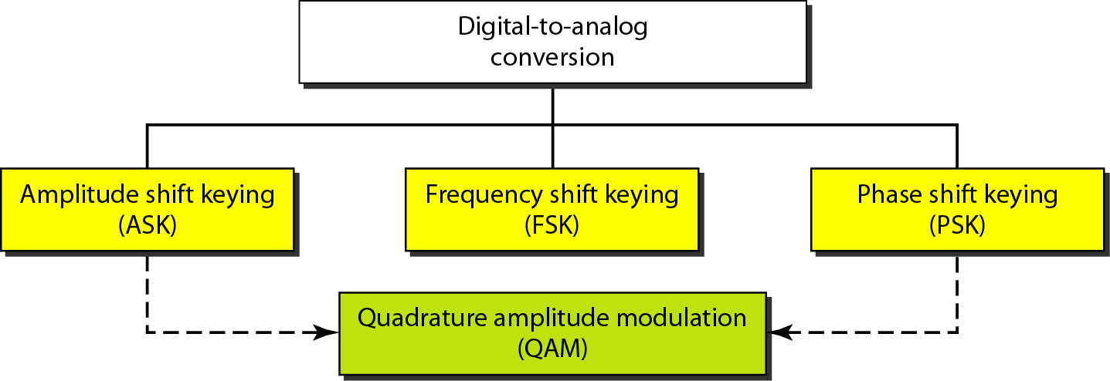
Types of Digital-to-Analog Conversion

Slide 15
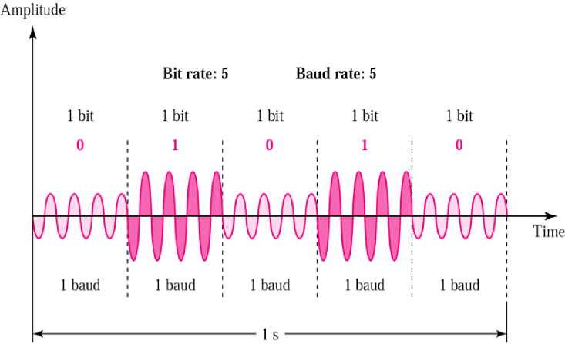
Amplitude Shift Keying
In amplitude shift keying (ASK), the amplitude of the carrier signal is varied to represent binary 1 or 0
frequency and phase remain constant while amplitude changes.
Notes:
Although we can have several levels (kinds) of signal elements, each with a different amplitude, ASK is normally implemented using only two levels. This is referred to as binary amplitude shift keying or on-off keying (OOK).
The peak amplitude of one signal level is 0; the other is the same as the amplitude of the carrier frequency

Slide 16
Binary ASK
A popular ASK technique is the binary ASK (on-off keying (OOK)).
On of the amplitude is zero

Slide 17
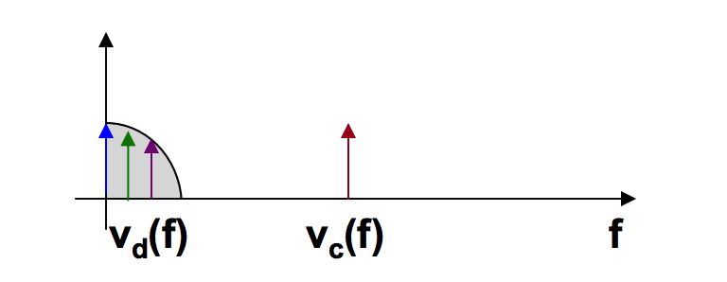
Implementation of Binary ASK
Notes:
If digital data are presented as a unipolar NRZ (see Chapter 4) digital signal with a
high voltage of I V and a low voltage of 0 V, the implementation can achieved by
multiplying the NRZ digital signal by the carrier signal coming from an oscillator.
When the amplitude of the NRZ signal is 1, the amplitude of the carrier frequency is held; when the amplitude of the NRZ signal is 0, the amplitude of the carrier frequency
IS zero.

Slide 18
Example
We have an available bandwidth of 100 kHz which spans from 200 to 300 kHz. What are the carrier frequency if we modulated our data by using ASK ?
Solution The middle of the bandwidth is located at 250 kHz. This means that our carrier frequency can be at f_{c} = 250 kHz.

Slide 19
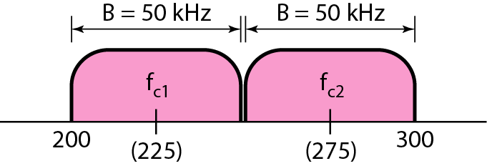
Example
In data communications, we normally use full-duplex links with communication in both directions. We need to divide the bandwidth into two with two carrier frequencies, as shown in figure. The figure shows the positions of two carrier frequencies and the bandwidths. The available bandwidth for each direction is now 50 kHz.

Slide 20
Amplitude Shift Keying
Demodulation: only the presence or absence of a sinusoid in a given time interval needs to be determined
Advantage: simplicity
Disadvantage: ASK is very susceptible to noise interference- noise usually (only) affects the amplitude, therefore ASK is the modulation technique most affected by noise
Application: ASK is used to transmit digital data over optical fiber

Slide 21
Multilevel ASK
We can have multilevel ASK in which there are more than two levels.
We can use 4,8, 16, or more different amplitudes for the signal and modulate the data using 2, 3, 4, or more bits at a time.
Notes:
The above discussion uses only two amplitude levels.

Slide 22
Frequency Shift Keying
In frequency shift keying (FSK), the frequency of the carrier signal is varied to represent binary 1 or 0.
Both peak amplitude and phase remain constant.
Notes:
The frequency of the modulated signal is constant for the duration of one signal element,
but changes for the next signal element if the data element changes.

Slide 23
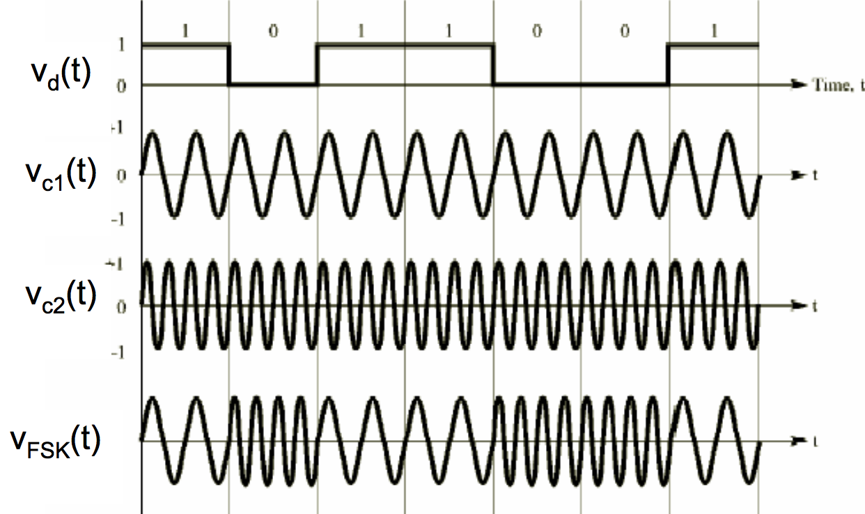

Slide 24
Frequency Shift Keying
demodulation: demodulator must be able to determine which of two possible frequencies is present at a given time
advantage: FSK is less susceptible to errors than ASK – receiver looks for specific frequency changes over a number of intervals, so voltage (noise) spikes can be ignored
disadvantage: FSK spectrum is 2 x ASK spectrum
application: over voice lines, in high-freq. radio transmission, etc.

Slide 25
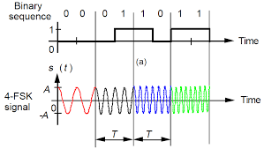
Multilevel FSK
We can use more than two frequencies. For example, we can use four different frequencies f₁, f₂, f₃, and f₄ to send 2 bits at a time.
However, we need to remember that the frequencies need to be apart of each other.
Notes:
Multilevel modulation (MFSK) is not uncommon with the FSK method.

Slide 26
Phase Shift Keying
In phase shift keying, the phase of the carrier is varied to represent binary 1 or 0
Both peak amplitude and frequency remain constant.
In binary PSK, we have only two signal elements: one with a phase of 0°, and the other with a phase of 180°.

Slide 27
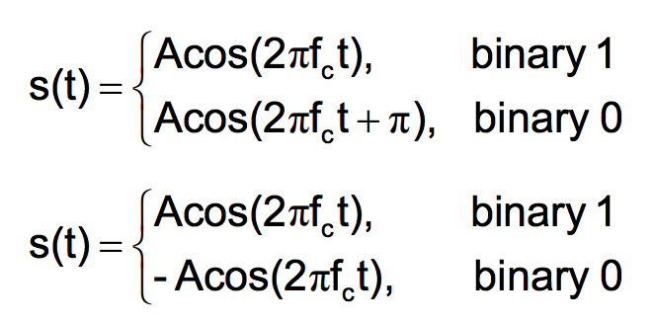
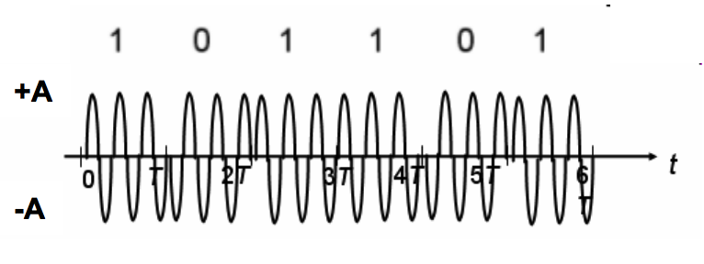
Phase Shift Keying
PSK is equivalent to multiplying carrier signal by +1 when the information is 1, and by -1 when the information is 0

Slide 28
Implementation of BPSK
Notes:
The implementation of BPSK is as simple as that for ASK.
the signal element with phase 180° can be seen as the complement of the signal element with phase 0°.
The implementation of BPSK is as simple as that for ASK. The reason
is that the signal element with phase 180° can be seen as the complement of the signal
element with phase 0°. This gives us a clue on how to implement BPSK. We use
the same idea we used for ASK but with a polar NRZ signal instead of a unipolar NRZ
signal, as shown in Figure 5.10. The polar NRZ signal is multiplied by the carrier frequency;
the 1 bit (positive voltage) is represented by a phase starting at 0°; the abit
(negative voltage) is represented by a phase starting at 180°.

Slide 29
Phase Shift Keying
demodulation: demodulator must determine the phase of received sinusoid with respect to some reference phase
advantage: PSK is less susceptible to errors than ASK, PSK is superior to FSK because we do not need two carrier signals, The bandwidth for BPSK is same as that for binary ASK.
disadvantage: more complex signal detection / recovery process, than in ASK and FSK

Slide 30
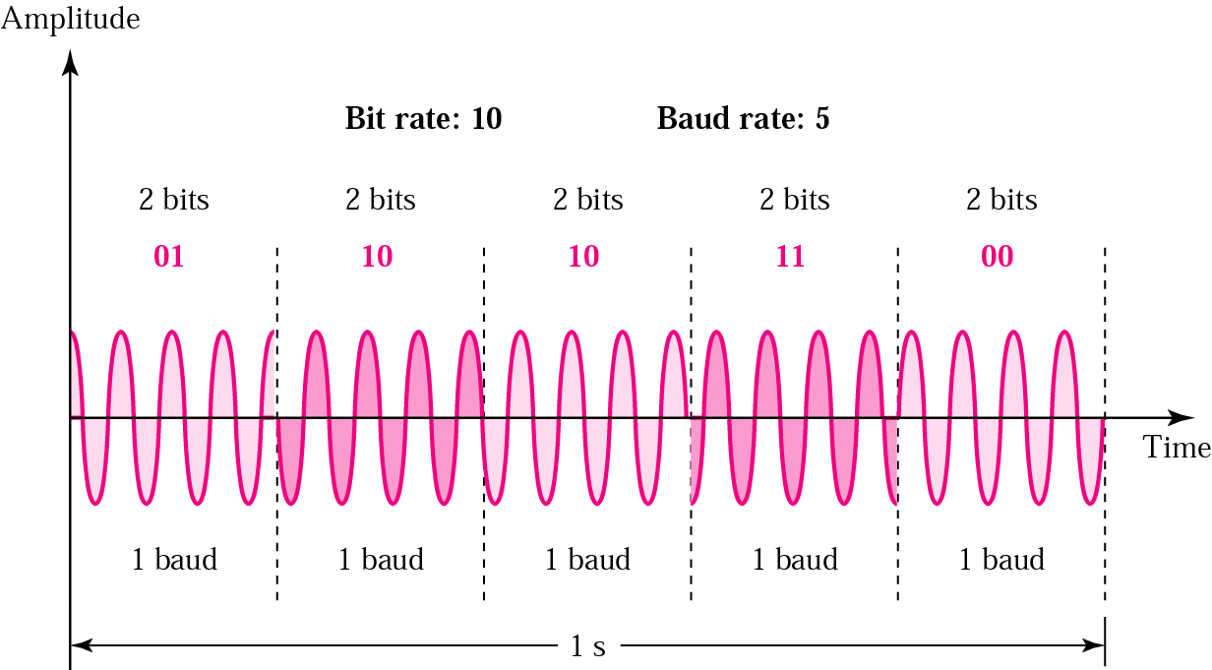
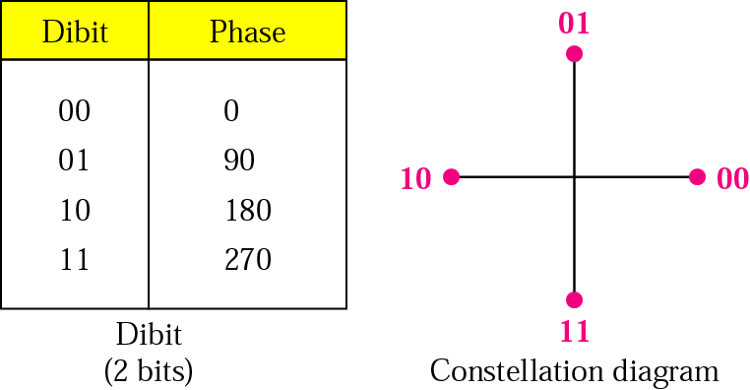
Quadrature PSK
QPSK = 4 PSK = PSK that uses phase shifts of 90º= π/2 rad
⇒ 4 different signals generated, each representing 2 bits

Slide 31
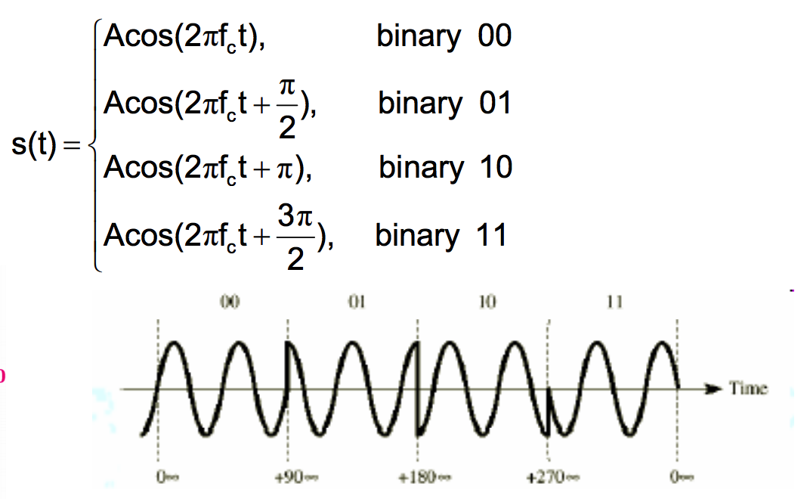
Quadrature PSK

Slide 32
Quadrature PSK
advantage: higher data rate than in PSK (2 bits per bit interval), while bandwidth occupancy remains the same
4-PSK can easily be extended to 8-PSK, i.e. n-PSK
however, higher rate PSK schemes are limited by the ability of equipment to distinguish small differences in phase

Slide 33
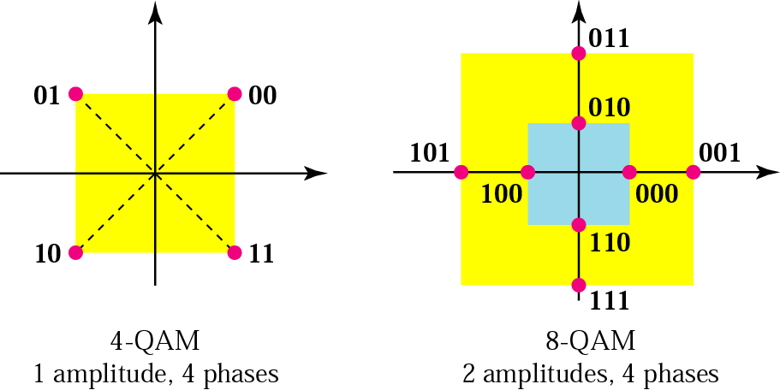
Quadrature Amplitude Modulation
Quadrature amplitude modulation is a combination of ASK and PSK.
The possible variations of QAM are numerous
Notes:
Figure 5.14a shows the simplest 4-QAM scheme (four different signal element
types) using a unipolar NRZ signal to modulate each carrier. This is the same
mechanism we used for ASK (OOK). Part b shows another 4-QAM using polar NRZ,
but this is exactly the same as QPSK. Part c shows another QAM-4 in which we used a
signal with two positive levels to modulate each of the two carriers. Finally, Figure 5.14d
shows a 16-QAM constellation of a signal with eight levels, four positive and four
negative.
Figure 5.14

Slide 34
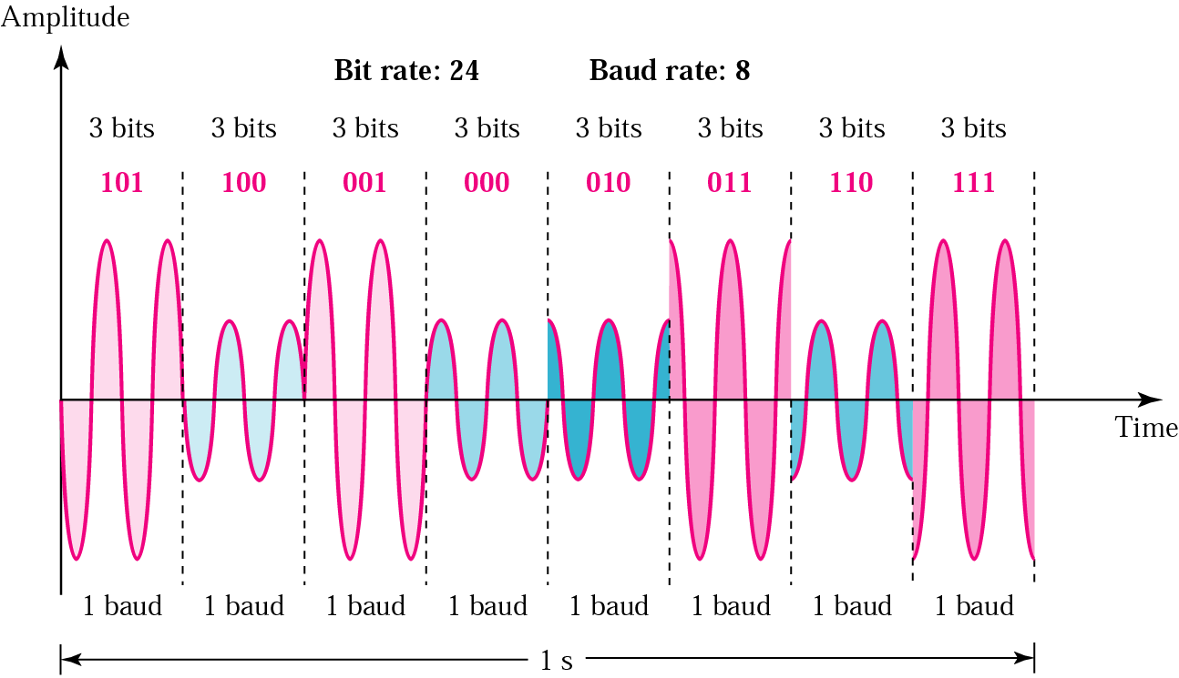
Ex: Time domain for an 8-QAM signal

Slide 35
Outline
Introduction
Modulation of Digital Data
Amplitude Shift Keying
Frequency Shift Keying
Phase Shift Keying
Quadrature Amplitude Modulation
Modulation of Analog Data
Amplitude Modulation
Frequency Modulation
Phase Modulation

Slide 36
Modulation of Analog Data
Analog-to-analog conversion, or analog modulation, is the representation of analog information by an analog signal.
One may ask why we need to modulate an analog signal; it is already analog. Modulation is needed if the medium is band-pass in nature or if only a band-pass bandwidth is available to us.

Slide 37
Types of Analog-to-Analog Modulation
Analog-to-analog conversion can be accomplished in three ways:

Slide 38
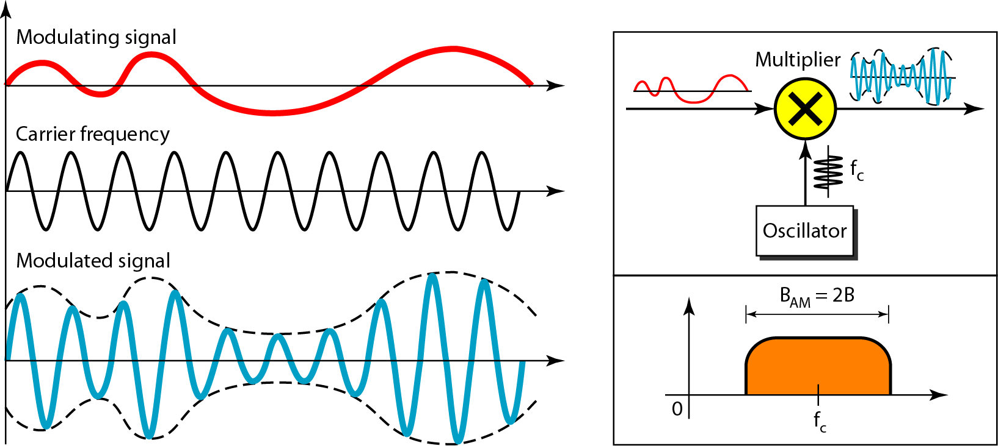
Amplitude Modulation (AM)
In AM transmission, the carrier signal is modulated so that its amplitude varies with the changing amplitudes of the modulating signal.
The frequency and phase of the carrier remain the same;
The modulating signal is the envelope of the carrier
Notes:
only the amplitude changes to follow variations in the information
AM is normally implemented by using a simple multiplier
because the amplitude of the carrier signal needs to be changed according to the amplitude
of the modulating signal.

Slide 39
AM Bandwidth
The modulation creates a bandwidth that is twice the bandwidth of the modulating signal and covers a range centered on the carrier frequency.
Notes:
However, the signal components above and below the carrier frequency carry exactly the same information. For this reason, some implementations
discard one-half of the signals and cut the bandwidth in half.
The total bandwidth required for AM can be determined from the bandwidth of the audio signal: BAM =2B.

Slide 40
Standard Bandwidth Allocation for AM Radio
The BW of an audio signal (speech and music) is usually 5 kHz. → an AM radio station needs a BW of 10kHz
AM stations are allowed carrier frequencies anywhere between 530 and 1700 kHz
However, each station's carrier frequency must be separated from those on either side of it by at least 10 kHz (one AM bandwidth) to avoid interference.
Notes:
. In fact, the Federal Communications Commission (FCC) allows 10 kHz for each AM station.

Slide 41
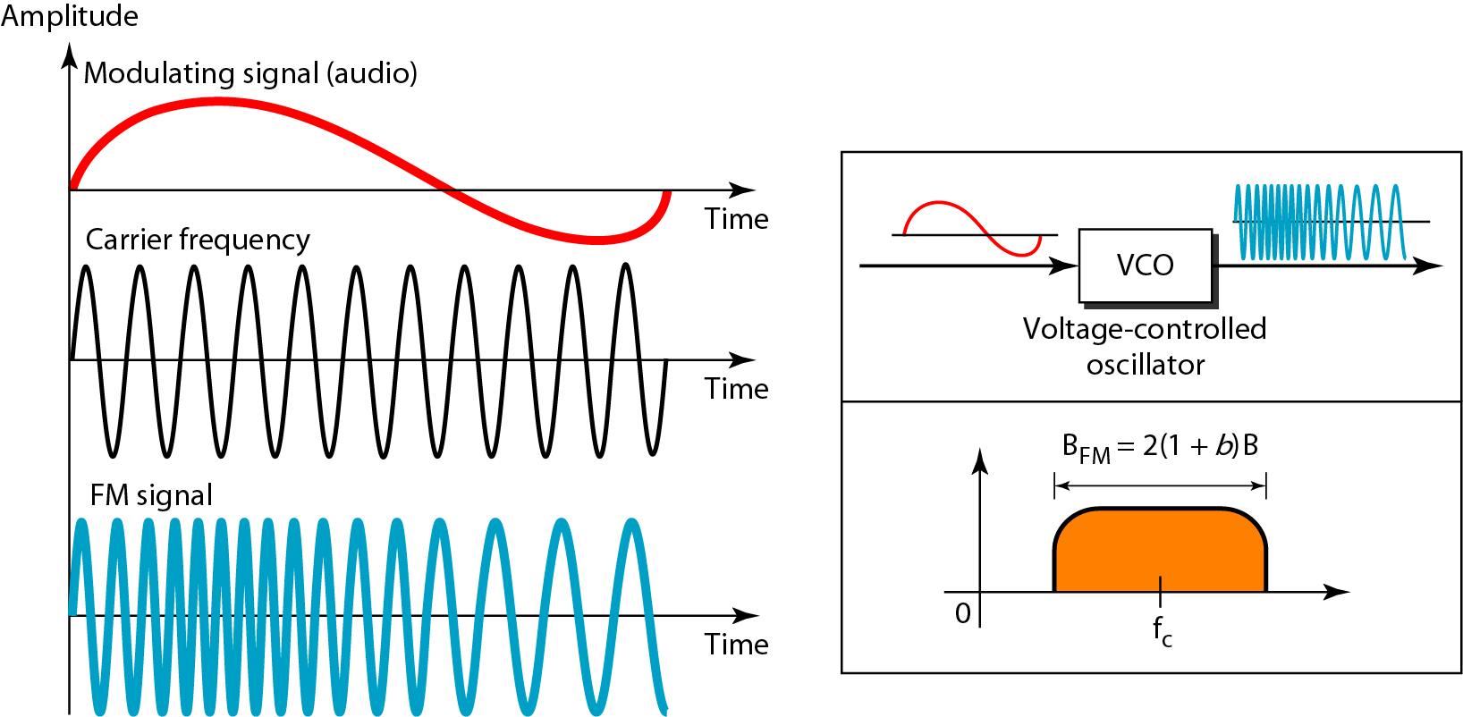
Frequency Modulation
In FM transmission, the frequency of the carrier signal is modulated to follow the changing voltage level (amplitude) of the modulating signal.
The peak amplitude and phase of the carrier signal remain constant
Notes:
but as the amplitude of the information signal
changes, the frequency of the carrier changes correspondingly

Slide 42
FM Bandwidth
The total bandwidth required for FM
B_{FM} = 2(1 + β)B
β is a factor depends on modulation technique with a common value of 4.
Notes:
As Figure 5.18 shows, FM is nOimalIy implemented by using a voltage-controlled oscillator as with FSK. The frequency of the oscillator changes according to the input
voltage which is the amplitude of the modulating signal.
The actual bandwidth is difficult to determine exactly, but it can be shown empirically that it is several times that of the analog signal or 2(1 + ~)B where ~ is a factor depends on modulation technique
with a common value of 4.

Slide 43
Standard Bandwidth Allocation for FM Radio
The bandwidth of an audio signal (speech and music) broadcast in stereo is almost 15 kHz.
The FCC allows 200 kHz (0.2 MHz) for each station. This mean β = 4 with some extra guard band.
FM stations are allowed carrier frequencies anywhere between 88 and 108 MHz.

Slide 44
Standard Bandwidth Allocation for FM Radio
Stations must be separated by at least 200 kHz to keep their bandwidths from overlapping.
To create even more privacy, the FCC requires that in a given area, only alternate bandwidth allocations may be used. The others remain unused to prevent any possibility of two stations interfering with each other.
Notes:
Given 88 to 108 MHz asa range, there are 100 potential PM bandwidths in an area, of which 50 can operate at anyone time. Figure 5.19 illustrates this concept.

Slide 45
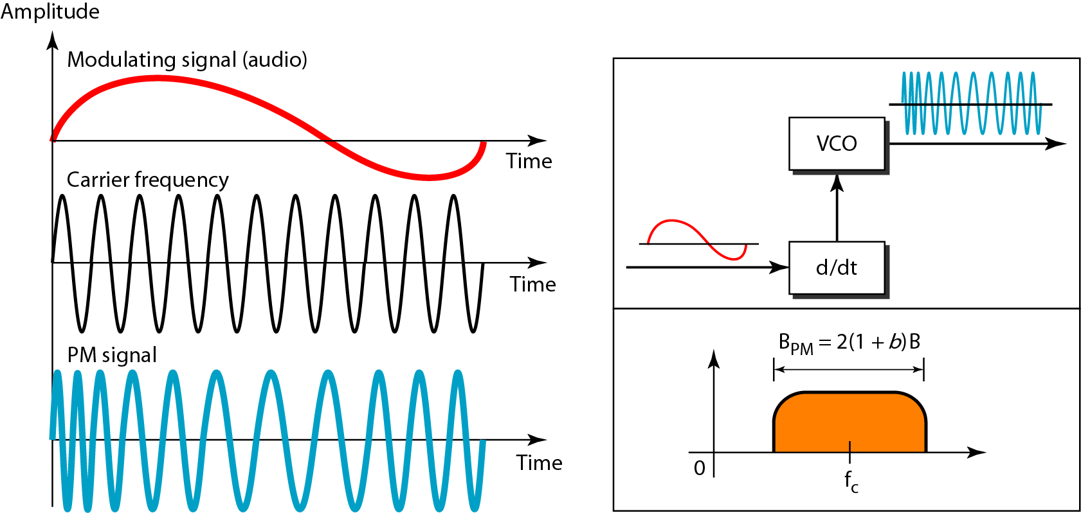
Phase Modulation
In PM transmission, the phase of the carrier signal is modulated to follow the changing voltage level (amplitude) of the modulating signal.
The peak amplitude and frequency of the carrier signal remain constant.
Notes:
, but as the amplitude of the information signal changes, the phase of the carrier changes correspondingly

Slide 46
Any Questions ?

