Slide 1
The OSI Model and the TCP/IP Protocol Suite
Outline:
  Protocol Layers
  OSI Model
  TCP/IP Model
  Addressing

Slide 2
OBJECTIVES
To discuss the OSI model and its layer architecture and to show the interface between the layers.
To briefly discuss the functions of each layer in the OSI model.
To introduce the TCP/IP protocol suite and compare its layers with the ones in the OSI model.
To show the functionality of each layer in the TCP/IP protocol with some examples.
To discuss the addressing mechanism used in some layers of the TCP/IP protocol suite for the delivery of a message from the source to the destination.

Slide 3
Computer Network Components
Components of a computer network:
    Computer with NIC (PCs, laptops, handhelds)
    routers & switches (IP router, Ethernet switch)
    Links” Transmission media” (wired, wireless)
    protocols (IP,TCP,CSMA/CD,CSMA/CA)
    applications (network services)
    i.e. Network Operating System (NOS)
    humans and service agents

Slide 4
Protocol “Layers”
Networks are complex!
many “pieces”:
  hosts
  routers
  links of various media
  applications
  protocols
  hardware, software
Question:
Is there any hope of organizing structure of network?
Or at least our discussion of networks?

Slide 5
Organization of air travel
ticket (purchase)
baggage (check)
gates (load)
runway takeoff
airplane routing
ticket (complain)
baggage (claim)
gates (unload)
runway landing
airplane routing
airplane routing
a series of steps

Slide 6
Layering of airline functionality
ticket (purchase)
baggage (check)
gates (load)
runway (takeoff)
airplane routing
ticket (complain)
baggage (claim
gates (unload)
runway (land)
airplane routing
ticket
baggage
gate
takeoff/landing
airplane routing
airplane routing
airplane routing
departure
airport
intermediate air-traffic
control centers
arrival
airport
Layers: each layer implements a service
  via its own internal-layer actions
  relying on services provided by layer below

Slide 7
Why layering?
Dealing with complex systems:
explicit structure allows identification, relationship of complex system’s pieces
  layered reference model for discussion
modularization eases maintenance, updating of system
  change of implementation of layer’s service transparent to rest of system
  e.g., change in gate procedure doesn’t affect rest of system

Slide 8
What’s a protocol?
human protocols:
“what’s the time?”
“I have a question”
introductions
… specific msgs sent
… specific actions taken when msgs received, or other events
network protocols:
machines rather than humans
all communication activity in Internet governed by protocols
protocols define format, order of msgs sent and received among network entities, and actions taken on msg transmission, receipt

Slide 9


What’s a protocol?
a human protocol and a computer network protocol:
Hi
TCP connection
request
Hi
TCP connection
response
Got the
time?
Get http://www.awl.com/kurose-ross
2:00
<file>
time
Q: Other human protocols?

Slide 10
PROTOCOL LAYERS
We discussed that a protocol is required when two entities need to communicate.
When communication is not simple, we may divide the complex task of communication into several layers.
Let us use a scenario in communication in which the role of protocol layering may be better understood.
We use two examples. In the first example, communication is so simple that it can occur in only one layer.

Slide 11
Example 1
Assume Maria and Ann are neighbors with a lot of common ideas. However, Maria speaks only Spanish, and Ann speaks only English.
Since both have learned the sign language in their childhood, they enjoy meeting in a cafe a couple of days per week and exchange their ideas using signs.
Occasionally, they also use a bilingual dictionary. Communication is face to face and Happens in one layer as shown in Figure.

Slide 12
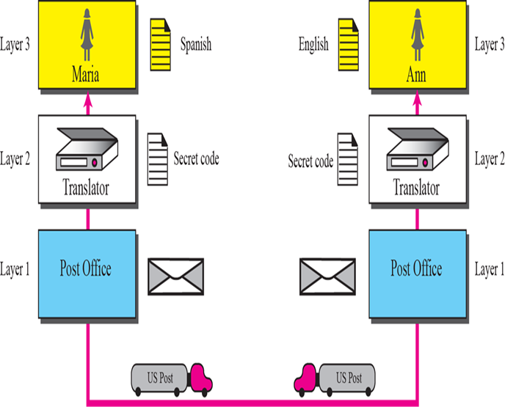
Example 2
Now assume that Ann has to move to another town because of her job. Before she moves, the two meet for the last time in the same cafe.
Although both are sad, Maria surprises Ann when she opens a packet that contains two small machines.
  The first machine can scan and transform a letter in English to a secret code or vice versa.
  The other machine can scan and translate a letter in Spanish to the same secret code or vice versa.
Ann takes the first machine; Maria keeps the second one.
The two friends can still communicate using the secret code, as shown in Figure.

Slide 13
PROTOCOL LAYERS
Network activity involves sending data from one computer to another. This complex process can be broken into discrete, sequential tasks. The sending computer must:
  Recognize the data.
  Divide the data into manageable chunks.
  Add information to each chunk of data to determine the location of the data and to identify the receiver.
  Add timing and error-checking information.
  Put the data on the network and send it on its way.
In this case, we may need several protocols, one for each layer.

Slide 14
THE OSI MODEL
In 1978, the International Organization for Standardization (ISO) released a set of specifications that described network architecture for connecting dissimilar devices.
Established in 1947, the International Standards Organization (ISO) is a multinational body dedicated to worldwide agreement on international standards.
Almost three-fourths of countries in the world are represented in the ISO.
An ISO standard that covers all aspects of network communications is the Open Systems Interconnection (OSI) model.

Slide 15

Note
ISO is the organization;
OSI is the model.

Slide 16
Topics Discussed in the Section
Layers in the OSI Model
Layered Architecture
Layer-to-layer Communication
Encapsulation

Slide 17
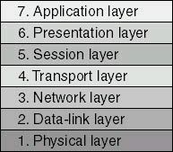
OSI Model Layers
The OSI reference model architecture divides network communication into seven layers.
Each layer covers different network activities, equipment, or protocols.
Layering specifies different functions and services as data moves from one computer through the network cabling to another computer.

Slide 18
OSI Model Layers
Each layer provides some service or action that prepares the data for delivery over the network to another computer.
The lowest layers—1 and 2—define the network's physical media and related tasks, such as putting data bits onto the network interface cards (NICs) and cable.
The highest layers define how applications access communication services.
The higher the layer, the more complex its task.

Slide 19

OSI Model Layers
Also, the OSI reference model defines how each layer communicates and works with the layers immediately above and below it.
The layers are separated from each other by boundaries called interfaces.
The interface defines the services offered by the lower networking layer to the upper one and further defines how those services will be accessed.
All requests are passed from one layer, through the interface, to the next layer.
Each layer builds upon the standards and activities of the layer below it.
Each layer provides services to the next-higher layer and shields the upper layer from the details of how the services below it are actually implemented.

Slide 20

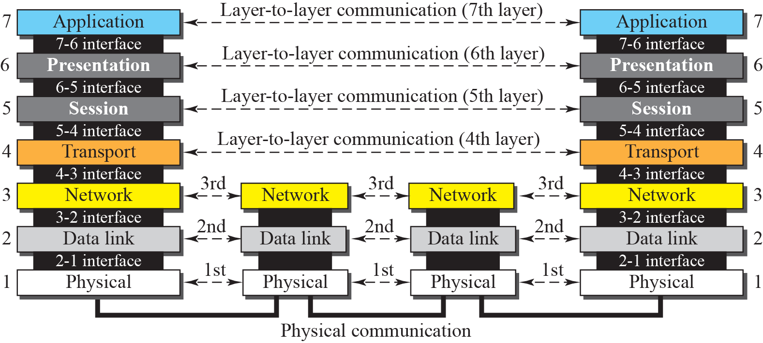
OSI layers

Slide 21
OSI Model Layers
With the exception of the lowest layer in the OSI networking model, no layer can pass information directly to its counterpart on another computer. Instead, information on the sending computer must be passed down through each successive layer until it reaches the physical layer.
The information then moves across the networking cable to the receiving computer and up that computer's networking layers until it arrives at the corresponding layer.

Slide 22
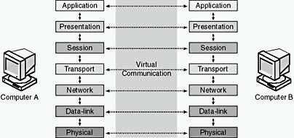
OSI Model Layers
But, we can visualize that each layer has a direct communication with its associated layer on the other computer. This provides a logical, or virtual, communication between peer layers

Slide 23
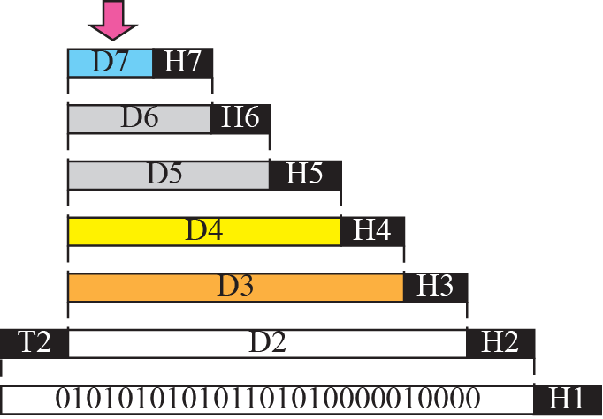


An exchange using the OSI model ( Encapsulation)

Slide 24
Encapsulation
Before data is passed from one layer to another, it is broken down into packets, or units of information, which are transmitted as a whole from one device to another on a network.
At the sender, each layer adds additional formatting or addressing to the packet, which is needed for the packet to be successfully transmitted across the network.
At the receiving end, the packet passes through the layers in reverse order. Each layer reads the information on the packet, strips it away, and passes the packet up to the next layer.
When the packet is finally passed up to the application layer, the packet is in its original form, which is readable by the receiver.

Slide 25
Encapsulation
source
message
M
application
transport
network
link
physical
segment
H_{t}
M
H_{t}
datagram
H_{n}
H_{n}
H_{t}
M
frame
H_{l}
H_{n}
H_{t}
M
link
physical
switch
destination
H_{n}
H_{t}
M
network
link
physical
M
application
transport
network
link
physical
H_{l}
H_{n}
H_{t}
M
H_{n}
H_{t}
M
H_{t}
M
H_{n}
H_{t}
M
H_{l}
H_{n}
H_{t}
M
router

Slide 26
TCP/IP Model
The TCP/IP protocol suite was developed prior to the OSI model.
Therefore, the layers in the TCP/IP protocol suite do not match exactly with those in the OSI model.
The original TCP/IP protocol suite was defined as four layers. Today, however, TCP/IP is thought of as a five-layer model.
Application
Troubleshooting, file sharing, internet
Transport
Flow control, error control
Internet
Network Access
IP addressing and routing of network traffic
Interface with the physical network

Slide 27
Comparison between OSI and TCP/IP
IOS Model
TCP/IP Model
Application
Presentation
Session
Transport
Network
Data Link
Physical
Application
Transport
Internet
Network Access

Slide 28
LAYERS IN THE OSI MODEL
In this section we briefly describe the functions of each layer in the OSI model.

Slide 29
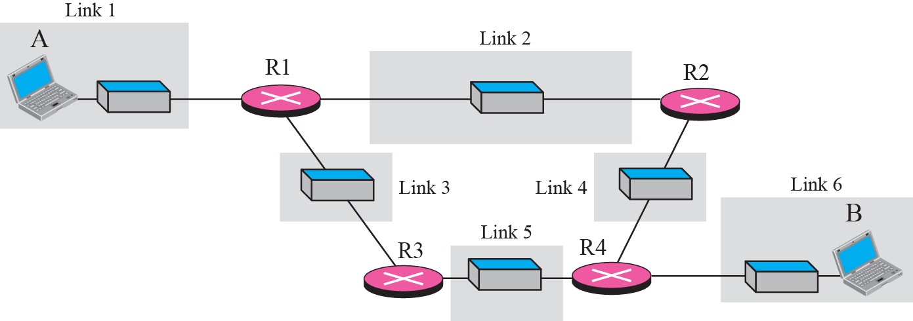
A private internet

Slide 30
Physical layer
The physical layer coordinates the functions required to transmit a bit stream over a physical medium.
It defines the procedures and functions that physical devices and interfaces have to perform for transmission occur.
The physical layer is concerned with the following:
  Physical characteristics of interfaces and media:
  Representation of the bits
  Data rate, the number of bits sent each second.
  Line configuration, Point to point or multipoint configuration.
  Physical topology
  Transmission Mode : Simplex, half duplex or full duplex

Slide 31
Note
The physical layer is responsible for moving individual bits from one
(node) to the next.

Slide 32
Communication at the physical layer

Slide 33
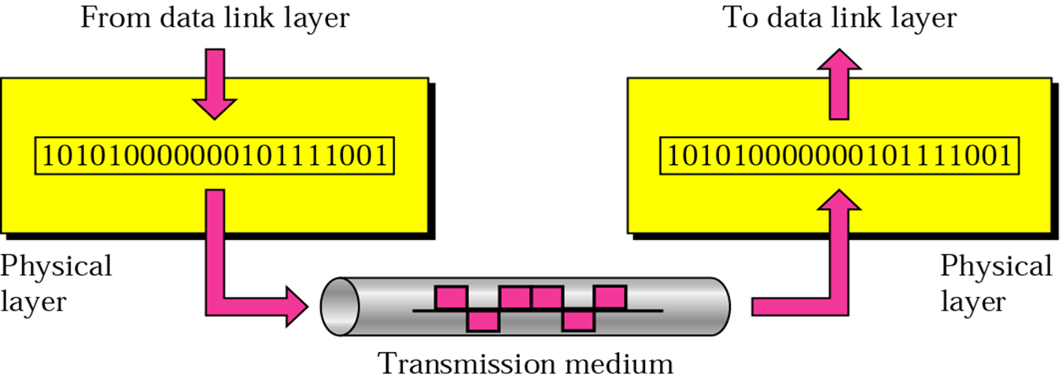
Note
The unit of communication at the physical layer is a bit.

Slide 34

Link Layer: Introduction
Some terminology:
hosts and routers are nodes
communication channels that connect adjacent nodes along communication path are links
  wired links
  wireless links
  LANs
layer-2 packet is a frame, encapsulates datagram
data-link layer has responsibility of
transferring datagram from one node
to adjacent node over a link

Slide 35
Link layer: context
datagram transferred by different link protocols over different links:
  e.g., Ethernet on first link, frame relay on intermediate links, 802.11 on last link
each link protocol provides different services
  e.g., may or may not provide rdt over link
transportation analogy
trip from Princeton to Lausanne
  limo: Princeton to JFK
  plane: JFK to Geneva
  train: Geneva to Lausanne
tourist = datagram
transport segment = communication link
transportation mode = link layer protocol
travel agent = routing algorithm

Slide 36
Link Layer Services
framing, link access:
  encapsulate datagram into frame, adding header, trailer
  channel access if shared medium
  “MAC” addresses used in frame headers to identify source, dest
    different from IP address!

Slide 37
Link Layer Services (more)
flow control:
  pacing between adjacent sending and receiving nodes
error detection:
  errors caused by signal attenuation, noise.
  receiver detects presence of errors:
    signals sender for retransmission or drops frame
error correction:
  receiver identifies and corrects bit error(s) without resorting to retransmission
half-duplex and full-duplex
  with half duplex, nodes at both ends of link can transmit, but not at same time

Slide 38
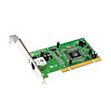

Where is the link layer implemented?
in each and every host
link layer implemented in “adaptor” (aka network interface card NIC)
host schematic
application
transport
network
link
cpu
memory
link
physical
host
bus
(e.g., PCI)
controller
physical
transmission
network adapter
card

Slide 39
Data Link Layer
The data link layer transforms the physical layer, a raw transmission facility, to a reliable link ( it make the physical layer appear error-free to the upper layer)
it responsible for node-to-node delivery.
The Data Link layer is concerned with the following:
  Framing.
  Physical addressing, each node has its unique address.
  Flow Control.
  Access Control.
  Error control, normally achieved through a trailer to the end of the frame.

Slide 40
Communication at the data link layer

Slide 41
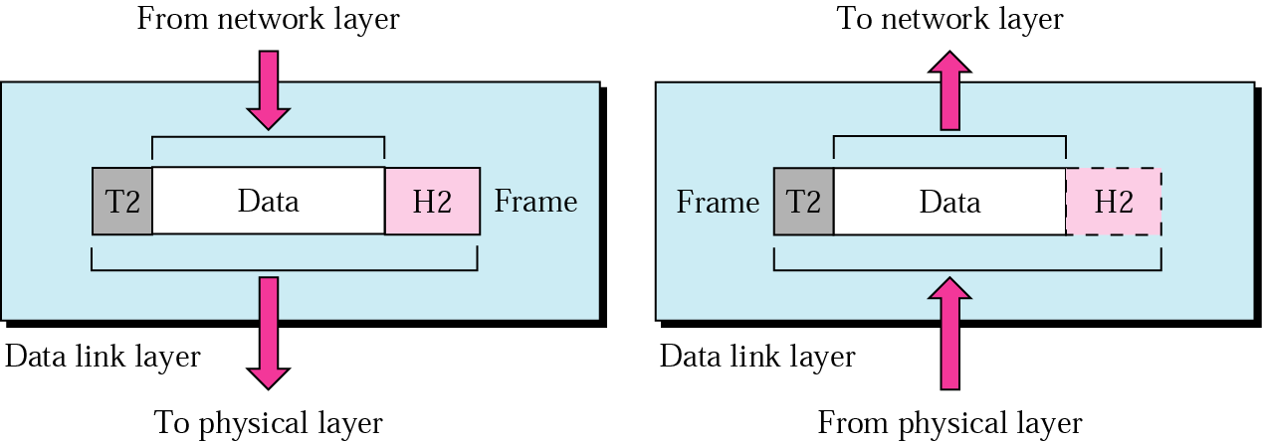
Note
The unit of communication at the data link layer is a frame.

Slide 42
Network layer
transport segment from sending to receiving host
on sending side encapsulates segments into datagrams
on rcving side, delivers segments to transport layer
network layer protocols in every host, router
router examines header fields in all IP datagrams passing through it
application
transport
network
data link
physical
network
data link
physical
network
data link
physical
network
data link
physical
network
data link
physical
network
data link
physical
network
data link
physical
network
data link
physical
network
data link
physical
network
data link
physical
application
transport
network
data link
physical
network
data link
physical
network
data link
physical

Slide 43
Two Key Network-Layer Functions
forwarding: move packets from router’s input to appropriate router output
routing: determine route taken by packets from source to dest.
  routing algorithms
analogy:
routing: process of planning trip from source to dest
forwarding: process of getting through single interchange

Slide 44
Network Layer
Is responsible for the source-to-destination delivery of a packet possible across multiple networks.
Functions:
  Logical addressing.
  Routing, It determines which path the data should take based on network conditions, priority of service, and other factors.

Slide 45
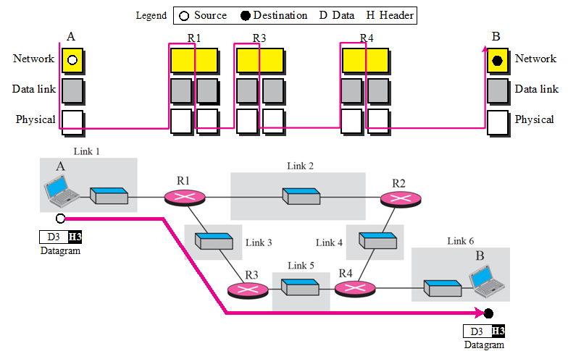

Slide 46
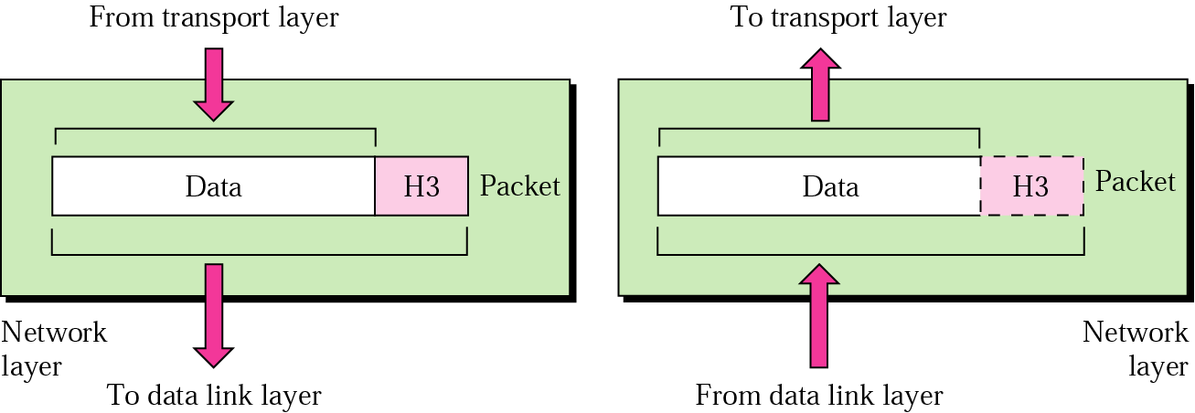
Note
The unit of communication at the network layer is a datagram (Packet).

