Slide 1
Internet and Intranet

Slide 2
Internet

Slide 3
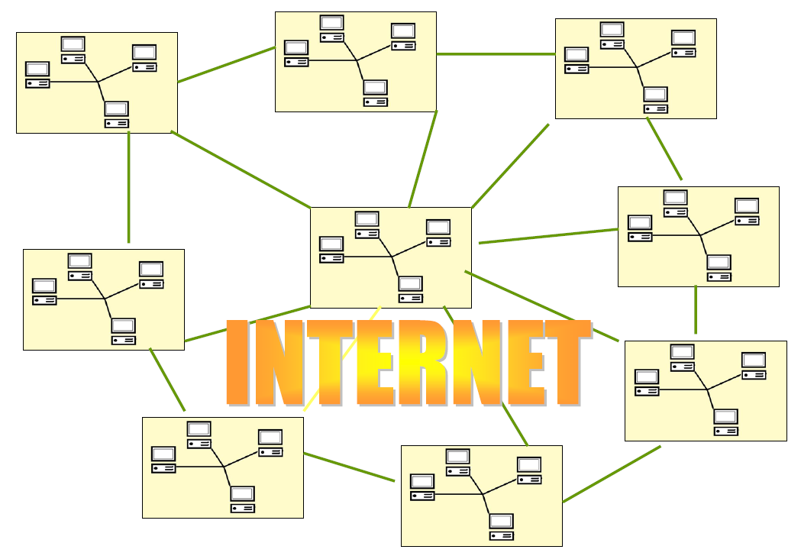
What is Internet?
A network is a group of connected communicating devices such as computers and printers. An internet is two or more networks that can communicate with each other.
The world’s largest computer network, consisting of millions of computers supporting tens of millions of users in hundreds of countries.

Slide 4
Internet History
The Internet was originally established to meet the research needs of the U.S. defense industry (ARPANET), but it has grown to develop (NSFNET) for those colleges that did not have access to ARPANET.
In 1990 most networks were leaving the slower ARPANET and linking to NSFNET, which was then called the Internet.
Internet now is a huge global network serving universities, academic researchers, commercial interests, government agencies, and private individuals over the world

Slide 5
The Internet Today
The Internet today is not a simple hierarchical structure. It is made up of many wide- and local-area networks joined by connecting devices and switching stations.
It is difficult to give an accurate representation of the Internet because it is continually changing-new networks are being added, existing networks are adding addresses, and networks of defunct companies are being removed.
Today most end users who want Internet connection use the services of Internet service providers (lSPs). The Internet today is run by private companies, not the government.

Slide 6
The Intranet

Slide 7
What is Intranet?
Intranet is :
A computer network that uses Internet standards (HTML, HTTP & TCP/IP protocols) & software.
Accessed only by authorized persons, especially members or employees of the organization
The main purpose of an intranet is:
To share company information and computing resources among employees.

Slide 8
Usage of Intranet
Many companies use intranets for tasks as:
Distributing a company newsletter
Sharing information
For facilitating the workgroups accordingly.
Instant knowledge about important news and memos.
Relationship building.
Increasing productivity.
Recommendations and suggestions.
Project management.

Slide 9
Intranet Characteristics
In general it looks like a private version of the Internet
Uses some (TCP/IP,HTTP) or all of the protocols of the internet.
Nodes interact in a client server relationship.
Nodes are identified by using Internet Protocol (IP) addresses
Files are identified by universal resource locators (URLs).
The data being exchanged are typically formatted using HTML and is controlled and displayed using a browser.
It may consist of many interlinked local area networks.

Slide 10
Intranet Characteristics
The users of intranet network may access the Internet via proxy server and firewall server, or it may be totally separate
It includes connections through one or more gateway to the outside Internet.
With tunneling, companies can send private messages through the public network, using encryption/decryption and other security safeguards to connect one part of their intranet to another.
When part of an intranet is made accessible to customers, partners, suppliers, or others outside the company, that part becomes part of an extranet.

Slide 11
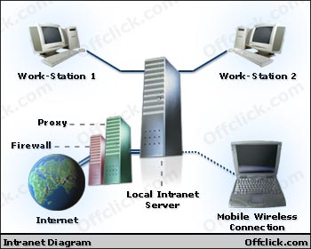
Intranet Diagram

Slide 12
Proxy Server
Is a server that acts as an intermediary between a workstation user and the Internet .
A proxy server is associated with or part of a gateway server that separates the enterprise network from the outside network.
The enterprise can ensure security, administrative control, and caching service by using a proxy server.

Slide 13
Proxy Server- How it works
A proxy server receives a request for an Internet service (such as a Web page request) from a user.
If it passes filtering requirements, the proxy server, assuming it is also a cache server, looks in its local cache of previously downloaded Web pages.
If it finds the page, it returns it to the user without needing to forward the request to the Internet.

Slide 14
Proxy Server- How it works
If the page is not in the cache, the proxy server, acting as a client on behalf of the user, uses one of its own IP addresses to request the page from the server out on the Internet.
When the page is returned, the proxy server relates it to the original request and forwards it on to the user.

Slide 15
Firewall
Firewall : A firewall is a set of related programs, located at a network gateway that protects the resources of a private network from users from other networks.
Firewall used in an intranet have the ability to screen messages in both directions so that company security is maintained.
A firewall surrounding an intranet fends off unauthorized access.

Slide 16
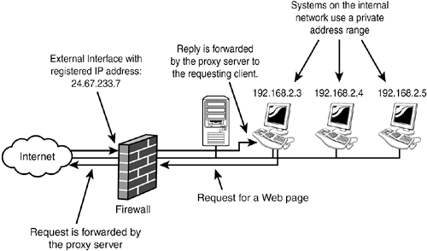
Proxy Server and Firewall

Slide 17
Gateway
A gateway is a network point that acts as an entrance to another network.
On the Internet, a node can be either a gateway node or a host (end-point) node.
Both the computers of Internet users and the computers that serve pages to users are host nodes.
The computers that control traffic within your company's network or at your local Internet service provider (ISP) are gateway nodes.

Slide 18
Gateway
In the network for an enterprise, a computer server acting as a gateway node is often also acting as a proxy server and a firewall server.
A gateway is often associated with:
a router, which knows where to direct a given packet of data that arrives at the gateway,
and a switch, which furnishes the actual path in and out of the gateway for a given packet.

Slide 19
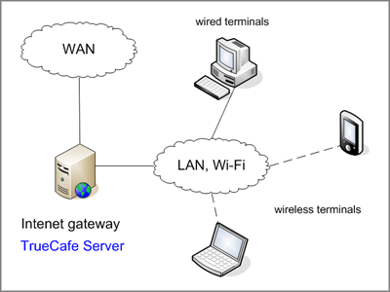
Gateway

