Slide 1
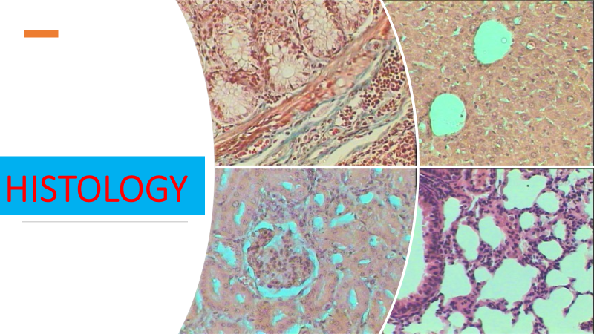
Lec 3
Connective tissue 1

Slide 2
Connective tissue
group of tissues in the body that maintain the form of the body and its organs and provide cohesion and internal support.
The connective tissues include several types of fibrous tissue that vary only in their density and cellularity, as well as the more specialized and recognizable variants—bone, ligaments, tendons, cartilage, and adipose (fat) tissue.

Slide 3
Components of Connective Tissue
All forms of connective tissue are composed of
1- stationary and migrating cells
2- Fibers
3- an amorphous matrix called ground substance
The proportions of these components vary from one part of the body to another depending on the local structural requirements
In some areas, the connective tissue is loosely organized and highly cellular; in others, its fibrous components predominate; and in still others, the ground substance may be its most conspicuous feature.

Slide 4
Cells of connective tissue
6
2
stationary
migrating
mast cells, macrophages, monocytes, lymphocytes, plasma cells, eosinophils.
fibroblasts
adipocytes

Slide 5
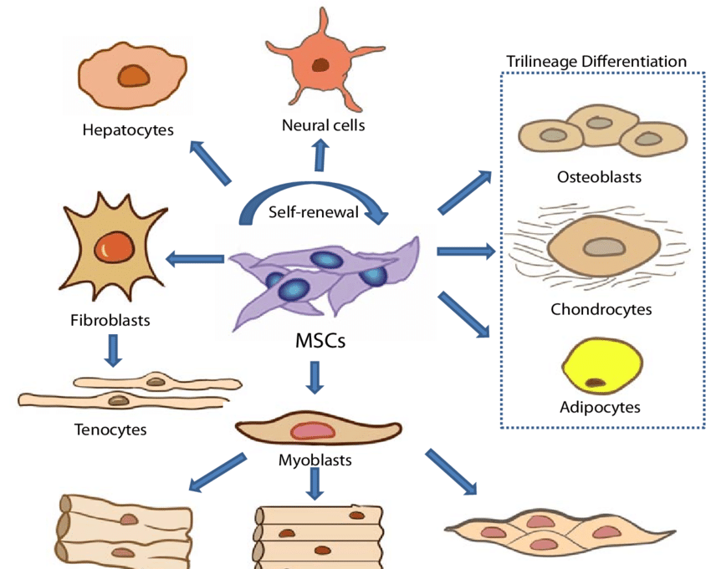
stationary cells
The origin of the stationary cells is the mesenchymal cells

Slide 6
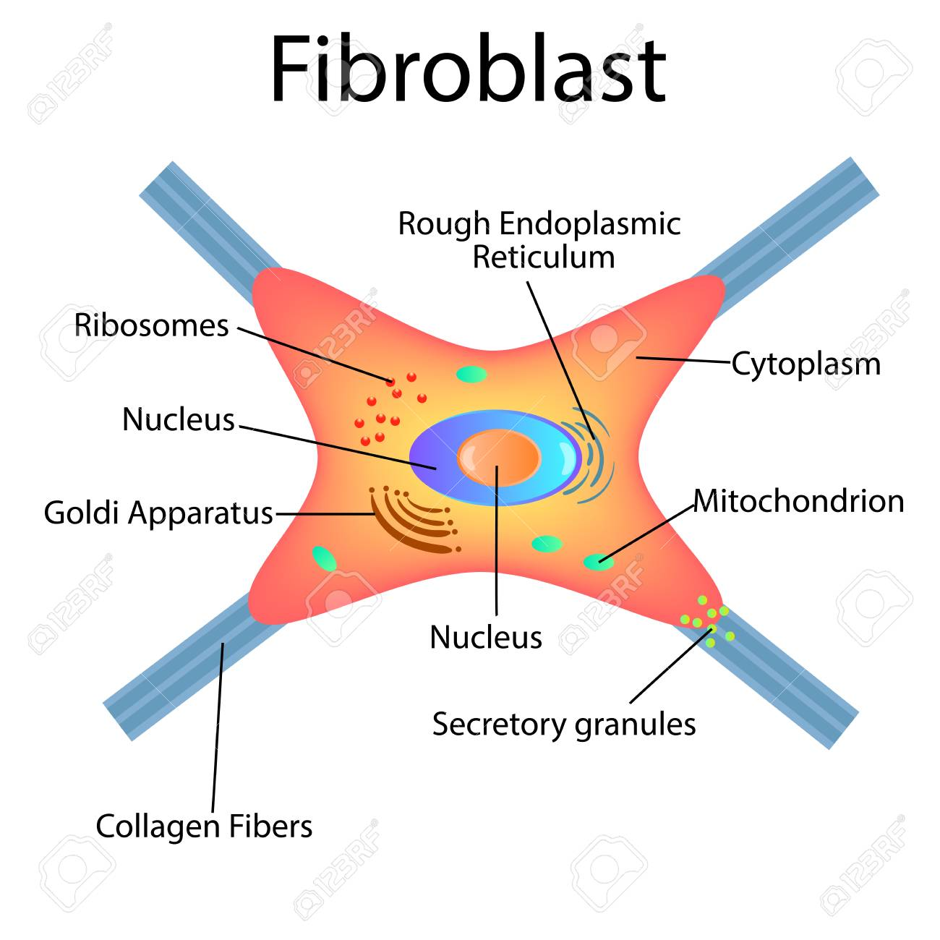
1- fibroblasts
the principal active cells of connective tissue, occurring as long spindle-shaped cells stretched along bundles of collagen fibrils.

Slide 7
function
to secrete collagen and constituents of the ground substance and to maintain these extracellular tissue components.
When organs are injured, it is believed that cells known as fibrocytes, which reside in the stroma, are stimulated to develop into fibroblasts.
The fibroblasts then migrate into the defect and deposit an abundance of new collagen, which forms a fibrous scar.
Fibrocyte
Fibroblast
Inactive
Active

Slide 8
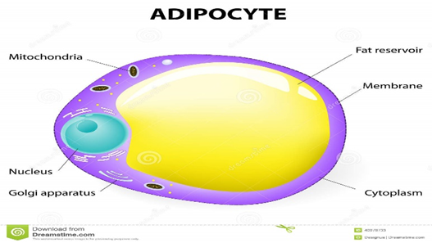
2-Adipose
fat cells are connective-tissue cells that are specialized for the synthesis and storage of reserve nutrients

Slide 9
They receive glucose and fatty acids from the blood and convert them to lipid, which accumulates in the body of the cell as a large oil droplet.
This distends the cell and imposes upon it a spherical form
The nucleus is displaced to the periphery, and other metabolically active constituents of the cell are confined to a thin rim of cytoplasm around the large central droplet of lipid.

Slide 10
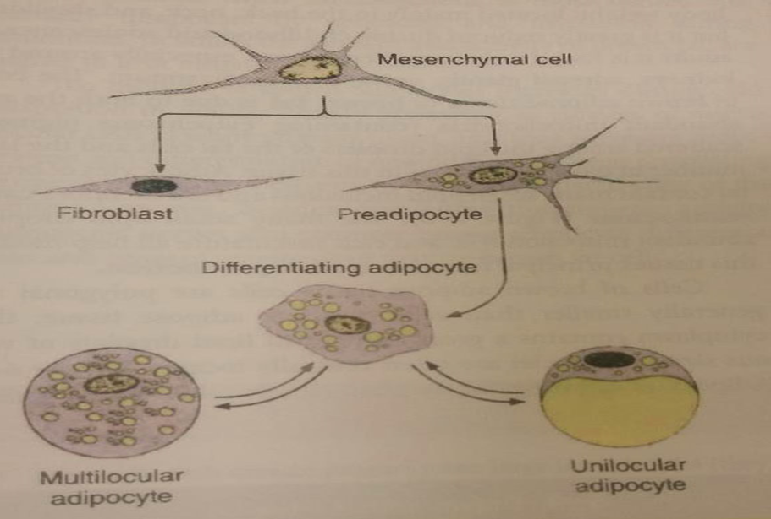
lipogenesis

Slide 11
What is lipogenesis ?
Lipogenesis is the metabolic process through which acetyl-CoA is converted to triglyceride for storage in fat
The triglycerides in fat are packaged within cytoplasmic lipid droplets.
The process begins with acetyl-CoA, which is an organic compound used to transfer energy from metabolism of carbohydrates, fatty acids, and ethanol.
Through the citric acid cycle, acetyl-CoA is broken down to produce ATP, which is then an energy source for many metabolic processes, including protein synthesis and muscle contraction.

Slide 12
Migrating cells
free cells that reside in the interstices of loose connective tissue
These vary in their abundance and are free to migrate through the extracellular spaces

Slide 13
1- the mast cells
these have a cell body filled with coarse granules that contain many biologically active substances
Histamine affects vascular permeability
heparin, when added to blood, delays or prevents its clotting

Slide 14
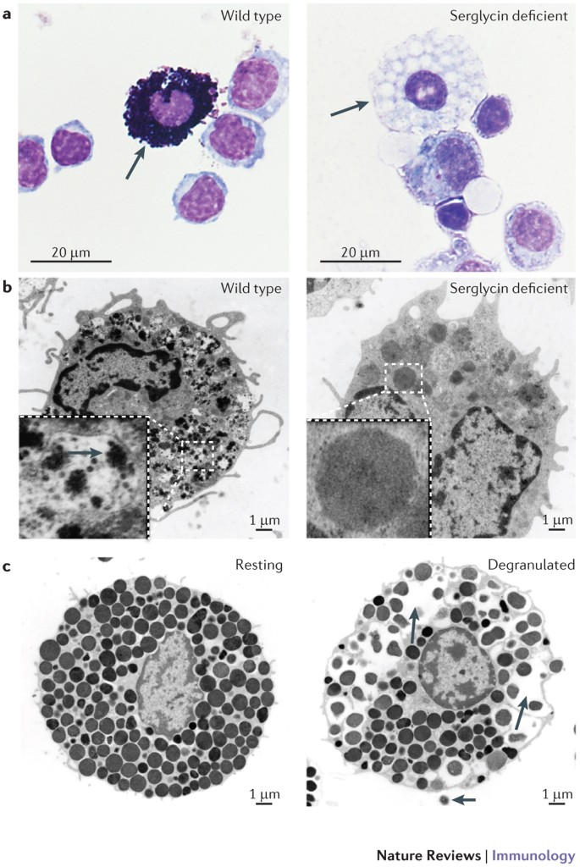
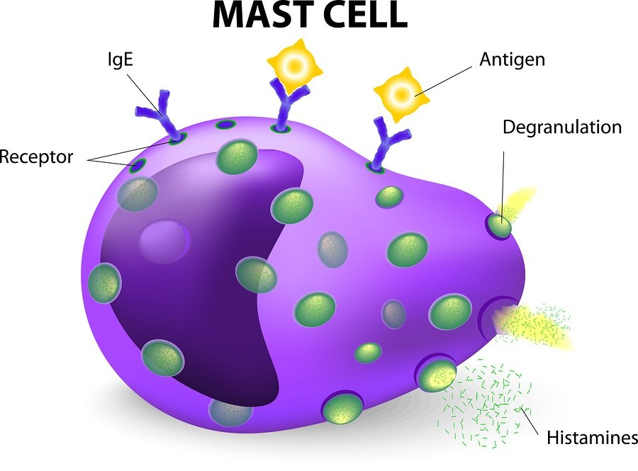
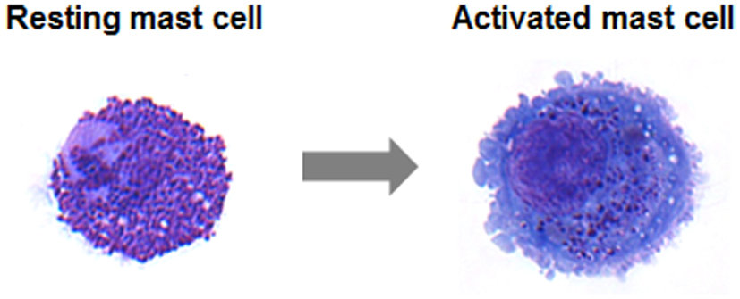

Slide 15
Mast cells respond to mechanical or chemical irritation by discharging varying numbers of their granules.
Histamine released from them causes fluid to escape from neighbouring capillaries or venules; this results in local swelling, as seen in the welt that appears around an insect bite.

Slide 16
2- Eosinophils
a type of white blood cell, or leukocyte
Some of these migrate through the walls of capillaries and take up residence in the connective tissues
They have polymorphous nuclei and, in the cell substance outside the nuclei, coarse granules that stain with eosin and other acid dyes.
The cells are believed to phagocytose and break down antigen-antibody complexes.

Slide 17
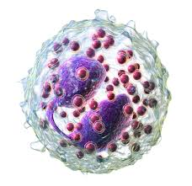

Slide 18
3- Plasma cells
Plasma cells are mature antibody-secreting lymphocytes that are present in limited numbers in loose connective tissues and in larger numbers in lymphoid tissue
Lymphocytes are a type of leukoctye that is able to recognize foreign proteins and to respond to their presence by proliferating and differentiating into plasma cells. The plasma cells in turn synthesize and release specific immunoglobulins, called antibodies, that combine with and neutralize the foreign proteins.
Lymphocytes are among the normal cellular elements of the blood, but they may also leave the blood and migrate in the connective tissues.

Slide 19
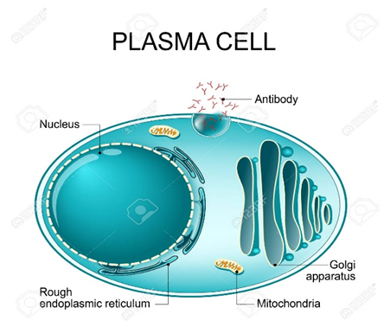

Slide 20
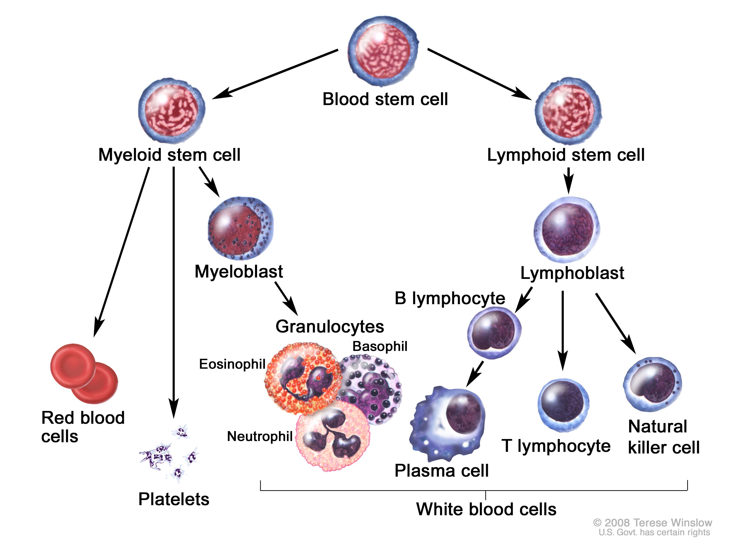

Slide 21
4- monocyte
a mononuclear cell larger than the lymphocyte and with different potentialities
These migratory cells can divide and, when appropriately stimulated, can transform into highly phagocytic macrophages.
The reaction of the blood and connective-tissue cells to injury is called inflammation and is usually accompanied by local heat, swelling, redness, and pain.

Slide 22
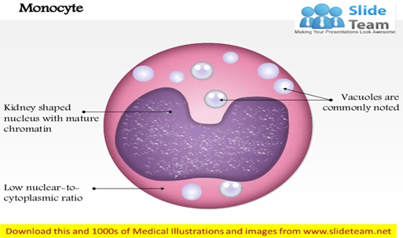
Under these conditions, the neutrophilic leukocytes (white blood cells called neutrophilic because of their neutral staining characteristics with certain dyes), which are not normally present in connective tissue in significant numbers, may migrate through the capillary walls in astronomical numbers and join the macrophages in the work of ingesting and destroying bacteria.

Slide 23
6- The macrophages
The macrophages, or histiocytes, are derived from circulating monocytes in the bloodstream; they are also important for tissue repair and for defense against bacterial invasion.
They have a great capacity for phagocytosis—the process by which cells engulf cellular debris, bacteria, or other foreign matter and break them down by intracellular digestion.

Slide 24
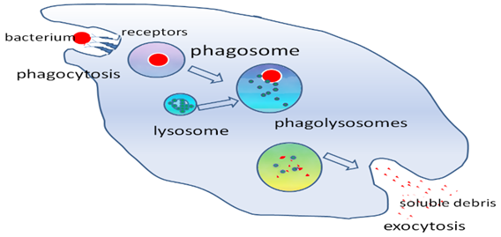

Slide 25
Macrophages in the liver are called Kupffer cells
Macrophage in the skin called Langerhans cells
Macrophage in the nervous tissue called Microglia
Macrophage in the bone called osteoclasts

Slide 26
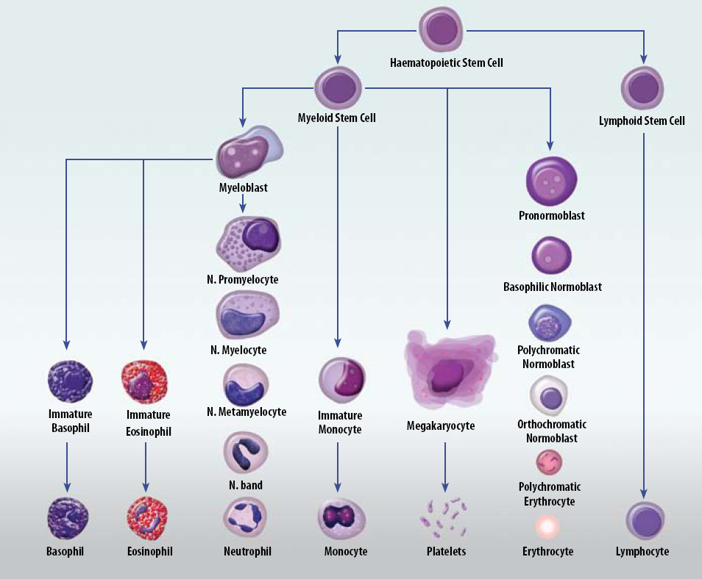

Slide 27
summary
Connective tissue
function
components
fibers
matrix
Cells
stationary
Migrating
Hemopiotic
Mesenchymal
Fibroblast
mast cells, macrophages, monocytes, lymphocytes, plasma cells, eosinophils.
Adipocytes

