Slide 1
KING SAUD UNIVERSITY
COLLEGE OF APPLIED STUDIES AND COMMUNITY SERVICE
CT 1402
Lab sheet #7
1st semester 1440-2018
PSK Modulator
BY: T. Elham Sunbu

Slide 2
OUTLINE:
PSK model

Slide 3
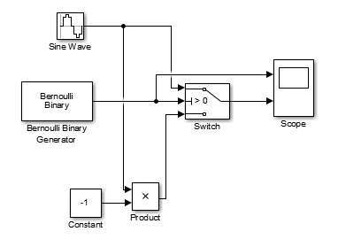
PSK Modulator
Implement a BPSK modulation that use the following carriers:
1- f = 7 Hz
2- f = 4 Hz
3- f = 5 Hz

Slide 4
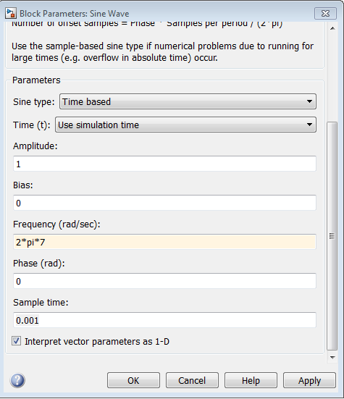
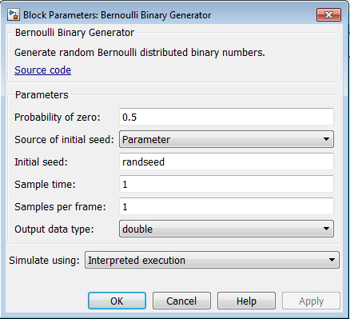

Slide 5
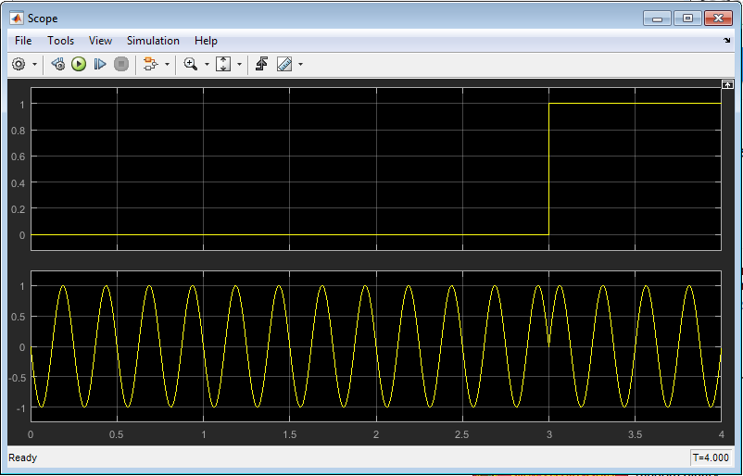
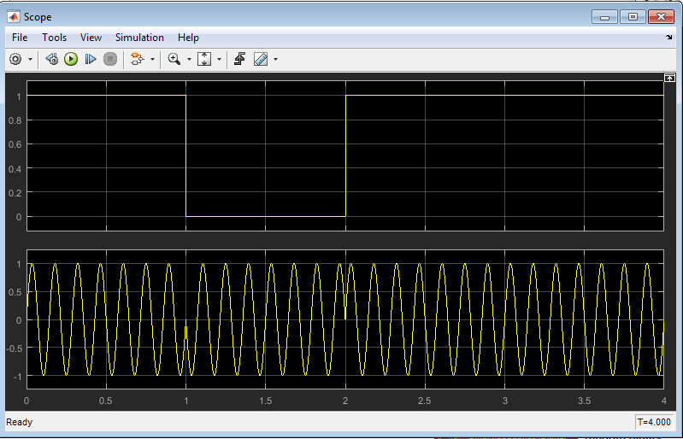

Slide 6
Any Question?

