Slide 1
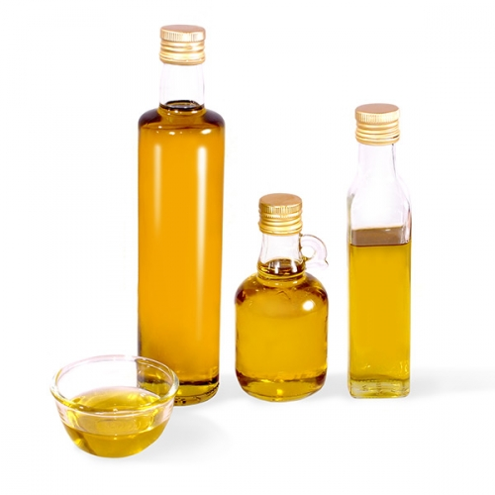
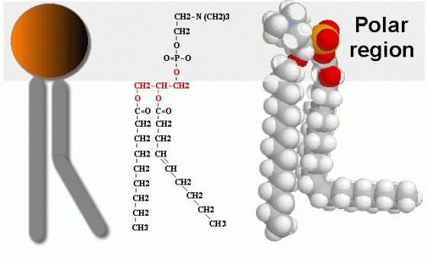
Lipids-I

Slide 2
-Lipids are esters of long chain fatty acids and alcohols.
-Fatty acids are lipids’ building blocks
-It can be defined as nonpolar organic compound insoluble in polar solvent , but soluble in organic solvents such as benzene ,ether, chloroform and boiling alcohol.
Biological role of lipids:
Lipids are found naturally in all living organisms.
1)It represents in cell structure and has a structural function in the cell : it presents in cell membranes.
2) An essential source of energy in the body. It give more energy than carbohydrate and proteins.

Slide 3
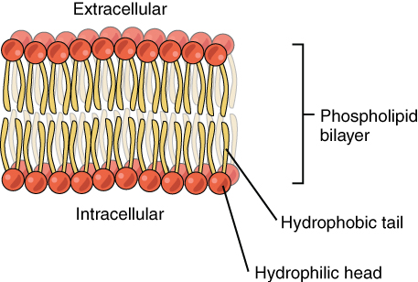
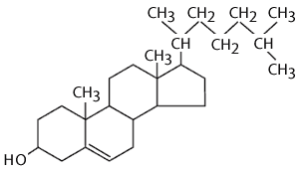
Fats can be divided according to their chemical composition to:
1) Simple lipids:
-These compounds are: esters of fatty acids with glycerol.
-The triacylglycerol (TAG) is the simplest and most common fat.
It is the form in which lipids are stored in the cell.
2) Compound (conjugated) lipids.
Lipids are linking with other compounds such as Proteolipids,
Phospholipids, Glycolipids
3) Derived lipids.
They are substances that are soluble in lipid or derived from the above groups
of lipids by hydrolysis; for examples, cholesterol and fat soluble vitamins.

Slide 4
1-Solubility test:
Objective: to test the solubility of oils in different solvent.
Principle:
Fats are not dissolved in water due to their nature, which is non-polar (hydrophobic), but it is soluble in organic solvents such as chloroform, benzene, and boiling alcohol.
Note: Different lipids have ability to dissolve in different organic solvent. This property enable us to separate a mixture of fat from each other.

Slide 5
Method:
Place 0.5ml of oil in 6 test tubes clean, dry containing 4ml of different solvents (acetone, chloroform , ether and ethanol, diluted acid and dilute alkaline),
Shake the tubes thoroughly, then leave the solution for about one minute,
Note: if it separated into two layers , the oil are not dissolve; but if one layer homogeneous transparent formed , oil be dissolved in the solvent
Results:
Tube | Solvent | Degree of solubility

Slide 6
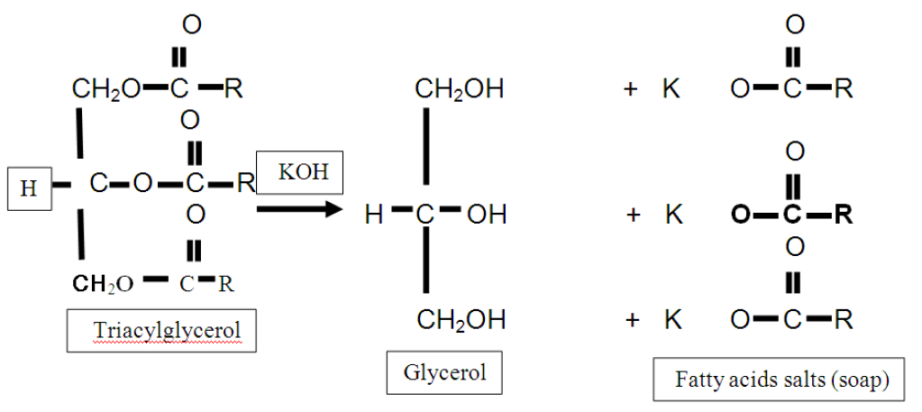
2-Saponification test:
Objective: to form the soap.
TAG can be hydrolyzed into its component fatty acids and alcohol. This reaction can also be carried out in the laboratory by a process called saponification where the hydrolysis is carried out in the presence of a strong base (such as NaOH or KOH).
Principle:
Saponification is a process of hydrolysis of oils or fat with alkaline and result in glycerol and salts of fatty acids (soap) .
Note: soap is salt of fatty acid. The soap is soluble in water but insoluble in ether. Soap works on emulsification of oils and fats in the water .

Slide 7
Method:
•Place 2 ml of oil in a large test tube (or flask).
• Add 4 ml of alcoholic potassium hydroxide.
• Boil the solution for 3 minutes. After this period, make sure it is perfectly saponification process, by taking a drop of the solution and mix with the water if oil separated indicates that the non-completion of the saponification. In this case, continued to boil until all the alcohol evaporates.
• Take the remaining solid material (soap) and add about 30 ml of water and keep it for the following tests.
• Shake the solution after it cools and noted to be thick foam.

Slide 8
3- Testing the separation of soap from the solution by salting out :
Objective: to investigate the effect of NaCl on soap solubility.
Principle:
To get the soap out of solution by salting out, when added solid sodium chloride to the solution until saturation; separated soap in the form of insoluble and floats above the surface.
The NaCl solution provides Na⁺ and Cl⁻ ions that bind to the polar water molecules, and help separate the water from the soap. This process is called salting out the soap.

Slide 9
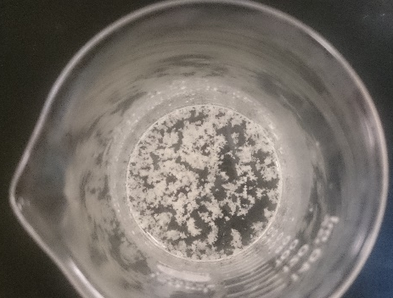
Method: Place about 10 ml of soap in the beaker, then add small amounts of sodium chloride in batches, stirring until saturated solution.

Slide 10
4-Test formation insoluble fatty acids salt (insoluble soaps):
Objective: to investigate the effect of different cations on soap solubility.
Principle:
-Working calcium, magnesium, lead or iron ions to the deposition of soap and make it insoluble in water, where solve these ions replace the sodium or potassium ions are present in soap.
-Due to the hard water contain significant quantities of Ca2+ , Mg2+ and some Fe3+ that react with the charged ends of the soaps to form insoluble salts of fatty acid. The insoluble salts of fatty acid that Ca²⁺ and Mg²⁺ form with soap anions cause white precipitate to from.

Slide 11
K+ soap + Ca+2sulfate => Ca+2 soap + K+ sulfate.
Potassium soap + calcium sulfate => calcium soap + potassium sulfate.
(a white precipitate from calcium stearte or oleate is formed).
Note: hard water, which contains salts of magnesium and calcium

Slide 12
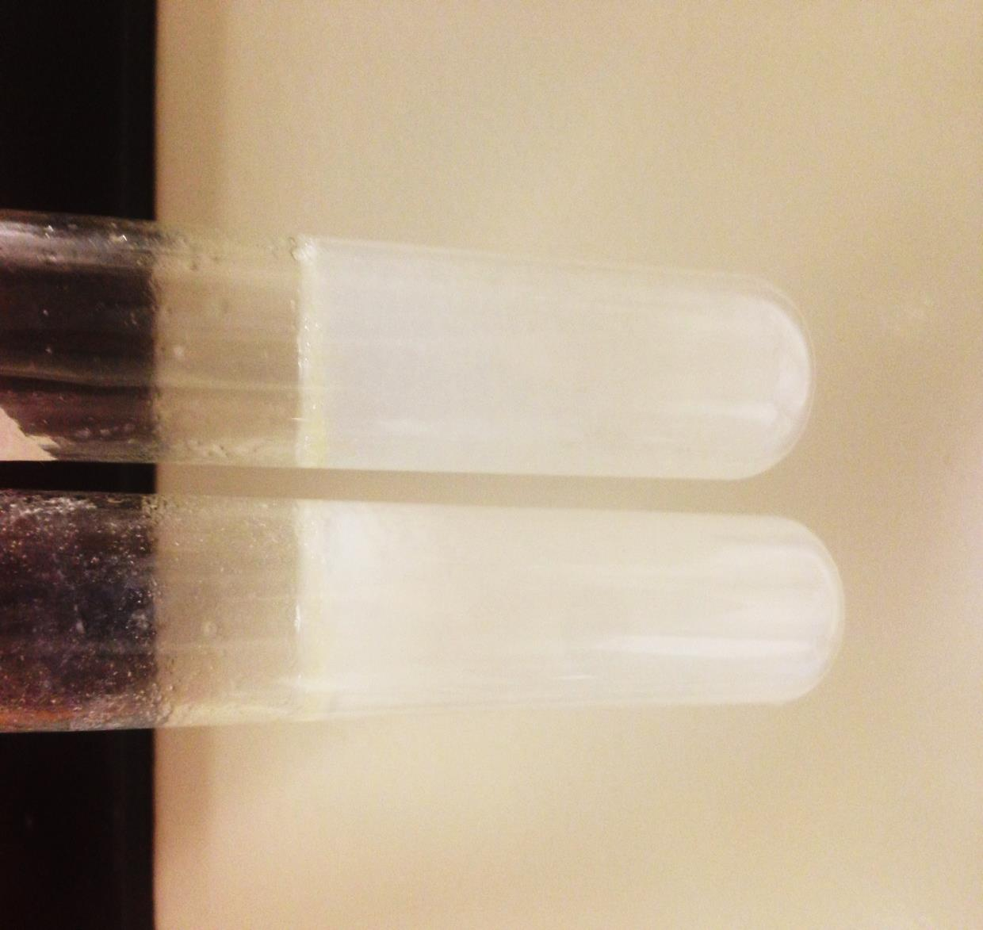
Method: 1 - Add about 4 ml of distilled water to 2 ml of soap in two test tubes. 2 - Add to the first tube a few drops of calcium chloride, to second tube MgCl.
Result:
Conclusion | Observation | Tube
 |  | CaCl2
 |  | MgCl2

Slide 13
Questions :
What is the chemical composition of soap?
How does soap emulsify oil?
What happens to the soap when washing with hard water ?

