Slide 1
KING SAUD UNIVERSITY
COLLEGE OF APPLIED STUDIES AND COMMUNITY SERVICE
CT 1402
Lab sheet #4
1st semester 1440-2018
Delta Modulation (DM)
BY: T. Elham Sunbu

Slide 2
OUTLINE:
DM model

Slide 3
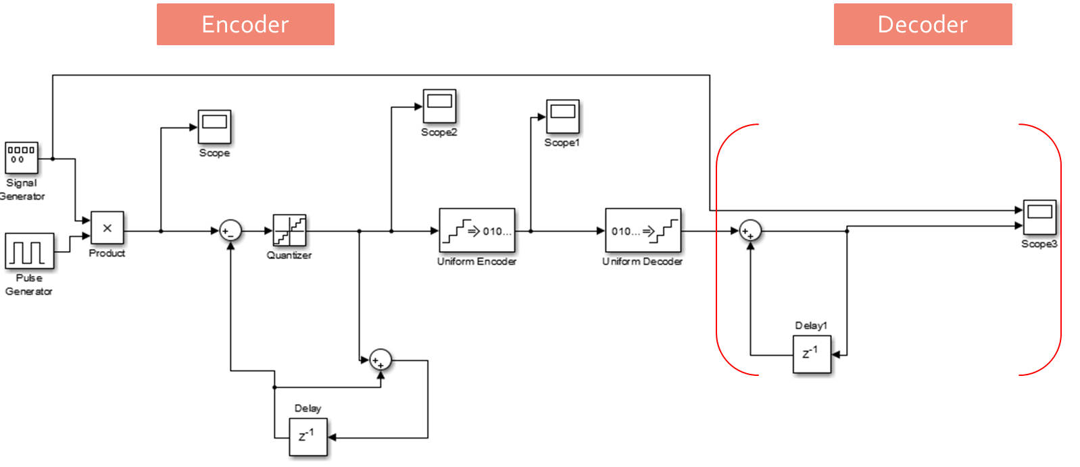
DM Using Simulink:

Slide 5
If there is no sample time option; can be add by following:
1- right click then choose → Explore

Slide 6
2- If there is no sample time here; → Choose show details

Slide 7
3- Then add sample time

Slide 8
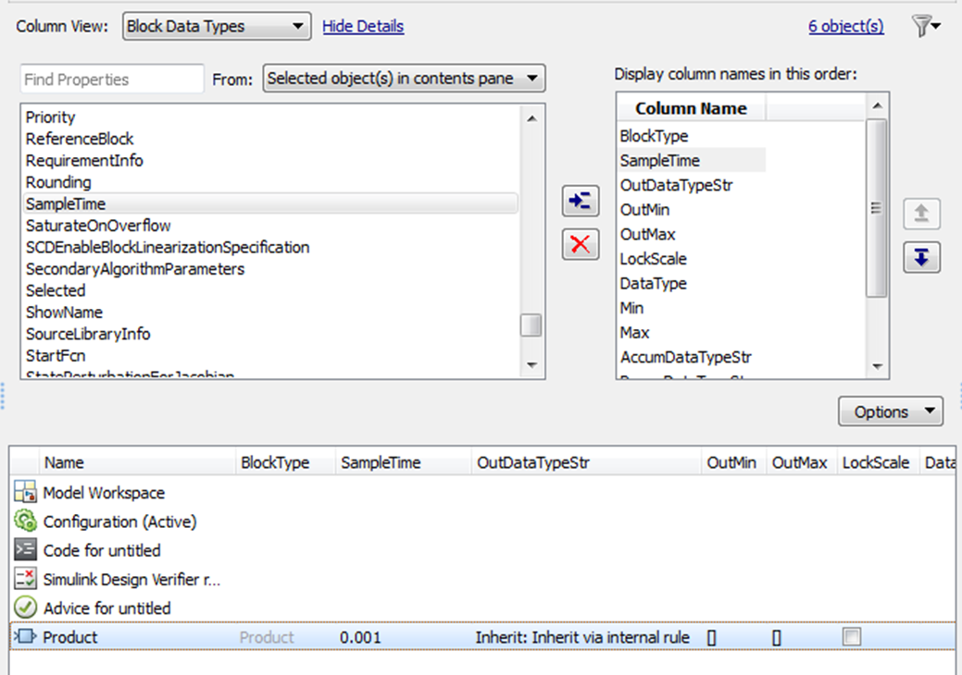
4- Then add value in sample time

Slide 12
Using a Matlab program to simulate a Delta Modulation modulator with demodulator?
Signal generator block(Amplitude "3", frequency "15 Hz"), Pulse generator block(period "1").

Slide 13
Any Question?

