Slide 1
KING SAUD UNIVERSITY
COLLEGE OF APPLIED STUDIES AND COMMUNITY SERVICE
CT 1402
Lab sheet #3
1st semester 1440-2018
Pulse Code Modulation (PCM)
BY: T. Elham Sunbu

Slide 2
OUTLINE:
PCM model

Slide 3
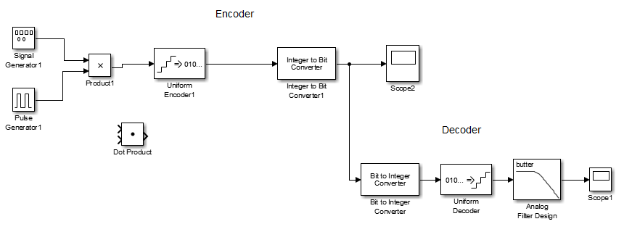
PCM Simulink Model

Slide 4
Generate a PCM Modulator and demodulator for the following signals:
Evaluation
2 sin(6πt)

Slide 5
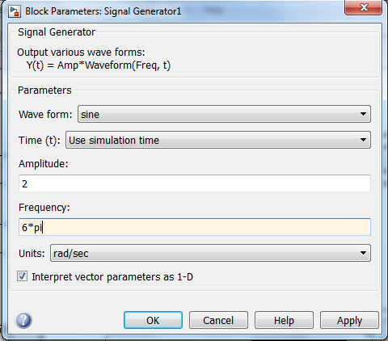
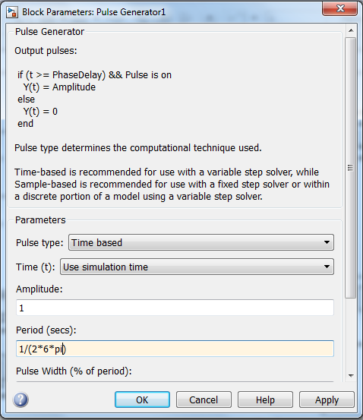

Slide 6
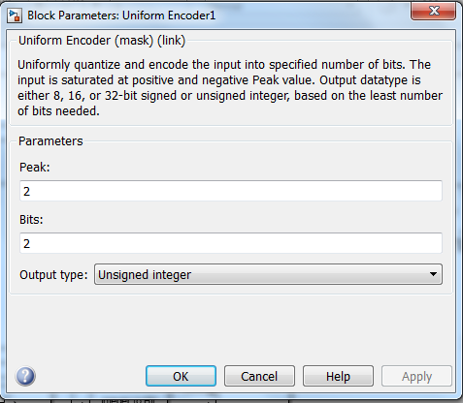
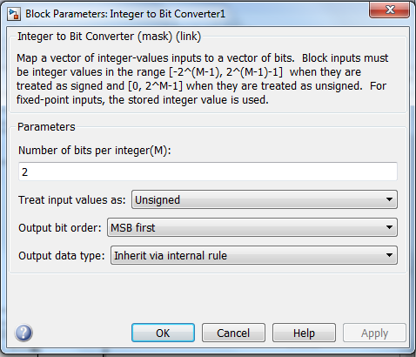

Slide 7
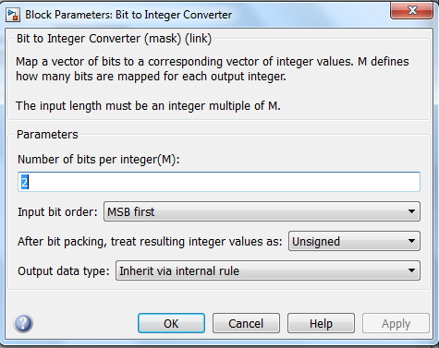
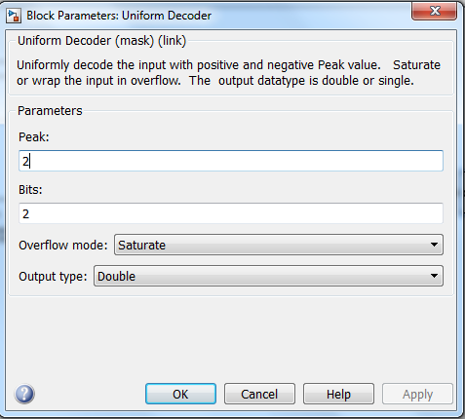

Slide 8
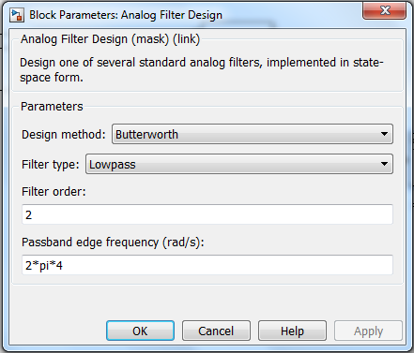
Generate a PCM Modulator and demodulator for the following signals:
4 sin(5πt)
8 sin(8πt)

Slide 9
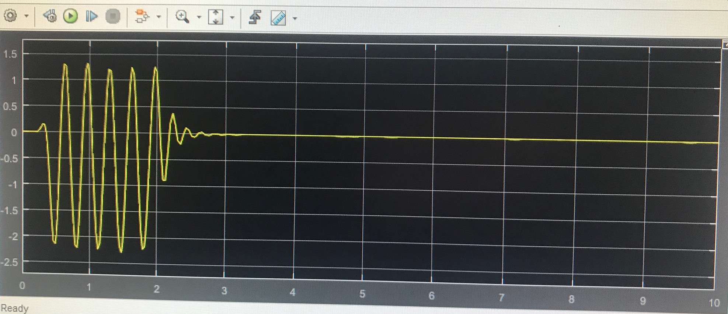
OUTPUT
Scope of encoder
Scope of decoder

Slide 10
Any Question?

