Slide 1
Line Encoding
Lab 6 – 2019/1440
By: Elham Sunbu

Slide 2
OUTLINE
Polar NRZ-L with Decoder.
Polar RZ with Decoder.
Polar MAN with Decoder.

Slide 3
Polar NRZ-L

Slide 4
Simulink

Slide 5
Settings

Slide 6
OUTPUT
Encoder Output
Decoder Output

Slide 7
Polar RZ

Slide 8
Simulink

Slide 9
Settings
Change the Binary number generator parameter as in NRZ
Change the Pulse Generators as following:

Slide 10
OUTPUT
Scope of encoder
Scope of decoder

Slide 11
Polar MAN

Slide 12
Simulink

Slide 13
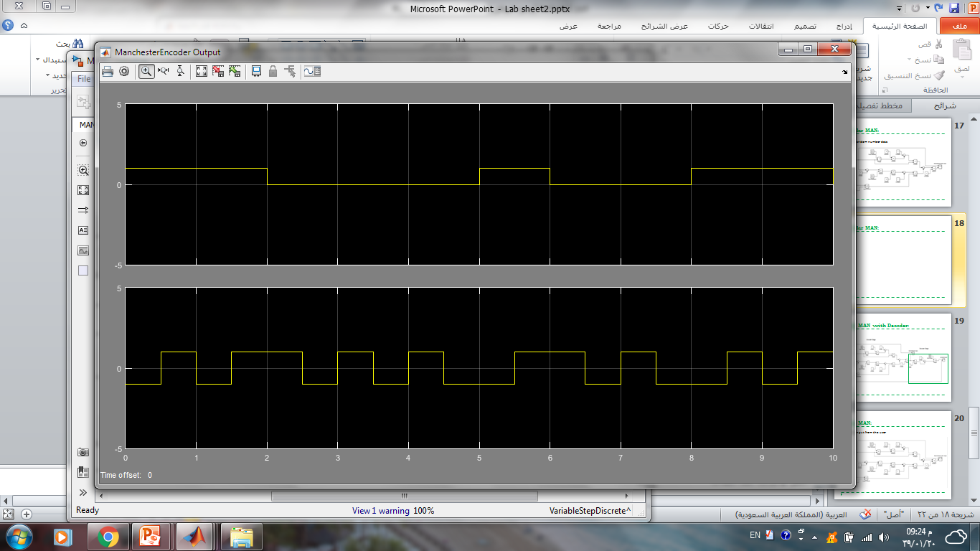
OUTPUT
Scope of encoder
Scope of decoder

Slide 14
Thank You

