Slide 1
Lab Exercise # 3
Zoo- 145
HISTOLOGY
Study of histological structure
of different organs

Slide 2
Lab Exercise # 3
Zoo- 145
HISTOLOGY is the branch of Biology that studies the microscopic structure of the tissues, organs and systems under the microscope
Type of Tissues
Epithelial Tissue
Muscular Tissue
Connective tissue
Nervous Tissue
Simple Squamous
Simple Columnar
Skeletal Muscle
Cardiac Muscle
Spinal Cord
Neuron
Hyaline Cartilage
Areolar Connective Tissue
*Blood Vessels: Arteries and Veins

Slide 3
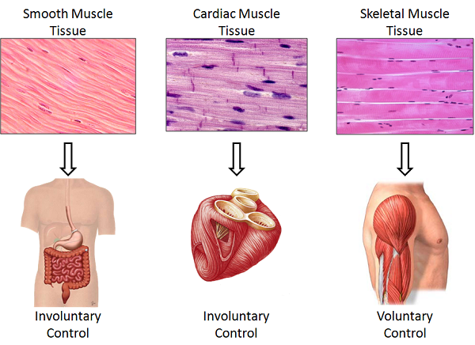
There are 3 types of muscle tissue:
Skeletal muscle tissue,
Cardiac muscle tissue, and
Smooth muscle tissue.

Slide 4
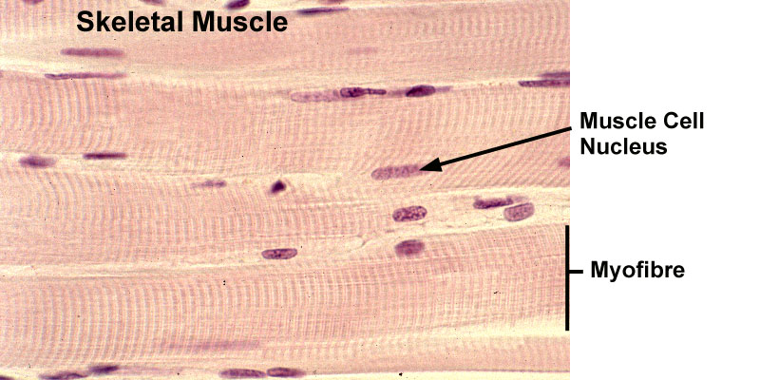
The Muscular Tissue
Striated Muscle
Skeletal muscle
Skeletal muscle is made up of individual components known as muscle fibers.
Each muscle fiber is formed of still finer fibers, myofibrils.
The identifying features of these muscles are haphazard distribution of nuclei among the muscle fibers.
The fibers are also transversely marked with lines or striations, dark and light bands.
Each muscle fiber is encased in a membrane, myolemma.

Slide 5
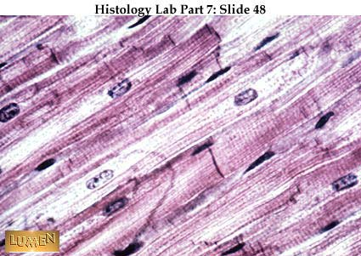
Lab Exercise # 3
Zoo- 145
Nucleus
Intercalated Disc
Cardiac muscle
Muscle fibers form the unit of cardiac muscle like striated muscle.
Cardiac Muscle have all structures like that of striated muscles except the nucleus are very well arranged and equally distributed one in each muscle fiber.
Cardiac muscle fiber is jointed and each joint form a deep impression which is generally called Intercalated Disc.

Slide 6
Lab Exercise # 3
Zoo- 145

Slide 7
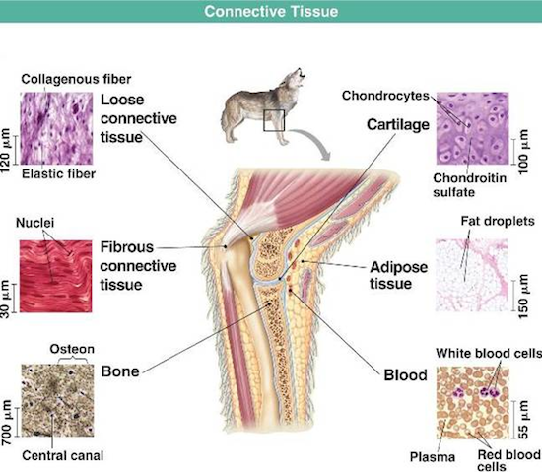

Slide 8
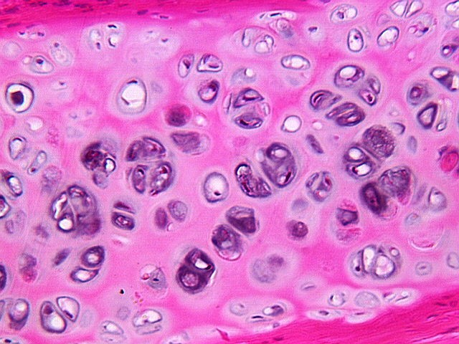
Lab Exercise # 3
Zoo- 145
The Connective Tissue
Hyaline Cartilage
Hyaline cartilage is covered externally by a fibrous membrane, called the perichondrium.
The chondrocytes cells are round or oval in shape and are located in group of two or four in each cavity, Lacunae.
It contains lots of empty spaces in between the cells. The matter that support the cells and cavities is thick and is called the matrix.

Slide 9
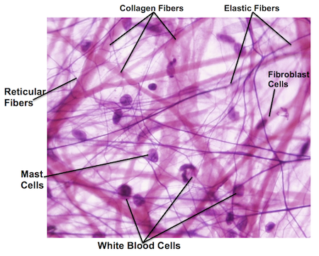
AREOLAR CONNECTIVE TISSUE
The term areolar CT means tissue with 'small open spaces' (areola) and refers to the appearance of small airy pockets between the network of cells and fibers.
Three main types of cells (fibroblasts, white blood cells, and mast cells)
Three types of fibers (collagen fibers,elastin fibers, and reticular fibers)
Background fluid matrix that all the elements sit in called ground substance.

Slide 10
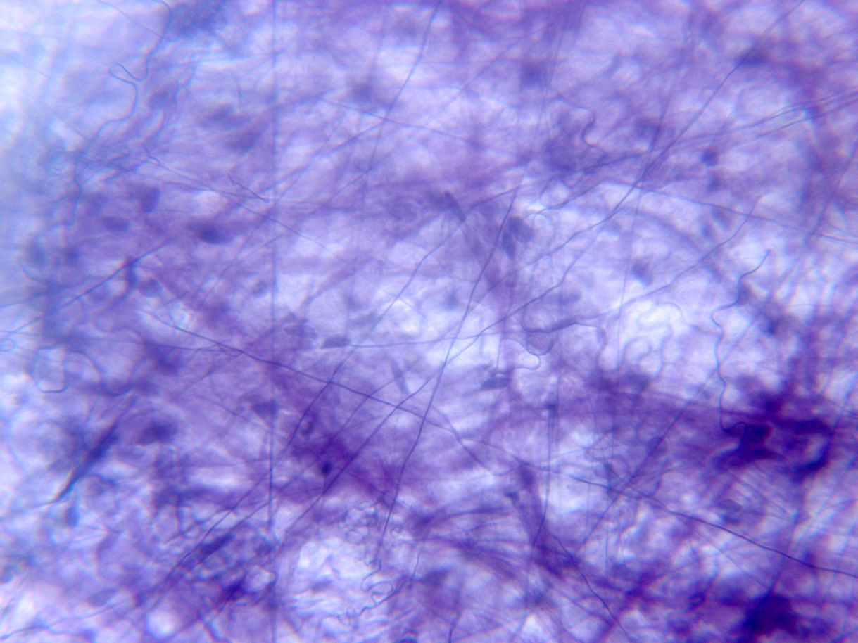
The Functions of Areolar Connective Tissue
Areolar tissue binds skin to the muscles beneath. This loose connective tissue also forms a link between organs - while also enabling a high degree of movement between adjacent body parts. The key functions of areolar tissue:
Support
Strength, and
Elasticity
Collagen Fibers
Elastic Fibers
Mast Cells
Fibroblast cells
White Blood Cells

Slide 11
Lab Exercise # 5
Zoo- 145
Thank you

