Slide 1
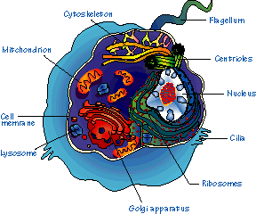
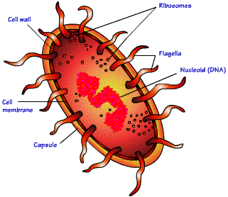
Lab Exercise # 2
Zoo- 145
Microscopic Study of the Structure and
Morphological Variations of the Cell

Slide 2
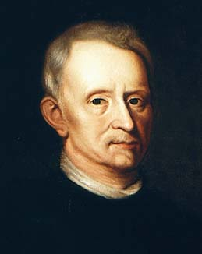
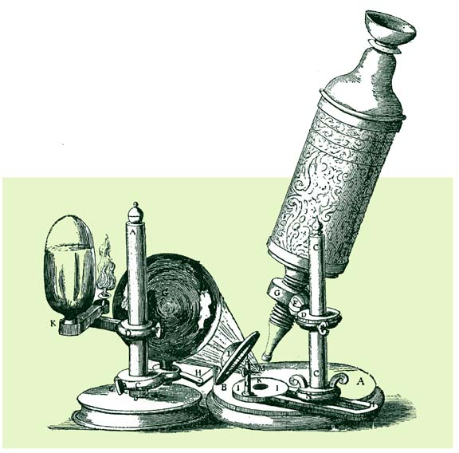
Lab Exercise # 2
Zoo- 145
Cells were discovered in
1665 by a British
scientist named
Robert Hooke.
He was able to observe the cell with the use of the microscope.

Slide 3
Lab Exercise # 2
Zoo- 145
Definition of Cell
A cell is the smallest unit that is capable of performing life functions.
Cells are the basic unit of life
All organisms are made up of cells
All cells come from pre-existing cells

Slide 4
Lab Exercise # 2
Zoo- 145
The Cells
Basic structural and functional unit of life
The Tissues
Cells group together to form tissues
The Organ
Different tissues combine together to form an organ
The System
Different organs combine together to form a system
The Body
Different systems combine together to form an animal or organism

Slide 5
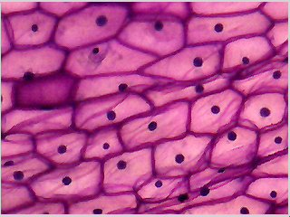
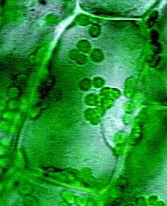
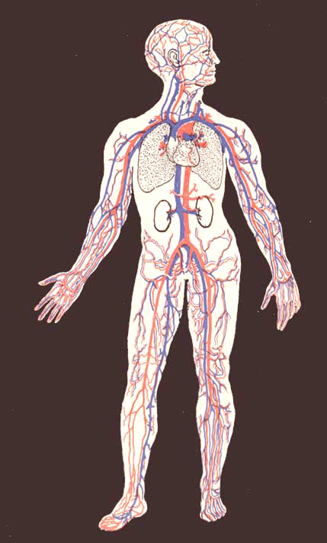


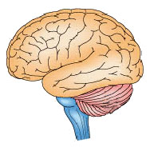
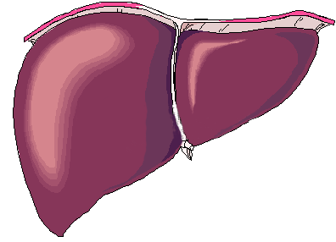
Lab Exercise # 2
Zoo- 145
Cells
Organisation of Life
Tissues
Animal
Organs
System

Slide 6
Lab Exercise # 2
Zoo- 145
Some cells are capable to live independent which are called single celled or unicellular organisms like the protozoa.
Classification of the cell
1- Prokaryotic cell: they are devoid of the true nucleus.
2- Eukaryotic cell: they have true nucleus (surround by nuclear membrane).
Structure of the cell: the true cell consist of three parts
1- The Central part (nucleus).
2- The Peripheral part (cytoplasm).
3- The Cell membrane encases both of these parts.

Slide 7
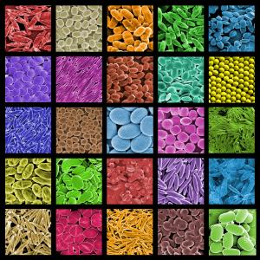
Lab Exercise # 2
Zoo- 145
Cells come in all shapes and sizes
Size: large, small etc
Shape: round, oval, polygonal etc

Slide 8
Lab Exercise # 2
Zoo- 145
Prokaryotic Cells
Do not have nucleus
Few internal structures
One-celled organisms, Example: Bacteria

Slide 9
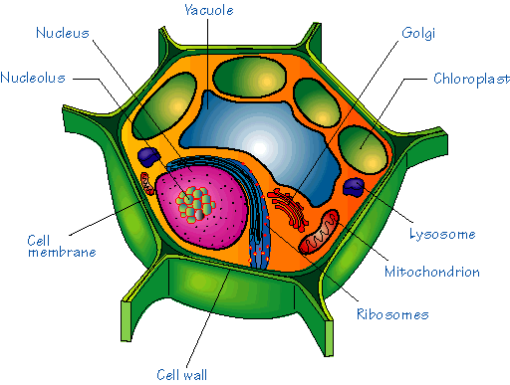
Eukaryotic Cells
Lab Exercise # 2
Zoo- 145
Contain nucleus and organelles surrounded by membranes
Most living organisms, example: humans
Usually larger than prokaryotic cells
Plant
Animal

Slide 10
Lab Exercise # 2
Zoo- 145
Paramecium
· Single-celled organism
· Shoe-shape
· The cilia are the locomotary organs
· It has two nuclei (macronucleus and micronucleus) and contractile, food vacuoles.
Macronucleus
Cilia

Slide 11
Lab Exercise # 2
Zoo- 145
Trypanosoma
· Single-celled organism
· Fusiform or sickle in the shape
· The flagellum is the locomotory organ
· It has one nucleus, parabasal granule and undulating membrane

Slide 12
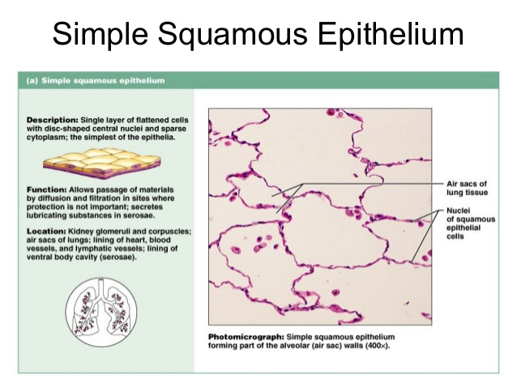

Slide 13
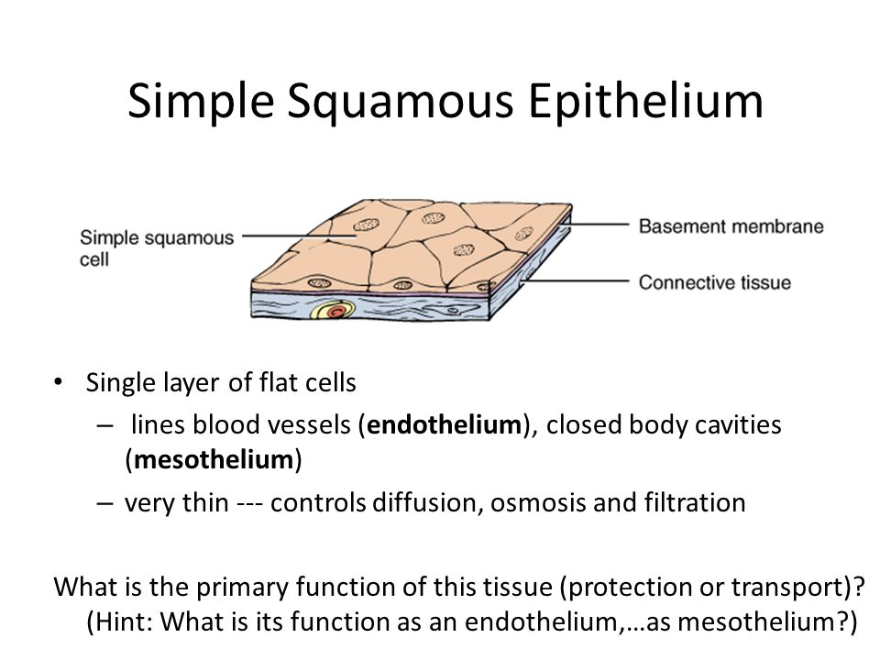
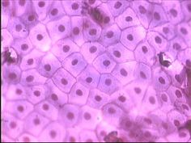
Simple squamous epithelial cells are thin and flat (the thinnest of all epithelial cell-types), which allows them to have a large surface area that is exposed to the lumen on one side (the apical surface), and to the basement membrane (i.e. basal lamina) on the other The cells, scale-like in appearance, tend to have larger, elliptically-shaped nuclei.
Function
Simple squamous epithelial cells function as mediators of filtration and diffusion. Due to their simple and thin construct, they allow for easy transmembrane movement (i.e. across the membrane, and through the cell) of small molecules.

Slide 14
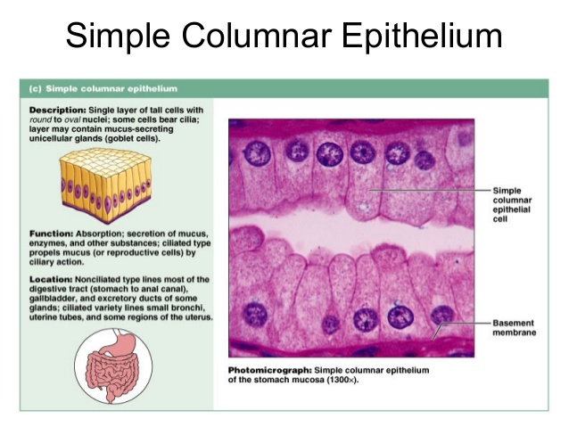

Slide 15
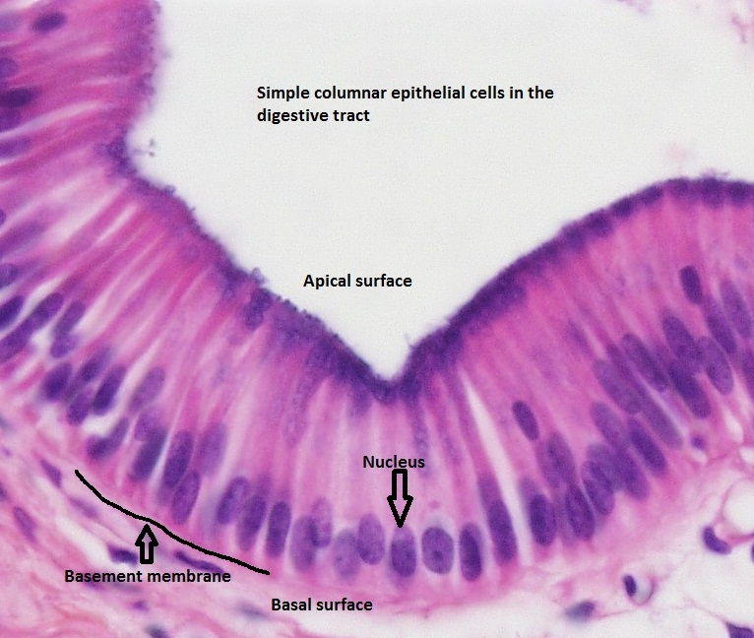
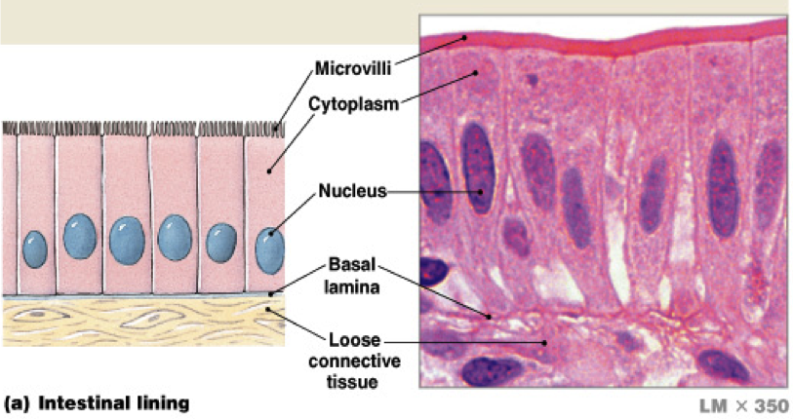
Simple columnar epithelial cells are longer than they are wide. Characteristically, their nucleui are found at the base of the cell. The cells are connected by tight junctions. The cells receive nutrients through the basement membrane, which separates the cells from the capillary basal layer.
They are found throughout the body's organ system, including the digestive tract and the female reproductive system. They are found in the respiratory system, including the nasal passage. Because epithelium can be innervated, simple columnar epithelial cells can also serve a sensory function: simple columnar epithelium line the ears and buccal cavity and are found in the eye.

Slide 16
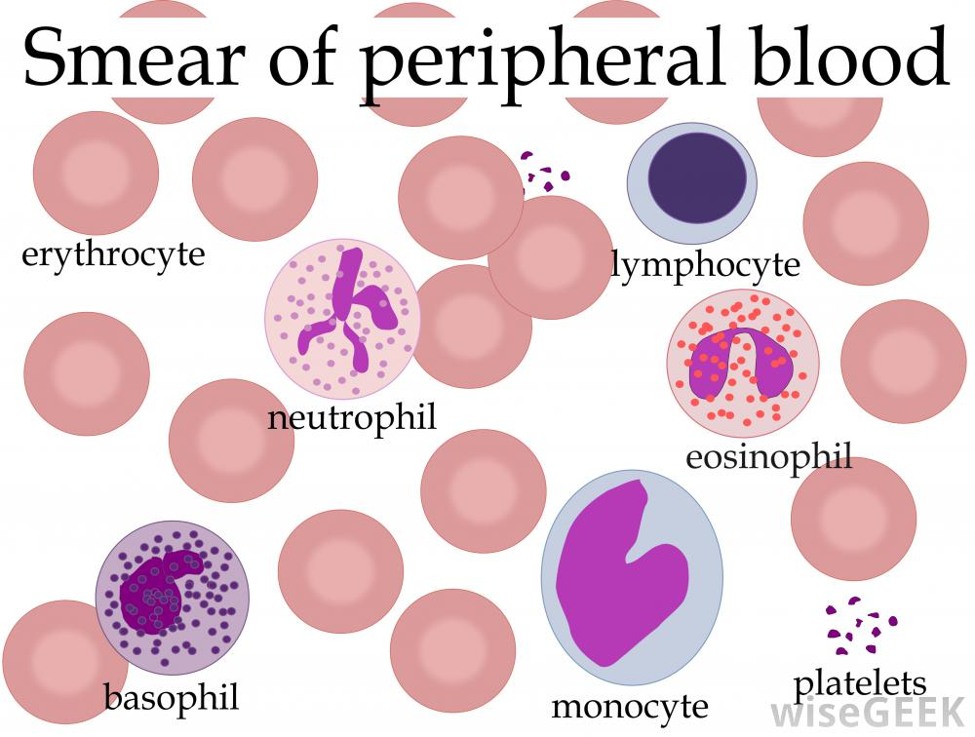
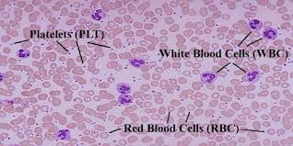
Peripheral blood cells
Are the cellular components of blood, consisting of red blood cells (erythrocytes),
white blood Cells (leucocytes), and platelets,

Slide 17
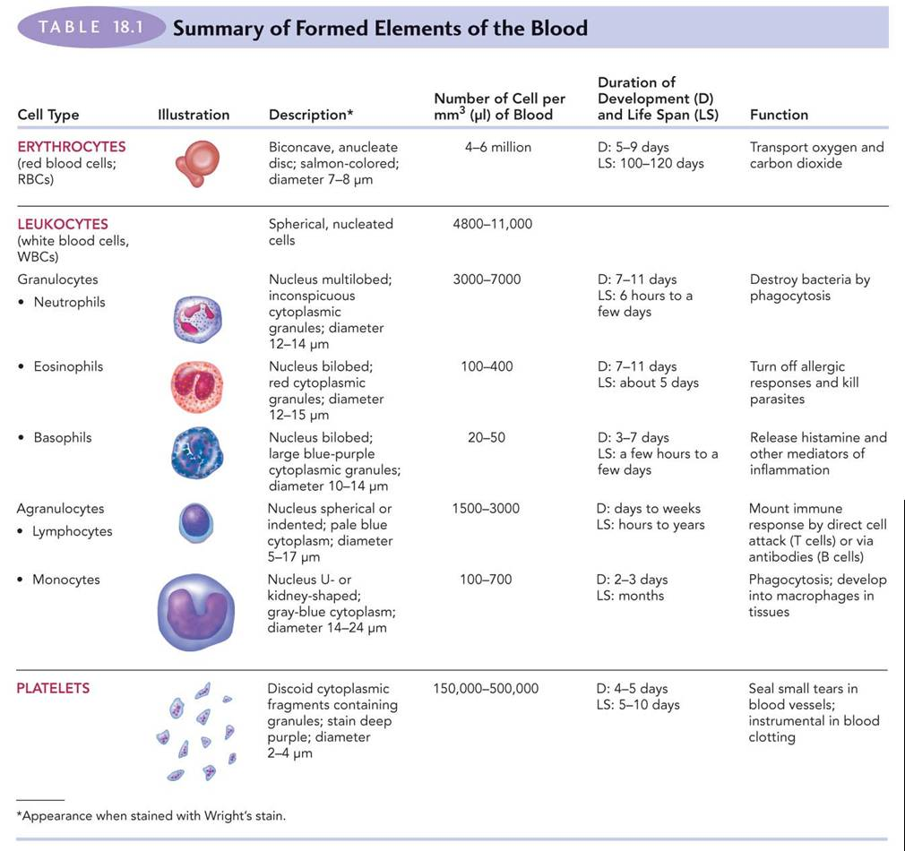

Slide 18
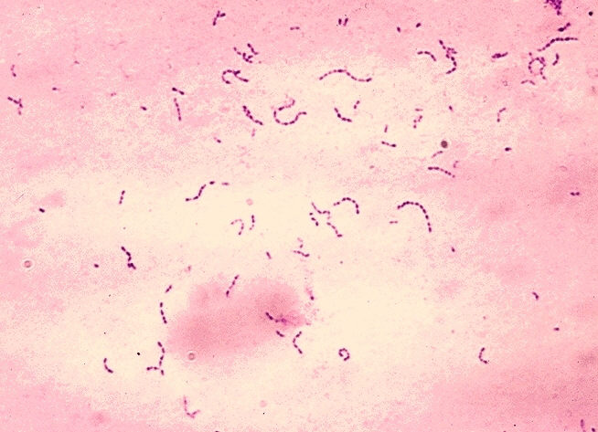
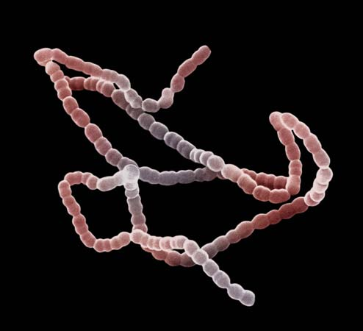
Streptococcus (Bacteria)
Streptococcus is a genus of coccus (spherical) gram-positive bacteria belonging to the phylum Firmicutes
and family Streptococcaceae. The term streptococcus (“twisted berry”) refers to the bacteria’s characteristic grouping in chains that resemble a string of beads. Streptococci are microbiologically characterized as gram-positive and nonmotile.

Slide 19
Thank you !

