Slide 1
Lab Exercise # 11
Zoo- 145
Anatomy of Rat
Male and Female Reproductive System of the Rat, Rattus norvegicus

Slide 2
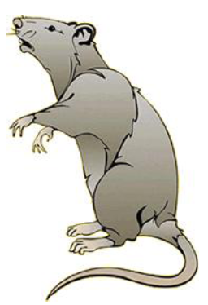
Lab Exercise # 11
Zoo- 145
The classification of the Rat (Rattus norvegicus)
Phylum: Chordata
Subphylum: Vertebrata
Class: Mammalia
Order: Rodentia
Family: Muridae
Genus: Rattus
Species: norvegicus

Slide 3
Lab Exercise # 11
Zoo- 145
Male Reproductive System
Internal Organs |  |  |  |  | External Organs
Epididymis Vasdeferens Seminal Vesical Spermatic Cord Cowpers glands Prostat glands |  |  |  |  |  |  | Urethra Penis Testes Scrotum
The Reproductive Organs of the Male Rat
The major reproductive organs of the male rat are the testes (singular: testis) which are located in the scrotal sac.
On the surface of the testis is a coiled tube called the epididymus, which collects and stores sperm cells.
The tubular vas deferens moves sperm from the epididymus to the urethra, which carries sperm though the penis and out the body.
The lumpy brown glands located to the left and right of the urinary bladder are the seminal vesicles.
The gland below the bladder is the prostate gland and it is partially wrapped around the penis.

Slide 4
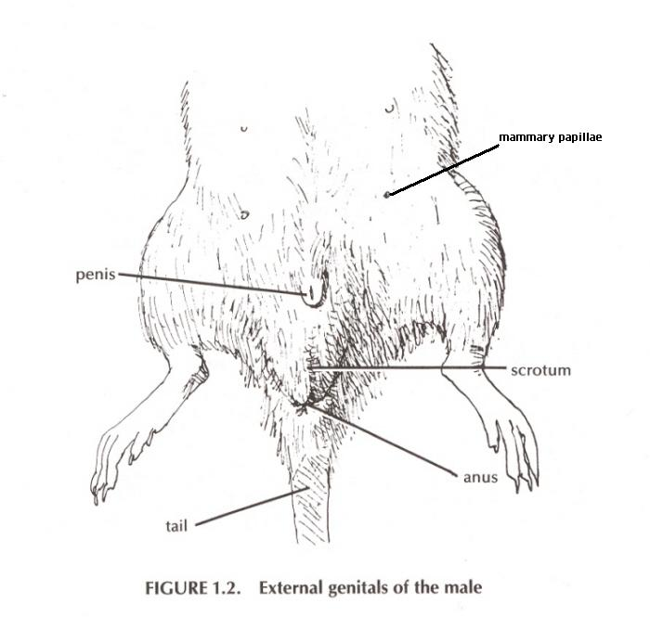

Slide 5
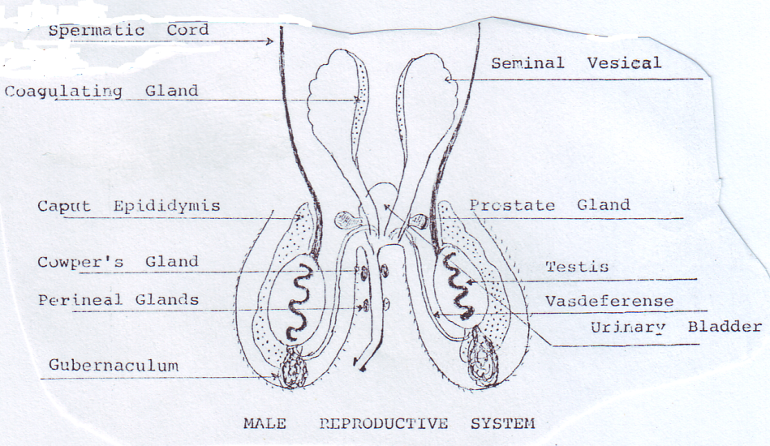
Lab Exercise # 11
Zoo- 145
Male reproductive System

Slide 6
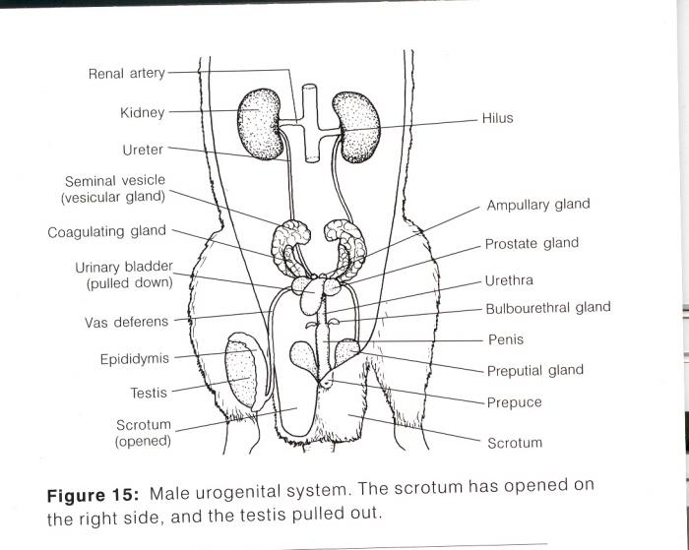
Lab Exercise # 11
Zoo- 145

Slide 7
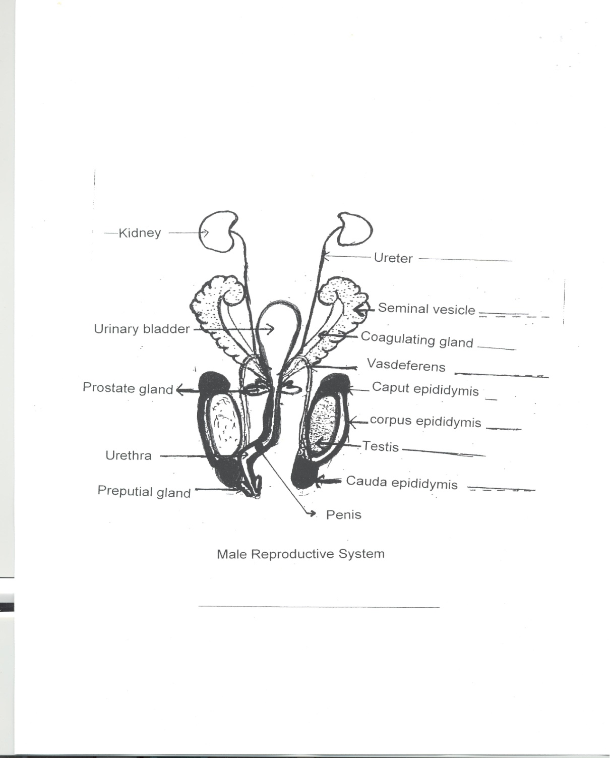

Slide 8
Lab Exercise # 11
Zoo- 145
Female Reproductive System
Internal Organs |  |  |  |  | External Organs
Vagina Uterus Oviduct Fallopian Tube Ovary Cowpers glands |  |  |  |  |  |  | Vulva
The Reproductive Organs of the Female Rat
The short gray tube lying dorsal to the urinary bladder is the vagina.
The vagina divides into two uterine horns that extend toward the kidneys.
This duplex uterus is common in some animals and will accomodate multiple embryos (a litter). In contrast, a simple uterus, like the kind found in humans has a single chamber for the development of a single embryo.
At the tips of the uterine horns are small lumpy glands called ovaries, which are connected to the uterine horns via oviducts. Oviducts are extremely tiny and may be difficult to find without a dissecting scope.

Slide 9
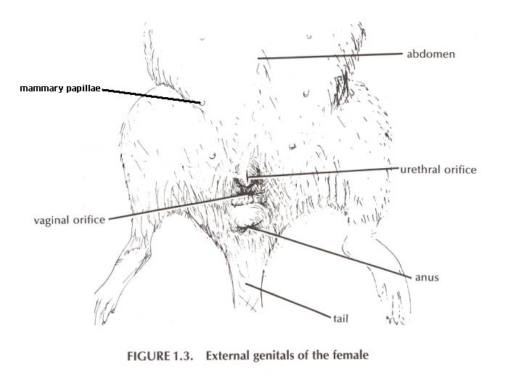
Lab Exercise # 10
Zoo- 145

Slide 10
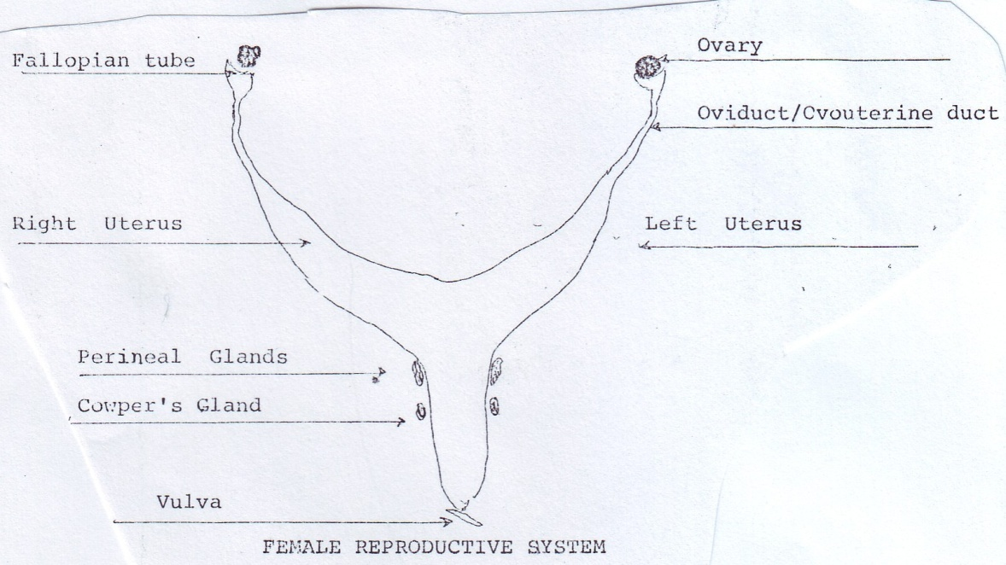
Lab Exercise # 11
Zoo- 145
Female reproductive System

Slide 11
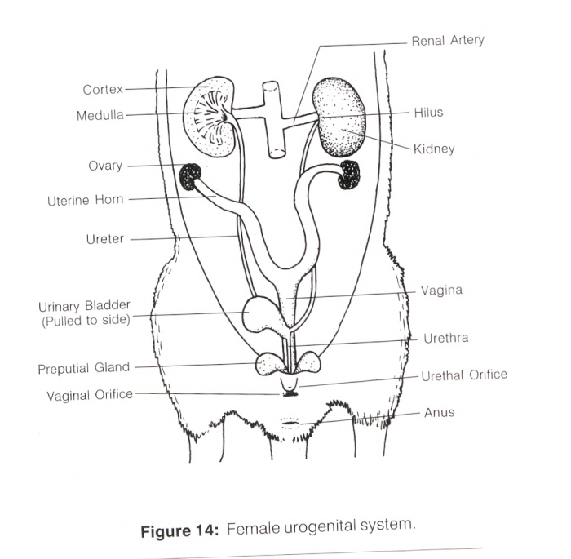
Lab Exercise # 11
Zoo- 145

Slide 12
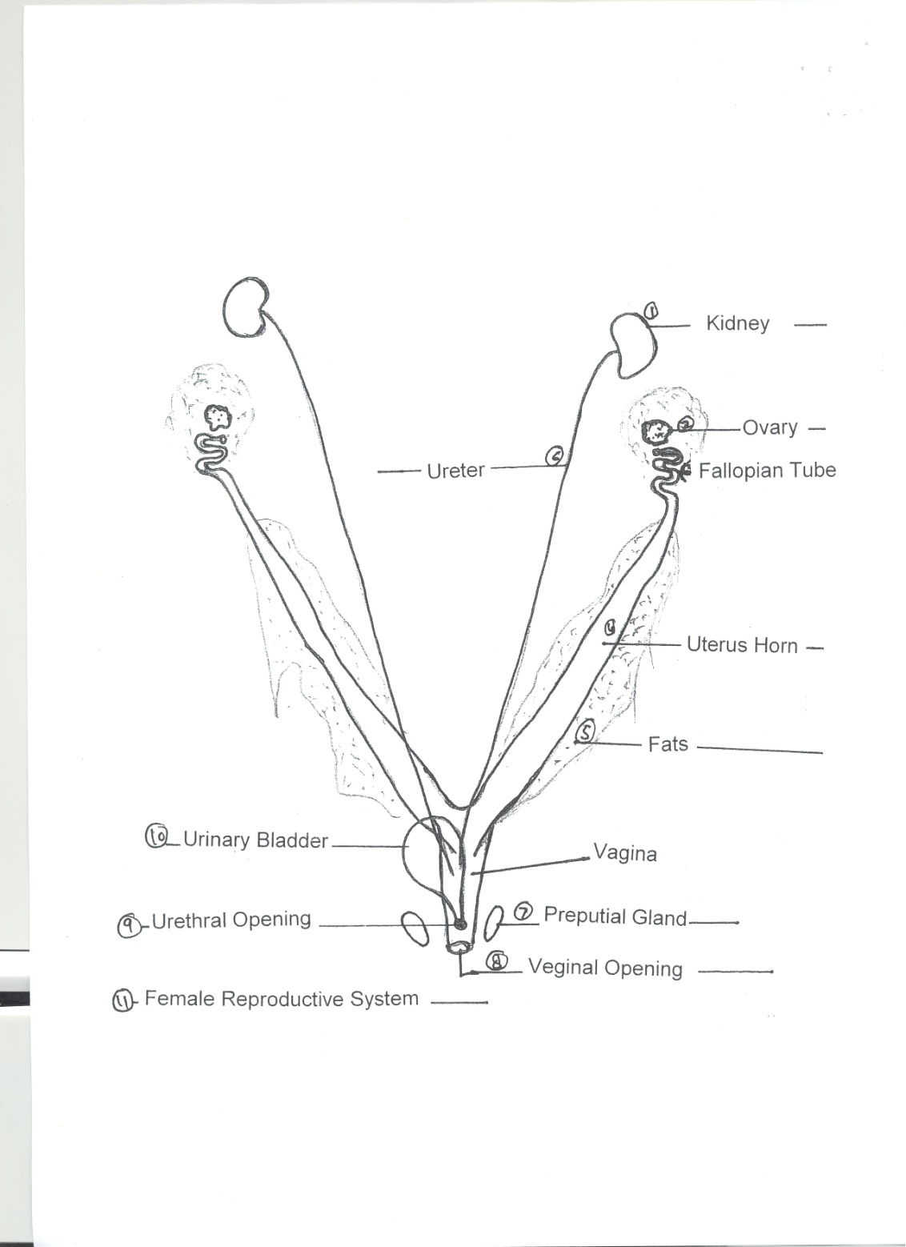

Slide 13
Reproductive system of Rat
Male Female

