Slide 1
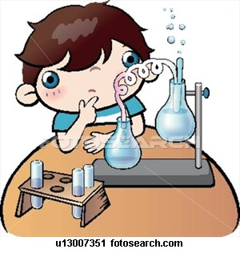
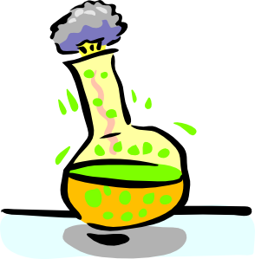
Dissolved Oxygen Measurements ( Winkler’s Method)
Amal Almuhanna
2012

Slide 2
Factors Affecting Oxygen Levels
1)Oxygen is removed from the water by chemical reactions, the decay process and respiration.
2)Water temperature and atmospheric pressure affect oxygen concentration in water.
3) Cold water at high atmospheric pressure holds more dissolved oxygen than warm water at low atmospheric pressure. 4) Degree of light penetration (turbidity, color and water depth) and the degree of water turbulence or wave action also affect oxygen concentrations.
Dissolved oxygen (D.O.) is reported as milligrams of oxygen per liter of water (mg/L) .
Aquatic plants produce oxygen by photosynthesis during daylight hours but they also use oxygen for respiration.

Slide 3
Introduction
Both plants and animals depend on dissolved oxygen for survival.
lack of oxygen can kill aquatic plants and animals.
Measuring dissolved oxygen is probably the most significant water quality test to determine the suitability of a stream for fish and many other aquatic organisms.

Slide 4
Principles of Winkler’s Method
Oxygen combines with Mangnous hydroxide to form higher hydroxides, which on acidification liberate iodine equivalent to that of oxygen fixed.
This iodine is titrated by standard Sodium thiosulfate solution using starch as an indicator.

Slide 5
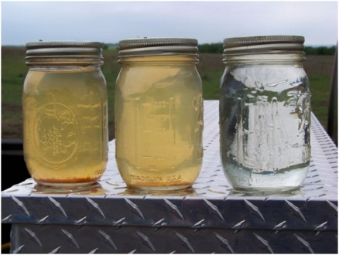
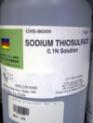
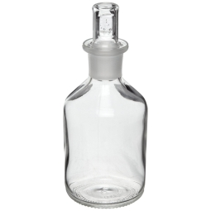
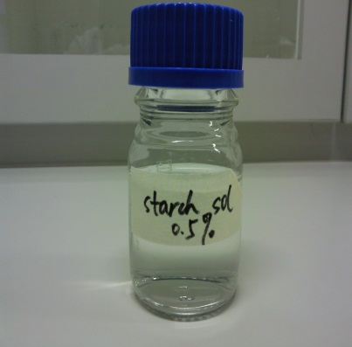
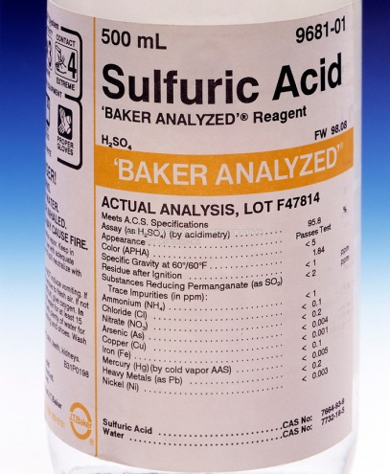
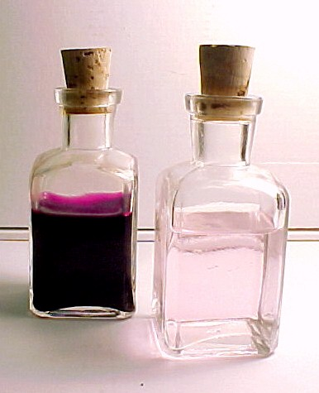
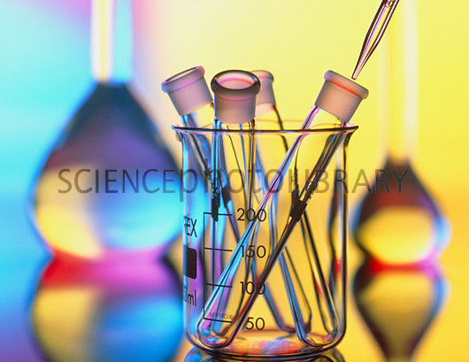
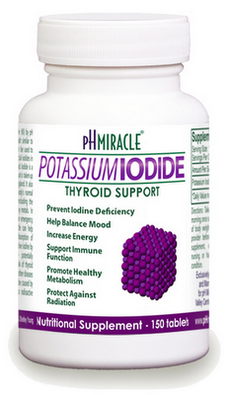
Materials
Water Samples.
Sodium thiosulfate titrant (0.025).
Narrow mouth 250 ml BOD bottles.
Sulfuric acid (concentrated)
Starch indicator.
Manganous sulfate solution
Alkaline- potassium iodide
Pipettes, Flasks

Slide 6
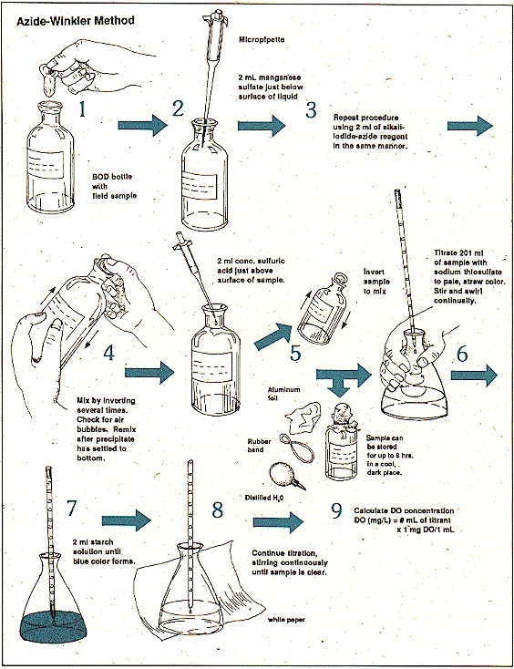
Procedure

Slide 7
Procedure cont.
Collecting the Sample
Testing for Dissolved Oxygen
Remove the stopper and add 1 ml Manganous sulfate.
Add 3 ml alkaline potassium iodide into the sample and insert the stopper, and shake vigorously, holding on to the top. If oxygen is present, a brownish-orange precipitate will form.
Allow the sample to stand until the precipitate settles halfway.

Slide 8
4) Remove the stopper and slowly add 2 ml sulfuric acid. Insert the stopper and shake vigorously to dissolve the precipitate.
5) Shake and wait until all the precipitate is dissolved.
The yellow color is from iodine.
6) Take a suitable aliquot 200 ml in a flask and titrate with Sodium thiosulfate solution till the colour changes to very light yellow.
7) Add 3ml of starch solution.
The prepared sample will turn blue from the added starch solution.
8) Continue adding drops and mixing until the prepared sample turns from blue to colorless (the end point

Slide 9
Results Analysis
Sample no. | ml of Sample | ml of titrant used | D.O. mg l ⁻¹
1- 2- 3- 4- 5- 6- 7-

Slide 10
Calculation
Science 1 ml of 0.025 N sodium thiosulfate is equivalent to 0.2 mg oxygen. D.O. mg l ⁻¹ = (8X1000XN) X v V
Where:- V= volume of sample v= volume of titrant used (ml) N= normality of the titrant Result. Express D.O. in mg l ¹

