Slide 1
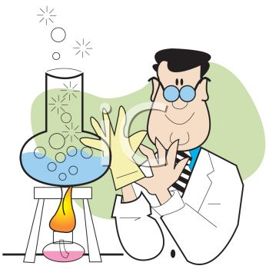
Alkalinity
Amal Almuhanna
2012

Slide 2
Alkalinity
In most natural waters bicarbonates and sometimes carbonates are present in appreciable amounts.
Their salts get hydrolyzed in solution and produce hydroxyl ions, consequently raising the pH.
M⁺ + HCO₃⁻ + H₂O = M⁺ + H₂CO₃ + OH⁻

Slide 3
Principle
Alkalinity is determined by titrating the sample with a standard solution of strong acid.
Alkalinity due to hydroxide and carbonate is determined to the first end point (pH 8.3) using phenolphthalein indicator and bicarbonate alkalinity is determined to the second end point (pH 4.5) using methyl orange indicator.

Slide 4
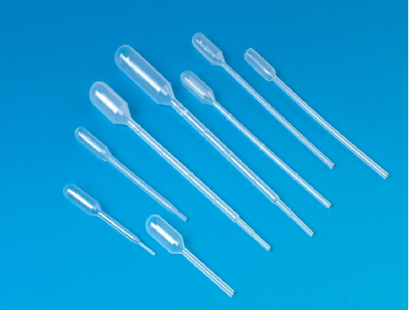
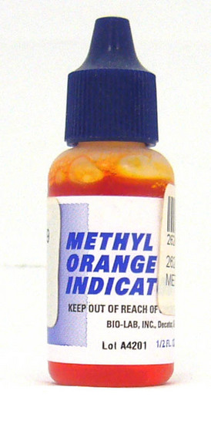
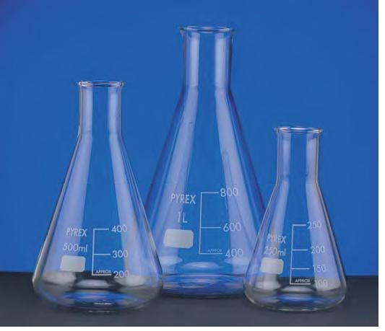
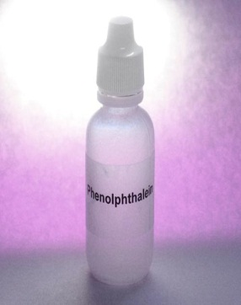
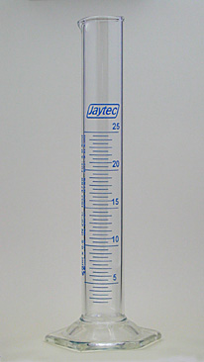
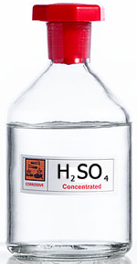
Requirement
Sulfuric acid (0.02 N).
Phenolphthalein indicator.
Methyl orange indicator.
Titration assembly (burette, pipette, Erlenmeyer flasks, measuring cylinder, stand, clamps etc.).

Slide 5
Method
Take 50 ml of water sample in Erlenmeyer flask
Add 2 drops of phenolphthalein indicator - If slight pink color appears, titrate with acid titrant to a colorless end point. -Note the reading as 'p' (ml of titrant used for phenolphthalein alkalinity).
Now add 2 drops of methyl orange in the same flask and continue to titrate further till the color change from yellow to orange.
- Note this reading as 't' (total volume of the titrant used for both titrations).

Slide 6
Calculation
Calculate the phenolphthalein and total alkalinity by the given formula:
Phenolphthalein alkalinity 'P' as mg l⁻¹ CaCO₃ = Phenolphthalein alkalinity 'T' as mg l⁻¹ CaCO₃ =
For the computation of amounts of carbonates, bicarbonates and hydroxides refer the following table.
Result
Express the total alkalinity and contribution of bicarbonates (HCO₃⁻), carbonates (CO₃⁻⁻) and hydroxide (OH⁻) as mg l⁻¹ of CaCO₃

Slide 7
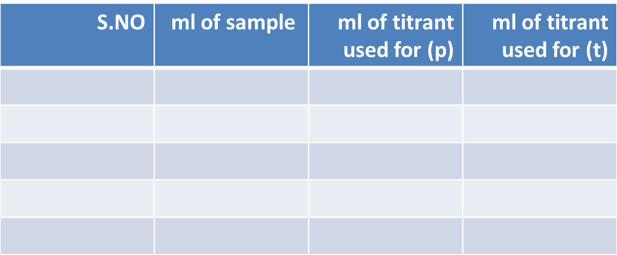
Observations
Calculations:
Phenolphthalein alkalinity (P) as mg-1 CaCO3 (mg/l)
= ml of titrant(p)X1000
ml of sample
Results: Expressed as mg/l

