Slide 1
Free Carbon dioxide dissolved in water
Amal Almuhanna
2012

Slide 2
Some scientific terms
1- Equivalent weight: The equivalent weight of a compound can be calculated by dividing the molecular weight by the number of positive or negative electrical charges that result from the dissolution of the compound(acidity or basicity).
ex: NaOH 23+16+2= molecular weight = 41
1
basicity

Slide 3
Some scientific terms
2- Molarity: is the number of moles of solute dissolved in one liter of solution.
The units, therefore are moles per liter, specifically it's moles of solute per liter of solution.

Slide 4
Some scientific terms
3-Normality: The normality of a solution is the gram equivalent weight of a solute per liter of solution.
Normality is the only concentration unit that is reaction dependent.

Slide 5
Free Carbon dioxide dissolved in water
Principle:-
It is the normal practice to distinguish free carbondioxide as the concentration of CO₂ + H₂CO₃, which is estimated by titrating the sample with standard alkali titrant to pH 8.3

Slide 6
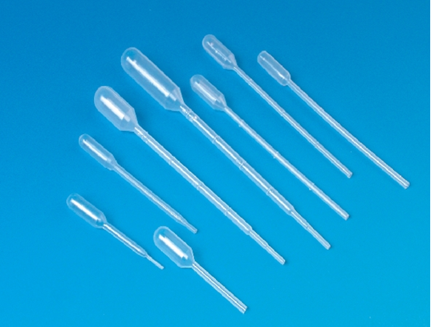
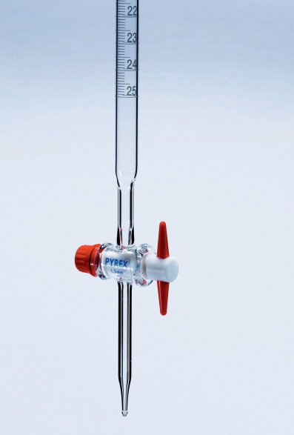
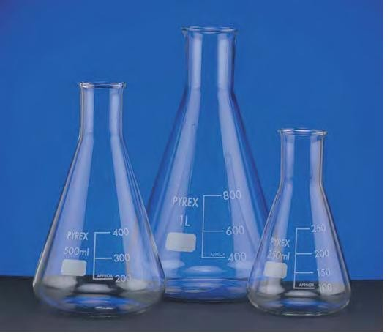
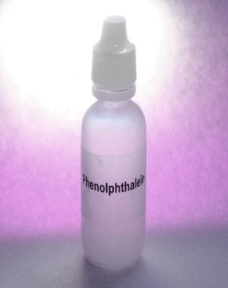
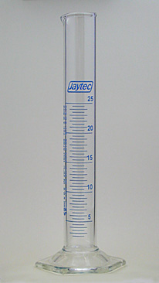
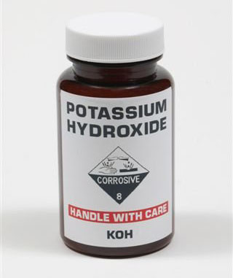
Requirement
Sodium Hydroxide (0.02272 N)
Phenolphthalein indicator
Titration assembly (burette, pipette, Conical flasks, measuring cylinder, stand, clamps etc.)

Slide 7
Method
Take 50 ml of water sample in a flask.
Add 2 drops of phenolphthalein indicator
If slight pink colour develops then free carbondioxide is absent).
If the solution remains colourless, titrate with standard alkali titrant to slight pink end point. 3) Note the reading and calculate the free carbondioxide in milligram per liter.

Slide 8
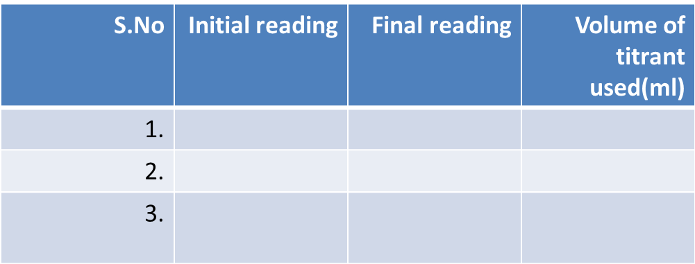
Observations
Calculations
Free CO2 (mg/l) = Volume of titrantX1000
Volume of sample
Results: Expressed as mg/l

