Slide 1
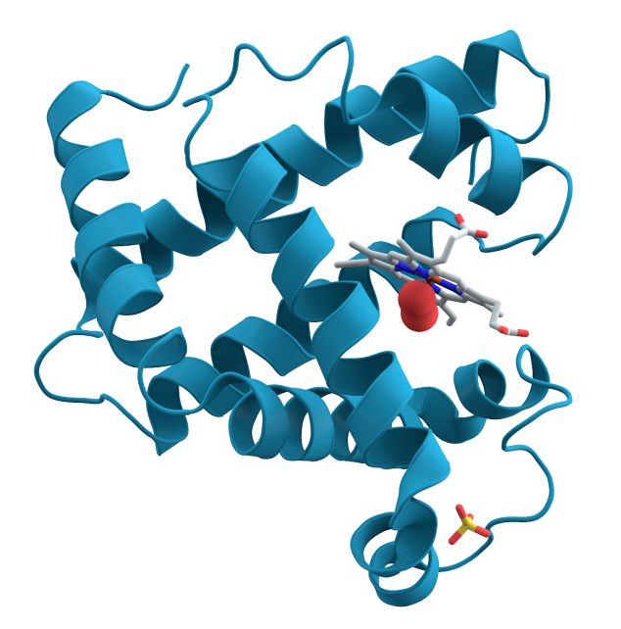
Qualitative tests of protein

Slide 2
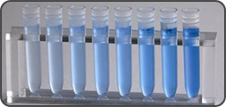
Certain functional groups in proteins can react to produce characteristically colored products.
-The color intensity of the product formed by a particular group varies among proteins in proportion to the number of reacting functional or free groups present and their accessibility to the reagent.

Slide 3
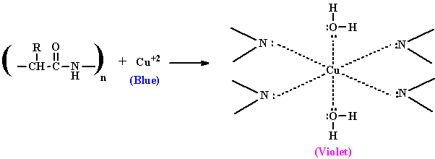
Biuret test:
This test is specific for the peptide bond. Substances containing not less than two peptide linkages give this test.
Objective:
detect the presence of peptides or proteins in a sample.
Principle:
When proteins and peptides (i.e peptide bonds) treated with an alkaline solution of dilute copper sulfate a violet color is formed . A positive test is indicated by the formation of a violet color.
Note: the color density is proportional to amount of proteins present.
* biuret reagent is alkaline copper sulfate solution.

Slide 4
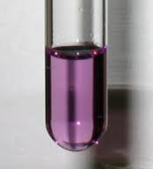
Method:
1- Add 2ml of protein Albumin
2- Add 1 ml of biuret reagent and mix well.
Result:

Slide 5
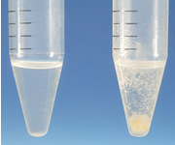
Protein precipitation
Is widely used in downstream processing of biological products in order to concentrate proteins and purify them from various contaminants.
The solubility of proteins is affected by pH, temperature, salts, heavy metal salts etc.

Slide 6
1.Effect of salt concentration on the protein solubility
2.Precipitation of proteins by acids.
3. Precipitation of protein by salts of heavy metals.
4. Protein denaturation.

Slide 7
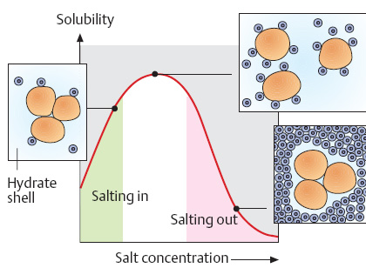
1.Effect of salt concentration on the protein solubility:
Objective: to investigate the effect of different salt concentration on protein solubility.
Principle:
The low salt concentration solutions make protein solubility easier using the attraction of salt ions to the functional groups of the protein (salting in).
On contrast, high salt concentration or solids dissolved in the reaction medium up till saturation solutions causes the protein to precipitate since salt ions, in this case, compete with the protein molecules in binding water molecules (salting out).
So the salt it just cause protein dehydration. e.g (NH4)SO4
Note: Each protein can be precipitated at specific salt concentration.
There is inverse relationship between the Mw of protein and the concentration of salt)
High Mw need low concentration salt ( low percentage of saturation)
Low Mw need high conc. of salt ( High percentage of saturation)

Slide 8
Egg Proteins:
Albumin and globulin
Separated by centrifugation at 3000 for 20 min.
The albumin is the supernatant because it is has low Mw. and globulin is the precipitate which is higher Mw than albumin.

Slide 9
+ NaCl
(low salt concentration
+ 50% saturated (NH₄)2SO₄
Globulin dissolves (salting in)
No precipitation
Albumin has low MW so it need higher salt concentration to precipitate
+ 50% saturated (NH₄)2SO₄
Globulin precipitate (salting out)
Globulin has high MW so it precipitate at lower salt concentration
+ 100% saturated (NH₄)2SO₄
Albumin precipitate (salting out)
Albumin has low MW so it precipitate at high salt concentration

Slide 10
Method:
T3 | T2 | T1
Take your T2 tube | Take 2 ml of your albumin sample | Take your globulin sample
Add a few amount of 100% solid (NH4)2SO4 | Slightly add 1 ml of 50% saturated (NH4)2SO4 solution | Add 4 ml of NaCl solution to your globulin tube
Shake it well and write your observation | record your observation . | Shake it well and write your observation
Result:
Comment | Observation | Tube
 |  | Globulin + NaCl
 |  | Albumin+50% saturated (NH4)2SO4
 |  | (Albumin+50% saturated (NH4)2SO4 ) + 100% saturated (NH4)2SO4

Slide 11
2.Precipitation of proteins by acids:
Objective:
To investigate the effects of strong acids on the protein solubility.
Principle:
This test depend on affecting solubility of the protein as a function of changes in pH. In highly acidic media, the protein will be positively charged, which is attracted to the acid anions that cause them to precipitate.

Slide 12
Method
B | A
Put 3 ml of the albumin solution | In a test tube, put 3ml of conc. nitric acid carefully
add 5-7 drops of T.C.A solution carefully | Using a dropper add to (albumin) on the inner wall of the tube to form a layer up the acid
Record your observation | Record your observation
Precipitation of albumin using
Trichloroacetic acid [TCA]
Result:
Comment | Observation | Tube
 |  | Conc. HNO3 + Albumin
 |  | Albumin + TCA
Precipitation of albumin using
concentrated nitric acid.

Slide 13
3. Precipitation of protein by salts of heavy metals:
Heavy metal salts usually contain Hg+2, Pb+2, Ag+1 Tl+1, Cd+2 and other metals with high atomic weights. Since salts are ionic they disrupt salt bridges in proteins. The reaction of a heavy metal salt with a protein usually leads to an insoluble metal protein salt.
Objective:
to identify the effect of heavy metal salt on protein.
Principle:
-Heavy metal salt will neutralize the protein:
By the negative charge of protein will bind with positive charge of metal ion . Then the protein will precipitate as insoluble metal protein salt .

Slide 14
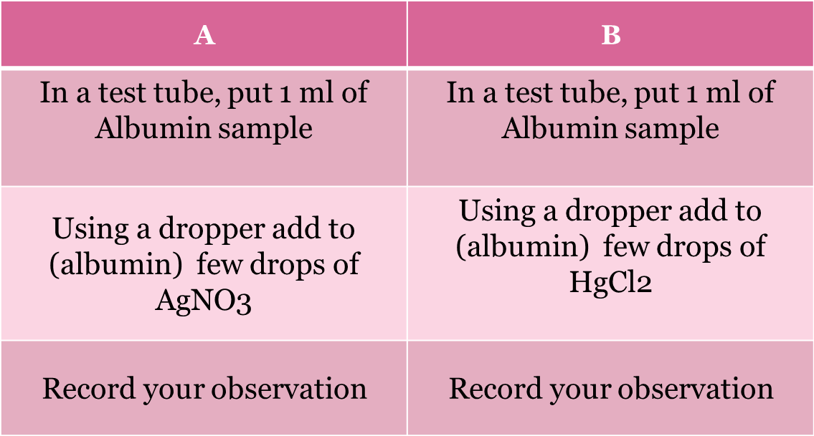
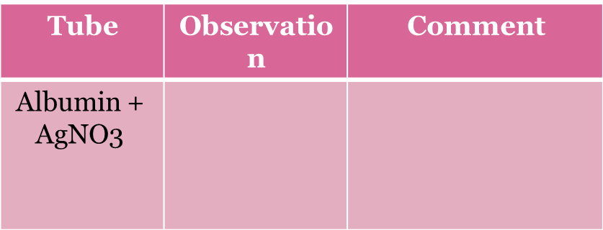
Method:
Result:

Slide 15
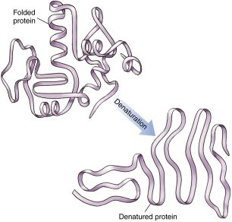
4. Protein denaturation:
Objective:
to investigate the effect of high temperature on protein structure.
Principle:
Non-covalent bond can be broken by heating, leading to protein denaturation and the precipitation.
Denaturation is a process in which the proteins losing its quaternary structure, tertiary structure and secondary structure, by application of some external factor or compound such as a strong acid or base, a conc. inorganic salt, an organic solvent (e.g., alcohol or chloroform), or heat.
- without alteration of the molecule's primary structure, i.e., without cleavage of any of the primary chemical bonds that link one amino acid to another.

Slide 16
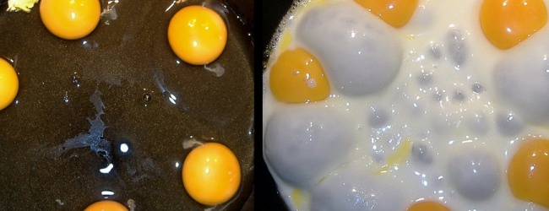
Method:
1- Take 1 ml of protein Albumin .
2- Place it in a boiling water bath for 5-10 minutes.
3-Remove aside to cool to room temperature.
4-Note the change.
Result:

Slide 17
Questions :
Do you think free amino acids will give a positive result with biuret test ? why?
What is the least number of amino acids bonded together by peptide bonds that will respond positively to biuret test?
After heating albumin at high temperature, does it still biologically active? Why?
Can we use salting out method in fractionating mixture of proteins? Explain your result with example.

