Slide 1
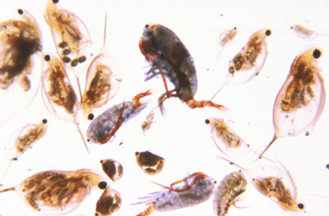
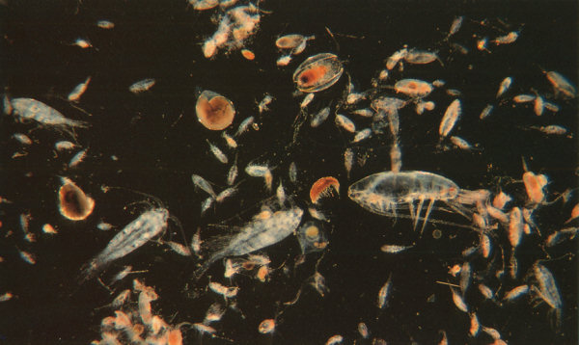
Zooplankton
Amal Almuhana
2012

Slide 2
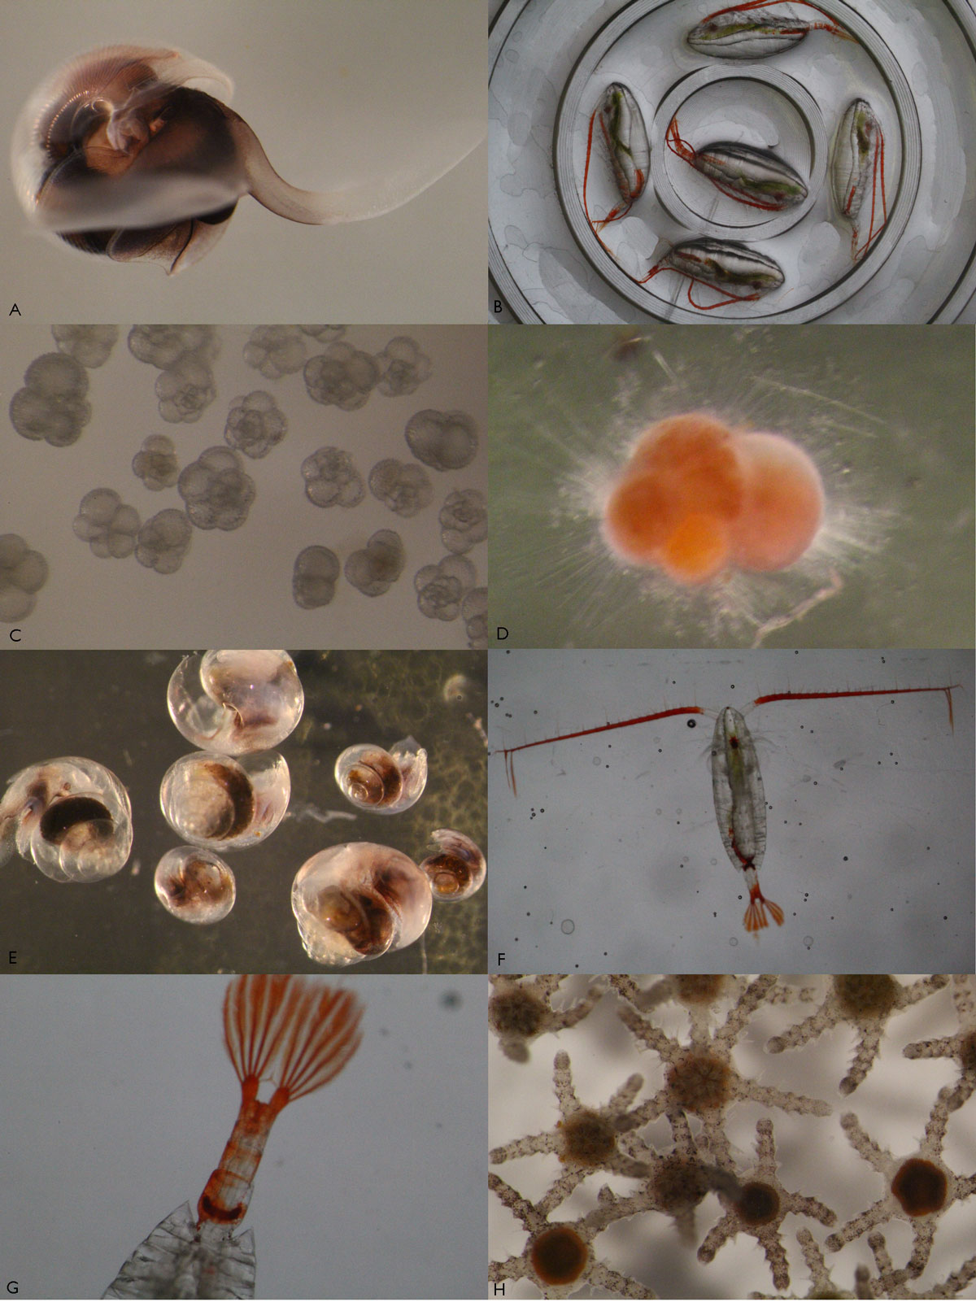
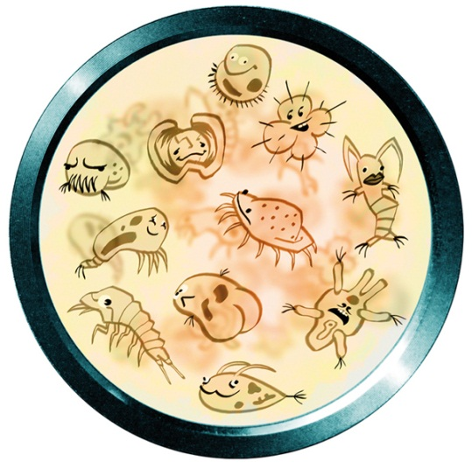
Introduction
It is the microscopic drifting animal component of planktons in the aquatic systems.
Most zooplankton belong to 3 major groups: 1) Protozoa 2) Rotifera
3)Cladocera 4) Copepoda are most common.
They can also be larger organisms like fish larva, insect larva or jellyfish

Slide 3
Importance of Zooplankton in the aquatic environment
1- zooplankton play a role in aquatic food webs, as a resource for consumers on higher trophic levels (including fish).
2- Act as a conduit for packaging the organic material in the biological pump.

Slide 4
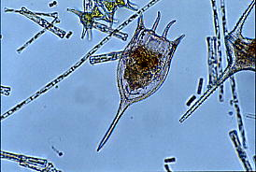
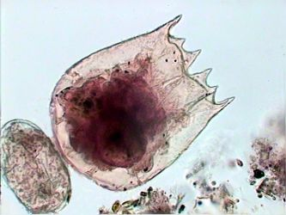
Characteristics
1- Armored with spines. 2- The ability of movement for :-
Effective defense
Search and feed upon the phytoplankton.
3- They form an important link between primary producers and consumers of higher order in aquatic food webs.
4- Primarily found in surface waters where food resources (phytoplankton or other zooplankton) are abundant.

Slide 5
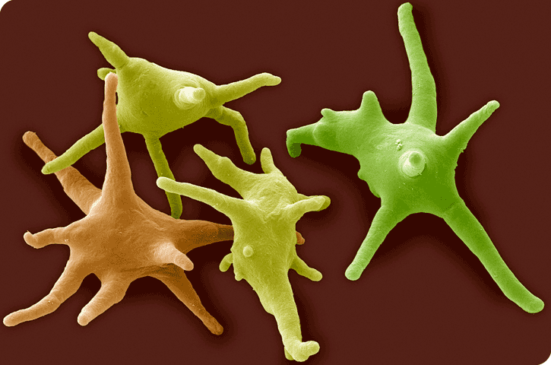
1) Protozoa
Protozoa are unicellular eukaryotic organisms.
Many of which are motile.
Originally, protozoa had been defined as unicellular protist with animal-like behavior, e.g., movement.
Protozoa were regarded as the partner group of protists to protophyta , which have plant-like behaviour, e.g., photosynthesis.

Slide 6
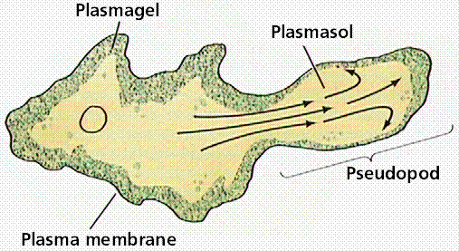
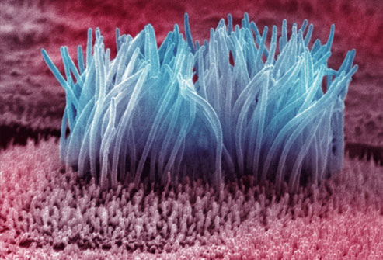
Characteristics
1- The inner portion the body is called the endoplasm.
2- The ectoplast, secretes the outer definite membrane ,the pellicle in some members. 3- Locomotion takes place either with the pseudopodia or with the help of cilia or flagella.
4- Food particles are directly ingested either from the surface of the body or through definite mouth
Pseudopodia
apper
cilia

Slide 7
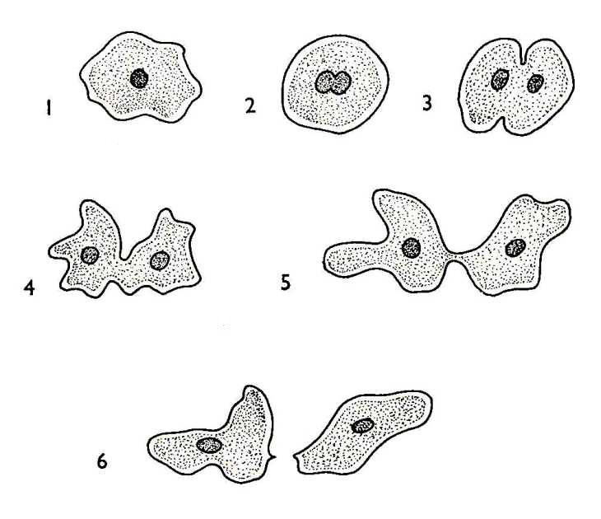
Characteristics cont.
5- In higher forms contractile vacuole opens to the exterior through temporary opening in the ectoplasm
In some members indigestible food is thrown out through an (anal) opening, which a permanent structure.
6- Most Reproduction either takes place by binary fission or multiple fission
Binary fission

Slide 8
Protozoa
Divided into four classes, namely 1- Flagellata (Mastigophora), 2-Sporozoa, 3-Rhizopoda 4- Ciliata (Ciliophora)

Slide 9
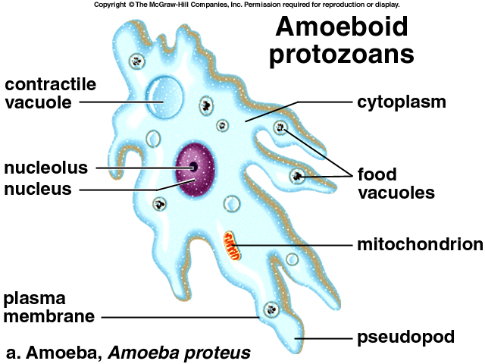
Order:- Tubulinida Family:- Amoebidae
Ex:- Amoeba
Body shape irregular.
Have pseudopodia
The body with ecto and endplasm.
Without shell or pellicle,covered with plasmalemma
Uni-or binucleate .
single contractile and food vacuoles

Slide 10
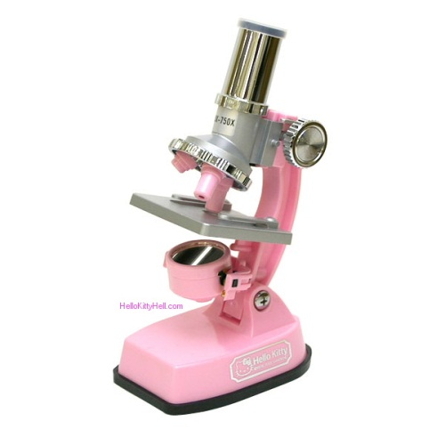
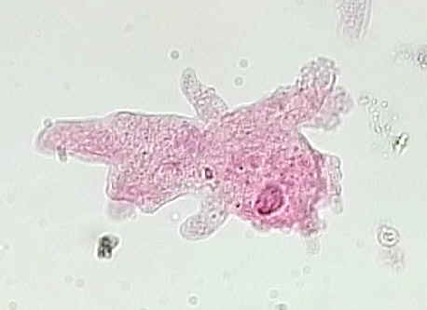
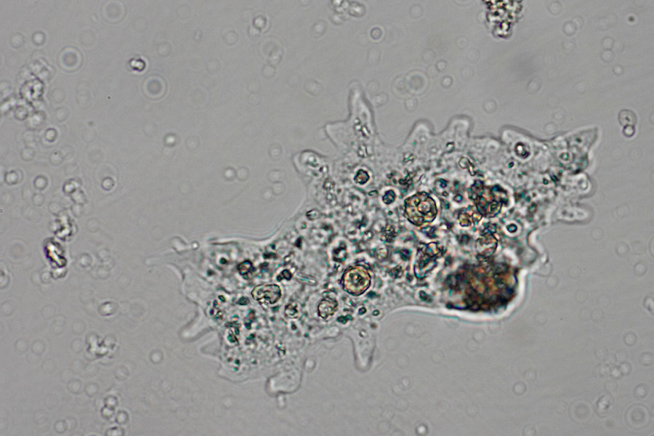
Under microscope
Amoeba

Slide 11
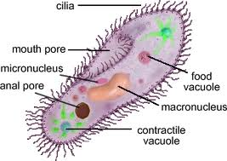
Order: Trichostomina Family: Paramecidae
Ex:-Paramecium
Body elongated
Pellicle firm and elastic
Body uniformly ciliated
Two nuclei , one micro and one macronucleus
contractile vacuole

Slide 12
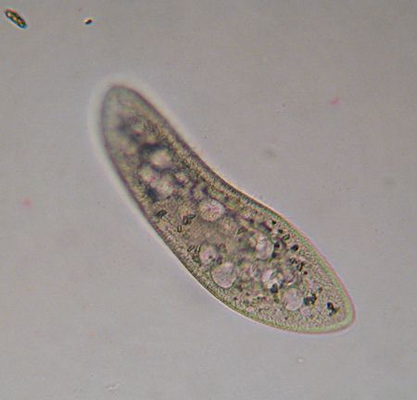
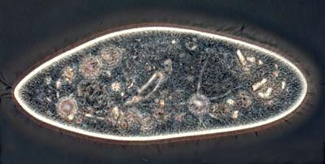
Under microscope
Paramecium

Slide 13
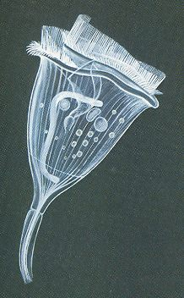
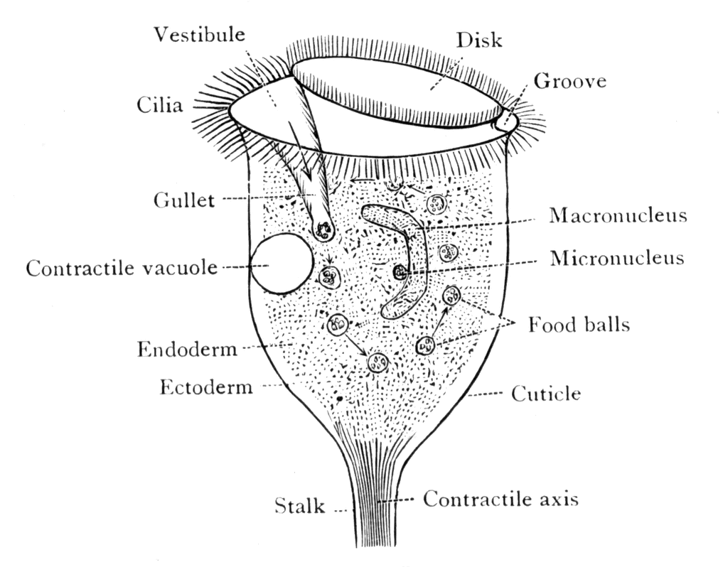
Order:- Sessilida Family:- Vorticellidae
Ex: Vorticella
Body inverted bell shaped.
Usually found in groups.
Two circles of cilia on the disc .
Endoplasm with a long and horse –shoe shaped.
Macronucleus and a small micronucleus.
Colorless, green or blue .

Slide 14
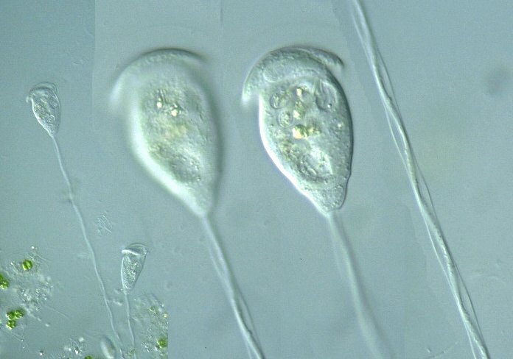
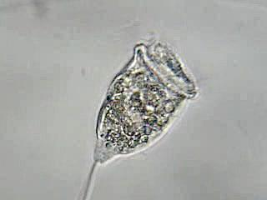
Under microscope
Vorticella

Slide 15
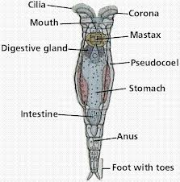
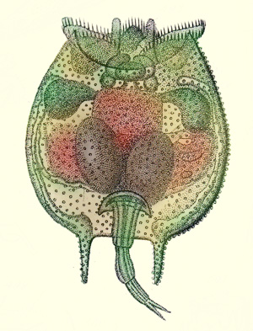
2) Rotifera
Called (wheels animalcules).
Mostly bilaterallly symmetrical.
Body usually sac shaped or cylindrical.
Body is transparent and internal organs are visible in living organisms .
Body is divided into head ,trunk and the post-anal part.
Apical area of the head ,bears wheel organ ,the corona, which helps in swimming and food collection .
Corona consists of circle of cilia around mouth .

Slide 16
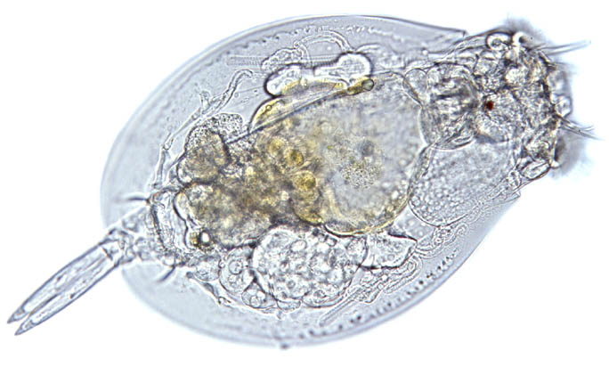
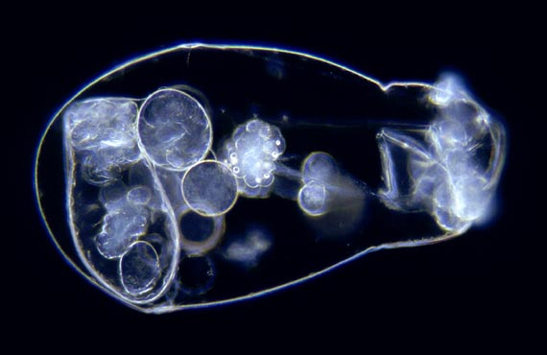
Rotifera cont.
8) Mostly littoral, sessile, but some are completely planktonic
9) Omnivorous, small (<12 µm)
10) Filter-feeding with corona.
11) Some are predatory, feed on protozoa, other rotifers, small crustaceans.

Slide 17
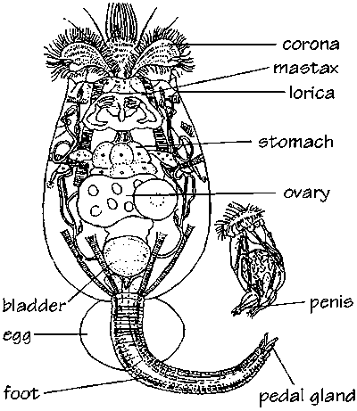
Ex: Brachionus
Anterior end with 2,4 or 6 spines.
Posterior end angled ,rounded or with 1 to 2 spines.
Foot opening posterior; foot long ,worm like ,wrinkled, flexible ,sharply
Eyes present.

Slide 18
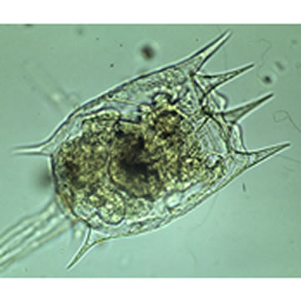
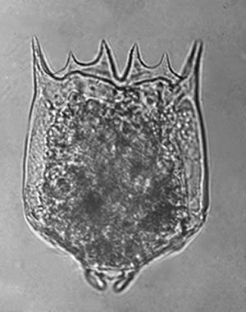
Under microscope
Brachionus

Slide 19
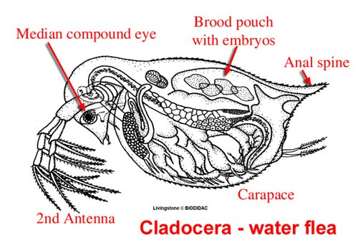
3- Cladocera (Water –Fleas)
The size of these crustaceans vary from .02mmto 3.0mm or more.
The external segmentation of the body is completely lost .
Head is distinct and separated from the rest of the body by means of a marked depression ,called notch .
The trunk is invariably covered either partly or completely , by bivalve carapace.
Head bears two light sensitive organs ,the large compound eye.
Head bears two pairs of appendages ,first antennae and second antennae .

Slide 20
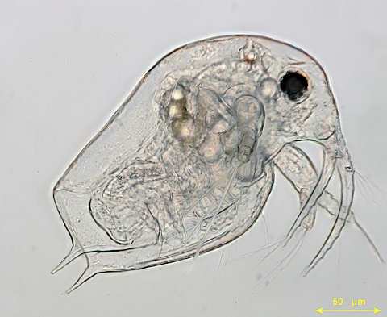
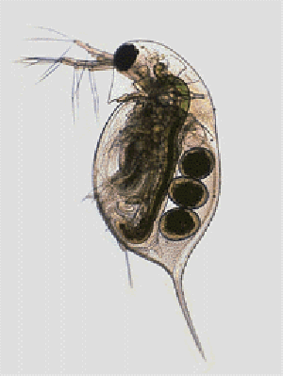
Under microscope
Daphnia

Slide 21
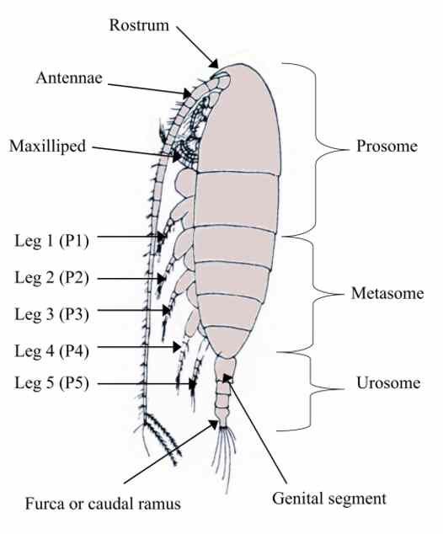
4-Copepods
Small crustaceans found in the sea and nearly every freshwater habitat.
Typically 1 to 2 mm.(0.04 to 0.08 in) long, with a teardrop shaped body.
Have an exoskeleton.
possess two pairs of antenna; the first pair are often long.

Slide 22
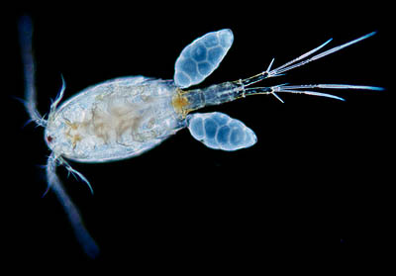
Under microscope
Cyclops

Slide 23
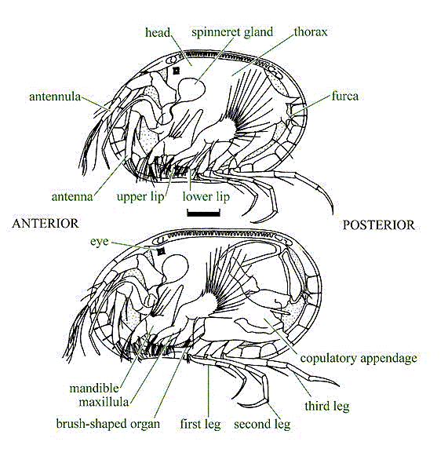
OSTRACODA(Mussel or Seed Shrimps)
Small crustaceans .
Body is completely enclosed in the bivalve carapace shell.
Outer wall is smooth or variously ornamented and colored .
It is impregnated with calcium carbonate .
Head region is very large and the trunk reduced.
Eye is visible through the shell single or double ,sometimes absent .

Slide 24
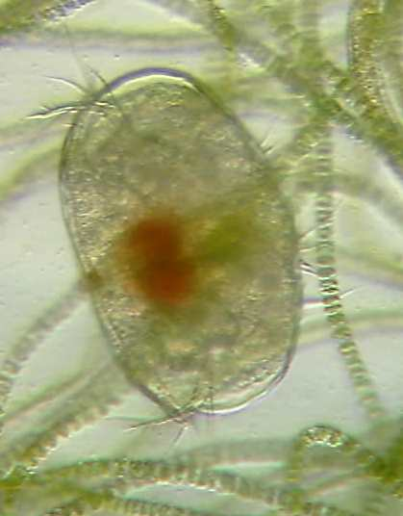
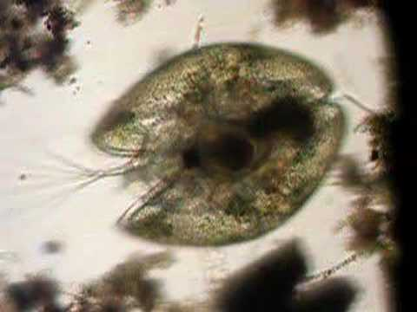
Under microscope
Ostracoda

Slide 25
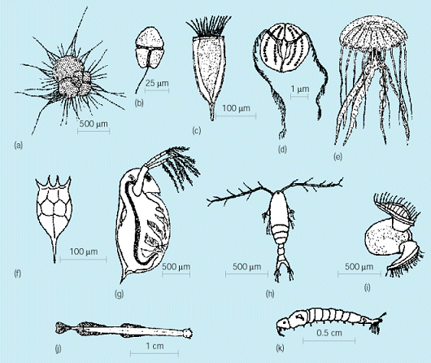
Representative zooplankton. (a) Foraminifera. (b) Dinoflagellate. (c) ciliate. (d) Ctenophore. (e) Cnidarian (scyphozoan jellyfish). (f) Rotifer. (g) Cladoceran. (h) Copepod. (i) Gastropod (mollusc)veliger larva. (j) Chaetognath. (k) Insect larva (Chaoborus).

