Slide 1
Router Configurations
2nd semester 1436-1437

Slide 2
Outline
Accessing a router for configuration
Command-Line Interface (CLI)
IOS CLI modes
Some Router Configurations

Slide 3
Getting Access to the Router
Most common methods to access the CLI:
Console port
Telnet or SSH
AUX port
Notes:
2.1.2.1 Console Access Method

Slide 4
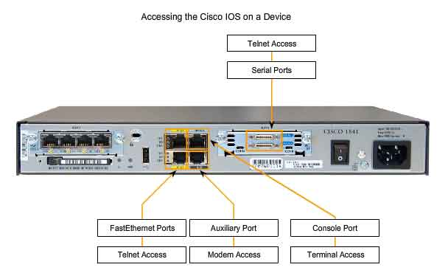
Getting Access to the Router

Slide 5
Command-Line Interface
CLI → command-line interface of the IOS.
CLI is the primary interface used to configure, manage, and troubleshoot Cisco devices.
This user interface enables you to directly execute IOS commands, and it can be accessed through a console, modem, or Telnet connection.
Access by any of these methods is generally referred to as an EXEC session
Notes:
Ref
http://www.informit.com/library/content.aspx?b=CCNA_Practical_Studies&seqNum=11

Slide 6
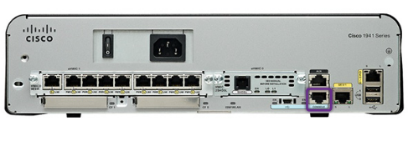
Console Access Method
Console Port
Device is accessible even if no networking services have been configured (out-of-band access)
Need a special console cable
Allows configuration commands to be entered
Should be configured with passwords to prevent unauthorized access
Device should be located in a secure room so console port cannot be easily accessed
Notes:
2.1.2.1 Console Access Method
Out-of-band access refers to access via a dedicated management channel that is used for device maintenance purposes only.
Console
The console port is a management port that provides out-of-band access to Cisco device. Out-of-band access refers to access via a dedicated management channel that is used for device maintenance purposes only. The advantage of using a console port is that the device is accessible even if no networking services have been configured, such as when performing an initial configuration of the networking device. When performing an initial configuration, a computer running terminal emulation software is connected to the console port of the device using a special cable. Configuration commands for setting up the switch or router can be entered on the connected computer.
The console port can also be used when the networking services have failed and remote access of the Cisco IOS device is not possible. If this occurs, a connection to the console can enable a computer to determine the status of the device. By default, the console conveys the device startup, debugging, and error messages. After the network technician is connected to the device, the network technician can perform any configuration commands necessary using the console session.
For many IOS devices, console access does not require any form of security, by default. However, the console should be configured with passwords to prevent unauthorized device access. In the event that a password is lost, there is a special set of procedures for bypassing the password and accessing the device. The device should also be located in a locked room or equipment rack to prevent unauthorized physical access.
In the event that a password is lost, there is a special set of procedures for bypassing the password and accessing the device.

Slide 7
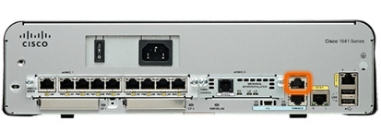
Telnet, SSH, and AUX Access Methods
Telnet
Method for remotely accessing the CLI over a network
Require active networking services and one active interface that is configured
Secure Shell (SSH)
Remote login similar to Telnet, but utilizes more security
Stronger password authentication
Uses encryption when transporting data
Aux Port
Out-of-band connection
Uses telephone line
Can be used like console port
Notes:
2.1.2.2 Telnet, SSH, and AUX Access Methods

Slide 8
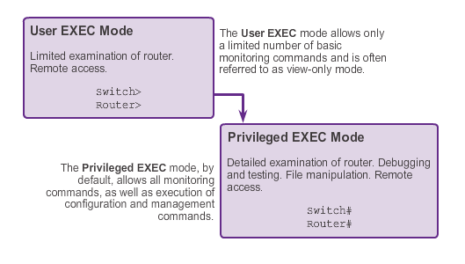
EXEC Levels or Modes
Two different EXEC sessions exist:
User EXEC level
Privileged EXEC level.
Password protection to the privileged EXEC level is highly recommended to prevent unauthorized configuration changes from being made to the router.
Notes:
Each level provides a different amount of access to the commands within the IOS.
User EXEC provides access to a limited number of commands that allow basic troubleshooting and monitoring of the router.
Privileged EXEC level allows access to all router commands, such as configuration and management settings.
2.1.3.2 Primary Modes
The two primary modes of operation are user EXEC mode and privileged EXEC mode. Tthe privileged EXEC mode has a higher level of authority in what it allows the user to do with the device.
User EXEC Mode
The user EXEC mode has limited capabilities but is useful for some basic operations. This mode is the first mode encountered upon entrance into the CLI of an IOS device.
This is often referred to as view-only mode. The user EXEC level does not allow the execution of any commands that might change the configuration of the device.
By default, there is no authentication required to access the user EXEC mode from the console. However, it is a good practice to ensure that authentication is configured during the initial configuration.
The user EXEC mode is identified by the CLI prompt that ends with the > symbol. This is an example that shows the > symbol in the prompt: Switch>
Privileged EXEC Mode
The execution of configuration and management commands requires that the network administrator use the privileged EXEC mode, or a more specific mode in the hierarchy.
The privileged EXEC mode can be identified by the prompt ending with the #symbol. Switch#
By default, privileged EXEC mode does not require authentication.
Global configuration mode and all other more specific configuration modes can only be reached from the privileged EXEC mode.
Upon initiating an EXEC session on the router, a user is placed in user EXEC mode. This is denoted in the router with the > prompt
To change to the privileged EXEC level, type in the command enable

Slide 9
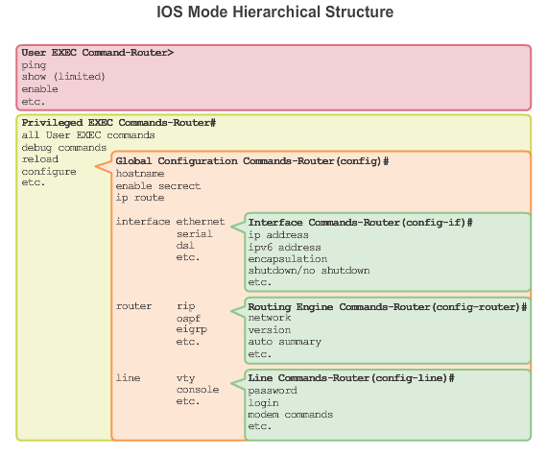
Cisco IOS Modes of Operation
Cisco IOS software is structured in a hierarchical manner
Notes:
It is important to understand this structure to successfully navigate within Cisco IOS software.
As mentioned previously, there are two EXEC modes: user EXEC and privileged EXEC.
Privileged EXEC mode is composed of various configuration modes:
Global configuration mode
Interface configuration mode
Router configuration mode
Line configuration mode
2.1.3.1 Cisco IOS Modes of Operations
In hierarchical order from most basic to most specialized, the major modes are:
User executive (User EXEC) mode
Privileged executive (Privileged EXEC) mode
Global configuration mode
Other specific configuration modes, such as Interface configuration mode.
Each mode has a distinctive prompt

Slide 10
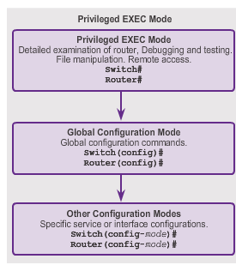
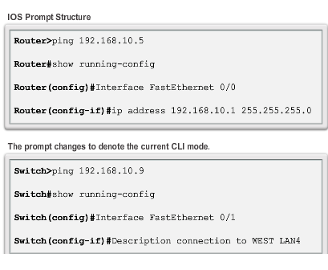
Global Configuration Mode and Submodes
Notes:
2.1.3.3 Global Configuration Mode and Submodes
Global configuration mode and interface configuration modes can only be reached from the privileged EXEC mode.
From global config, CLI configuration changes are made that affect the operation of the device as a whole.
Switch# configure terminal
Switch(config)#
From the global config mode, the user can enter different subconfiguration modes. Each of these modes allows the configuration of a particular part or function of the IOS device.
Interface mode - to configure one of the network interfaces (Fa0/0, S0/0/0)
Line mode - to configure one of the physical or virtual lines (console, AUX, VTY)
To exit a specific configuration mode and return to global configuration mode, enter exit at a prompt. To leave configuration mode completely and return to privileged EXEC mode, enter end or use the key sequence Ctrl-Z.
As commands are used and modes are changed, the prompt changes to reflect the current context.
Within each mode, certain commands are available for execution. Using the context-sensitive help, you can see a list of which commands are available. While navigating the CLI, the router prompt changes to reflect your current position within the CLI hierarchy. Table 2-2 summarizes the main command prompts within the CLI hierarchy.

Slide 11
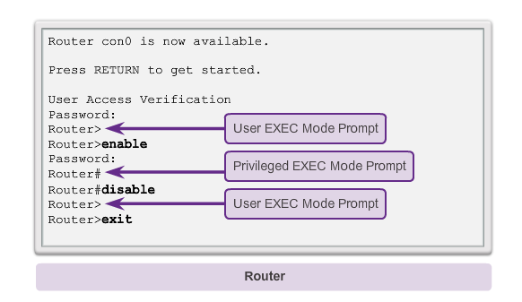
Navigating Between IOS Modes
Notes:
2.1.3.4 Navigating between IOS Modes
The enable and disable commands are used to change the CLI between the user EXEC mode and the privileged EXEC mode, respectively.

Slide 12
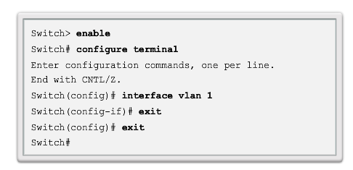
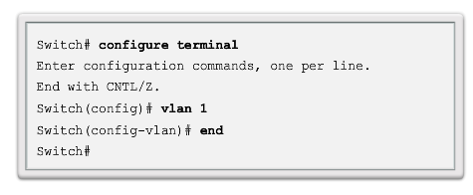
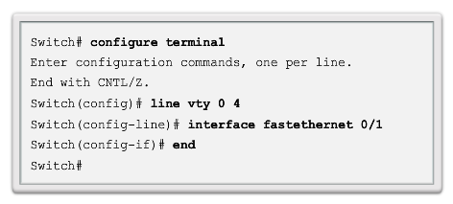
Navigating Between IOS Modes (cont.)
Notes:
2.1.3.5 Navigating between IOS Modes (cont.)
To move from the global configuration mode to the privileged EXEC mode, you enter the command exit.
To move from any submode of the global configuration mode to the mode one step above it in the hierarchy of modes, enter the exit command.
To move from any submode of the privileged EXEC mode to the privileged EXEC mode, enter the end command or enter the key combination Ctrl+Z.
To move from any submode of the global configuration mode to another “immediate” submode of the global configuration mode, simply enter the corresponding command that is normally entered from global configuration mode

Slide 14
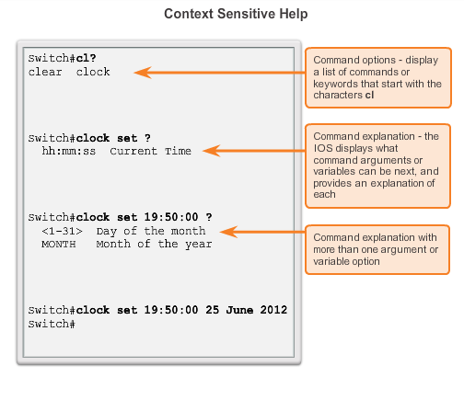
Context-Sensitive Help
Notes:
2.1.4.3 Context Sensitive Help
The IOS has several forms of help available:
Context-sensitive help
Command Syntax Check
Hot Keys and Shortcuts

Slide 15
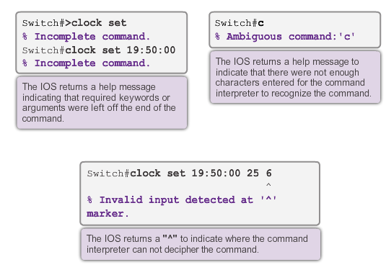
Command Syntax Check
Notes:
2.1.4.4 Command Syntax Check
There are three different types of error messages:
Ambiguous command
Incomplete command
Incorrect command

Slide 16
Hot Keys and Shortcuts
Tab – Completes the remainder of a partially typed command or keyword.
Ctrl-R – Redisplays a line.
Ctrl-A – Moves to the beginning of the line.
Ctrl-Z – Exits the configuration mode and returns to user EXEC.
Down Arrow – Allows the user to scroll forward through former commands.
Up Arrow – Allows the user to scroll backward through former commands.
Ctrl-shift-6 – Allows the user to interrupt an IOS process such as ping or traceroute.
Ctrl-C – Exits the current configuration or aborts the current command.
Notes:
2.1.4.5 Hot Keys and Shortcuts
Tab - This is a good technique to use when you are learning because it allows you to see the full word used for the command or keyword.
Ctrl-Z - Because the IOS has a hierarchical mode structure, you may find yourself several levels down. Rather than exit each mode individually, use Ctrl-Z to return directly to the privileged EXEC prompt at the top level.
Ctrl-Shift-6 - Using the escape sequence. When an IOS process is initiated from the CLI, such as a ping or traceroute, the command runs until it is complete or is interrupted. While the process is running, the CLI is unresponsive. To interrupt the output and interact with the CLI, press Ctrl-Shift-6.
Commands and keywords can be abbreviated to the minimum number of characters that -identify a unique selection.

Slide 17
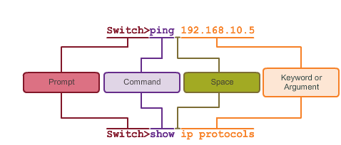
IOS Command Structure
Notes:
2.1.4.1 IOS Command Structure
Each IOS command has a specific format or syntax and can only be executed at the appropriate mode.
The commands are not case-sensitive. Following the command are one or more keywords and arguments.
Unlike a keyword, an argument is generally not a predefined word. An argument is a value or variable defined by the user
Switch> ping IP address
Switch> ping 10.10.10.5
The command is ping and the user defined argument is the 10.10.10.5.
Similarly, the syntax for entering thetraceroute command is:
Switch> traceroute IP address
Switch> traceroute 192.168.254.254
The command is traceroute and the user defined argument is the 192.168.254.254.

Slide 18
Some Router Configurations
Configuring hostname
Disabling DNS Lookup
Banner message
Limiting Access to Device Configurations
Encrypting Password Display
Saving running configuration Files
Enable IP on a Host, a Switch, a Router Interface
Verify Interface Settings

Slide 19
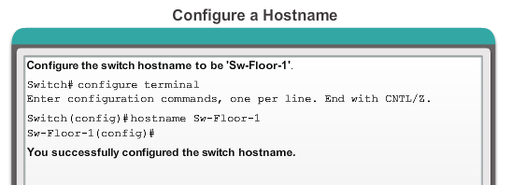
Configuring Hostnames
Hostnames allow devices to be identified by network administrators over a network or the Internet.
Router(config)# hostname NAME
Notes:
2.2.1.4 Configuring Hostnames
Some guidelines for naming conventions:
Start with a letter
Contains no spaces
Ends with a letter or digit
Uses only letters, digits, and dashes
Be less than 64 characters in length

Slide 20
Disabling DNS Lookup
IP domain name lookups or DNS resolution is enabled by default.
To disable DNS resolution, use the following command:
Router(config)#no ip domain-lookup
Disables the router from translating unfamiliar words (typos) into IP addresses.

Slide 21
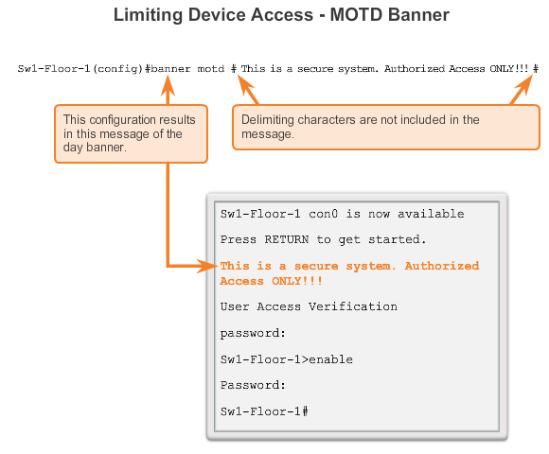
Banner Messages
Notes:
Important part of the legal process in the event that someone is prosecuted for breaking into a device
Wording that implies that a login is "welcome" or "invited" is not appropriate
Often used for legal notification because it is displayed to all connected terminals

Slide 22
Securing Device Access
These are device access passwords:
enable password – Limits access to the privileged EXEC mode
enable secret – Encrypted, limits access to the privileged EXEC mode
console password – Limits device access using the console connection
VTY password – Limits device access over Telnet
Notes:
2.2.2.1 Securing Device Access
Consider these key points when choosing passwords:
Use passwords that are more than eight characters in length.
Use a combination of upper and lowercase letters, numbers, special characters, and/or numeric sequences in passwords.
Avoid using the same password for all devices.
Avoid using common words such as password or administrator, because these are easily guessed

Slide 23
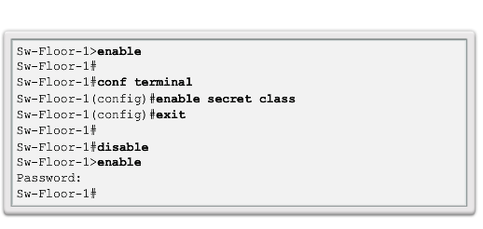
Securing Privileged EXEC Access Mode
Use the enable secret command, not the older enable password command.
The enable secret command provides greater security because the password is encrypted.
Notes:
2.2.2.2 Securing Privileged EXEC Access

Slide 24
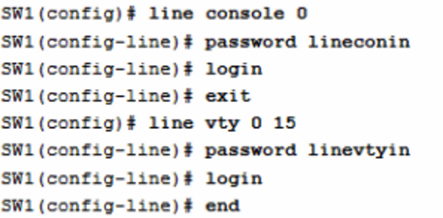
Securing User EXEC Access
Console port must be secured; it reduces the chance of unauthorized personnel physically plugging a cable into the device and gaining device access.
VTY lines allow access to a Cisco device via Telnet. The number of VTY lines supported varies with the type of device and the IOS version.
Notes:
2.2.2.3 Securing User EXEC Access

Slide 25
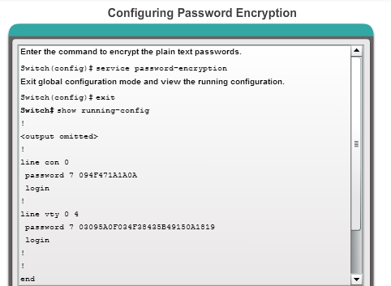
Encrypting Password Display
service password-encryption
Prevents passwords from showing up as plain text when viewing the configuration
Keeps unauthorized individuals from viewing passwords in the configuration file
Once applied, removing the encryption service does not reverse the encryption
Notes:
2.2.2.4 Encrypting Password Display

Slide 26
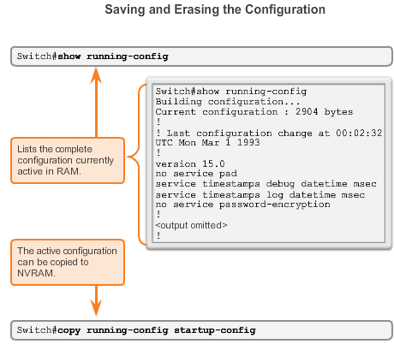
Configuration Files
Notes:
2.2.3.1 Configuration Files
Switch# erase startup-config
After the command is issued, the switch will prompt you for confirmation:
Erasing the nvram filesystem will remove all configuration files! Continue? [confirm]
Confirm is the default response. To confirm and erase the startup configuration file, press . Pressing any other key will abort the process.

Slide 27
Document Network Addressing
Network Documentation should include at least the following in a topology diagram and addressing table:
Device names
Interfaces
IP addresses and
subnet mask
Default gateways
Notes:
27
4.1.2 Connect Devices
4.1.2.3 Document Network Addressing

Slide 28
Default Gateways
To enable network access devices must be configured with the following IP address information
IP address - Identifies a unique host on a local network.
Subnet mask - Identifies the host’s network subnet.
Default gateway - Identifies the router a packet is sent to to when the destination is not on the same local network subnet.

Slide 30
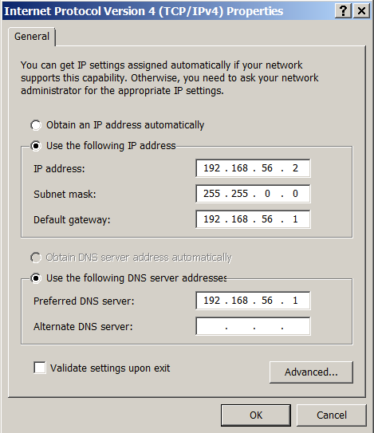
Enable IP on a Host
There are two ways: Static or Dynamic IP addresses

Slide 31
Enable IP on a Host
Statically Assigned IP address –
Host is manually assigned the IP address, subnet mask and default gateway. DNS server IP address can also be assigned.
Used to identify specific network resources such as network servers and printers
Can be used in very small networks with few hosts.

Slide 32
Enable IP on a Host
Dynamically Assigned IP Address –
IP Address information is dynamically assigned by a server using Dynamic Host Configuration Protocol (DHCP)
Most hosts acquire their IP address information through DHCP
DHCP services can be provided by Cisco routers

Slide 33
Enable IP on a Switch
Network infrastructure devices require IP addresses to enable remote management.
On a switch the management IP address is assigned on a virtual interface

Slide 34
Enable IP on a Router Interface
To be available a router interface must be:
Configured with an address and subnet mask .
Activated – by default LAN and WAN interfaces are not activated. Must be activated using no shutdown command.
Other parameters - serial cable end labeled DCE must be configured with the clock rate command.
Optional description can be included.

Slide 35
Configuring Interfaces
STEPS
1. interface type number
2. ip address ip-address mask
3. no shutdown
4. exit

Slide 36
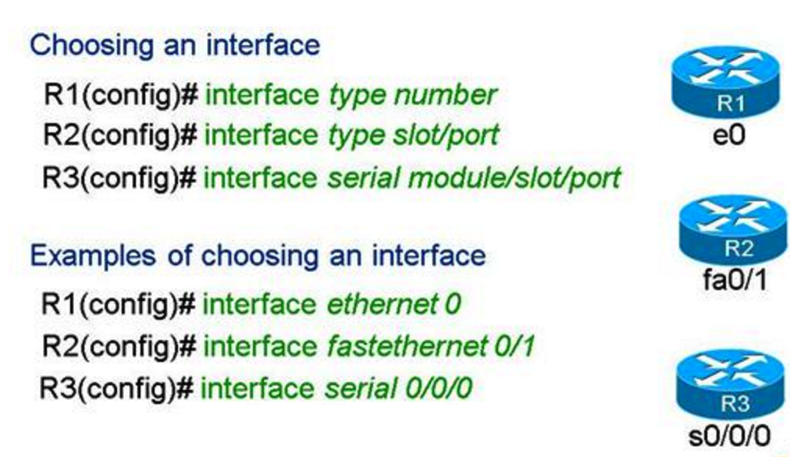
Configuring Interfaces
Notes:
The type of interface includes things such as serial, ethernet, fastethernet, gigabitethernet, atm, tunnel, loopback, etc.
The number, slot/number and module/slot/number are numbers used to uniquely identify an interface on different types of routers.

Slide 38
Verify Interface Settings
Show commands to verify operation and configuration of interface.
show ip interfaces brief
show running-config
Show commands to gather more detailed interface information.
show interfaces
show ip interfaces

Slide 39
