Slide 1
Qualitative tests of amino acids

Slide 2
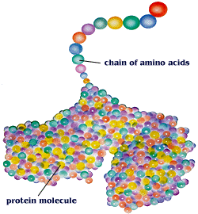
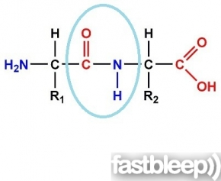
Amino acids :
Amino acid play A central role as building block of proteins.
as intermediates in metabolism, converted to specialized products.
There are 20 natural amino acids that are found within proteins.
All of them are L-α amino acids.

Slide 3
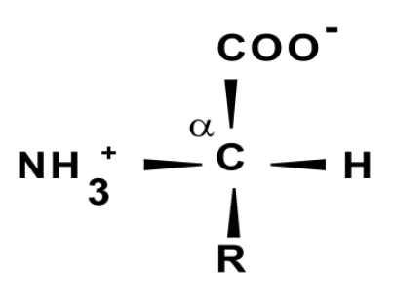
Amino acids structure
-All amino acids found in proteins have this basic structure, differing only in the structure of the R-group or the side chain.
-The simplest, and smallest, amino acid found in proteins is glycine for which the R-group is hydrogen (H).

Slide 4
Classification of amino acids :
Classification of amino acid depending on the R-group ionization (polarity) in water:
1- Non-polar.
2- Uncharged polar.
3-polar amino acids :
A-Basic polar (positively charged).
B- Acidic polar (negatively charged).

Slide 5
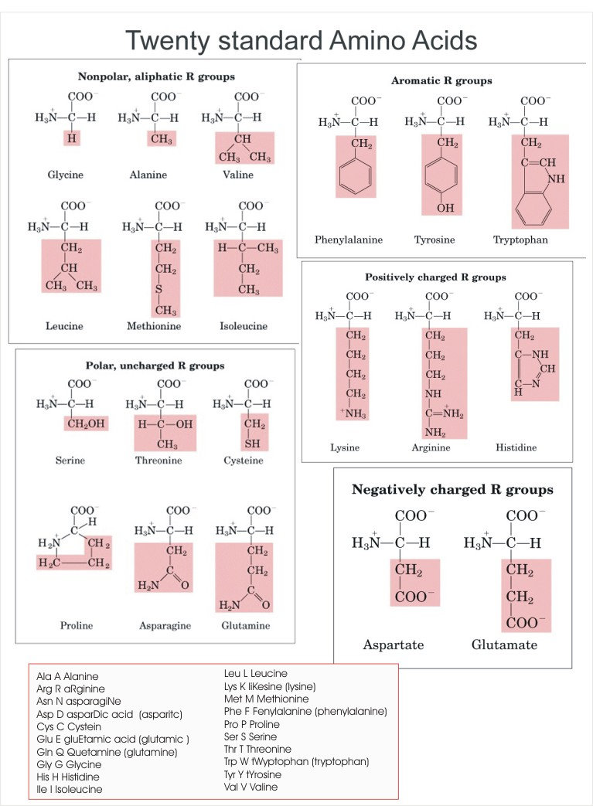

Slide 6
Some properties of Amino Acids :
1- Amphoteric Compounds:
which mean they can act as acids and bases
Due to presence of carboxyl group COOH that able to donate proton(H⁺), and convert to COO) ⁻COOH → COO ⁻ ).
Also presence of amino group NH2 which is enable to accept this proton(H⁺) and convert into NH3⁺ (NH2 → NH3⁺ ).

Slide 7
Amino acids are amphoteric Compounds
Amphoteric properties of amino acids due to the presence of their ionizable α-amino and α-carboxylic group can act sometimes as acids and sometimes as bases depending on the pH of their media .

Slide 8
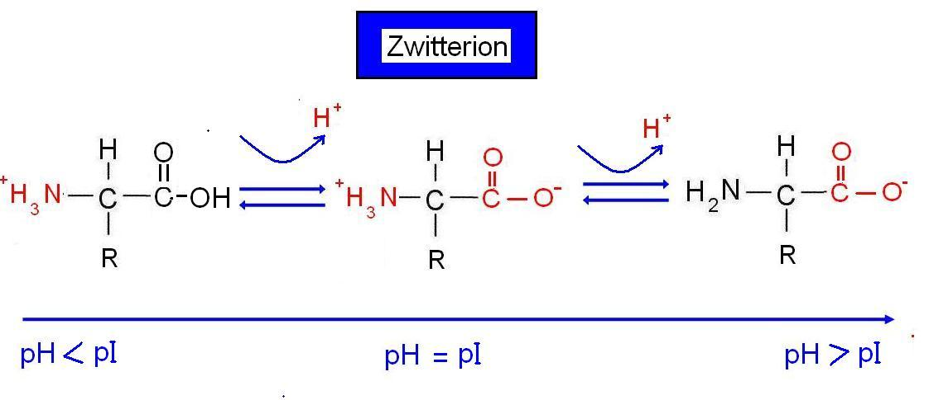
2- Isoelectric point (PI):
It is the pH value at which concentration of anionic and cationic groups are equal (i.e. the net charge of this molecule equals zero).
It is known as a point at which the molecule does not move to either cathode or anode if it is put in electric field and its solubility is minimum so it is possible to precipitate at this point.
Each amino acid have a different PI

Slide 9
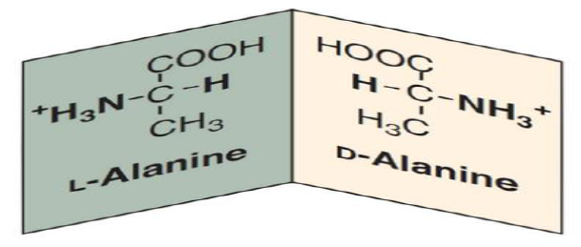
3-Optical Activity :
Amino acids are able to rotate polarized light either to the left (livo) L- a.a or to the right (dextro) D- a.a , since they have an asymmetric C atom (a carbon atom linked to 4 different groups), except glycine which lacks asymmetric C atom (has 2 H+ on α-C) .

Slide 10
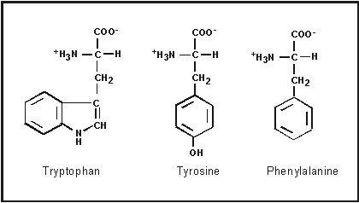
4-Light Absorption:
The aromatic amino acids tryptophan , tyrosine , phenyl alanine absorb ultraviolet light at 280nm ,which explains the absorption of proteins at 280nm.

Slide 11
Qualitative tests of amino acids
2. Ninhydrin tes
3.Xanthoproteic test
4. Millon's test
6. Lead sulfite test
1.Solubility test
5.Sakaguchi Test

Slide 12
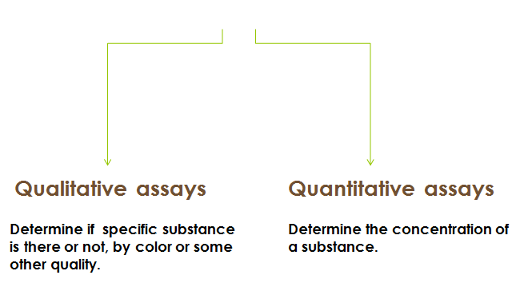

Slide 13
1.Solubility test:
-Objective:
investigate the solubility of selected amino acid in various solutions.
-Principle:
Polar amino acids are more soluble in water[polar] than non-polar, due to presence of amino and carboxyl group which enables amino acids to accept and donate protons to aqueous solution.
Polar amino acids are soluble in polar solvent, and vice versa.

Slide 14
Method:
1.Add 4ml of different solvents in 3 clean test tubes then place 1 ml of each amino acid.
2.Shake the tubes thoroughly, then leave the solution for about one minute.
3.Notice what happened to the solution .
4. Record your result .
Result:
Arginine | glycine
 |  | o.1M HCL
 |  | 0.1M NaOH
 |  | Chloroform

Slide 15
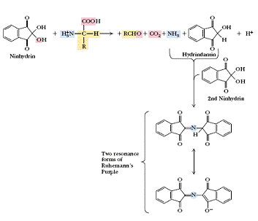
2. Ninhydrin test:
Objective:
-to detect α-L-amino acids
Principle:
1.Ninhydrin (triketohydrindene hydrate) degrades amino acids into aldehydes (on pH range 4-8), ammonia and CO2 though a series of reactions.
The net result is ninhydrin in a partially reduced from hydrindantin.
2.Ninhydrin then condenses with ammonia and hydrindantin to produce an intensely blue or purple pigment, sometimes called ruhemann's purple

Slide 16
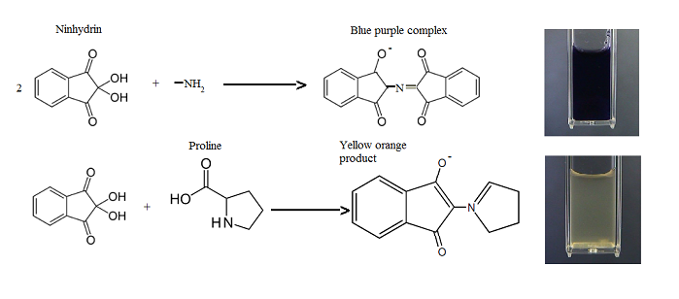
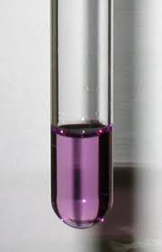
All amino acids that have a free amino group will give positive result (purple color) .
While not free amino group-proline and hydroxy-proline (amino acids) will give a
(yellow color).
Note: Many substances other than amino acids, such as amines will yield a blue color with ninhydrin, particularly if reaction is carried out on filter paper.

Slide 17
Method:
1-Place 1 ml of each of the solutions in a test tube and add 1 ml of ninhydrin solution.
2- Boil the mixture over a water bath for 2 min.
3- Allow to cool and observe the blue color formed
4- Complete the below table.
Result:
Conclusion | Result | Tube
 |  | Glycine | A
 |  | Tryptophan | B
 |  | Proline | C

Slide 18
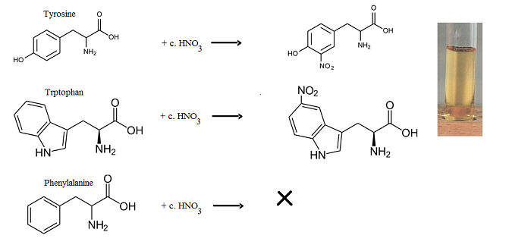
3.Xanthoproteic test :
Objective:
to differentiate between aromatic amino acids which give positive results [yellow color] and other amino acids.
Principle:
Concentrated nitric acid react with aromatic nucleus present in the amino acid side chain [nitration reaction] →giving the solution yellow color.
* The salts of these derivatives are orange in color.

Slide 19
Note:
Amino acids tyrosine and tryptophan →contain activated benzene rings [aromatic nucleus] which are easily nitrated to yellow colored compounds.
The aromatic ring of phenyl alanine dose not react with nitric acid despite it contains a benzene ring, but it is not activated, therefore it will not react

Slide 20
Method:
1- Label four tubes (1 - 4), then add 1 ml of each amino acid solutions and phenol solution to those test tubes each alone.
2- Add 1 ml of concentrated HNO3. then record your result
3-Now COOL THOROUGHLY under the tap and CAUTIOSLY add 5 drops of 10M NaOH to make the solution strongly alkaline(the alkaline is added to be sure about the nitration).
Result:
+ NaOH | + HNO3
 |  | Tyrosine
 |  | Tryptophan
 |  | plenylalnin
 |  | Glycine
Tyrosine
Tryptophan
phenylalanine
phenol

Slide 21
4. Sakaguchi Test:
Objective:
detection of amino acid containing gauanidium group. In other words it’s a test for, arginine.
Principle:
In alkaline solution, arginine react with α-naphthol and sodium hypobromite /chlorite as an oxidize agent, to form red complexes as a positive result.

Slide 22
Method:
•Label 2 test tube and put in each one 2 ml of the amino acid solution .
•Add to each tube 2ml of NaOH solution. Mix well
•Add to each tube 2ml of α-naphthol solution. Mix well
•Add to each tube 5 drops of sodium hypobromite solution, and record your result
Result:
Glycine
Arginine
Conclusion | Observation | Tube
 |  | Glycine
 |  | Arginine

Slide 23
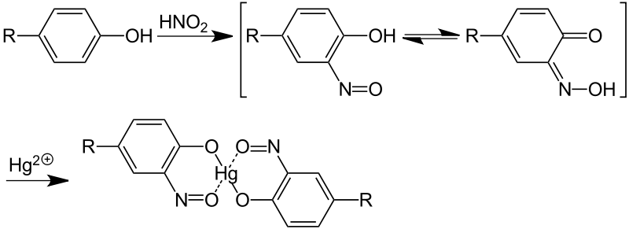
5.Millon's test:
Objective:
This test is specific for tyrosine. Because it is the only amino acid containing
a phenol group, a hydroxyl group attached to benzene ring.
Principle:
The phenol group of tyrosine is first nitrated by nitric acid in the test solution. Then the nitrated tyrosine complexes mercury ions in the solution to form a brick-red solution or precipitate of nitrated tyrosine, in all cases, appearance of red color is positive test.
Note: all phenols (compound having benzene ring
and OH attached to it) give positive results in Millon’s test
Notes:
نظري

Slide 24
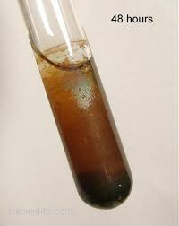
6. Lead Sulfite Test:
Objective:
This test specific for–SH [sulfhydral group ]containing amino acid (Cysteine).
Principle:
- Sulfur in cystine, is converted to sodium sulfide by boiling with 40% NaOH.
- The Na2S can be detected by the precipitation of PbS (lead sulfide) from an alkaline solution when adding lead acetate Pb (CH3COO)2.
Notes:
نظري

Slide 25
Questions:
- Why proline gives a yellow color in ninhydrin test?
- Discuss the reasons of which aromatic amino acids give positive result but not aliphatic ones in Xanthoproteic test?
- Which of the amino acids contain (-SH) group?
- What is the difference between cystein and cystin ?

