Slide 1
1101csc
Creating Your First C Program
Using Visual Studio 2010

Slide 2

(1)Download and Install Microsoft Visual Studio 2010 on your PC
1-Open your internet explorer then type the address of the(e-Transactions & Communications) http://etc.ksu.edu.sa
in the address bar then press Enter
2-Click

Slide 3

3-Click on
Visual Studio 2010 is Microsoft’s Integrated Development Environment (IDE) for creating, running and debugging programs (also called applications) written in various .NET programming languages.
4-After being downloaded on your PC, click on the installation icon then follow the wizard

Slide 4
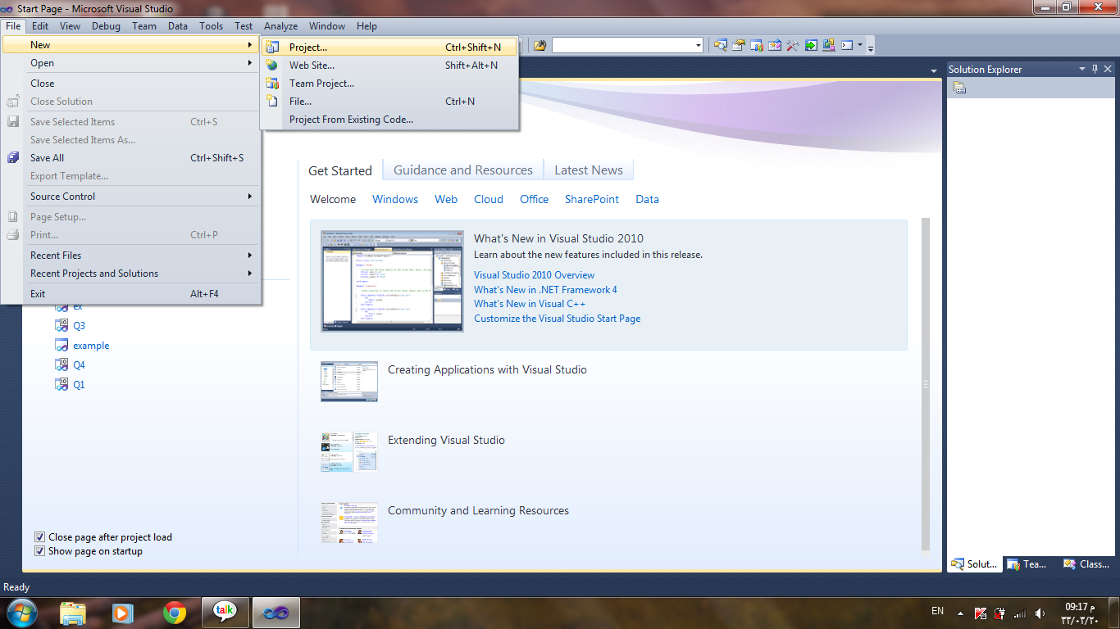
(2)Getting Start With Microsoft Visual Studio 2010

Slide 5
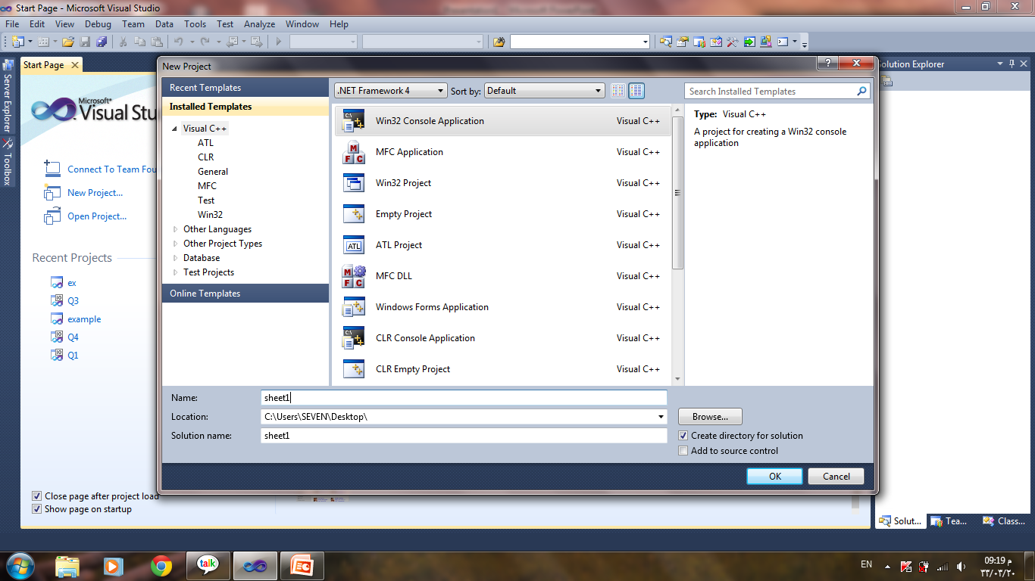

Slide 6
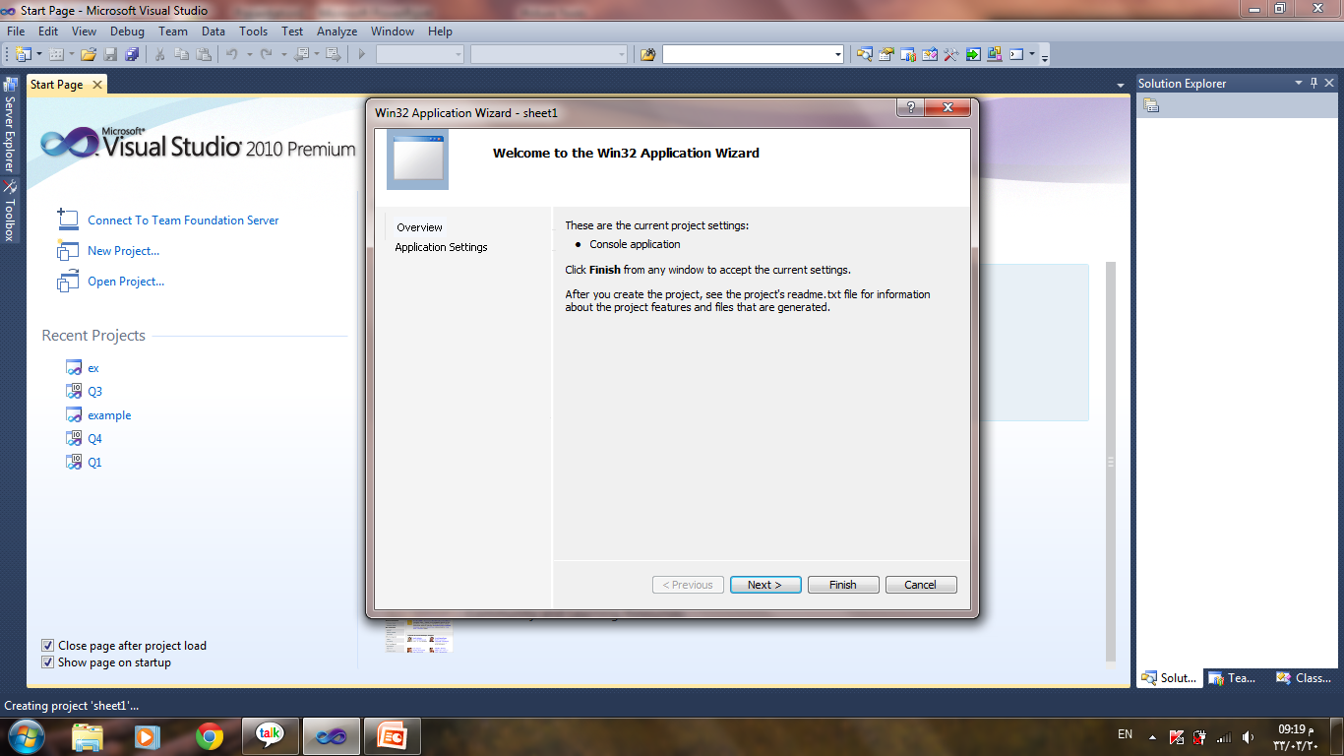

Slide 7
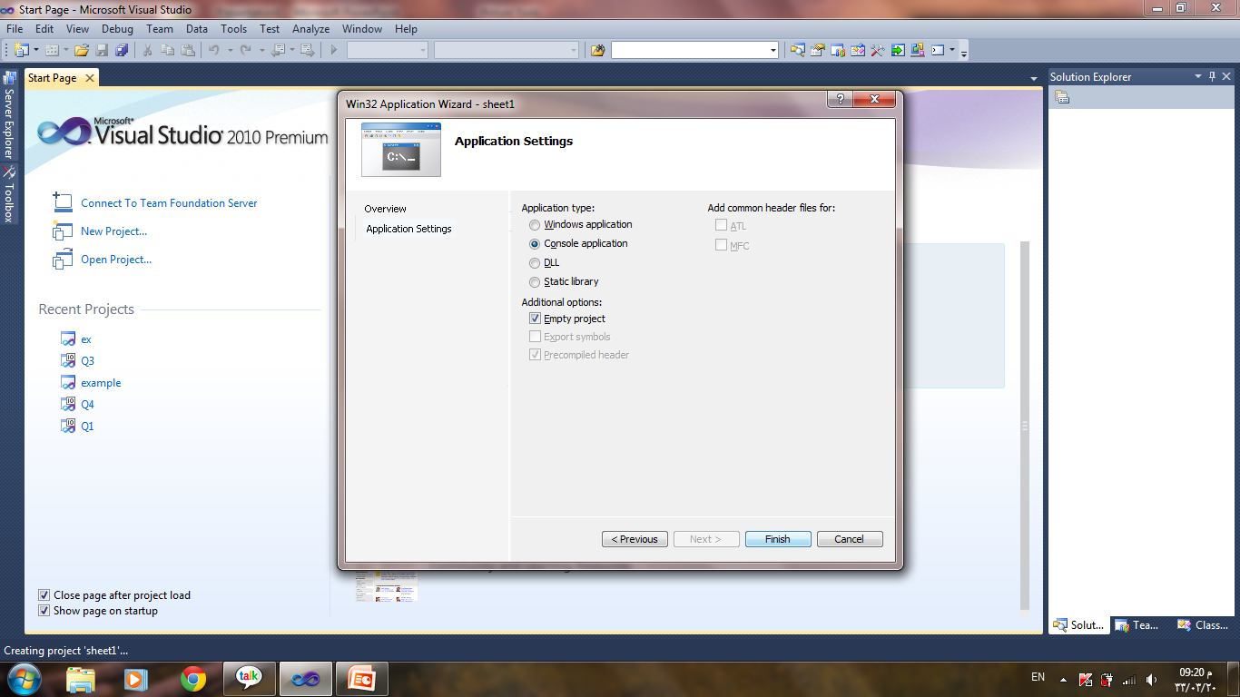

Slide 8
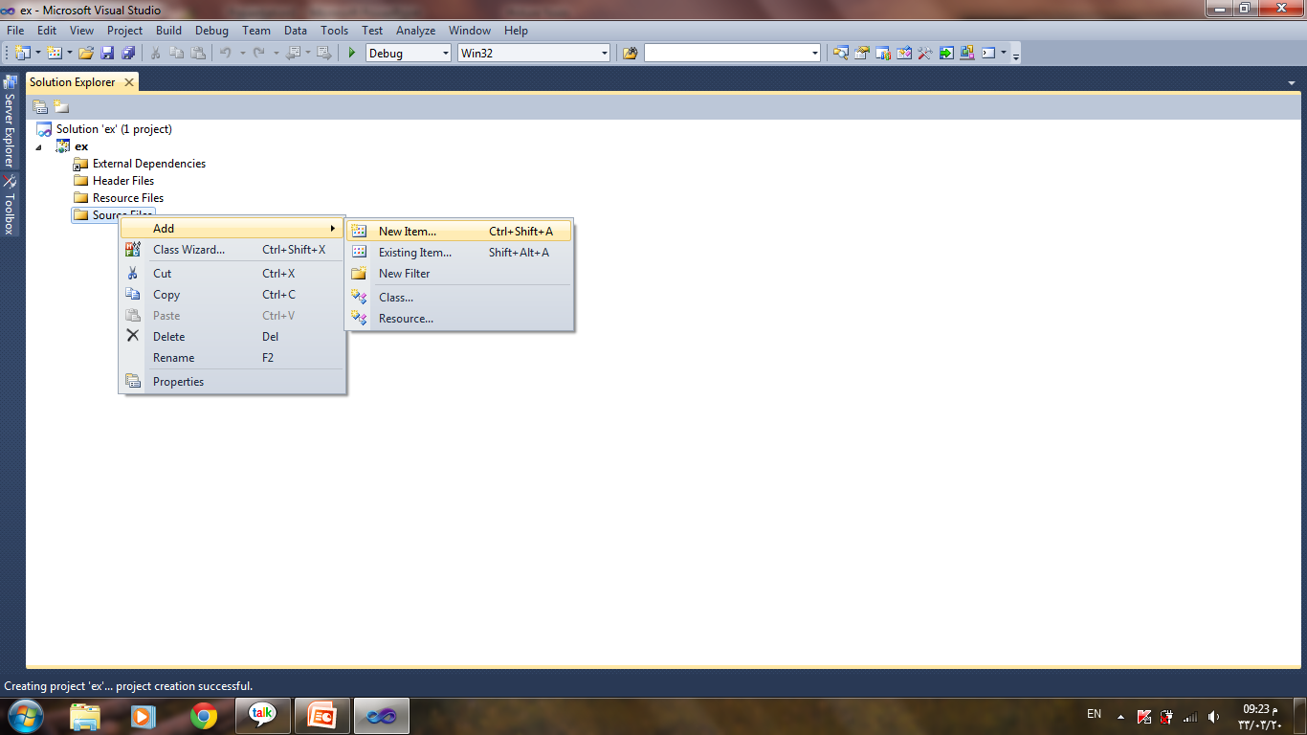

Slide 9
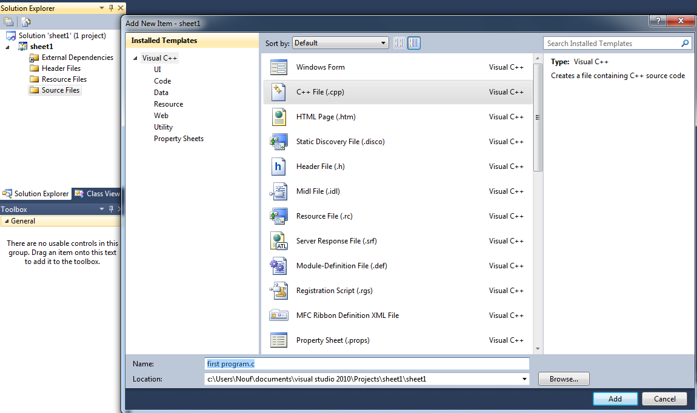
change extension to .C,
default is .CPP.
To work with C language program source file
The name should be with extension .C.

Slide 10
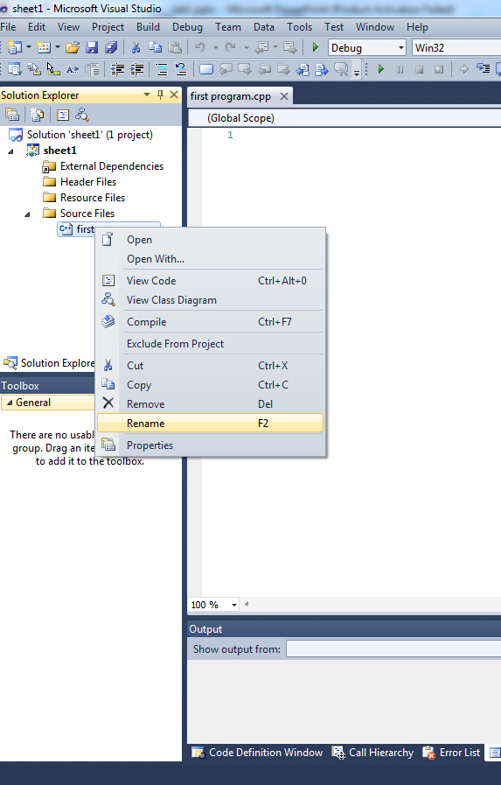
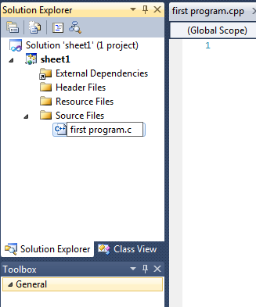
Other way to do it
1 -Right click
3 change the extension to .C
2

Slide 11
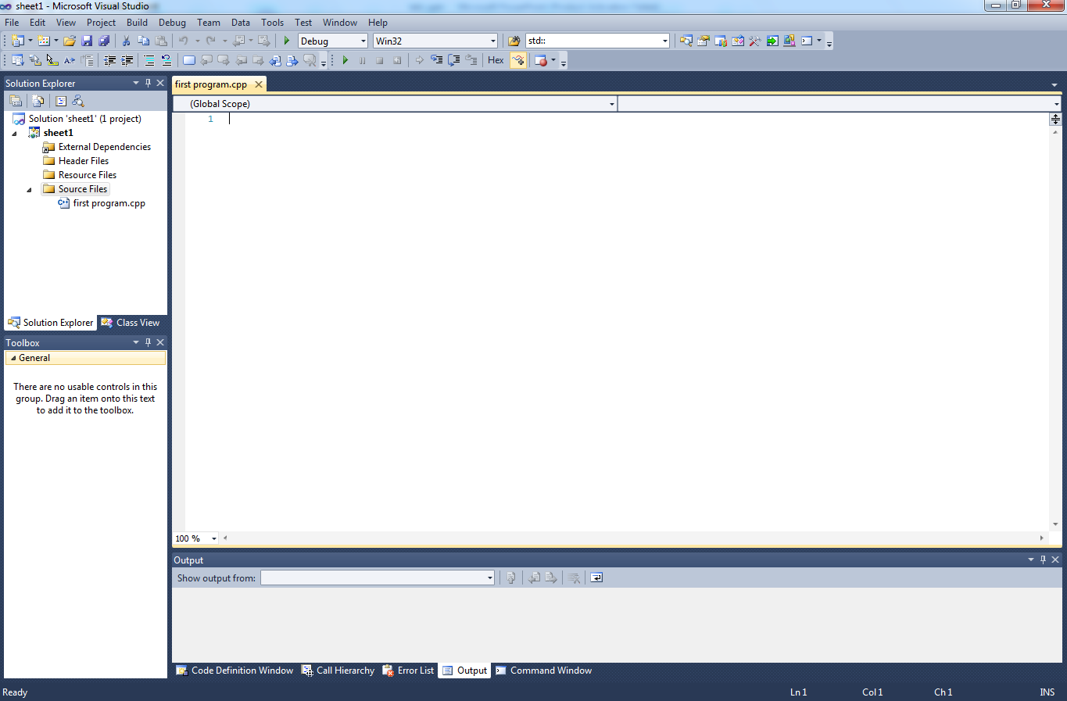
The most important 3 windows in the interface

Slide 12
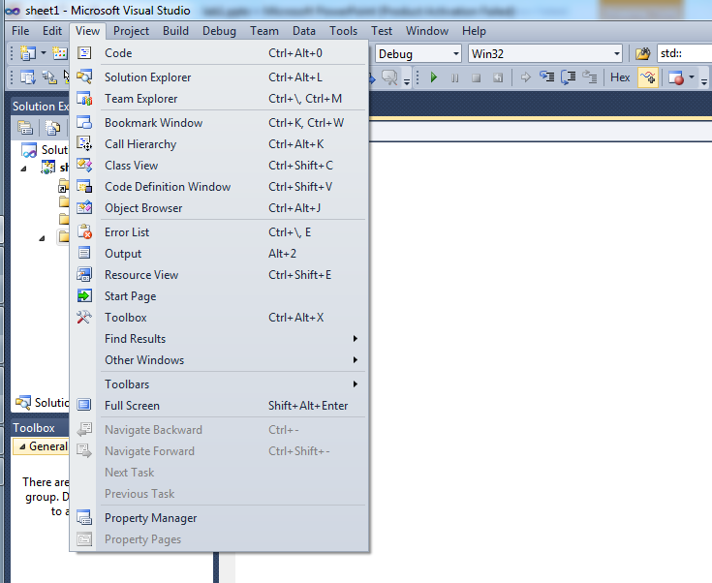
If it’s not shown in the IDE, select View menu

Slide 13
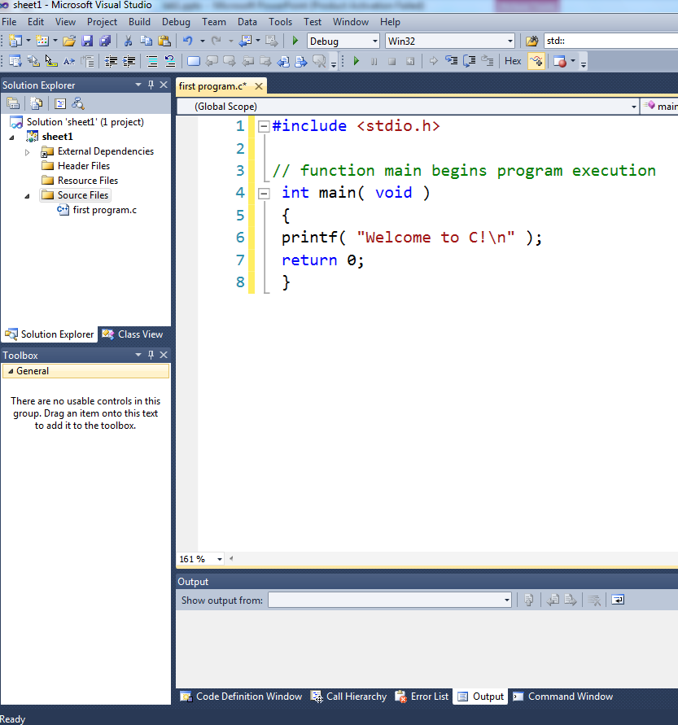
write a small
printing program
as shown

Slide 14
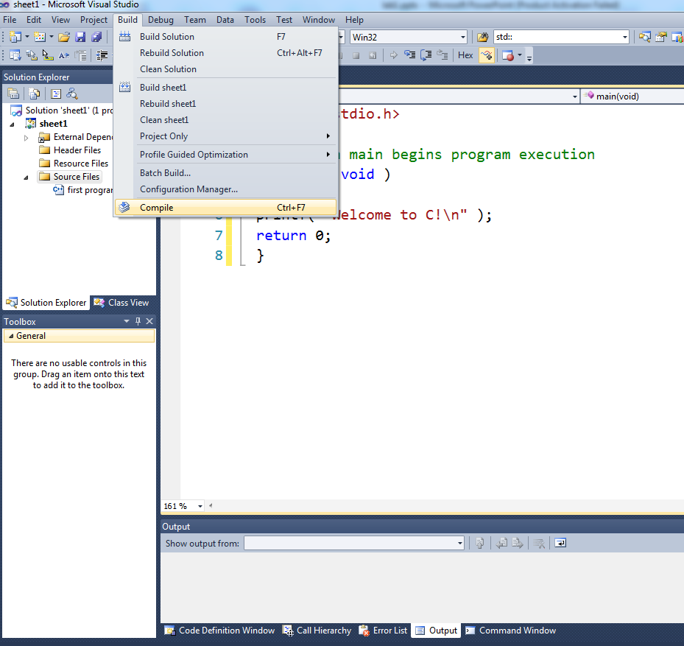
To check your code syntax

Slide 15
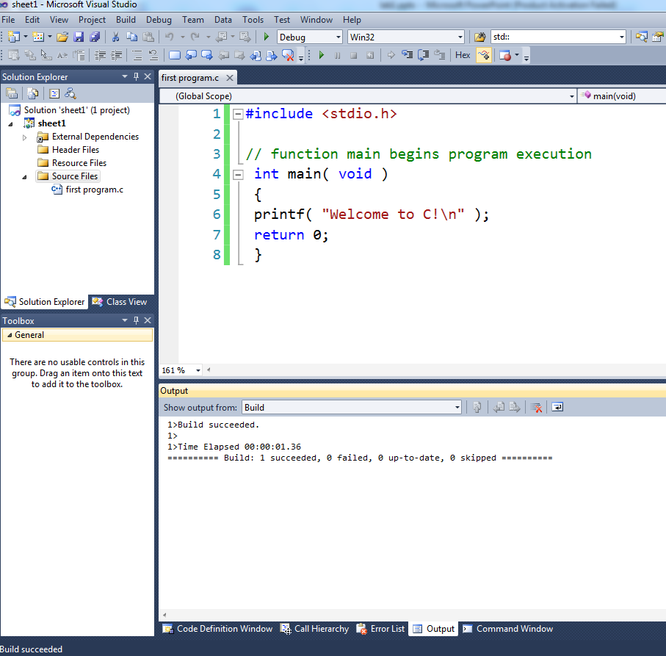

Slide 16
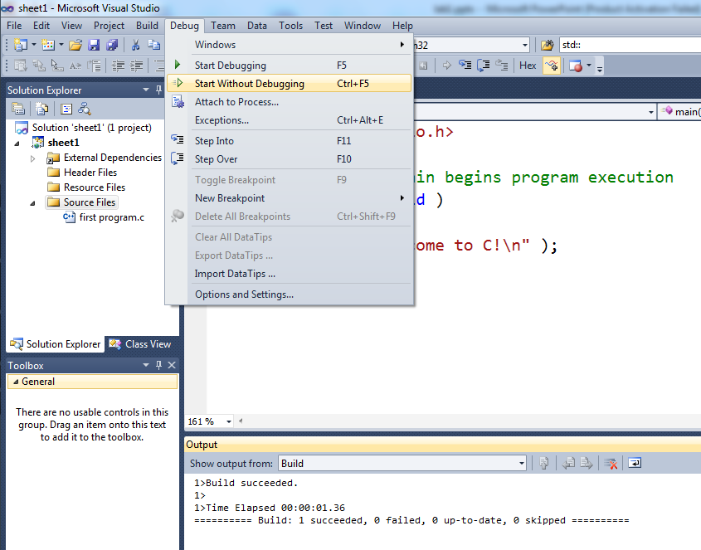
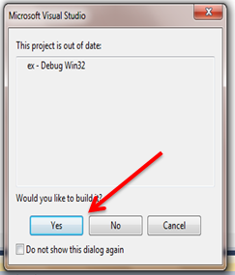

Slide 17
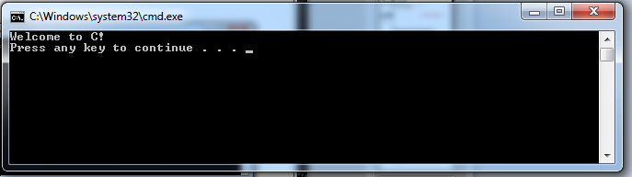

Slide 18
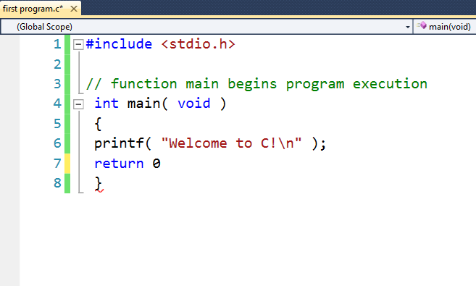
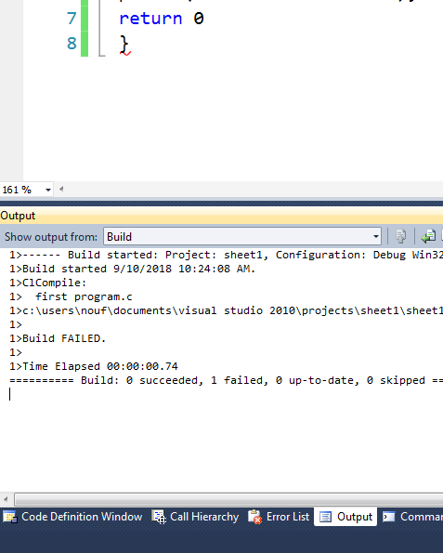
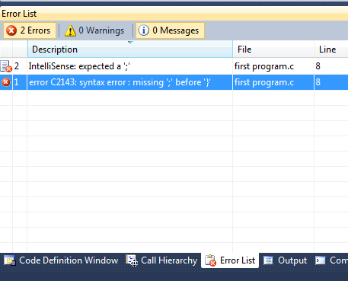
If your code contains syntax errors it will be underlined in red

Slide 19
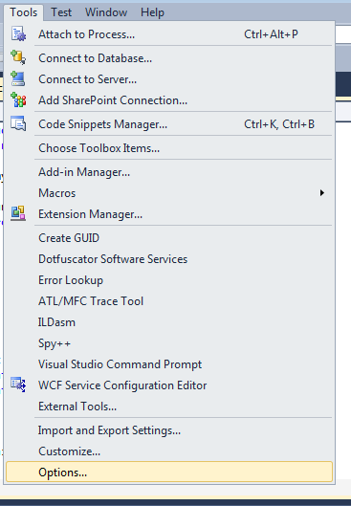
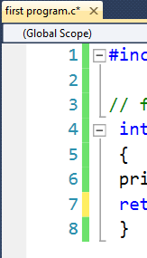
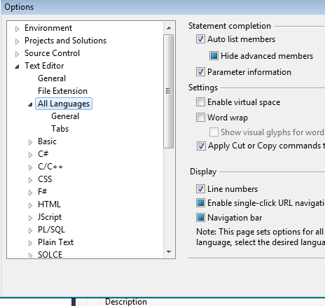
Display Line
Numbers
in the Editor

Slide 20
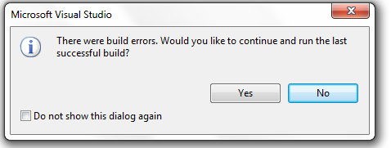
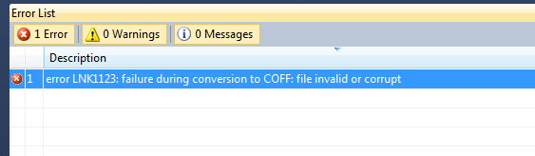
a common mistake you could face it when you build your program

Slide 21
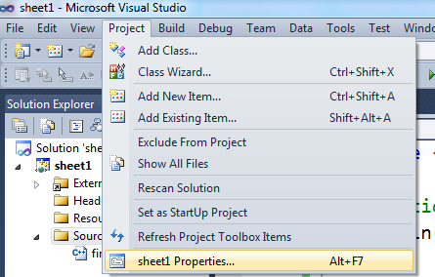
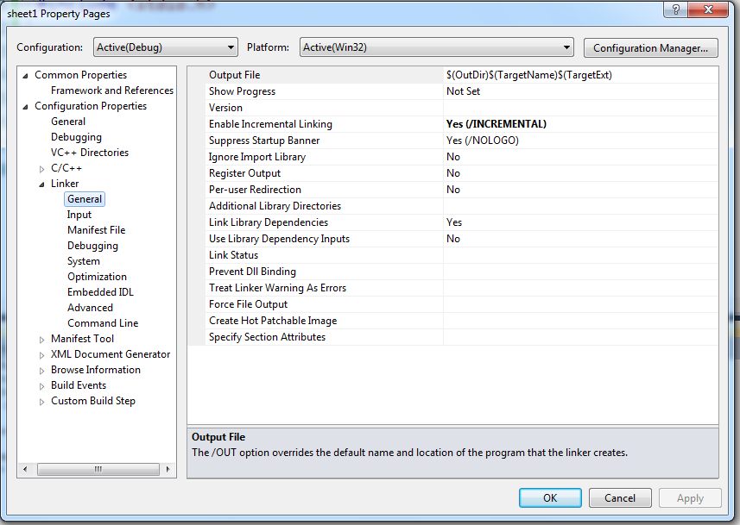
change the incremental linking value from yes to no or vice versa

