Slide 1
LINQ to DATABASE-2

Slide 2
12.7 Retrieving Data from Multiple Tables with LINQ
Creating the BooksDataContext
The code combines data from the three tables in the Books database and displays the relationships between the book titles and authors in three different ways.
It uses LINQ to SQL classes that have been created using the same steps as the previous example.
As in previous examples, the BooksDataContext object (Fig. 12.22, line 7) allows the program to interact with the database.

Slide 4
12.7 Retrieving Data from Multiple Tables with LINQ
Combining Author Names with the ISBNs of the Books They’ve Written
The first query (Fig. 12.23, lines 11–14) joins data from two tables and returns a list of author names and the ISBNs representing the books they’ve written, sorted by LastName then FirstName.
The query takes advantage of the properties that LINQ to SQL creates based on foreign-key relationships between the database’s tables.
These properties enable you to easily combine data from related rows in multiple tables.

Slide 5
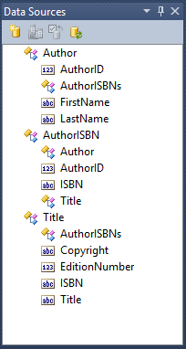
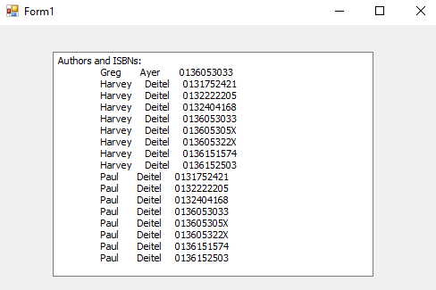
Equevalent query
Dim authorsAndISBNs =
From author In database.Authors
From book In database.AuthorISBNs
Order By author.LastName, author.FirstName
Where author.AuthorID = book.AuthorID
Select author.FirstName, author.LastName, book.ISBN

Slide 6
12.7 Retrieving Data from Multiple Tables with LINQ
The first From clause (line 11) gets one author from the Authors table.
The second From clause (line 12) uses the generated AuthorISBNs property of the Author class to get only the rows in the AuthorISBN table that link to the current author—that is, the ones that have the same AuthorID as the current author.

Slide 7
12.7 Retrieving Data from Multiple Tables with LINQ
The combined result of the two From clauses is a collection of all the authors and the ISBNs of the books they’ve authored.
The two From clauses introduce two range variables into the scope of this query—other clauses can access both range variables to combine data from multiple tables.
Line 14 combines the FirstName and LastName of an author from the Authors table with a corresponding ISBN from the AuthorISBNs table.

Slide 8
12.7 Retrieving Data from Multiple Tables with LINQ
Combining Author Names with the Titles of the Books They’ve Written
The second query (Fig. 12.24, lines 27–31) gives similar output, but uses the foreign-key relationships to go one step further and get the actual title of each book that an author wrote.
The first From clause (line 27) gets one title from the Titles table.

Slide 9
12.7 Retrieving Data from Multiple Tables with LINQ
The second From clause (line 28) uses the generated AuthorISBNs property of the Title class to get only the rows in the AuthorISBN table that link to the current title—that is, the ones that have the same ISBN as the current title.
Each of those book objects contains an Author property that represents the foreign-key relationship between the AuthorISBNs table and the Authors table.
This Author property gives us access to the names of the authors for the current book.

Slide 10
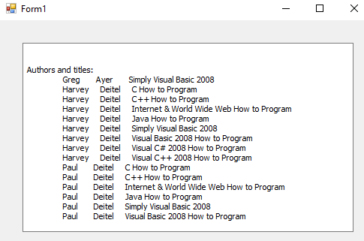

Slide 11
12.7 Retrieving Data from Multiple Tables with LINQ
Line 29 introduces the Let query operator, which allows you to declare a new variable in a LINQ query—usually to create a shorter name for an expression.
The variable can be accessed in later statements just like a range variable.
The author variable created in the Let clause refers to book.Author.
The Select clause (line 31) uses the author and title variables introduced earlier in the query to get the FirstName and LastName of each author from the Authors table and the Title of each book from the Titles table.

Slide 12
12.7 Retrieving Data from Multiple Tables with LINQ
Organizing Book Titles by Author
Most queries return results with data arranged in a relational-style table of rows and columns.
The last query (Fig. 12.25, lines 45–51) returns hierarchical results.
Each element in the results contains the name of an Author and a list of Titles that the author wrote.
The LINQ query does this by using a nested query in the Select clause.
The outer query iterates over the authors in the database.
The inner query takes a specific author and retrieves all titles that the author worked on.

Slide 13
12.7 Retrieving Data from Multiple Tables with LINQ
The Select clause (lines 47–51) creates an anonymous type with two properties:
The property Name (line 47) combines each author’s name, separating the first and last names by a space.
The property Titles (line 48) receives the result of the nested query, which returns the Title of each book written by the current author.
The nested For Each…Next statements (lines 57–67) use the properties of the anonymous type created by the query to output the hierarchical results.
The outer loop displays the author’s name and the inner loop displays the titles of all the books written by that author.

Slide 15
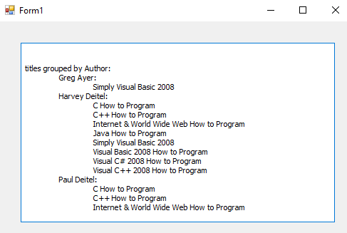

Slide 16
12.7 Retrieving Data from Multiple Tables with LINQ
Notice the duplicate Title identifier in the expression book.Title.Title used in the inner Order By and Select clauses (lines 50–51).
This is due to the database having a Title column in the Titles table, and is another example of following foreign-key relationships.
The range variable book iterates over the rows of the AuthorISBN for the current author’s books.
Each book’s Title property contains the corresponding row from the Titles table for that book.
The second Title in the expression returns the Title column (the title of the book) from that row of the Titles.

