Slide 1
GC211 Data Structures and Algorithms in Java

Slide 2
Who is running it?
Sara Almudauh
E-mail: moodawah@ksu.edu.sa
Website: http://fac.ksu.edu.sa/moodawah
Office : building 26 –Ground floor-Office 100

Slide 3
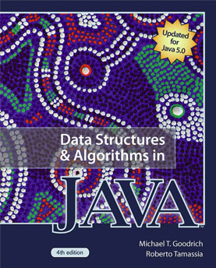
Resources
Handouts & lecture notes
Text Book : Data Structures and Algorithms in Java
(4th edition)
by
Michael T. Goodrich and Roberto Tamassia

Slide 4
Warnings
Attendance is very important !! You are allowed to miss 25% of your lectures only or you will not be allowed to enter the final

Slide 5
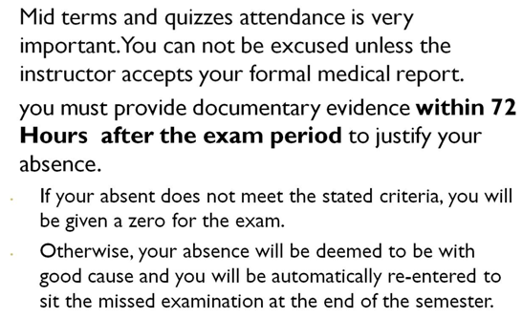
Warnings

Slide 6
Tutorial
Tutorial work is not group work !! Study before it.
Try out example code
Ask any questions

Slide 7
Mid Exams
2 in total
40% of Final Marks (20%) of each
No Mae-exams will be without a medical excuse or “something major”.
INDIVIDUAL

Slide 8
Final Exam
40% of total marks
Multiple Choice
Long Questions
Subject? Everything!
Standard Exam Format / conditions
End of Semester 1

Slide 9
Final Mark Calculation
Assessment task | Proportion of Final Assessment
Mid Exam 1 | 20%
Mid Exam 2 | 20%
Quizzes | 10%
Homework | 10%
Final Exam | 40%
Total | 100%

Slide 10
Good Luck !! ☺

