Slide 1
Global Edition Chapter 1 Marketing: Creating and Capturing Customer Value
Copyright ©2014 by Pearson Education

Slide 2
Creating and Capturing Customer Value
Topic Outline
What Is Marketing?
Understanding the Marketplace and Customer Needs
Designing a Customer-Driven Marketing Strategy
Preparing an Integrated Marketing Plan and Program
Building Customer Relationships
Capturing Value from Customers
The Changing Marketing Landscape
Copyright ©2014 by Pearson Education

Slide 3
What Is Marketing?
Marketing is
a process by which companies create value for customers
and build strong customer relationships
to capture value from customers in return.
Copyright ©2014 by Pearson Education

Slide 4
Marketing Process

Slide 5
Understanding the Marketplace and Customer Needs
Customer Needs, Wants, and Demands
Needs
Physical—food, clothing, warmth, safety
Social—belonging and affection
Individual—knowledge and self-expression
Wants
Demands
Form that needs take as they are shaped by culture and individual personality
Wants backed by buying power
States of deprivation
Copyright ©2014 by Pearson Education

Slide 6
Understanding the Marketplace and Customer Needs
Market offerings are some combination of products, services, information, or experiences offered to a market to satisfy a need or want
Marketing myopia is focusing only on existing wants and losing sight of underlying consumer needs
Copyright ©2014 by Pearson Education

Slide 7
Understanding the Marketplace and Customer Needs
Customer Value and Satisfaction
Expectations
Customers
Value and satisfaction
Marketers
Set the right level of expectations
Not too high or low
Copyright ©2014 by Pearson Education

Slide 8
Understanding the Marketplace and Customer Needs
Exchange
the act of obtaining a desired object from someone by offering something in return
Marketing actions try to create, maintain, grow exchange relationships.
Copyright ©2014 by Pearson Education

Slide 9
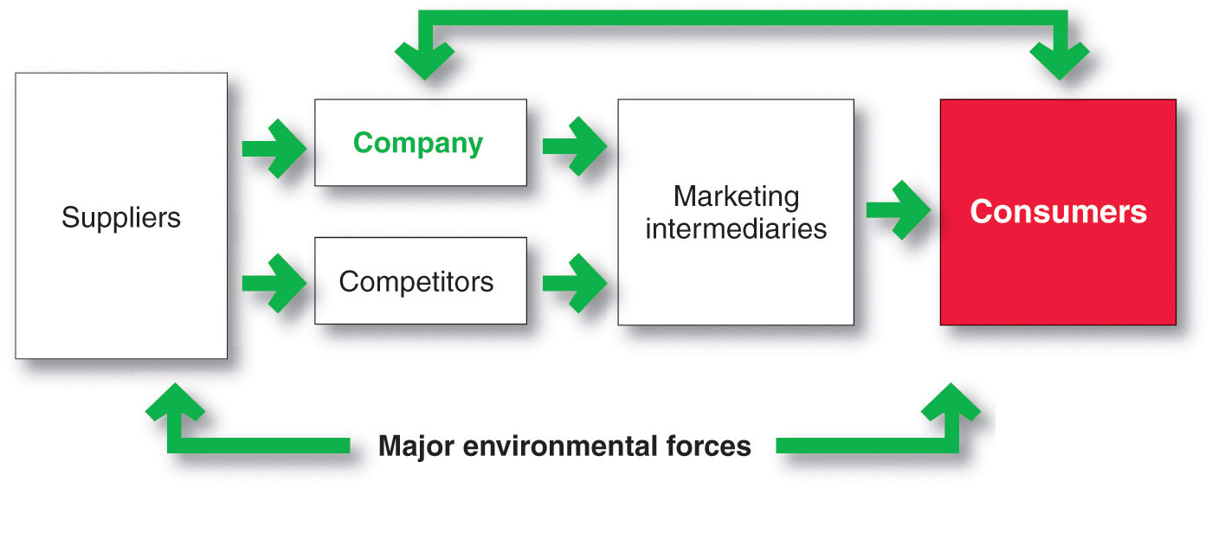
Understanding the Marketplace and Customer Needs
Markets are the set of actual and potential buyers of a product
Copyright ©2014 by Pearson Education

Slide 10
Designing a Customer-Driven Marketing Strategy
Marketing management is the art and science of choosing target markets and building profitable relationships with them
What customers will we serve?
How can we best serve these customers?
Copyright ©2014 by Pearson Education

Slide 11
Designing a Customer-Driven Marketing Strategy
Selecting Customers to Serve
Market segmentation refers to dividing the markets into segments of customers
Target marketing refers to which segments to go after
Copyright ©2014 by Pearson Education

Slide 12
Designing a Customer-Driven Marketing Strategy
Choosing a Value Proposition
Brand’s Value Proposition
Set of benefits or values
a company promises to deliver
to customers to satisfy their needs
Copyright ©2014 by Pearson Education

Slide 13
Designing a Customer-Driven Marketing Strategy
Marketing Management Orientations
Production concept
Product concept
Selling concept
Marketing concept
Societal concept
Copyright ©2014 by Pearson Education

Slide 14
Designing a Customer-Driven Marketing Strategy
Marketing Management Orientations
Production concept
consumers will favor products
that are available and highly affordable
Copyright ©2014 by Pearson Education

Slide 15
Designing a Customer-Driven Marketing Strategy
Marketing Management Orientations
Product concept
consumers favor products that offer
the most quality, performance, and features.
Focus is on continuous product improvements.
Copyright ©2014 by Pearson Education

Slide 16
Designing a Customer-Driven Marketing Strategy
Marketing Management Orientations
Selling concept
consumers will not buy enough of the firm’s products unless it undertakes a large scale selling and promotion effort
Copyright ©2014 by Pearson Education

Slide 17
Designing a Customer-Driven Marketing Strategy
Marketing Management Orientations
Marketing concept knowing the needs and wants of the target markets and delivering the desired satisfactions better than competitors do
Copyright ©2014 by Pearson Education

Slide 18
Designing a Customer-Driven Marketing Strategy
Marketing Management Orientations
Societal marketing
make good marketing decisions by considering consumers’ wants and long-term interests
company’s requirements
society’s long-run interests
Copyright ©2014 by Pearson Education

Slide 19
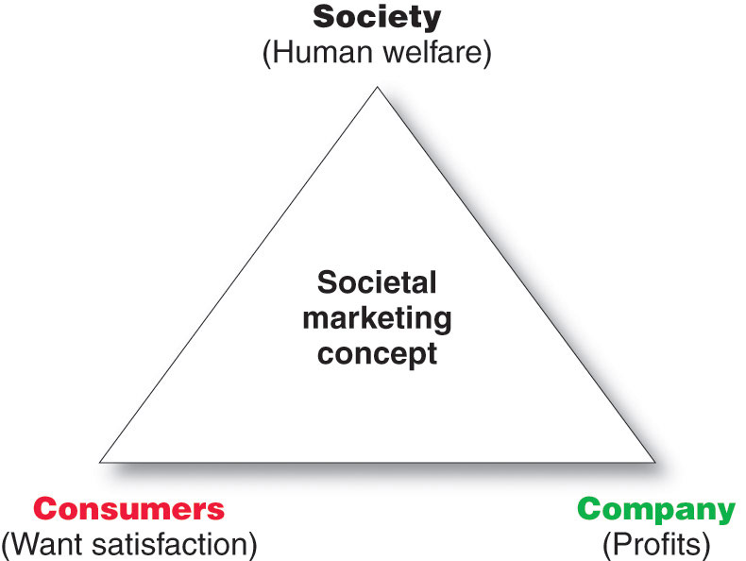
Designing a Customer-Driven Marketing Strategy
Copyright ©2014 by Pearson Education

Slide 20
Preparing an Integrated Marketing Plan and Program
The marketing mix: set of tools (four Ps) the firm uses to implement its marketing strategy. It includes product, price, promotion, and place.
Integrated marketing program: comprehensive plan that communicates and delivers the intended value to chosen customers.
Copyright ©2014 by Pearson Education

Slide 21
Building Customer Relationships
Customer Relationship Management (CRM)
The overall process of building and maintaining profitable customer relationships by delivering superior customer value and satisfaction
Copyright ©2014 by Pearson Education

Slide 22
Building Customer Relationships
Relationship Building Blocks:
Customer Value and Satisfaction
Customer- perceived value
Customer satisfaction
The difference between total customer value and total customer cost
The extent to which a product’s perceived performance matches a buyer’s expectations
Copyright ©2014 by Pearson Education

Slide 23
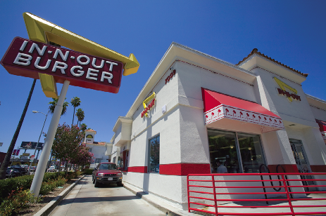
Building Customer Relationships
Customer Relationship Levels and Tools
Basic Relationships
Full Partnerships
Copyright ©2014 by Pearson Education

Slide 24
Building Customer Relationships
The Changing Nature of Customer Relationships
Relating with more carefully selected customers uses selective relationship management to target fewer, more profitable customers
Relating more deeply and interactively by incorporating more interactive two way relationships through blogs, Websites, online communities and social networks
Copyright ©2014 by Pearson Education

Slide 25
Building Customer Relationships
The Changing Nature of Customer Relationships
Customer-managed relationships
Customers, empowered by today’s new
digital technologies,
interact with companies and each other to shape
their relationships with brands.
Copyright ©2014 by Pearson Education

Slide 26
Building Customer Relationships
Partner relationship management involves working closely with partners in other company departments and outside the company to jointly bring greater value to customers
Copyright ©2014 by Pearson Education

Slide 27
Building Customer Relationships
Partner Relationship Management
Partners inside the company is every functional area interacting with customers
Electronically
Cross-functional teams
Copyright ©2014 by Pearson Education

Slide 28
Building Customer Relationships
Partner Relationship Management
Marketers connect with their suppliers, channel partners, and competitors by developing partnerships
Supply chain is a channel that stretches from raw materials to components to final products to final buyers
Copyright ©2014 by Pearson Education

Slide 29
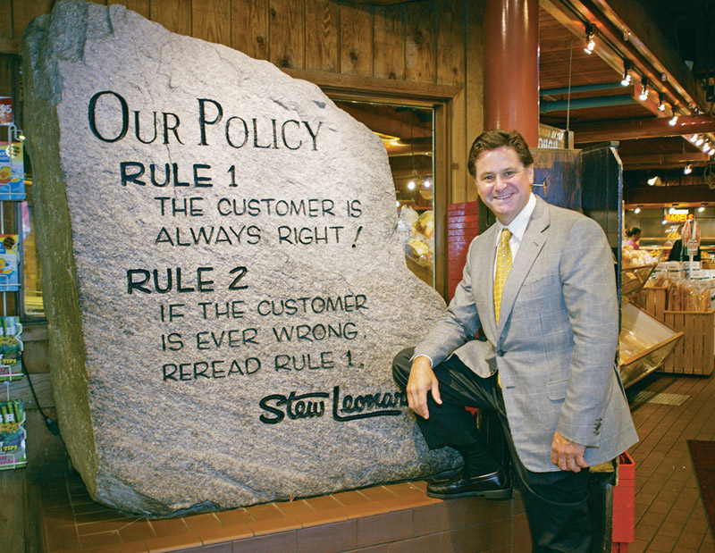
Capturing Value from Customers
Creating Customer Loyalty and Retention
Customer lifetime value is the value of the entire stream of purchases that the customer would make over a lifetime of patronage
Copyright ©2014 by Pearson Education
Notes:
.

Slide 30
Capturing Value from Customers
Growing Share of Customer
Share of customer
the portion of the customer’s purchasing
that a company gets in its product categories
Copyright ©2014 by Pearson Education

Slide 31
Capturing Value from Customers
Customer equity
the total combined customer lifetime values of all of the company’s customers
Copyright ©2014 by Pearson Education

Slide 32
Capturing Value from Customers
Building Customer Equity
Right relationships with the right customers involves treating customers as assets that need to be managed and maximized
Different types of customers require different relationship management strategies
Copyright ©2014 by Pearson Education

Slide 33
The Changing Marketing Landscape
Changing Economic Environment
New consumer frugality
Marketers focus on value for the customer
Copyright ©2014 by Pearson Education

Slide 34
The Changing Marketing Landscape Digital Age
Online marketing is the fastest-growing
Click- and- mortar companies evolved
Copyright ©2014 by Pearson Education

Slide 35
The Changing Marketing Landscape
Not-for-profit marketing growth
Rapid Globalization
Sustainable marketing
Copyright ©2014 by Pearson Education

Slide 36
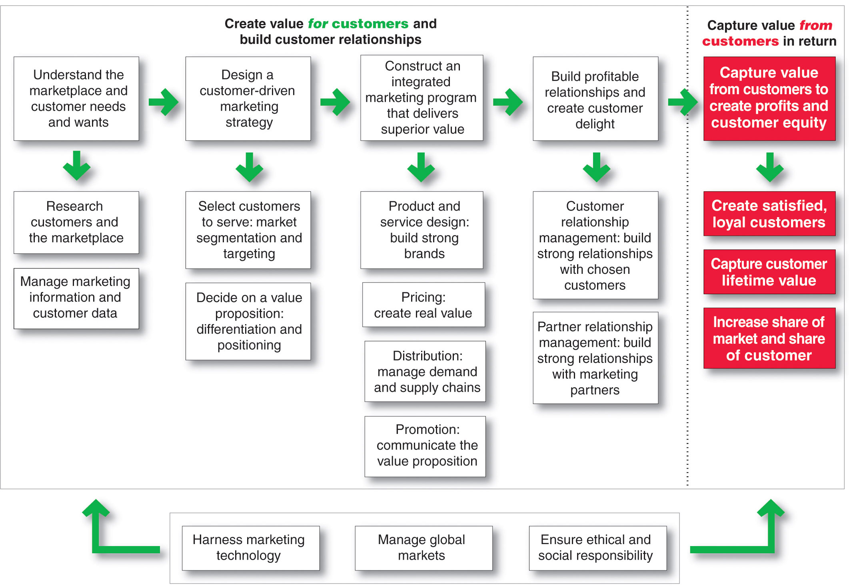
So, What Is Marketing? Pulling It All Together
Copyright ©2014 by Pearson Education

