Slide 1
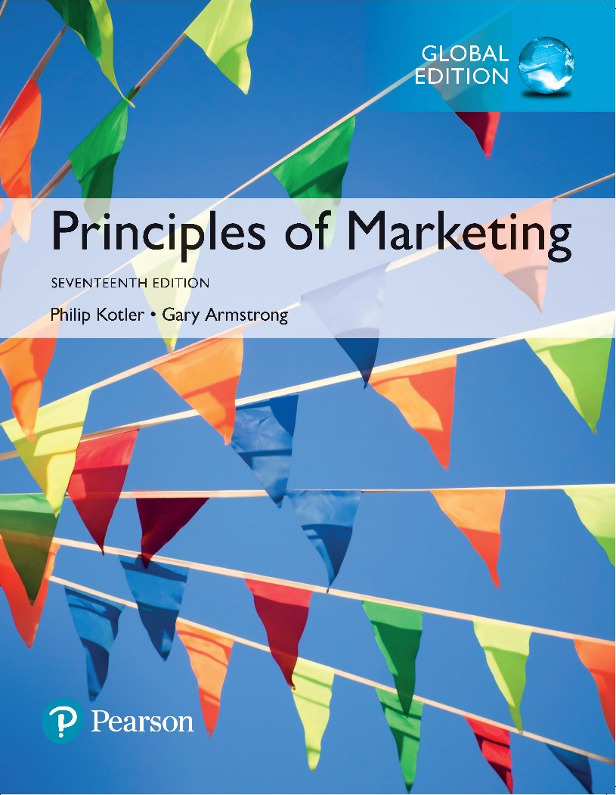
Principles of Marketing Seventeenth Edition
Chapter 20
Sustainable Marketing: Social Responsibility and Ethics
Copyright © 2018 Pearson Education Ltd. All Rights Reserved.

Slide 2
Learning Objectives
20-1 Define sustainable marketing and discuss its importance.
20-2 Identify the major social criticisms of marketing.
20-3 Define consumerism and environmentalism and explain how they affect marketing strategies.
20-4 Describe the principles of sustainable marketing.
20-5 Explain the role of ethics in marketing.

Slide 3
Learning Objective 1
Define sustainable marketing and discuss its importance.

Slide 4
Sustainable Marketing
Sustainable marketing is socially and environmentally responsible marketing that meets the present needs of consumers and businesses while also preserving or enhancing the ability of future generations to meet their needs.
Notes:
Sustainable marketing calls for meeting the present needs of consumers and businesses while preserving or enhancing the ability of future generations to meet their needs. Whereas the marketing concept recognizes that companies thrive by fulfilling the day-to-day needs of customers, sustainable marketing calls for socially and environmentally responsible actions that meet both the immediate and future needs of customers and the company. Truly sustainable marketing requires a smooth-functioning marketing system in which consumers, companies, public policy makers, and others work together to ensure responsible marketing actions.

Slide 5
Sustainable Marketing
Notes:
Sustainable marketing calls for socially and environmentally responsible actions that meet the present needs of consumers and businesses while also preserving or enhancing the ability of future generations to meet their needs. Figure 20.1 compares the sustainable marketing concept with marketing concepts we studied in earlier chapters.
The marketing concept recognizes that organizations thrive from day to day by determining the current needs and wants of target customers and fulfilling those needs and wants more effectively and efficiently than competitors do.
Figure 20.1 illustrates the following:
The societal marketing concept considers the future welfare of consumers.
The strategic planning concept considers future company needs.
The sustainable marketing concept considers both.
Sustainable marketing calls for socially and environmentally responsible actions that meet both the immediate and future needs of customers and the company.
Truly sustainable marketing requires a smooth-functioning marketing system in which consumers, companies, public policy makers, and others work together to ensure socially and environmentally responsible marketing actions. Unfortunately, however, the marketing system doesn’t always work smoothly. The following sections examine several sustainability questions:
What are the most frequent social criticisms of marketing?
What steps have private citizens taken to curb marketing ills?
What steps have legislators and government agencies taken to promote sustainable marketing?
What steps have enlightened companies taken to carry out socially responsible and ethical marketing that creates sustainable value for both individual customers and society as a whole?

Slide 6
Learning Objective 2
Identify the major social criticisms of marketing.
Notes:
Discussion Question
What is planned obsolescence? How do marketers respond to this criticism?
Learning Objective 2 Summary
Marketing’s impact on individual consumer welfare has been criticized for its high prices, deceptive practices, high-pressure selling, shoddy or unsafe products, planned obsolescence, and poor service to disadvantaged consumers. Marketing’s impact on society has been criticized for creating false wants and too much materialism, too few social goods, and cultural pollution. Critics have also denounced marketing’s impact on other businesses for harming competitors and reducing competition through acquisitions, practices that create barriers to entry, and unfair competitive marketing practices. Some of these concerns are justified; some are not.

Slide 7
Social Criticisms of Marketing
Marketing’s Impact on Individual Consumers
High prices
Deceptive practices
High-pressure selling
Shoddy, harmful, or unsafe products
Planned obsolescence
Poor service to disadvantaged consumers
Notes:
Marketing receives much criticism. Some of this criticism is justified; much is not. Social critics claim that certain marketing practices hurt individual consumers, society as a whole, and other business firms.
Consumers have many concerns about how well the American marketing system serves their interests. Surveys usually show that consumers hold mixed or even slightly unfavorable attitudes toward marketing practices. Consumer advocates, government agencies, and other critics have accused marketing of harming consumers through high prices, deceptive practices, high-pressure selling, shoddy or unsafe products, planned obsolescence, and poor service to disadvantaged consumers. Such questionable marketing practices are not sustainable in terms of long-term consumer or business welfare.

Slide 8
Social Criticisms of Marketing
Marketing’s Impact on Individual Consumers
High Prices:
Complaint:
Prices are too high due to high costs of:
distribution
advertising and promotion
excessive mark-ups
Response:
Intermediaries are important and offer value.
Advertising informs buyers of availability and merits of a brand.
Consumers don’t understand the cost of doing business.
Notes:
Many critics charge that the American marketing system causes prices to be higher than they would be under more “sensible” systems. Such high prices are hard to swallow, especially when the economy takes a downturn. Critics point to the following factors.
High costs of distribution: A long-standing charge is that greedy marketing channel members mark up prices beyond the value of their services. Critics charge that there are too many intermediaries, that intermediaries are inefficient, or that they provide unnecessary or duplicate services.
High advertising and promotion costs: Modern marketing is also accused of pushing up prices to finance heavy advertising and sales promotion. For example, a few dozen tablets of a heavily promoted brand of pain reliever sell for the same price as 100 tablets of less-promoted brands.
Excessive markups: Critics also charge that some companies mark up goods excessively. They point to the drug industry, where a pill costing five cents to make may cost the consumer $2 to buy. They point to the pricing tactics of funeral homes that prey on the confused emotions of bereaved relatives and the high charges for auto repairs and other services.

Slide 9
Social Criticisms of Marketing
Marketing’s Impact on Individual Consumers
Deceptive practices:
Complaint: Companies use deceptive practices that lead customers to believe they will get more value than they actually do. These practices fall into three categories.
Deceptive pricing
Deceptive promotion
Deceptive packaging
Notes:
Deceptive pricing includes practices such as falsely advertising “factory” or “wholesale” prices or a large price reduction from a phony high retail list price.
Deceptive promotion includes practices such as misrepresenting the product’s features or performance or luring customers to the store for a bargain that is out of stock.
Deceptive packaging includes exaggerating package contents through subtle design, using misleading labeling, or describing size in misleading terms.

Slide 10
Social Criticisms of Marketing
Marketing’s Impact on Individual Consumers
Deceptive practices:
Response: Support legislation to protect consumers from deceptive practices
Make lines clear—is it deception, alluring imagery, or puffery (exaggeration for effect)?
Products that are harmful
Products that provide little benefit
Products that are not made well
Notes:
Deceptive practices have led to legislation and other consumer protection actions. For example, in 1938 Congress enacted the Wheeler-Lea Act, which gave the Federal Trade Commission power to regulate “unfair or deceptive acts or practices.” The FTC has since published several guidelines listing deceptive practices. Despite regulations, however, some critics argue that deceptive claims are still common, even for well-known brands. For example, Skechers recently paid $50 million for violations related to its rocker-bottom Shape-ups and several consumer groups recently complained that Coca-Cola’s vitaminwater brand made deceptive and unsubstantiated—even “outlandish”— health claims for its products.
The toughest problem is defining what is “deceptive.” For instance, an advertiser’s claim that its chewing gum will “rock your world” isn’t intended to be taken literally. Instead, the advertiser might claim, it is “puffery”—innocent exaggeration for effect. However, others claim that puffery and alluring imagery can harm consumers in subtle ways.
Marketers argue that most companies avoid deceptive practices. Because such practices harm a company’s business in the long run, they simply aren’t sustainable. Profitable customer relationships are built on a foundation of value and trust. If consumers do not get what they expect, they will switch to more reliable products. In addition, consumers usually protect themselves from deception. Most consumers recognize a marketer’s selling intent and are careful when they buy, sometimes even to the point of not believing completely true product claims.

Slide 11
Social Criticisms of Marketing
Marketing’s Impact on Individual Consumers
High pressure selling:
Complaint:
Salespeople use high-pressure selling that persuades people to buy goods they had no intention of buying.
Response:
Most selling involves building long-term relationships with valued customers. High-pressure or deceptive selling can damage these relationships.
Notes:
It is often said that insurance, real estate, and used cars are sold, not bought. Salespeople are trained to deliver smooth, canned talks to entice purchases. They sell hard because sales contests promise big prizes to those who sell the most. Similarly, TV infomercial pitchmen use “yell and sell” presentations that create a sense of consumer urgency that only those with the strongest willpower can resist.
But in most cases, marketers have little to gain from high-pressure selling. Although such tactics may work in one-time selling situations for short-term gain, most selling involves building long-term relationships with valued customers. High-pressure or deceptive selling can seriously damage such relationships.

Slide 12
Social Criticisms of Marketing
Marketing’s Impact on Individual Consumers
Shoddy, harmful, and unsafe products
Complaint:
Products have poor quality, provide little benefit, and can be harmful.
Response:
Good marketers realize there is no value in marketing shoddy, harmful, or unsafe products.
Notes:
Another criticism concerns poor product quality or function. One complaint is that, too often, products and services are not made or do not perform well. A second complaint concerns product safety. Product safety has been a problem for several reasons, including company indifference, increased product complexity, and poor quality control. A third complaint is that many products deliver little benefit, or may even be harmful.
Is the soft drink industry being socially irresponsible by aggressively promoting overindulgence to ill-informed or unwary consumers? Or is it simply serving the wants of customers by offering products that ping consumer taste buds while letting consumers make their own consumption choices? Is it the industry’s job to police public tastes? As in many matters of social responsibility, what’s right and wrong may be a matter of opinion.
Most manufacturers want to produce quality goods. After all, the way a company deals with product quality and safety problems can damage or help its reputation. Companies selling poor-quality or unsafe products risk damaging conflicts with consumer groups and regulators. Unsafe products can result in product liability suits and large awards for damages. More fundamentally, consumers who are unhappy with a firm’s products may avoid future purchases and talk other consumers into doing the same. Thus, quality missteps are not consistent with sustainable marketing.

Slide 13
Social Criticisms of Marketing
Planned obsolescence
Complaint:
Producers cause their products to become obsolete.
Response:
Planned obsolescence is really the result of a competitive market.
Notes:
Critics also have charged that some companies practice planned obsolescence, causing their products to become obsolete before they actually should need replacement. They accuse some producers of using materials and components that will break, wear, rust, or rot sooner than they should. And if the products themselves don’t wear out fast enough, other companies are charged with perceived obsolescence—continually changing consumer concepts of acceptable styles to encourage more and earlier buying. An obvious example is constantly changing clothing fashions.
Still others are accused of introducing planned streams of new products that make older models obsolete, turning consumers into “serial replacers.” Critics claim that this occurs in the consumer electronics industries. If you’re like most people, you probably have a drawer full of yesterday’s hottest technological gadgets—from mobile phones and cameras to iPods and flash drives—now reduced to the status of fossils. It seems that anything more than a year or two old is hopelessly out of date.
Marketers respond that consumers like style changes; they get tired of the old goods and want a new look in fashion. Or they want the latest high-tech innovations, even if older models still work. Much of the so-called planned obsolescence is the working of the competitive and technological forces in a free society—forces that lead to ever-improving goods and services.

Slide 14
Social Criticisms of Marketing
Marketing’s Impact on Individual Consumers
Poor service to disadvantaged consumers
Complaint:
American marketers serve disadvantaged customers poorly.
Response:
Some marketers profitably target these customers and the FTC has taken action against marketers that do.
Notes:
Finally, the American marketing system has been accused of poorly serving disadvantaged consumers. For example, critics claim that the urban poor often have to shop in smaller stores that carry inferior goods and charge higher prices. The presence of large national chain stores in low-income neighborhoods would help to keep prices down. However, the critics accuse major chain retailers of redlining, drawing a red line around disadvantaged neighborhoods and avoiding placing stores there.
For example, the nation’s poor areas have 30 percent fewer supermarkets than affluent areas do. As a result, many low-income consumers find themselves in food deserts, which are awash with small markets offering frozen pizzas, Cheetos, Twinkies, and Cokes, but where fruits and vegetables or fresh fish or chicken are out of reach.
Clearly, better marketing systems must be built to service disadvantaged consumers. In fact, many marketers profitably target such consumers with legitimate goods and services that create real value. In cases in which marketers do not step in to fill the void, the government likely will. For example, the FTC has taken action against sellers who advertise false values, wrongfully deny services, or charge disadvantaged customers too much.

Slide 15
Social Criticisms of Marketing
Marketing’s Impact on Individual Consumers
False wants and too much materialism
Complaint:
The marketing system urges too much interest in material possessions.
Response:
People do have strong defenses against advertising and other marketing tools.
Notes:
The American marketing system has been accused of adding to several “evils” in American society at large, such as creating too much materialism, too few social goods, and a glut of cultural pollution.
Critics have charged that the marketing system urges too much interest in material possessions, and that America’s love affair with worldly possessions is not sustainable. Too often, people are judged by what they own rather than by who they are. The critics do not view this interest in material things as a natural state of mind but rather as a matter of false wants created by marketing. Marketers, they claim, stimulate people’s desires for goods and create materialistic models of the good life. Thus, marketers have created an endless cycle of mass consumption based on a distorted interpretation of the “American Dream.”
In this view, marketing’s purpose is to promote consumption, and the inevitable outcome of successful marketing is unsustainable overconsumption. Says one critic: “For most of us, our basic material needs are satisfied, so we seek in ever-growing consumption the satisfaction of wants, which consumption cannot possibly deliver.”
Marketers respond that such criticisms overstate the power of business to create needs. Marketers are most effective when they appeal to existing wants rather than when they attempt to create new ones. Furthermore, people seek information when making important purchases and often do not rely on single sources. Even minor purchases that may be affected by advertising messages lead to repeat purchases only if the product delivers the promised customer value. Finally, the high failure rate of new products shows that companies are not able to control demand.
On a deeper level, our wants and values are influenced not only by marketers but also by family, peer groups, religion, cultural background, and education. If Americans are highly materialistic, these values arose out of basic socialization processes that go much deeper than business and mass media could produce alone. Moreover, consumption patterns and attitudes are also subject to larger forces, such as the economy.

Slide 16
Social Criticisms of Marketing
Marketing’s Impact on Individual Consumers
Too few social goods
Complaint:
Businesses oversell private goods at the expense of public goods.
Response:
There needs to be a balance between private and public goods.
Notes:
As private goods increase, they require more public services that are usually not forthcoming. For example, an increase in automobile ownership (private goods) requires more highways, traffic control, parking spaces, and police services (public goods). The overselling of private goods results in social costs. For cars, some of the social costs include traffic congestion, gasoline shortages, and air pollution.
One option is to make producers bear the full social costs of their operations. For example, the government is requiring automobile manufacturers to build cars with more efficient engines and better pollution-control systems. Automakers will then raise their prices and if the price of some car models is too high, these models will disappear. Demand will then move to those producers that can support the sum of the private and social costs.
A second option is to make consumers pay the social costs. For example, many cities around the world are now charging congestion tolls in an effort to reduce traffic congestion.

Slide 17
Social Criticisms of Marketing
Marketing’s Impact on Individual Consumers
Cultural pollution
Complaint:
Marketing and advertising create cultural pollution.
Response:
Marketing and advertising are planned to reach only a target audience and consumers have alternatives.
Notes:
Critics charge the marketing system with creating cultural pollution. They feel our senses are being constantly assaulted by marketing and advertising. Commercials interrupt serious programs; pages of ads obscure magazines; billboards mar beautiful scenery; spam fills our e‑mailboxes. What’s more, the critics claim, these interruptions continually pollute people’s minds with messages of materialism, sex, power, or status. Some critics call for sweeping changes.
Marketers answer the charges of commercial noise with these arguments: First, they hope that their ads primarily reach the target audience. But because of mass-communication channels, some ads are bound to reach people who have no interest in the product and are therefore bored or annoyed. People who buy magazines they like or who opt in to e-mail or mobile marketing programs rarely complain about the ads because they involve products and services of interest.
Second, because of ads, many television, radio, and online sites are free to users. Ads also help keep down the costs of magazines and newspapers. Many people think commercials are a small price to pay for these benefits. In addition, consumers find many television commercials entertaining and seek them out; for example, ad viewership during the Super Bowl usually equals or exceeds game viewership. Finally, today’s consumers have alternatives and can choose not to expose themselves to advertising.

Slide 18
Social Criticisms of Marketing
Marketing’s Impact on Other Businesses
Acquisition of competitors
Barriers to entry
Unfair competitive marketing practices
Notes:
Critics also charge that a company’s marketing practices can harm other companies and reduce competition. They identify three problems: acquisitions of competitors, marketing practices that create barriers to entry, and unfair competitive marketing practices.
Critics claim that firms are harmed and competition reduced when companies expand by acquiring competitors rather than by developing their own new products. Acquisition is a complex subject. In some cases, acquisitions can be good for society. The acquiring company may gain economies of scale that lead to lower costs and lower prices. But acquisitions can also be harmful and, therefore, are closely regulated by the government.
Critics have also charged that marketing practices bar new companies from entering an industry. Large marketing companies can use patents and heavy promotion spending or tie up suppliers or dealers to keep out or drive out competitors. Those concerned with antitrust regulation recognize that some barriers are the natural result of the economic advantages of doing business on a large scale. Existing and new laws can challenge other barriers. For example, some critics have proposed a progressive tax on advertising spending to reduce the role of selling costs as a major barrier to entry.
Finally, some firms have, in fact, used unfair competitive marketing practices with the intention of hurting or destroying other firms. They may set their prices below costs, threaten to cut off business with suppliers, or discourage the buying of a competitor’s products. Although various laws work to prevent such predatory competition, it is often difficult to prove that the intent or action was really predatory. In recent years, Walmart has been accused of using predatory pricing in selected market areas to drive smaller, mom-and-pop retailers out of business.

Slide 19
Learning Objective 3
Define consumerism and environmentalism and explain how they affect marketing strategies.
Notes:
Discussion Question
What is consumerism? What rights do consumers have and why do some critics feel buyers need more protection?
Learning Objective 3 Summary
Concerns about the marketing system have led to citizen action movements. Consumerism is an organized social movement intended to strengthen the rights and power of consumers relative to sellers. Alert marketers view it as an opportunity to serve consumers better by providing more consumer information, education, and protection. Environmentalism is an organized social movement seeking to minimize the harm done to the environment and quality of life by marketing practices. Most companies are now accepting responsibility for doing no environmental harm. They are adopting policies of environmental sustainability—developing strategies that both sustain the environment and produce profits for the company. Both consumerism and environmentalism are important components of sustainable marketing.

Slide 20
Consumer Actions to Promote Sustainable Marketing
Consumerism is the organized movement of citizens and government agencies to improve the rights and power of buyers in relation to sellers.
Notes:
Consumerism is an organized movement of citizens and government agencies to improve the rights and power of buyers in relation to sellers. Traditional sellers’ rights include the following:
The right to introduce any product in any size and style, provided it is not hazardous to personal health or safety, or, if it is, to include proper warnings and controls
The right to charge any price for the product, provided no discrimination exists among similar kinds of buyers
The right to spend any amount to promote the product, provided it is not defined as unfair competition
The right to use any product message, provided it is not misleading or dishonest in content or execution
The right to use buying incentive programs, provided they are not unfair or misleading

Slide 21
Consumer Actions to Promote Sustainable Marketing
Consumerism
Traditional buyers’ rights include:
The right not to buy a product that is offered for sale
The right to expect the product to be safe
The right to expect the product to perform as claimed
Comparing these rights, many believe that the balance of power lies on the seller’s side.
Notes:
Buyers can refuse to buy, but critics feel that the buyer has too little information, education, and protection to make wise decisions when facing sophisticated sellers.

Slide 22
Consumer Actions to Promote Sustainable Marketing
Consumerism
Advocates call for:
The right to be well informed about important aspects of the product
The right to be protected against questionable products and marketing practices
The right to influence products and marketing practices in ways that will improve the “quality of life”
The right to consume now in a way that will preserve the world for future generations of consumers
Notes:
Consumer advocates call for the additional consumer rights shown on this slide.
Each proposed right has led to more specific proposals by consumerists and consumer protection actions by the government. For example, the right to be informed includes the right to know the true interest on a loan (truth in lending), the true cost per unit of a brand (unit pricing), the ingredients in a product (ingredient labeling), the nutritional value of foods (nutritional labeling), product freshness (open dating), and the true benefits of a product (truth in advertising).
Proposals related to consumer protection include strengthening consumer rights in cases of business fraud and financial protection, requiring greater product safety, ensuring information privacy, and giving more power to government agencies.
Proposals relating to quality of life include controlling the ingredients that go into certain products and packaging and reducing the level of advertising “noise.”
Proposals for preserving the world for future consumption include promoting the use of sustainable ingredients, recycling and reducing solid wastes, and managing energy consumption.
Sustainable marketing applies not only to businesses and governments but also to consumers. Consumers have not only the right but also the responsibility to protect themselves instead of leaving this function to the government or someone else.

Slide 23
Consumer Actions to Promote Sustainable Marketing
Environmentalism
Environmentalism is an organized movement of concerned citizens, businesses, and government agencies to protect and improve people’s living environment.
Environmental sustainability involves earning profits while helping to save the planet.
Notes:
Whereas consumerists consider whether the marketing system is efficiently serving consumer wants, environmentalists are concerned with marketing’s effects on the environment and the environmental costs of serving consumer needs and wants.
Environmentalists are not against marketing and consumption; they simply want people and organizations to operate with more care for the environment. “The road to well-being doesn’t go via reduced consumption,” says sustainability advocate and Unilever CEO Paul Polman. “It has to be done via more responsible consumption.”
However, the marketing system’s goal, environmentalists assert, should not be to maximize consumption, consumer choice, or consumer satisfaction but rather to maximize life quality. Life quality means not only the quantity and quality of consumer goods and services but also the quality of the environment, now and for future generations.
Companies are now adopting policies of environmental sustainability and are taking action not because someone is forcing them to or to reap short-run profits but because it’s the right thing to do—because it’s for their customers, the company’s well-being, and the planet’s environmental future.

Slide 24
Consumer Actions to Promote Sustainable Marketing
Environmentalism
Environmental sustainability includes:
Pollution prevention involves not just cleaning up waste but also eliminating or minimizing waste before it is created.
Product stewardship involves minimizing the pollution from production and all environmental impact throughout the full product life cycle.
Notes:
Figure 20.2 shows a grid that companies can use to gauge their progress toward environmental sustainability. It includes both internal and external greening activities that will pay off for the firm and environment in the short run, and beyond greening activities that will pay off in the longer term.
Pollution prevention means eliminating or minimizing waste before it is created. Companies emphasizing prevention have responded with internal green marketing programs— designing and developing ecologically safer products, recyclable and biodegradable packaging, better pollution controls, and more energy-efficient operations.
At the next level, companies can practice product stewardship—minimizing not only pollution from production and product design but also all environmental impacts throughout the full product life cycle, while at the same time reducing costs.
Many companies are adopting design for environment (DFE) and cradle-to-cradle practices. This involves thinking ahead to design products that are easier to recover, reuse, recycle, or safely return to nature after usage, thus becoming part of the ecological cycle. Design for environment and cradle-to-cradle practices not only help to sustain the environment, but they can also be highly profitable for the company.

Slide 25
Consumer Actions to Promote Sustainable Marketing
Environmentalism
Environmental sustainability includes:
New clean technologies involve looking ahead and planning new technologies for competitive advantage.
Sustainability vision is a guide to the future that shows the company that the company’s products, processes, and policies must evolve and what is needed to get there.
Notes:
Today’s greening activities focus on improving what companies already do to protect the environment. The beyond greening activities identified in Figure 20.2 look to the future. First, internally, companies can plan for new clean technology.
For example, by 2020, Coca-Cola has committed to reclaiming and recycling the equivalent of all the packaging it uses around the world. It has also pledged to dramatically reduce its overall environmental footprint. To accomplish these goals, the company invests heavily in new clean technologies that address a host of environmental issues, such as recycling, resource usage, distribution, and even outdoor advertising.
Companies can develop a sustainability vision, which serves as a guide to the future. It shows how the company’s products and services, processes, and policies must evolve and what new technologies must be developed to get there. This vision of sustainability provides a framework for pollution control, product stewardship, and new environmental technology for the company and others to follow.
Most companies today focus on the upper-left quadrant of the grid in Figure 20.2, investing most heavily in pollution prevention. Some forward-looking companies practice product stewardship and are developing new environmental technologies. However, emphasizing only one or two quadrants in the environmental sustainability grid can be shortsighted.

Slide 26
Consumer Actions to Promote Sustainable Marketing

Slide 27
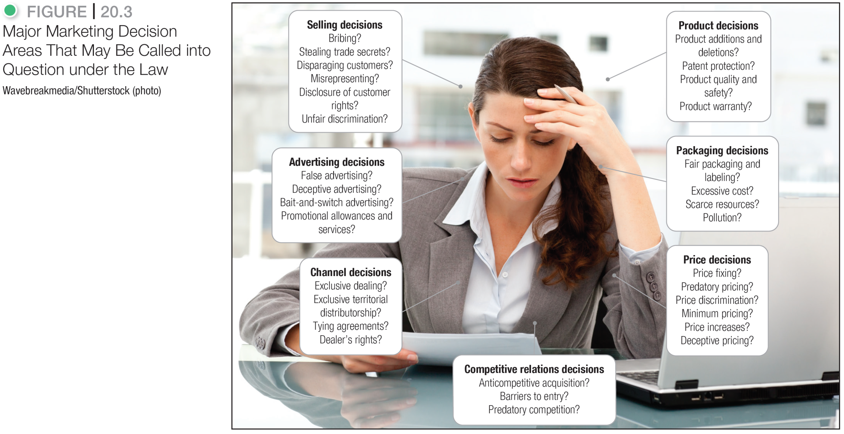
Consumer Actions to Promote Sustainable Marketing
Notes:
Citizen concerns about marketing practices will usually lead to public attention and legislative proposals. Many of the laws that affect marketing were identified in Chapter 3. The task is to translate these laws into a language that marketing executives understand as they make decisions about competitive relations, products, price, promotion, and distribution channels. Figure 20.3 illustrates the major legal issues facing marketing management.
In the end, marketers themselves must take responsibility for sustainable marketing. That means operating in a responsible and ethical way to bring both immediate and future value to customers.

Slide 28
Learning Objective 4
Describe the principles of sustainable marketing.

Slide 29
Business Actions Toward Sustainable Marketing
Sustainable Marketing Principles
Consumer-Oriented Marketing
Customer-Value Marketing
Innovative Marketing
Sense-of-mission Marketing
Societal Marketing
Notes:
At first, many companies opposed consumerism, environmentalism, and other elements of sustainable marketing. They thought the criticisms were either unfair or unimportant. But by now, most companies have grown to embrace sustainability principles as a way to create both immediate and future customer value and strengthen customer relationships.
Under the sustainable marketing concept, a company’s marketing should support the best long-run performance of the marketing system. It should be guided by five sustainable marketing principles: consumer-oriented marketing, customer-value marketing, innovative marketing, sense-of-mission marketing, and societal marketing.

Slide 30
Business Actions Toward Sustainable Marketing
Consumer-Oriented Marketing
View marketing activities from the consumer's point of view
Deliver superior value
Notes:
Consumer-oriented marketing means that the company should view and organize its marketing activities from the consumer’s point of view. It should work hard to sense, serve, and satisfy the needs of a defined group of customers—both now and in the future. The good marketing companies that we’ve discussed throughout this text have had this in common: an all-consuming passion for delivering superior value to carefully chosen customers. Only by seeing the world through its customers’ eyes can the company build sustainable and profitable customer relationships.

Slide 31
Business Actions Toward Sustainable Marketing
Consumer-Value Marketing
Invest in customer-value-building marketing
Create value FOR customers
Notes:
According to the principle of customer-value marketing, the company should put most of its resources into customer-value-building marketing investments. Many things marketers do—one-shot sales promotions, cosmetic product changes, direct-response advertising—may raise sales in the short run but add less value than would actual improvements in the product’s quality, features, or convenience. Enlightened marketing calls for building long-run consumer loyalty and relationships by continually improving the value consumers receive from the firm’s market offering. By creating value for consumers, the company can capture value from consumers in return.

Slide 32
Business Actions Toward Sustainable Marketing
Innovative Marketing
Company seeks real product and marketing improvements
Notes:
The principle of innovative marketing requires that the company continuously seek real product and marketing improvements. The company that overlooks new and better ways to do things will eventually lose customers to another company that has found a better way. As we discussed in Chapter 9, an excellent example of an innovative marketer is Samsung:
Not too many years ago, Samsung was a copycat consumer electronics brand you bought if you couldn’t afford Sony. But today, the brand holds a high-end, cutting-edge aura. In 1996, Samsung Electronics turned its back on making cheap knock-offs and set out to overtake rival Sony, not just in size but also in style and innovation.
Every new product had to pass the “Wow!” test: if it didn’t get a “Wow!” reaction during market testing, it went straight back to the design studio. Thanks to its strategy of innovation, the company quickly surpassed its lofty goals—and more. Samsung Electronics is now, by far, the world’s largest consumer electronics company, with 50 percent greater sales than Sony

Slide 33
Business Actions Toward Sustainable Marketing
Sense-of-Mission Marketing
Define mission in broad social terms rather than narrow product terms.
Notes:
According to the concept of sense-of-mission marketing, when a company defines a social mission, employees feel better about their work and have a clearer sense of direction. Brands linked with broader missions can serve the best long-run interests of both the brand and consumers.
For example, the PEDIGREE Brand makes good dog food, but that’s not what the brand is really all about. Instead, the brand came up with the tagline “Dogs rule.” The tagline “is the perfect encapsulation of everything we stand for,” says a PEDIGREE marketer. “Everything that we do is because we love dogs, because dogs rule. It’s just so simple.” This mission-focused positioning drives everything the brand does—internally and externally.
PUMA states its mission more broadly, as one of producing customer-satisfying products while also contributing to a sustainable future:
“At PUMA, we believe that our position as the creative leader in sport lifestyles gives us the opportunity and the responsibility to contribute to a better world for the generations to come. A better world in our vision—PUMAVision—would be safer, more peaceful, and more creative than the world we know today....”
However, having a double bottom line of values and profits isn’t easy. Over the years, companies such as Patagonia, Ben & Jerry’s, The Body Shop, and Burt’s Bees—all known and respected for putting “principles before profits”—have at times struggled with less-than-stellar financial returns. In recent years, however, a new generation of social entrepreneurs has emerged, well-trained business managers who know that to do good, they must first do well in terms of profitable business operations.

Slide 34
Business Actions Toward Sustainable Marketing
Societal Marketing
Notes:
Following the principle of societal marketing, a company makes marketing decisions by considering consumers’ wants, the company’s requirements, consumers’ long-run interests, and society’s long-run interests. Companies should be aware that neglecting consumer and societal long-run interests is a disservice to consumers and society. Alert companies view societal problems as opportunities.
Sustainable marketing calls for products that are not only pleasing but also beneficial. The difference is shown in Figure 20.4. Products can be classified according to their degree of immediate consumer satisfaction and long-run consumer benefit.
Deficient products, such as bad-tasting and ineffective medicine, have neither immediate appeal nor long-run benefits.
Pleasing products give high immediate satisfaction but may hurt consumers in the long run. Examples include cigarettes and junk food.
Salutary products have low immediate appeal but may benefit consumers in the long run; for instance, bicycle helmets or some insurance products.
Desirable products give both high immediate satisfaction and high long-run benefits, such as a tasty and nutritious breakfast food.
Companies should try to turn all of their products into desirable products. The challenge posed by pleasing products is that they sell very well but may end up hurting the consumer. The product opportunity, therefore, is to add long-run benefits without reducing the product’s pleasing qualities. The challenge posed by salutary products is to add some pleasing qualities so that they will become more desirable in consumers’ minds.

Slide 35
Learning Objective 5
Explain the role of ethics in marketing.
Notes:
Discussion Questions
What is the sustainable marketing concept? How should companies gauge their progress toward achieving it?
Learning Objective 5 Summary
Increasingly, companies are responding to the need to provide company policies and guidelines to help their managers deal with questions of marketing ethics. Of course, even the best guidelines cannot resolve all the difficult ethical decisions that individuals and firms must make. But there are some principles from which marketers can choose. One principle states that the free market and the legal system should decide such issues. A second and more enlightened principle puts responsibility not on the system but in the hands of individual companies and managers. Each firm and marketing manager must work out a philosophy of socially responsible and ethical behavior. Under the sustainable marketing concept, managers must look beyond what is legal and allowable and develop standards based on personal integrity, corporate conscience, and long-term consumer welfare.

Slide 36
Marketing Ethics and the Sustainable Company
Marketing Ethics
Corporate marketing ethics policies are broad guidelines that everyone in the organization must follow that cover distributor relations, advertising standards, customer service, pricing, product development, and general ethical standards.
Notes:
Good ethics are a cornerstone of sustainable marketing. In the long run, unethical marketing harms customers and society as a whole. Further, it eventually damages a company’s reputation and effectiveness, jeopardizing its very survival. Thus, the sustainable marketing goals of long-term consumer and business welfare can be achieved only through ethical marketing conduct.
Conscientious marketers face many moral dilemmas. The best thing to do is often unclear. Because not all managers have fine moral sensitivity, companies need to develop corporate marketing ethics policies.

Slide 37
Marketing Ethics and the Sustainable Company
Marketing Ethics
Who should guide companies?
The free market and the legal system?
Individual companies and managers?
Notes:
The finest guidelines cannot resolve all the difficult ethical situations the marketer faces. If marketers choose immediate sales-producing actions in all these cases, their marketing behavior might well be described as immoral or even amoral. If they refuse to go along with any of the actions, they might be ineffective as marketing managers and unhappy because of the constant moral tension.
Managers need a set of principles that will help them figure out the moral importance of each situation and decide how far they can go in good conscience.
But what principle should guide companies and marketing managers on issues of ethics and social responsibility? One philosophy is that the free market and the legal system should decide such issues. Under this principle, companies and their managers are not responsible for making moral judgments. Companies can in good conscience do whatever the market and legal systems allow.
A second philosophy puts responsibility not on the system but in the hands of individual companies and managers. This more enlightened philosophy suggests that a company should have a social conscience. Companies and managers should apply high standards of ethics and morality when making corporate decisions, regardless of “what the system allows
Each company and marketing manager must work out a philosophy of socially responsible and ethical behavior. Under the societal marketing concept, each manager must look beyond what is legal and allowed and develop standards based on personal integrity, corporate conscience, and long-run consumer welfare.

Slide 38
Marketing Ethics and the Sustainable Company
The Sustainable Company
At the foundation of marketing is the belief that companies that fulfill the needs and wants of customers will thrive.
Companies that fail to meet customer needs, or that intentionally or unintentionally harm customers, others in society, or future generations will decline.
Notes:
The finest guidelines cannot resolve all the difficult ethical situations the marketer faces. If marketers choose immediate sales-producing actions in all these cases, their marketing behavior might well be described as immoral or even amoral. If they refuse to go along with any of the actions, they might be ineffective as marketing managers and unhappy because of the constant moral tension.
Managers need a set of principles that will help them figure out the moral importance of each situation and decide how far they can go in good conscience.
But what principle should guide companies and marketing managers on issues of ethics and social responsibility? One philosophy is that the free market and the legal system should decide such issues. Under this principle, companies and their managers are not responsible for making moral judgments. Companies can in good conscience do whatever the market and legal systems allow.
A second philosophy puts responsibility not on the system but in the hands of individual companies and managers. This more enlightened philosophy suggests that a company should have a social conscience. Companies and managers should apply high standards of ethics and morality when making corporate decisions, regardless of “what the system allows
Each company and marketing manager must work out a philosophy of socially responsible and ethical behavior. Under the societal marketing concept, each manager must look beyond what is legal and allowed and develop standards based on personal integrity, corporate conscience, and long-run consumer welfare.

Slide 39
Marketing Ethics and the Sustainable Company
The Sustainable Company
A sustainable company goes beyond caring for the needs of today’s customers and has concern for tomorrow’s customers and the broader world.
Notes:
At the foundation of marketing is the belief that companies that fulfill the needs and wants of customers will thrive. Companies that fail to meet customer needs or that intentionally or unintentionally harm customers, others in society, or future generations will decline.
Says one observer, “Sustainability is an emerging business megatrend, like electrification and mass production, that will profoundly affect companies’ competitiveness and even their survival.” Says another, “increasingly, companies and leaders will be assessed not only on immediate results but also on...the ultimate effects their actions have on societal wellbeing.”
Sustainable companies are those that create value for customers through socially, environmentally, and ethically responsible actions.
Sustainable marketing provides the context in which companies can build profitable customer relationships by creating value for customers in order to capture value from customers in return—now and in the future.

