Slide 1
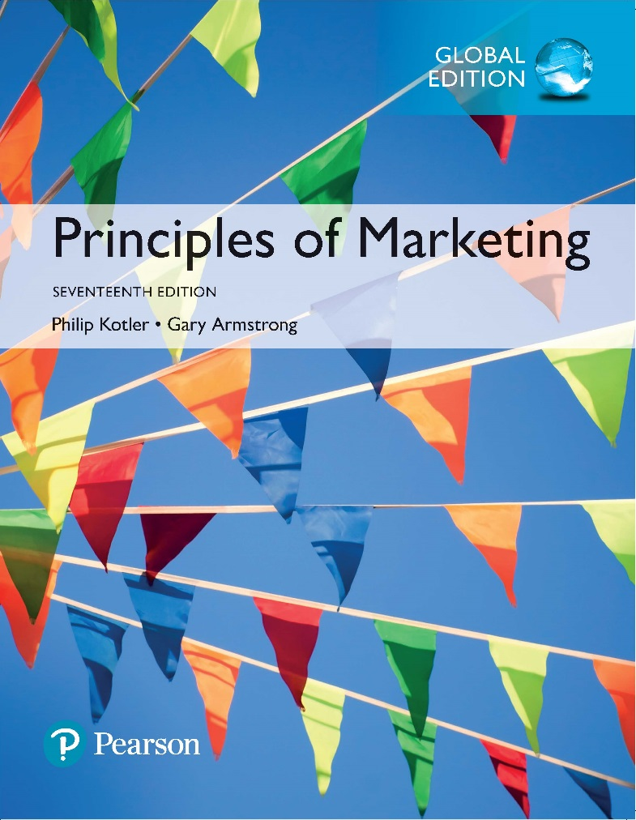
Principles of Marketing Seventeenth Edition
Chapter 17
Digital, Online, Social Media, and Mobile Marketing
Copyright © 2018 Pearson Education Ltd. All Rights Reserved.

Slide 2
Learning Objectives
17-1 Define direct and digital marketing and discuss their rapid growth and benefits to customers and companies.
17-2 Identify and discuss the major forms of direct and digital marketing.
17-3 Explain how companies have responded to the internet and the digital age with various online marketing strategies.
17-4 Discuss how companies use social media and mobile marketing to engage consumers and create brand community.
17-5 Identify and discuss the traditional direct marketing forms and overview public policy and ethical issues presented by direct marketing.

Slide 3
Learning Objective 1
Define direct and digital marketing and discuss their rapid growth and benefits to customers and companies.
Notes:
Discussion Question
Discuss how the various forms of direct digital and social media marketing benefit customers and companies.
Learning Objective 1 Summary
Direct and digital marketing involve engaging directly with carefully targeted individual consumers and customer communities to both obtain an immediate response and build lasting customer relationships. Companies use direct marketing to tailor their offers and content to the needs and interests of narrowly defined segments or individual buyers to build direct customer engagement, brand community, and sales. Today, spurred by the surge in Internet usage and buying, and by rapid advances digital technologies—from smartphones, tablets, and other digital devices to the spate of online social and mobile media—direct marketing has undergone a dramatic transformation.in marketing has undergone a dramatic transformation.
For buyers, direct and digital marketing are convenient, easy to use, and private. They give buyers anywhere, anytime access to an almost unlimited assortment of products and buying information. Direct marketing is also immediate and interactive, allowing buyers to create exactly the configuration of information, products, or services they desire and then order them on the spot. Finally, for consumers who want it, digital marketing through online, mobile, and social media provides a sense of brand engagement and community—a place to share brand information and experiences with other brand fans. For sellers, direct and digital marketing are powerful tools for building customer engagement and close, personalized, interactive customer relationships. They also offer greater flexibility, letting marketers make ongoing adjustments to prices and programs, or make immediate, timely, and personal announcements and offers.

Slide 4
Direct and Digital Marketing
Direct and digital marketing involve engaging directly with carefully targeted individual consumers and customer communities to both obtain an immediate response and build lasting customer relationships.
Notes:
Companies use direct marketing to tailor their offers and content to the needs and interests of narrowly defined segments or individual buyers. In this way, they build customer engagement, brand community, and sales.
For example, GEICO interacts directly with customers—by telephone, through its Web site or phone app, or on its Facebook, Twitter, and YouTube pages—to build individual brand relationships, give insurance quotes, sell policies, or service customer accounts.

Slide 5
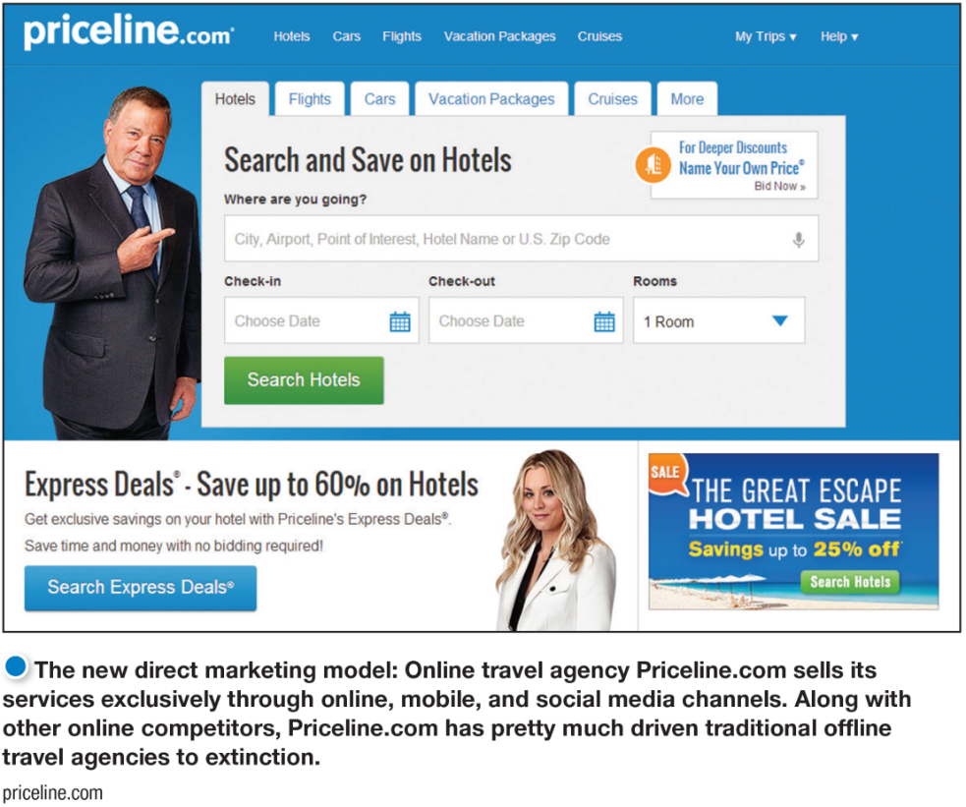
Direct and Digital Marketing
The New Direct Marketing Model
For many companies today, direct and digital marketing constitute a complete model for doing business.
Notes:
The new direct marketing model: Online travel agency Priceline.com sells its services exclusively through online, mobile, and social media channels. Along with other online competitors, Priceline.com has pretty much driven traditional offline travel agencies into extinction.
Spurred by the surge in Internet usage and buying, and by rapid advances in digital technologies direct marketing has undergone a dramatic transformation. In previous chapters we have discussed direct marketing as direct distribution—as marketing channels that contain no intermediaries. We also included direct and digital marketing elements of the promotion mix—as an approach for engaging consumers directly and creating brand community. In actuality, direct marketing is both of these things and much more.
Most companies still use direct marketing as a supplementary channel or medium, but for many companies today, direct and digital marketing are more than just supplementary channels or advertising media— they constitute a complete model for doing business. Firms employing this direct model use it as the only approach. Companies such as Facebook, Amazon, Google, eBay, Netflix, GEICO, and Priceline.com have successfully built their entire approach to the marketplace around direct and digital marketing.

Slide 6
Direct and Digital Marketing
Rapid Growth of Direct and Digital Marketing
Direct and digital marketing have become the fastest-growing form of marketing.
Direct marketing continues to become more Internet-based, and digital direct marketing is claiming a surging share of marketing spending and sales.

Slide 7
Direct and Digital Marketing
Benefits of Direct and Digital Marketing—Buyers
Convenience
Ready access to many products
Access to comparative information about companies, products, and competitors
Interactive and immediate
Notes:
Discussion Question
When do you find direct mail to be a benefit as a consumer?
Students might mention favorite retailers that email them coupons every week or coupons they get in the mail.
For buyers, direct and digital marketing are convenient, easy, and private. They give buyers anywhere, anytime access to an almost unlimited assortment of goods and a wealth of
Product and buying information.
Digital marketing through online, mobile, and social media provides a sense of brand engagement and community—a place to share brand information and experiences
with other brand fans.

Slide 8
Direct and Digital Marketing
Benefits of Direct and Digital Marketing—Sellers
Tool to build customer relationships
Low-cost, efficient, fast alternative to reach markets
Flexible
Access to buyers not reachable through other channels
Notes:
Direct and digital marketing lets marketers make ongoing adjustments to prices and programs, or create immediate, timely, and personal engagement and offers. For example, last Fourth of July, home improvement retailer Lowe’s issued a stop motion “Happy 4th of July” Vine video showing tools exploding into fireworks, a nice supplement to its ongoing Vine series of do-it-yourself videos.
General Electric celebrated last year’s National Inventors’ Day by asking its Twitter followers for offbeat invention ideas, then created illustrations of the best ones, such as a “hand-holding robot.”
Especially in today’s digital environment, direct marketing provides opportunities for real-time marketing that links brands to important moments and trending events in customers’ lives (see Real Marketing 17.1). It is a powerful tool for moving customers through the buying process and for building customer engagement, community, and personalized relationships.

Slide 9
Learning Objective 2
Identify and discuss the major forms of direct and digital marketing.
Notes:
Discussion Question
List and briefly describe the various forms of direct and digital marketing.
Learning Objective 2 Summary
The main forms of direct and digital marketing include traditional direct marketing tools and the new direct digital marketing tools.
Traditional direct approaches are face-to-face personal selling, direct-mail marketing, catalog marketing, telemarketing, DRTV marketing, and kiosk marketing. These traditional tools are still heavily used and very important in most firm’s direct marketing efforts.
In recent years, however, a dazzling new set of direct digital marketing tools has burst onto the marketing scene, including online marketing (Web sites, online ads and promotions, e-mail, online videos, and blogs), social media marketing, and mobile marketing. The chapter first discusses the fast-growing new digital direct marketing tools and then examines the traditional tools.

Slide 10
Forms of Direct and Digital Marketing
Notes:
The major forms of direct marketing—as shown in Figure 17.1 above —are digital and social media marketing, and traditional direct marketing.
Traditional direct marketing tools include face-to-face selling, direct-mail marketing, catalog marketing, telemarketing, direct-response television marketing, and kiosk marketing.
In recent years, however, a dazzling new set of digital direct marketing tools has burst onto the marketing scene, including online marketing (Web sites, online ads and promotions, e-mail, online videos, and blogs), social media marketing, and mobile marketing.

Slide 11
Learning Objective 3
Explain how companies have responded to the internet and the digital age with various online marketing strategies.
Notes:
Discussion Question
Compare and contrast a marketing Web site and a branded community Web site.
Learning Objective 3 Summary
The Internet and digital age have fundamentally changed customers’ notions of convenience, speed, price, product information, service, and brand interactions. As a result, they have given marketers a whole new way to create customer value, engage customers, and build customer relationships. The Internet now influences a staggering 50 percent of total sales—including sales transacted online plus those made in stores but encouraged by online research. To reach this burgeoning market, most companies now market online.
Online marketing takes several forms, including company Web sites, online advertising and promotions, e-mail marketing, online video, and blogs. Social media and mobile marketing also take place online. But because of their special characteristics, we discuss these fast-growing digital marketing approaches in separate sections. For most companies, the first step in conducting online marketing is to create a Web site. The key to a successful Web site is to create enough value and engagement to get consumers to come to the site, stick around, and come back again.
Online advertising has become a major promotional medium. The main forms of online advertising are display ads and search related ads. E-mail marketing is also an important form of digital marketing. Used properly, e-mail lets marketers send highly targeted, tightly personalized, relationship-building messages. Another important form of online marketing is posting digital video content on brand Web sites or social media. Marketers hope that some of their videos will go viral, engaging consumers by the millions. Finally, companies can use blogs as effective means of reaching customer communities. They can create their own blogs and advertise on existing blogs or influence content there.

Slide 12
Marketing, The Internet, and the Digital Age
Digital and social media marketing—Using digital marketing tools such as websites, social media, mobile apps and ads, online video, email, and blogs that engage consumers anywhere, anytime via their digital devices.

Slide 13
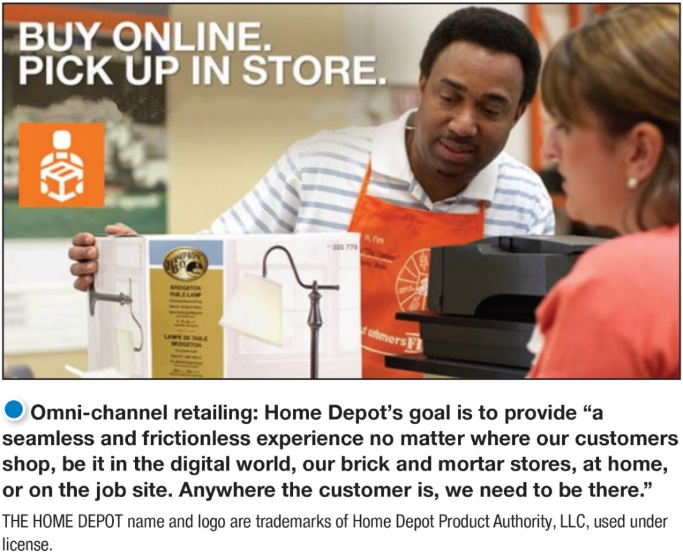
Marketing, The Internet, and the Digital Age
Omni-channel retailing creates a seamless cross-channel buying experience that integrates in-store, online, and mobile shopping—creates a single shopping experience.
Notes:
Traditional retailers have a major opportunity here. Online giants aren’t the only ones benefiting from the demand for e-commerce.
Percentage of total sales achieved online:
Macy’s—20% (7th largest U.S. e-tailer)
Staples—22%
Williams Sonoma—50%
Victoria’s Secret—20%
Neiman Marcus—27%

Slide 14
Marketing, The Internet, and the Digital Age
Online Marketing
Online marketing is marketing via the Internet using company Web sites, online ads and promotions, e-mail, online video, and blogs. Marketing Web sites engage consumers to move them closer to a direct purchase or other marketing outcome. Branded community Web sites present brand content that engages consumers and creates customer community around a brand.
Notes:
Online marketing refers to marketing via the Internet using company Web sites, online advertising and promotions, e-mail marketing, online video, and blogs. Social media and mobile marketing also take place online and must be closely coordinated with other forms of digital marketing. However, because of their special characteristics, we discuss the fast growing social media and mobile marketing approaches in separate sections.
For most companies, the first step in conducting online marketing is to create a Web site. Web sites vary greatly in purpose and content. Some Web sites are primarily marketing Web sites.
While branded community Web sites don’t try to sell anything at all.

Slide 15
Marketing, The Internet, and the Digital Age
Online Marketing
Online advertising is advertising that appears while consumers are browsing online and includes display ads, search-related ads, online classifieds, and other forms.
E-mail marketing involves sending highly targeted, highly personalized, relationship-building marketing messages via e-mail.
Spam is unsolicited, unwanted commercial e-mail messages.
Notes:
As consumers spend more and more time online, companies are shifting more of their marketing dollars to online advertising to build brand sales or attract visitors to their Internet, mobile, and social media sites. Online advertising has become a major promotional medium. Together, display and search-related ads account for the largest portion of firms’ digital marketing budgets, capturing 30 percent of all digital marketing spending.
E-mail marketing remains an important and growing digital marketing tool. “Social media is the hot new thing,” says one observer, “but e-mail is still the king.” By one estimate, 91 percent of all U.S. consumers use e-mail every day. What’s more, e-mail is no longer limited to PCs and workstations; 65 percent of all e-mails are now opened on mobile devices. Not surprisingly, then, a recent study found that e-mail is 40 times more effective at capturing customers than Facebook and Twitter combined. Marketers sent an estimated more than 838 billion e-mails last year.

Slide 16
Marketing, The Internet, and the Digital Age
Online Marketing
Online video marketing involves posting digital video content on brand Web sites or social media sites such as YouTube, Facebook, and others.
Viral marketing is the digital version of word-of-mouth marketing: videos, ads, and other marketing content that is so infectious that customers will seek it out or pass it along to friends.
Notes:
Because customers find and pass along the message or promotion, viral marketing can be very inexpensive. And when video or other information comes from a friend, the recipient is much more likely to view or read it.
Some videos are made for the Web and social media. Such videos range from “how-to” instructional videos and public relations (PR) pieces to brand promotions and brand-related entertainment. Other videos are ads that a company makes primarily for TV and other media but posts online before or after an advertising campaign to extend their reach and impact.

Slide 17
Marketing, the Internet, and the Digital Age
Online Marketing
Blogs are online journals where people and companies post their thoughts and other content, usually related to narrowly defined topics.
Notes:
Brands also conduct online marketing through various digital forums that appeal to specific special-interest groups.
Blogs can be about anything, from politics or baseball to haiku, car repair, brands, or the latest television series. According to one study, there are now more than 31 million blogs in the United States. Many bloggers use social networks such as Twitter, Facebook, and Instagram to promote their blogs, giving them huge reach. Such numbers can give blogs—especially those with large and devoted followings—substantial influence.

Slide 18
Learning Objective 4
Discuss how companies use social media and mobile marketing to engage consumers and create brand community.
Notes:
Discussion Question
Discuss the advantages and challenges of social media marketing.
Learning Objective 4 Summary
Mobile marketing features marketing messages, promotions, and other content delivered to on-the-go consumers through their mobile devices. Marketers use mobile marketing to engage customers anywhere, anytime during the buying and relationship building processes. The widespread adoption of mobile devices and the surge in mobile Web traffic have made mobile marketing a must for most brands, and almost every major marketer is now integrating mobile marketing into its direct marketing programs. Many marketers have created their own mobile online sites. Others have created useful or entertaining mobile apps to engage customers with their brands and help them shop.

Slide 19
Social Media and Mobile Marketing
Social Media Marketing
Advantages:
Targeted and personal
Interactive
Immediate and timely
Real-time marketing
Cost effective
Engagement and social sharing capabilities
Notes:
Social Media Marketing
There exists a dazzling array of online social media and digital communities. Countless independent and commercial social networks have arisen that give consumers online places to congregate, socialize, and exchange views and information. Wherever consumers congregate, marketers will surely follow. According to one survey, nearly 90 percent of U.S. companies now use social media networks as part of their marketing mixes.
Using Social Media
Marketers can use existing social media or they can set up their own. Using existing social media seems the easiest. Thus, most brands have set up shop on a host of social media sites with links to each brand’s Facebook, Google+, Twitter, YouTube, Flickr, Instagram, or other social media pages.
Using social media presents advantages and challenges.
Because consumers have so much control over social media content, even the seemingly most harmless social media campaign can backfire. With social media, “you’re going into the consumer’s backyard. This is their place,” warns one social marketer. “Social media is a pressure cooker,” says another. “The hundreds of thousands, or millions, of people out there are going to take your idea, and they’re going to try to shred it or tear apart and find what’s weak or stupid in it.”

Slide 20
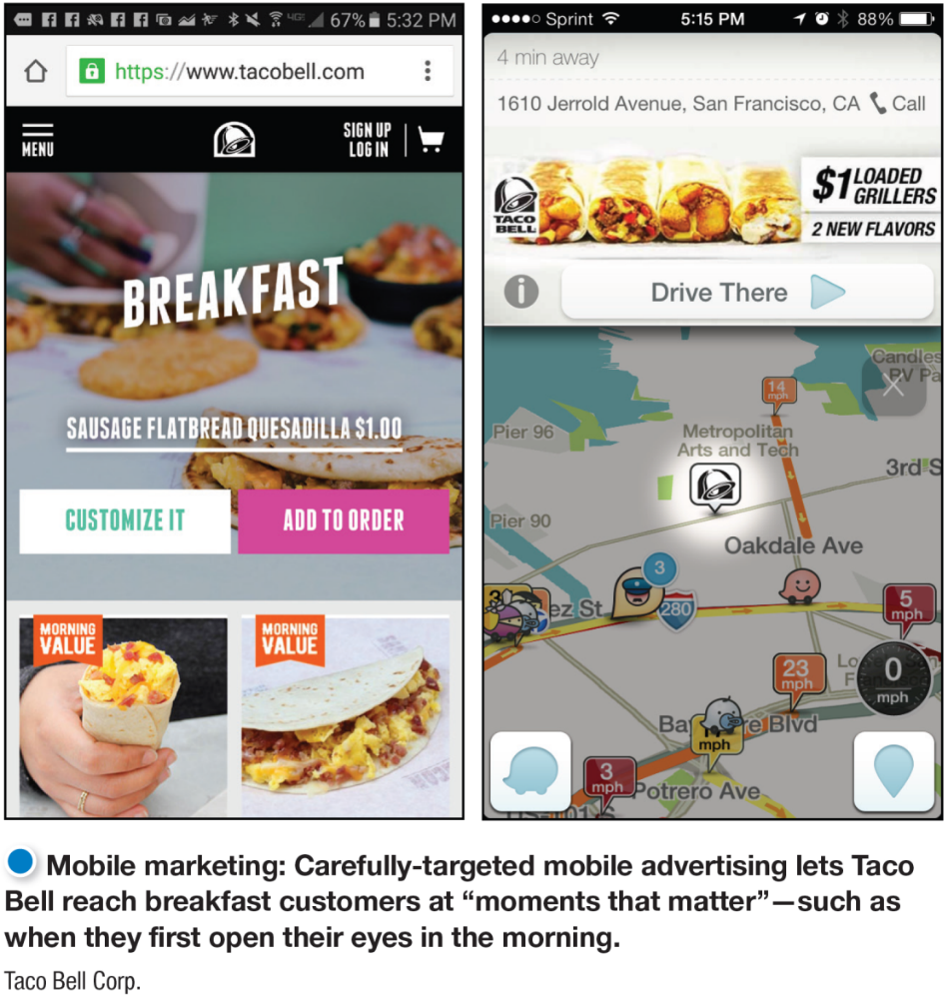
Social Media and Mobile Marketing
Mobile Marketing
Mobile marketing delivers messages, promotions, and other content to on-the-go consumers through mobile phones, smartphones, tablets, and other mobile devices.
Notes:
Mobile marketing engages customers anywhere, anytime during the buying and relationship building processes. The widespread adoption of mobile devices and the surge in mobile Web traffic have made mobile marketing a must for most brands.
With the recent proliferation of mobile phones, smartphones, and tablets, mobile device penetration is now greater than 100 percent in the United States.. The mobile apps market has exploded globally: There are more than 2 million apps available and the average smartphone has 25 apps installed on it.

Slide 21
Learning Objective 5
Identify and discuss the traditional direct marketing forms and overview public policy and ethical issues presented by direct marketing.
Notes:
Discussion Question
List and briefly describe the major traditional forms of direct marketing.
Learning Objective 5 Summary
Although the fast-growing digital marketing tools have grabbed most of the headlines lately, traditional direct marketing tools are very much alive and still heavily used. The major forms are face-to-face or personal selling, direct-mail marketing, catalog marketing, telemarketing, direct-response television (DRTV) marketing, and kiosk marketing.
Direct-mail marketing consists of the company sending an offer, announcement, reminder, or other item to a person at a specific address. Some marketers rely on catalog marketing—selling through catalogs mailed to a select list of customers, made available in stores, or accessed online. Telemarketing consists of using the telephone to sell directly to consumers. DRTV marketing has two forms: direct-response advertising (or infomercials) and interactive television (iTV) marketing. Kiosks are information and ordering machines that direct marketers place in stores, airports, hotels, and other locations.
Direct marketers and their customers usually enjoy mutually rewarding relationships. Sometimes, however, direct marketing presents a darker side. The aggressive and sometimes shady tactics of a few direct marketers can bother or harm consumers, giving the entire industry a black eye. Abuses range from simple excesses that irritate consumers to instances of unfair practices or even outright deception and fraud. The direct marketing industry has also faced growing concerns about invasion-of-privacy and Internet security issues. Such concerns call for strong action by marketers and public policy makers to curb direct marketing abuses. In the end, most direct marketers want the same things that consumers want: honest and well-designed marketing offers targeted only toward consumers who will appreciate and respond to them.

Slide 22
Traditional Direct Marketing Forms
Direct-mail marketing involves an offer, announcement, reminder, or other item to a person at a particular address.
Personalized
Easy-to-measure results
Costs more than mass media
Provides better results than mass media
Notes:
Direct mail is well suited to direct, one-to-one communication. It permits high target-market selectivity, can be personalized, is flexible, and allows the easy measurement of results.
Although direct mail costs more per thousand people reached than mass media such as television or magazines, the people it reaches are much better prospects.
Direct mail has proved successful in promoting all kinds of products, from books, insurance, travel, gift items, gourmet foods, clothing, and other consumer goods to industrial products of all kinds. Charities also use direct mail heavily to raise billions of dollars each year.

Slide 23
Traditional Direct Marketing Forms
Catalog direct marketing involves printed and Web-based catalogs.
Benefits of Web-based catalogs
Lower cost than printed catalogs
Unlimited amount of merchandise
Real-time merchandising
Interactive content
Promotional features
Challenges of Web-based catalogs
Require marketing
Difficulties in attracting new customers
Notes:
Advances in technology, along with the move toward personalized, one-to-one marketing, have resulted in exciting changes in catalog marketing. More and more catalogs have gone digital, a variety of online-only catalogers have emerged, and most print catalogers have added Web-based catalogs and smartphone catalog shopping apps.
Despite the advantages of digital catalogs, paper catalogs are still thriving. They create emotional connections; turning actual catalog pages engages consumers in a way that digital images simply can’t.
In addition, printed catalogs are one of the best ways to drive online and mobile sales, making them more important than ever in the digital era. According to one study, about 58 percent of online shoppers browse physical catalogs for ideas, and 31 percent have a retailer’s catalog with them when they make a purchase online.

Slide 24
Traditional Direct Marketing Forms
Telemarketing involves using the telephone to sell directly to consumers and business customers.
Outbound telephone marketing sells directly to consumers and businesses.
Inbound telephone marketing uses toll-free numbers to receive orders from television and print ads, direct mail, and catalogs.
Notes:
Discussion Question
What are the benefits and challenges of telephone direct marketing?
Benefits:
Purchasing convenience
Increased product service and information
Challenges:
Unsolicited outbound telephone marketing
Do-Not-Call Registry
Telemarketing accounts for almost 14.9 percent of all direct marketing-driven sales. B-to-B marketers also use telemarketing extensively, accounting for nearly 56 percent of all telephone marketing sales.
Properly designed and targeted telemarketing provides many benefits, including purchasing convenience and increased product and service information. However, the explosion in unsolicited outbound telephone marketing over the years annoyed many consumers. In 2003, U.S. lawmakers responded with the National Do Not Call Registry. The legislation bans most telemarketing calls to registered phone numbers (although people can still receive calls from nonprofit groups, politicians, and companies with which they have recently done business). Consumers responded enthusiastically. To date, more than 209 million home and mobile phone numbers have been registered. Businesses that break do-not-call laws can be fined up to $16,000 per violation.
Do-not-call legislation has hurt parts of the consumer telemarketing industry. However, two major forms of telemarketing—inbound consumer telemarketing and outbound B-to-B telemarketing—remain strong and growing. Telemarketing also remains a major fund-raising tool for nonprofit and political groups. Interestingly, do-not-call regulations appear to be helping some direct marketers more than it’s hurting them. Rather than making unwanted calls, many of these marketers are developing “opt-in” calling systems, in which they provide useful information and offers to customers who have invited the company to contact them by phone or e-mail. The opt-in model provides better returns for marketers than the formerly invasive one.

Slide 25
Traditional Direct Marketing Forms
Direct-response television marketing includes the following:
60 to 120 second advertisements that describe products or give customers a toll-free number or website for ordering
30-minute infomercials such as home shopping channels
Notes:
Discussion Question
Students have often purchased from these late night television ads. Ask what they have purchased and their satisfaction with the products.
Direct-response television marketing takes one of two major forms: direct-response television advertising and interactive TV (iTV) advertising. Using direct-response television advertising, direct marketers air television spots, which persuasively describe a product and give customers a toll-free number or a website for ordering. It also includes full 30-minute or longer advertising programs, called infomercials, for a single product.
Successful direct-response advertising campaigns can ring up big sales. For example, little-known infomercial maker Guthy-Renker has helped propel its Proactiv Solution acne treatment and other “transformational” products into power brands that pull in $1.8 billion in sales annually to five million active customers (compare that to only about $150 million in annual drugstore sales of acne products in the United States).
DRTV ads are often associated with somewhat loud or questionable pitches for cleaners, stain removers, kitchen gadgets, and nifty ways to stay in shape without working very hard at it.
In recent years, however, a number of large companies—from P&G, Disney, Revlon, Apple, and Kodak to Toyota, Coca-Cola, Anheuser-Busch, and even the U.S. Navy—have begun using infomercials to sell their wares, refer customers to retailers, recruit members, or attract buyers to their online sites.
A more recent form of direct-response television marketing is interactive TV (iTV), which lets viewers interact with television programming and advertising. Thanks to technologies such as interactive cable systems, Internet-ready smart TVs, and smartphones and tablets, consumers can now use their TV remotes, phones, or other devices to obtain more information or make purchases directly from TV ads.
Direct-response television marketing less expensive than other forms of promotion and easier to track results.

Slide 26
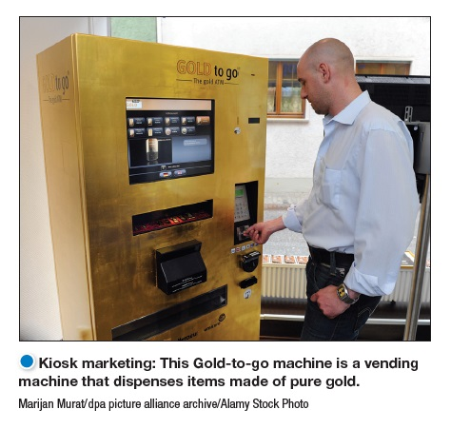
Traditional Direct Marketing Forms
Kiosk Marketing
Notes:
As consumers become more and more comfortable with digital and touch-screen technologies, many companies are placing information and ordering machines—called kiosks—in stores, airports, hotels, college campuses, and other locations. Kiosks are everywhere these days, from self-service hotel and airline check-in devices, to unmanned product and information kiosks in malls, to in-store ordering devices that let you order merchandise not carried in the store. Many modern “smart kiosks” are now wireless-enabled. And some machines can even use facial recognition software that lets them guess gender and age and make product recommendations based on that data.

Slide 27
Public Policy Issues in Direct and Digital Marketing
Irritation includes annoying and offending customers.
Unfairness includes taking unfair advantage of impulsive or less-sophisticated buyers.
Deception includes “heat merchants” who design mailers and write copy designed to mislead consumers.
Fraud includes identity theft and financial scams.
Consumer privacy involves concerns that marketers may have too much information and use it to take unfair advantage.
Notes:
Direct marketing excesses sometimes annoy or offend consumers. For example, most of us dislike direct-response TV commercials that are too loud, long, and insistent. Our mailboxes fill up with unwanted junk mail, our e-mailboxes bulge with unwanted spam, and our computer screens flash with unwanted display or pop-up ads.
One common form of Internet fraud is phishing, a type of identity theft that uses deceptive e‑mails and fraudulent online sites to fool users into divulging their personal data. Many consumers also worry about online security. They fear that unscrupulous snoopers will eavesdrop on their online transactions, picking up personal information or intercepting credit and debit card numbers.
Another Internet marketing concern is that of access by vulnerable or unauthorized groups. For example, marketers of adult-oriented materials and sites have found it difficult to restrict access by minors. A survey by Consumer Reports found 5 million U.S. children under age 10 on Facebook, which supposedly allows no children under age 13 to have a profile. It found another 2.5 million 11- and 12-year-old Facebook subscribers. And it’s not just Facebook. Unfortunately, this requires the development of technology solutions, and as Facebook puts it, “That’s not so easy.”

Slide 28
Public Policy Issues in Direct and Digital Marketing
A Need for Action
AdChoices
Can Spam
Children’s Online Privacy Protection Act (COPPA)
TRUSTe
Notes:
Discussion Question
What must marketers consider when designing a site for children?
AdChoices advertising option icon in the upper right of this online ad, consumers can learn why they are seeing the ad and opt out if they wish.
To curb direct marketing excesses, various government agencies are investigating not only do-not-call lists but also do-not-mail lists, do-not-track online lists, and Can Spam legislation. In response to online privacy and security concerns, the federal government has considered numerous legislative actions to regulate how Internet and mobile operators obtain and use consumer information. For example, Congress is drafting legislation that would give consumers more control over how online information is used. In addition, the FTC is taking a more active role in policing online privacy.
All of these concerns call for strong actions by marketers to monitor and prevent privacy abuses before legislators step in to do it for them. Advertiser groups recently issued new guidelines for sites. Among other measures, the guidelines call for Web marketers to alert consumers if their activities are being tracked. The ad industry has agreed on an advertising option icon—a little “i” inside a triangle—that it will add to most behaviorally targeted online ads to tell consumers why they are seeing a particular ad and allowing them to opt out.
Of special concern are the privacy rights of children. In 2000, Congress passed the Children’s Online Privacy Protection Act (COPPA), which requires online operators targeting children to post privacy policies on their sites. They must also notify parents about any information they’re gathering and obtain parental consent before collecting personal information from children under age 13. With the subsequent advent of online social networks, mobile phones, and other new technologies, privacy groups are now urging the U.S. Senate to extend COPPA to include both the new technologies and teenagers.
TRUSTe is a nonprofit self-regulatory organization, works with many large corporate sponsors, including to audit privacy and security measures and help consumers navigate the Internet safely. According

