Slide 1
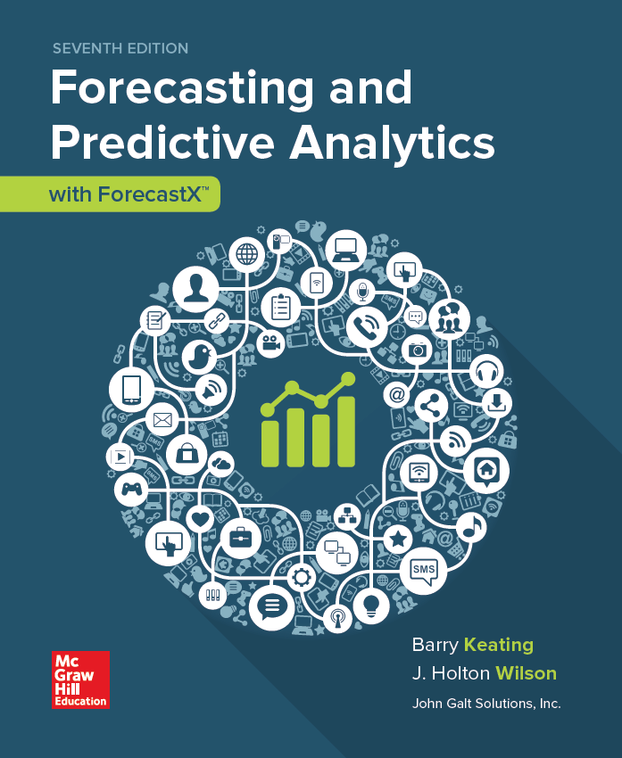
Chapter 5
Explanatory Models 1: Forecasting with Multiple Regression Causal Models
© 2019 McGraw-Hill Education. All rights reserved. Authorized only for instructor use in the classroom. No reproduction or further distribution permitted without the prior written consent of McGraw-Hill Education.
Notes:
1

Slide 2
Multiple Regression Model (Chapter 5)
We add additional explanatory variables…
Notes:
2
2

Slide 3
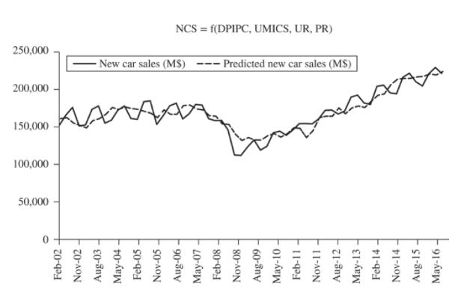
Figure 5.2 Multiple Regression
Regression Statistics
Adjusted R Square 0.816
Standard Error 11,690.644
Observations 60 DW = 1.376
 | Coefficients | Std Error | t Stat | P-value | P/2
Intercept | 25,304.350 | 37,454.530 | 0.676 | 0.502 | 0.251
DPIPC | 3.227 | 0.392 | 8.240 | 0.000 | 0.000
UMICS | 1,123.363 | 210.582 | 5.335 | 0.000 | 0.000
UR | −7,659.605 | 1,661.586 | −4.610 | 0.000 | 0.000
PR | −3,216.777 | 1,412.449 | −2.277 | 0.027 | 0.013
Jump to long description
Notes:
3
3

Slide 4
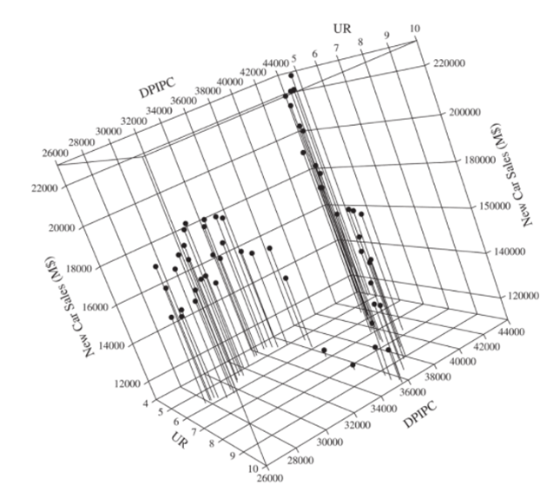
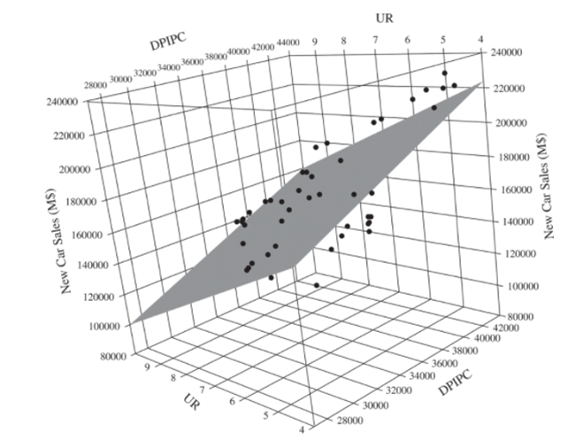
Figure 5.3 New car sales (NCS) in millions of dollars with DPIPC and UR viewed in three dimensions.
Jump to long description
Notes:
4
4

Slide 5
Table 5.2 Five Quick Checks
The Multiple Regression Model for New Car Sales
Regression Statistics
Adjusted R Square 0.816
Standard Error 11,690.644
Observations 60 DW = 1.376
The statistical evaluation of multiple-regression models is similar to that discussed for simple regression.
Check the signs of the coefficients.
Check the significance of the coefficients.
Evaluate the multiple coefficient of determination (multiple R²).
Check for autocorrelation (Durbin Watson).
Check for multicollinearity.
 | Coefficients | Std Error | t Stat | P-value | P/2
Intercept | 25,304.350 | 37,454.530 | 0.676 | 0.502 | 0.251
DPIPC | 3.227 | 0.392 | 8.240 | 0.000 | 0.000
UMICS | 1,123.363 | 210.582 | 5.335 | 0.000 | 0.000
UR | −7,659.605 | 1,661.586 | −4.610 | 0.000 | 0.000
PR | −3,216.777 | 1,412.449 | −2.277 | 0.027 | 0.013
ANOVA | df | SS | MS | F | Sig F
Regression | 4 | 36,221,956,000.002 | 9,055,489,000.000 | 66.257 | 0.000
Residual | 55 | 7,516,913,590.181 | 36,671,156.185
Total | 59 | 43,738,869,590.183
Notes:
5
5

Slide 6
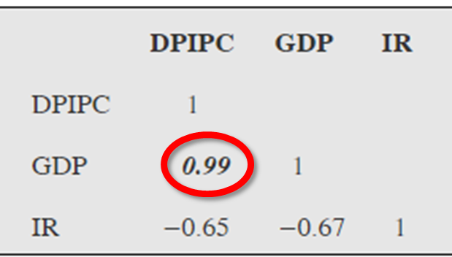
Multicollinearity
In multiple-regression analysis, one of the assumptions that are made is that the independent variables are not highly linearly correlated with each other or with linear combinations of other independent variables. If this assumption is violated, a problem known as multicollinearity results.
If we look at these correlations between these variables, we can see a problem. Clearly, there is a very strong linear association between GDP and DPIPC. In this case, both of these variables are measuring essentially the same thing.
Jump to long description
Notes:
6
6

Slide 7
New Car Sales Regression Correlations
UMICS | DPIPC | PR | UR
UMICS | 1.00
DPIPC | −0.16 | 1.00
PR | 0.25 | −0.43 | 1.00
UR | −0.68 | 0.15 | −0.62 | 1.00
Note that no pair of independent variables has a correlation that is close to 1.0. The correlations of 1.00 along the main diagonal are to be expected. They simply tell us that each variable is perfectly correlated with itself.
Notes:
7
7

Slide 8
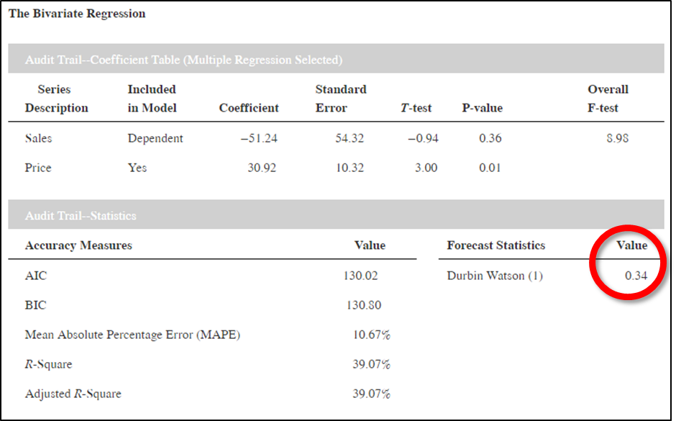
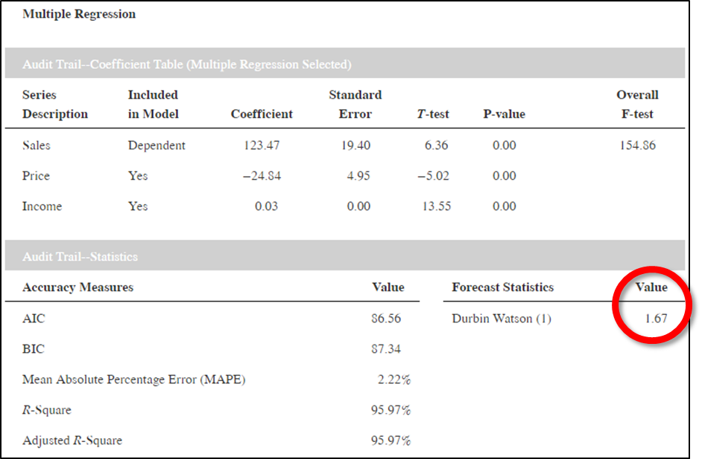
Omitted Variable Problem Table 5.5
The most common reason for serial correlation is that an important explanatory variable has been omitted.
Jump to long description
Notes:
8
8

Slide 9
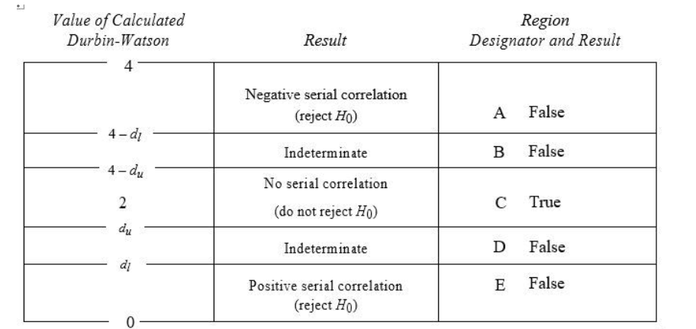
Durbin-Watson
Jump to long description

Slide 10
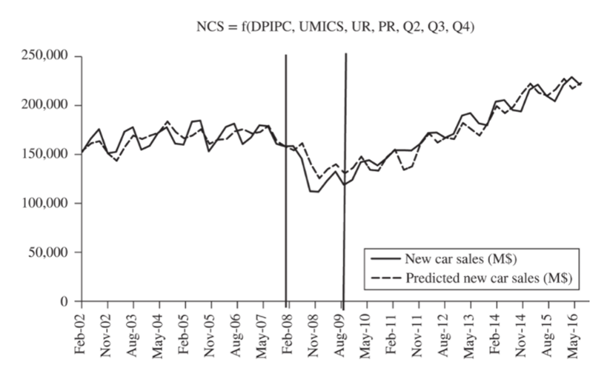
Accounting for Seasonality
Table 5.7
Audit Trail — Statistics
Audit Trail — ANOVA Table (Multiple Regression Selected)
Accuracy Measures | Value | Forecast Statistics | Value
AIC | 1,277.42 | Durbin- Watson (4) | 1.03
BIC | 1,279.51 | Durbin- Watson (1) | 1.16
MAPE | 5.05%
Adjusted R-Square | 84.46%
Source of variation | SS | df | MS | SEE | Overall F-test
Regression | 37,748,211,961.83 | 7 | 5,392,601,708.83 |  | 46.81
Error | 5,990,657,628.35 | 52 | 115,204,954.39 | 10,733.36
Total | 43,738,869,590.18 | 59
Audit Trail — Coefficient Table (Multiple Regression Selected)
Figure 5.7
Series Description | Coefficient | Standard error | T-test | P-value | P/2
Intercept | 32,398.89 | 34,589.87 | 0.94 | 0.35 | 0.18
UMICS | 1,060.42 | 195.40 | 5.43 | 0.00 | 0.00
DPIPC | 3.14 | 0.36 | 8.71 | 0.00 | 0.00
UR | −8,232.04 | 1,535.96 | −5.36 | 0.00 | 0.00
PR | −3,582.75 | 1,300.78 | −2.75 | 0.01 | 0.00
Q2 | 5,880.09 | 3,944.63 | 1.49 | 0.14 | 0.07
Q3 | 14,330.37 | 4,011.36 | 3.57 | 0.00 | 0.00
Q4 | 5,138.04 | 4,006.04 | 1.28 | 0.21 | 0.10
Jump to long description

Slide 11
Fifth Step: Check for Multicollinearity
 | New Car Sales (M$) | DPIPC | UMICS | UR | PR | Q2 | Q3 | Q4
New Car Sales (M$) | 1.00
DPIPC | 0.48 | 1.00
UMICS | 0.64 | −0.16 | 1.00
UR | −0.58 | 0.15 | −0.68 | 1.00
PR | −0.02 | −0.43 | 0.25 | −0.62 | 1.00
Q2 | 0.04 | 0.03 | 0.06 | −0.01 | −0.03 | 1.00
Q3 | 0.16 | 0.00 | 0.03 | 0.03 | 0.01 | −0.35 | 1.00
Q4 | −0.07 | 0.03 | −0.11 | 0.02 | −0.01 | −0.35 | −0.33 | 1.00
From the correlations shown above, we see that this is not a problem for this model (evaluation Step 5).
Notes:
11
11

Slide 12
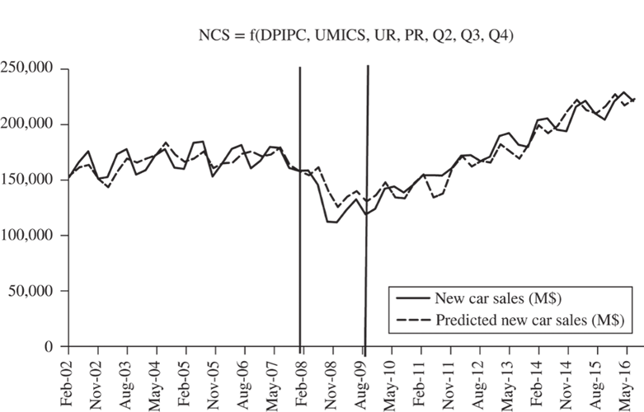
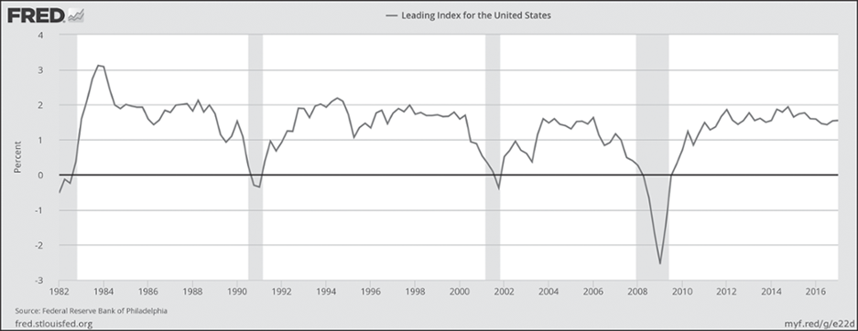
Using a Dummy Variable to Account for Seasonality
Figure 5.7
Figure 5.8
We see in Figures 5.7 and 5.8 that the 2008–2009 recession seems to correspond with the lower-than-expected NCS in that period. This gives us an opportunity to demonstrate another application of a dummy variable. We will create a variable equal to one for all of 2008 and 2009 but zero otherwise.
Jump to long description

Slide 13
Table 5.8
Audit Trail — ANOVA Table (Multiple Regression Selected)
Source of variation | SS | df | MS | SEE | Overall F-test
Regression | 39,712,666,421.52 | 8 | 4,964,083,302.69 |  | 62.88
Error | 4,026,203,168.66 | 51 | 78,945,160.17 | 8,885.11
Total | 43,738,869,590.18 | 59
Accuracy Measures | Value
AIC | 1,253.58
BIC | 1,255.67
MAPE | 4.21%
Adjusted R-Square | 89.35%
Audit Trail — Coefficient Table (Multiple Regression Selected)
Series Description | Coefficient | Standard error | T-test | P-value | P/2
Intercept | 125,763.55 | 34,208.05 | 3.68 | 0.00 | 0.00
DPIPC | 2.82 | 0.31 | 9.21 | 0.00 | 0.00
UMICS | 354.74 | 214.89 | 1.65 | 0.10 | 0.05
UR | −10,663.56 | 1,361.70 | −7.83 | 0.00 | 0.00
PR | −4,705.72 | 1,100.07 | −4.28 | 0.00 | 0.00
Q2 | 6,299.04 | 3,266.46 | 1.93 | 0.06 | 0.03
Q3 | 14,896.56 | 3,322.56 | 4.48 | 0.00 | 0.00
Q4 | 3,944.55 | 3,324.83 | 1.19 | 0.24 | 0.12
Recession | −23,253.91 | 4,661.63 | −4.99 | 0.00 | 0.00
Forecast Statistics
Durbin- Watson (4)
1.00
Durbin- Watson (1)
1.69
Notes:
13
13

Slide 14
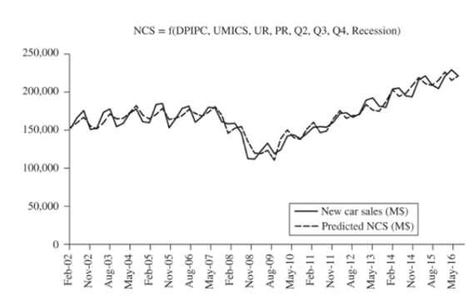
Figure 5.9 The Resulting Model with Dummies
Jump to long description

Slide 15
Extensions of Regression
Linear and Nonlinear Trends: Table 5.10
Results for the Model with Time as the Only Independent Variable
Results for the Model with Time and Time Squared as Independent Variables
Audit Trail—ANOVA Table (Multiple Regression Selected)
Audit Trail—ANOVA Table (Multiple Regression Selected)
Source of variation | SS | df | MS | SEE | Overall F-test
Regression | 1,843,110.02 | 1 | 1,843,110.02 |  | 32.05
Error | 690,163.98 | 12 | 57,513.67 | 239.82
Total | 2,533,274.00 | 13
Source of variation | SS | df | MS | SEE | Overall F-test
Regression | 2,406,605.23 | 2 | 1,203,302.62 |  | 104.50
Error | 126,668.77 | 11 | 11,515.34 | 107.31
Total | 2,533,274.00 | 13
Audit Trail — Coefficient Table (Multiple Regression Selected)
Audit Trail—Coefficient Table (Multiple Regression Selected)
Series Description | Coefficient | Standard error | T-test | P-value | P/2
Intercept | 1,373.93 | 135.38 | 10.15 | 0.00 | 0.00
Time | 90.01 | 15.90 | 5.66 | 0.00 | 0.00
Series Description | Coefficient | Standard error | T-test | P-value | P/2
Intercept | 1,930.36 | 99.98 | 19.31 | 0.00 | 0.00
Time | −118.65 | 30.67 | −3.87 | 0.00 | 0.00
Time² | 13.91 | 1.99 | 7.00 | 0.00 | 0.00
Audit Trail—Statistics
Accuracy Measures | Value | Forecast Statistics | Value
AIC | 193.01 | Durbin Watson (1) | 0.57
BIC | 193.65
MAPE | 8.64%
R-Square | 72.76%
Audit Trail — Statistics
Accuracy Measures | Value | Forecast Statistics | Value
AIC | 169.27 | Durbin Watson (1) | 1.67
BIC | 169.91
MAPE | 4.06%
Adjusted R-Square | 94.09%

Slide 16
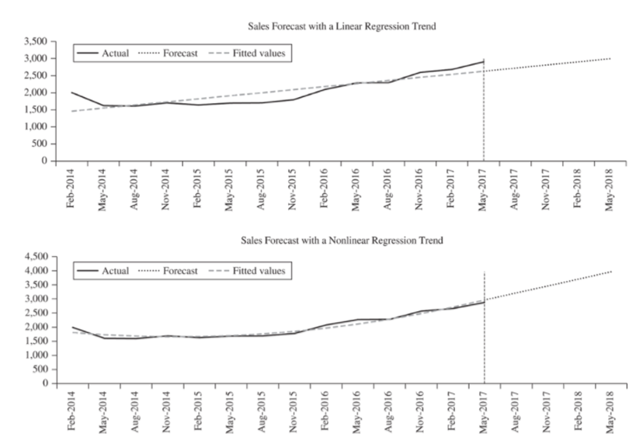
Extensions of Regression
Linear and Nonlinear Trends: Figure 5.12
Jump to long description

Slide 17
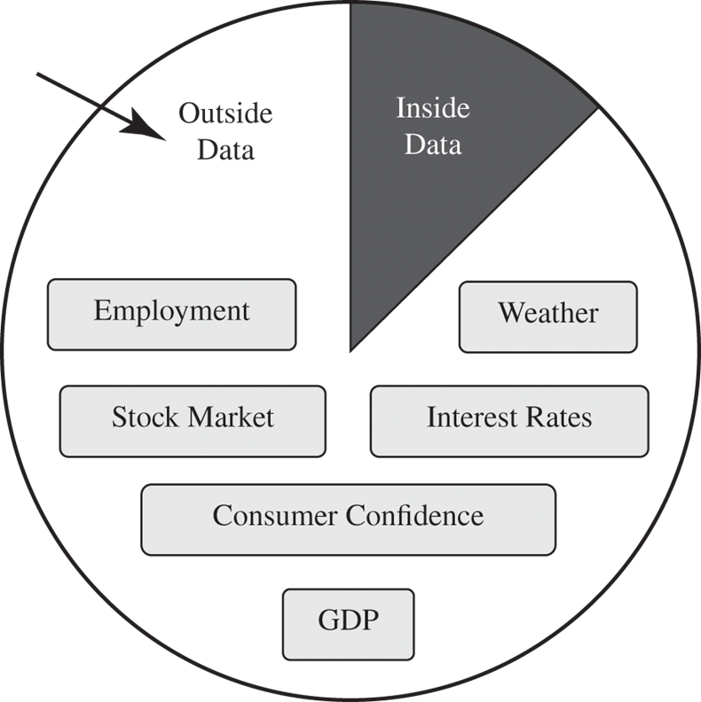
Independent Variable Selection Figure 5.13
Jump to long description

Slide 18
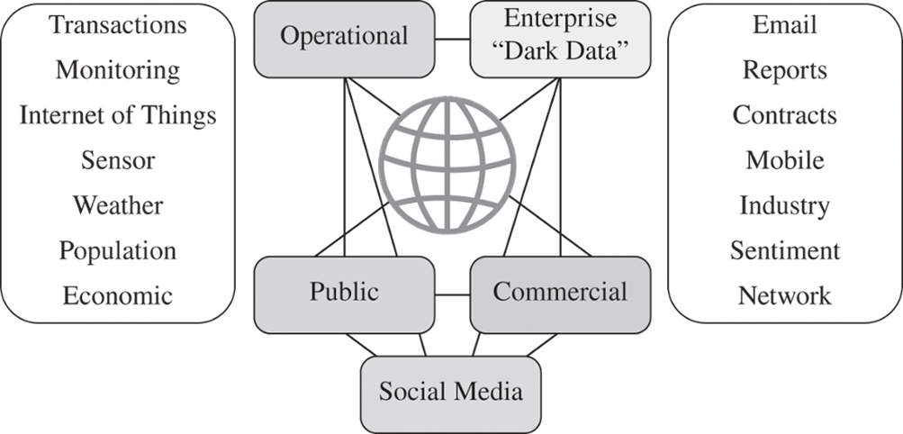
Independent Variable Selection Figure 5.14
Jump to long description

Slide 19
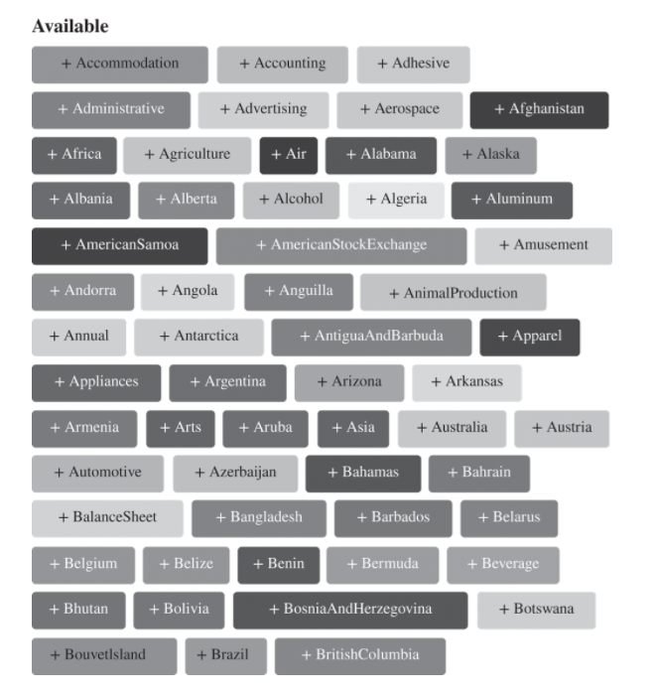
Prevedere “Tabs” Figure 5.15
Jump to long description

Slide 20
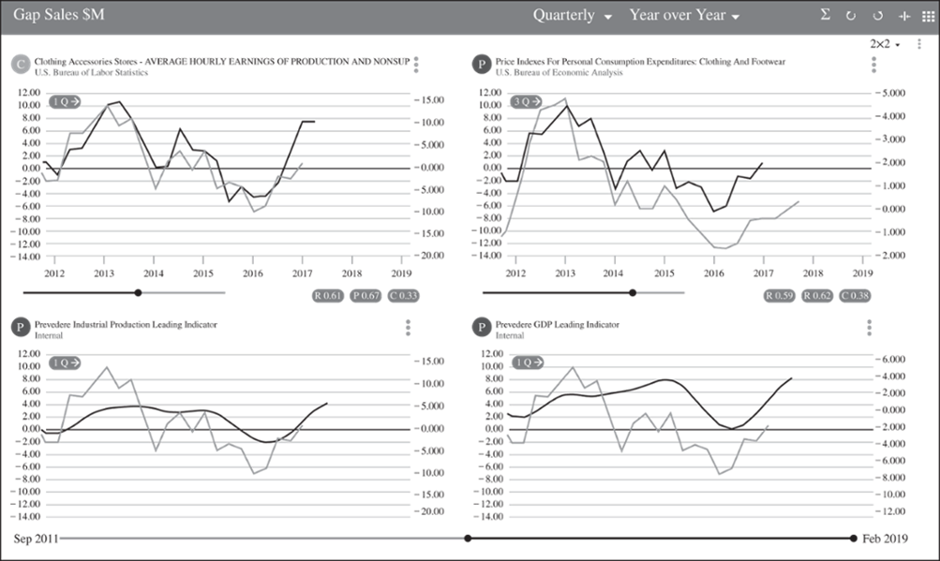
Indicators with Lead Times Shown Figure 5.17
Jump to long description

Slide 21
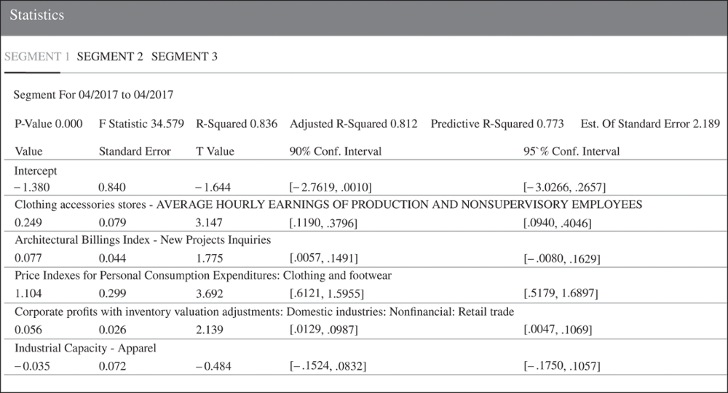
Segmented Regression: Segment 1 Shown
Jump to long description

Slide 22
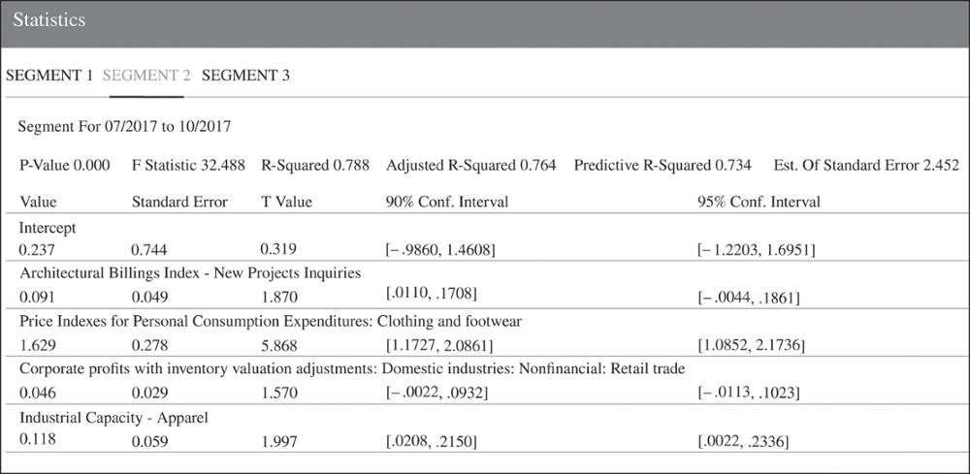
Segmented Regression: Segment 2 Shown
Jump to long description

Slide 23
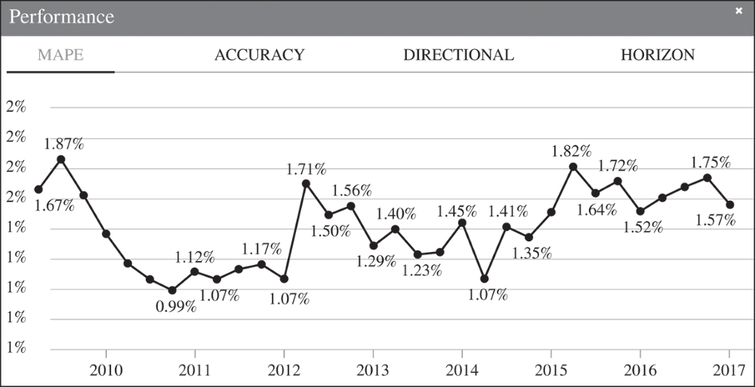
Segmented Regression Model Performance
Figure 5.20
Jump to long description

Slide 24
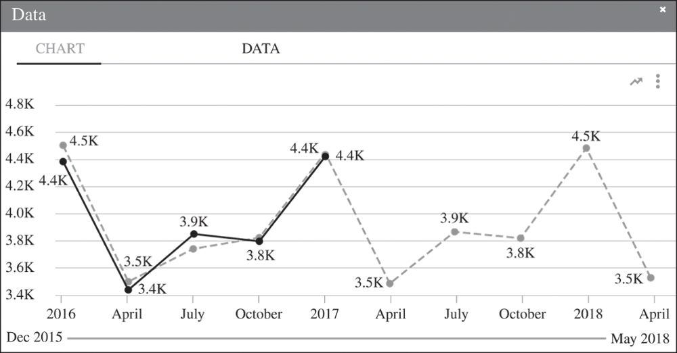
Segmented Regression Forecast Period
Figure 5.21
Jump to long description

Slide 25
Appendix of Image Long Descriptions

Slide 26
Figure 5.2 Multiple Regression - Appendix
The predicted new car sales closely follows the actual new car sales, but with less variation.
Jump to the image

Slide 27
Figure 5.3 New car sales (NCS) in millions of dollars with DPIPC and UR viewed in three dimensions. - Appendix
This graph looks like a cube with one edge representing the new car sales figures in millions of dollars, another edge representing the D P I P C which is scaled from 26,000 to 44,000, and a third edge representing the unemployment rate, which is scaled from 5 to 10. The points tend to fall in two clusters, one with low unemployment rates, low to moderate D P I P C, and moderate sales figures. The other cluster occurs at high D P I P C, but spans all unemployment rates and spans all sales figures.
Jump to the image

Slide 28
Multicollinearity - Appendix
DPIPC-DPIPC 1
GDP-DPIPC 0.99 (value is circled)
GDP-GDP 1
IR-DPIPC –0.65
IR-GDP –0.67
IR-IR 1
Jump to the image

Slide 29
Omitted Variable Problem Table 5.5 - Appendix
(Left image) Audit Trail - Coefficient Table (Multiple Regression Selected)
Sales:
Included in Model - Dependent
Coefficient –51.24, Standard Error 54.32, T-test –0.94, P-value 0.36, Overall F-test 8.98
Price:
Included in Model - Yes
Coefficient 30.92, Standard Error 10.32, T-test 3.00, P-value 0.01
Audit Trail - Statistics
AIC 130.02, BIC 130.80, MAPE 10.67%, R-Square 39.07%, Adjusted R-Square 39.07
Durbin Watson (1) 0.34 (value circled)
(Right image) Audit Trail - Coefficient Table (Multiple Regression Selected)
Sales:
Included in Model - Dependent
Coefficient 123.47, Standard Error 19.40, T-test 6.36, P-value 0.00, Overall F-test 154.86
Price:
Included in Model - Yes
Coefficient –24.84, Standard Error 4.95, T-test –5.02, P-value 0.00
Income:
Included in Model - Yes
Coefficient 0.03, Standard Error 0.00, T-test 13.55, P-value 0.00
Audit Trail - Statistics
AIC 86.56, BIC 87.34, MAPE 2.22%, R-Square 95.97%, Adjusted R-Square 95.97
Durbin Watson (1) 1.67 (value circled)
Jump to the image

Slide 30
Durbin-Watson - Appendix
The three column headers are: 1) Value of Calculated Durbin-Watson, 2) Result, and 3) Region Designator and Result. Values are as follows:
(4 – d-sub-l) to 4, Negative serial correlation (reject H-naught), A False.
(4 – d-sub-u) to (4 – d-sub-l), Indeterminate, B False.
d-sub-u to (4 – d-sub-u) including 2, No serial correlation (do not reject H-naught), C True.
d-sub-l to d-sub-u, Indeterminate, D False.
0 to d-sub-l, Positive serial correlation (reject H-naught), E False.
Jump to the image

Slide 31
Accounting for Seasonality - Appendix
Vertical lines are drawn at 2008 and 2009, showing the recession. Also shown are the predicted new car sales throughout this time period. Sometimes the predictions were over the actual and sometimes they were under, but the predictions tended to follow the actuals fairly closely.
Jump to the image

Slide 32
Using a Dummy Variable to Account for Seasonality - Appendix
(Figure 5.7) Vertical lines are drawn at 2008 and 2009, showing the recession. Also shown are the predicted new car sales throughout this time period. Sometimes the predictions were over the actual and sometimes they were under, but the predictions tended to follow the actuals fairly closely.
(Figure 5.8) The graph displays the leading index for the United States for the years 1982 to 2016. Periods of recession are indicated by vertical bars shaded in gray. The longest and most drastic recession was from 2008 to 2009.
Jump to the image

Slide 33
Figure 5.9 The Resulting Model with Dummies - Appendix
Also shown are the predicted new car sales throughout this time period. Sometimes the predictions were over the actual and sometimes they were under, but the predictions tended to follow the actuals fairly closely.
Jump to the image

Slide 34
Extensions of Regression
Linear and Nonlinear Trends: Figure 5.12 - Appendix
The data is concave up and increasing, so the quadratic trend fits well.
Jump to the image

Slide 35
Independent Variable Selection Figure 5.13 - Appendix
85% of the relevant information to use in constructing a forecast is data external to the company such as employment, the stock market, customer confidence, GDP, weather, and interest rates.
Jump to the image

Slide 36
Independent Variable Selection Figure 5.14 - Appendix
Data can be operational, public, commercial, from social media, and enterprise "dark data" and can come from transactions, monitoring, internet of things, sensor, weather, population, economic, email, reports, contracts, mobile, industry, sentiment, and network.
Jump to the image

Slide 37
Prevedere “Tabs” Figure 5.15 - Appendix
Bouvetlsland + Brazil + Bhutan + Bolivia + Botswana + Belgium
+ BalanceSheet + Bangladesh + Barbados + Belarus + Automotive + Azerbaijan + Bahamas + Bahrain
+ Armenia + Annual + Andorra
+ AmericanSamoa + Albania + Alberta + Alcohol + Algeria + Aluminum + Africa + Agriculture + Air + Alabama + Alaska
+ Administrative + Advertising + Aerospace + Afghanistan + Accommodation + Accounting + Adhesive
+ AmericanStockExchange + Amusement + Angola + Anguilla + AnimalProduction + Appliances + Argentina + Antarctica + AntiguaAndBarbuda + Arizona + Arkansas + Apparel + Arts + Aruba + Asia + Australia + Austria + Belize + Benin + Bermuda + Beverage
+ BosniaAndHerzegovina
+ BritishColumbia
Jump to the image

Slide 38
Indicators with Lead Times Shown Figure 5.17 - Appendix
The first graph shows the clothing accessories stores average hourly earnings of production and nonsupport from the U.S. Bureau of Labor Statistics from 2012 to 2017. The second graph gives the price indexes for personal consumption expenditures: Clothing and Footwear from the U.S. Bureau of Economic Analysis from 2002 to 2017. The third graph shows the prevedere industrial production leading indicator and the last graph shows the provedere GDP Leading indicator.
Jump to the image

Slide 39
Segmented Regression: Segment 1 Shown - Appendix
Information shown is the segment for 4/2017 to 4/2017. The P-value is 0, the F Statistic 34.579, the R-squared 0.0836, the adjusted R-squared is 0.812, the predictive R-squared is 0.773, and the estimate of the standard error is 2.189. The intercept is negative 1.380, the Standard Error is 0.84, the T value is negative 1.644, the 90% confidence interval is negative 2.7619 to 0.001, and the 95% confidence interval is negative 3.0266 to 0.2657. The same statistics are provided for the clothing accessories stores average hourly earnings of production and nonsupervisory employees, the architectural billings index - new product inquiries, the price indexes for personal consumption expenditures: clothing and footwear, corporate profits with inventory valuation adjustments: domestic industries: nonfinancial: retail trade, and industrial capacity - apparel.
Jump to the image

Slide 40
Segmented Regression: Segment 2 Shown - Appendix
This segment is from 7/2017 to 10/2017. The P-value is 0, the F statistic is 32.488, the R-squared value is 0.788, the adjusted R-squared value is 0.764, the predictive R-squared is 0.734, and the estimate of the standard error is 2.452. The value of the intercept is 0.237, the standard error is 0.744, the T value is 0.319, the 90% confidence interval is negative 0.9860 to 1.4608 and the 95% confidence interval is negative 1.2203 to 1.6951. The same information is provided for the architectural billings index - new projects inquiries, price indexes for personal consumption expenditures: clothing and footwear, Corporate profits with inventory valuation adjustments: Domestic industries: Nonfinancial: Retail trade and Industrial Capacity - Apparel.
Jump to the image

Slide 41
Segmented Regression Model Performance Figure 5.20 - Appendix
The MAPE values were fairly horizontal. They varied from about 1 to about 1.8 and were most often around 1.4%
Jump to the image

Slide 42
Segmented Regression Forecast Period Figure 5.21 - Appendix
The actual sales were 4.4K, 3.4K, 3.9K, 3.8K, and 4.4K. The forecasted sales (starting with April 2017) are 3.5K, 3.9K, 3.8K, 4.5K, and 3.5K.
Jump to the image

