Slide 1
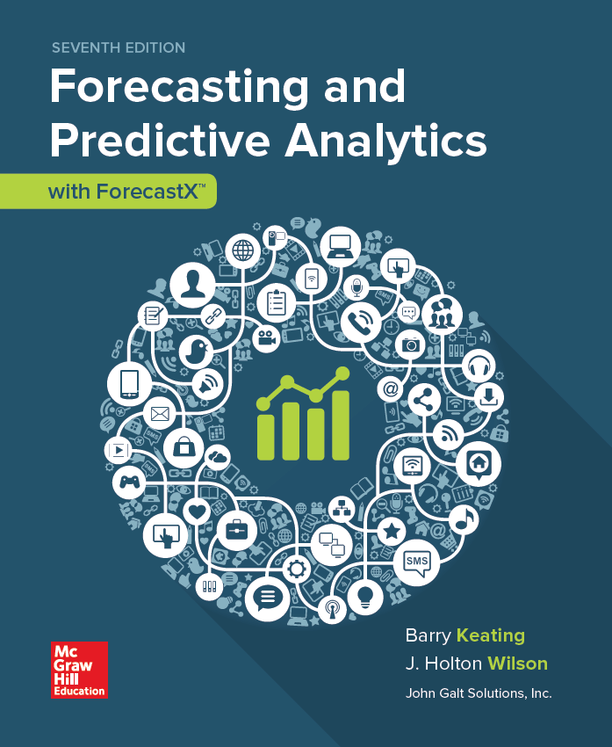
Chapter 4
Extrapolation 2: Introduction to Forecasting with Regression Trend Models
© 2019 McGraw-Hill Education. All rights reserved. Authorized only for instructor use in the classroom. No reproduction or further distribution permitted without the prior written consent of McGraw-Hill Education.
Notes:
1

Slide 2
Regression Models (Demand Planning Models) 1
A mathematical model to represent the relationship between a dependent variable (y) and an independent variable (x).
Can be used to answer questions such as...Does y tend to increase when x increases?
Describes the way in which one variable is related to another (e.g. Sales and Price).
Notes:
2
2

Slide 3
Regression Models (Demand Planning Models) 2
Many sophisticated software packages are available -- but there is a danger in using canned packages unless you are familiar with the underlying concepts.
Today’s software packages are easy to employ, but you need to learn the underlying concepts.
Notes:
3
3

Slide 4
Regression Models (Demand Planning Models) 3
A regression model is a simplified or ideal representation of the real world.
All scientific inquiry is based to some extent on models - that is the set of simplifying assumptions - on which regression is based.
Notes:
4
4

Slide 5
Least Squares Linear Regression
Y = a + b X
Y = Dependent Variable
X = Independent Variable
a = Intercept of the line
b = Slope of the line
When the term “Regression” is used, this is the model that is being referenced.
Notes:
5
5

Slide 6
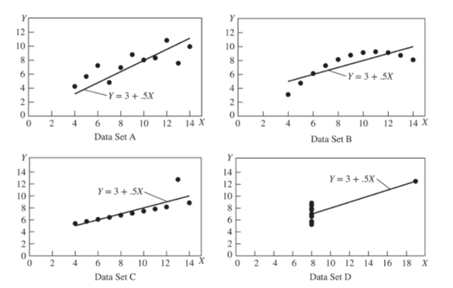
Figure 4.1
It is important to look at the data before plunging ان تغوص في into data analysis and the selection of an appropriate set of forecasting techniques.
Jump to long description
Notes:
6
6

Slide 7
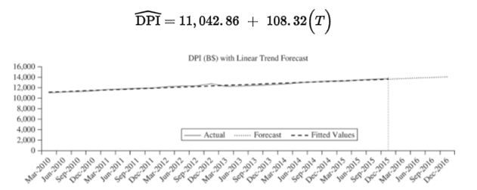
Figure 4.3 A Trend Regression
Jump to long description

Slide 8
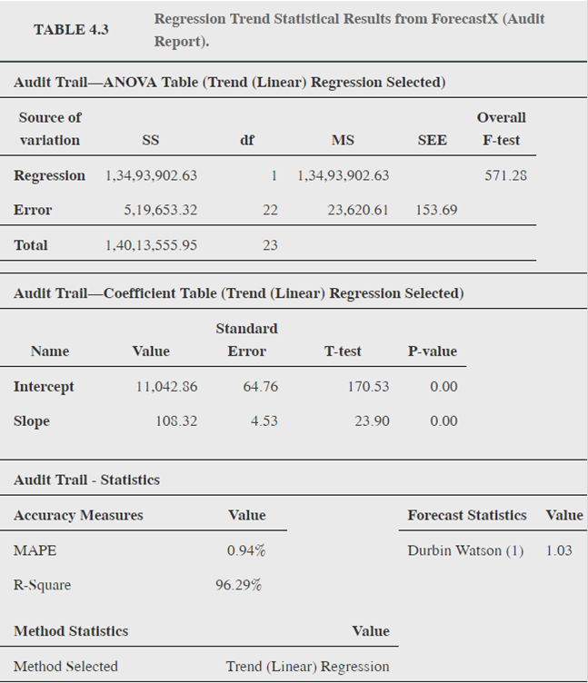
Audit Report result from ForecastX
In most cases it is best to use the Audit Report to examine results in order to see all the diagnostic statistics in one location.
Jump to long description
Notes:
8
8

Slide 9
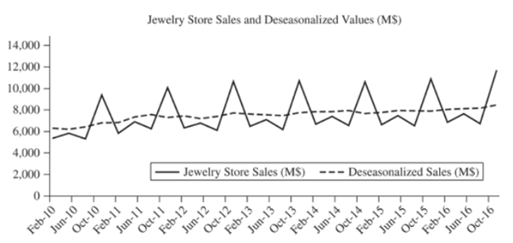
Data for a Causal Regression
Jump to long description

Slide 10
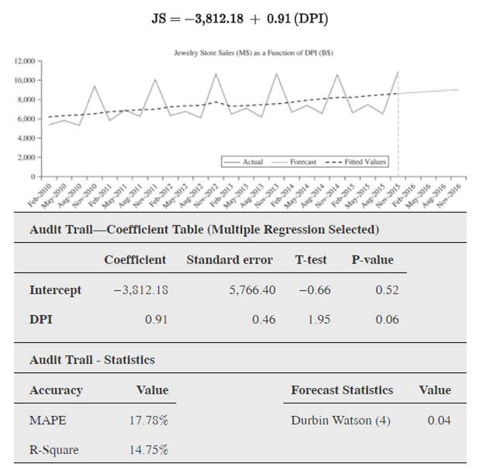
Figure 4.5 Jewelry Sales Causal Regression
Data for 2010–2015 were used to estimate this model. The positive slope (0.91) indicates that, on average, JS increases by $0.91 million for each additional $1 billion increase in disposable personal income.
A major problem with this model is apparent in the graph. It is clear from the graph of actual and predicted retail sales that this model fails to deal with the seasonality in JS.
Jump to long description
Notes:
10
10

Slide 11
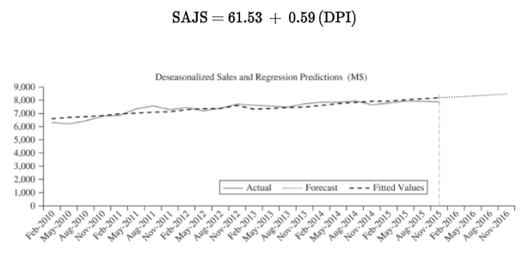
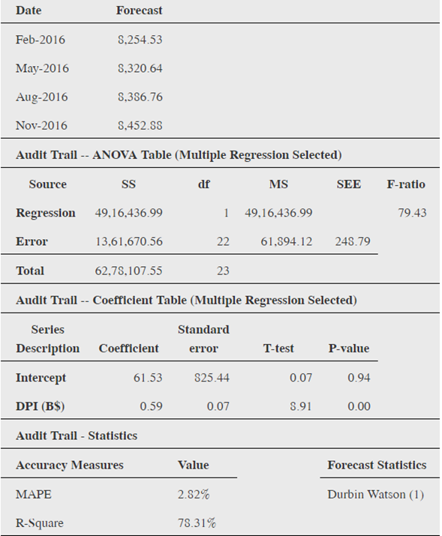
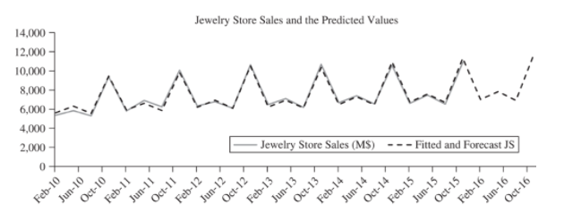
Figures 4.7 and 4.8 Seasonally Adjusted Jewelry Sales Model and Reseasonalized Forecast Values
Jump to long description
Notes:
11
11

Slide 12
Four Quick Checks (for regression models)
4 اختبارات
If you perform 4 quick checks you will rarely misinterpret the results of a regression estimate.
إذا قمت بإجراء 4 اختبارات سريعة ، فنادراً ما تسيء تفسير نتائج تقدير الانحدار.
The checks require no reference tables or calculations.
Failure to perform the checks could lead to consistent misinterpretation of the results
.
We will add a fifth quick check in the following chapter.
Notes:
12
12

Slide 13
Four Quick Checks 1
Does the model make economic sense (i.e., check slope term)?
Is there a statistically significant relationship between the dependent and independent variables (t-test)?
What percentage of the variation in the dependent variable does the regression model explain (R-Square)?
Is there a problem of serial correlation among the error terms in the model (Durbin-Watson)?
Notes:
13
13

Slide 14
Four Quick Checks 2
check slope term
t-test
R-Square
Durbin-Watson
Notes:
14
14

Slide 15
First Quick Check الاختبار الأول
Does the model make economic sense?
Economic Meaning
The Slope Term (what is its sign?)
There is almost always an economic or business logic that indicates whether the relationship between the dependent variable (Y) and an independent variable (X) should be positive or negative.
Notes:
15
15

Slide 16
Second Quick Check الاختبار الثانى
Is the coefficient statistically significant?
Use a t-test to examine the null hypothesis that the slope of the true relationship between X and Y is equal to zero.
Hint: if the t-statistic is greater than 2, the coefficient is statistically significant (rule of thumbشئ متعارف عليه).
Notes:
16
16

Slide 17
Third Quick Check الاختبار الثالث
Coefficient of Determination (“R-Squared”)
The third check of regression results is to evaluate what percent of the variation (i.e., up-and-down movement) in the dependent variable is explained by variation in the independent variable.

Slide 18
A Fourth Quick Check (perhaps the most important check?) الاختبار الرابع
Business and economic data is most often time series data. In using regression analysis with time series data a problem known as autocorrelation can cause some difficulty.
Autocorrelation (serial correlation) is a significant pattern in the error terms or residuals.
If present, the t-ratios will be overstated and the F-statistic and R-Squared statistics will be unreliable.
Notes:
18
18

Slide 19
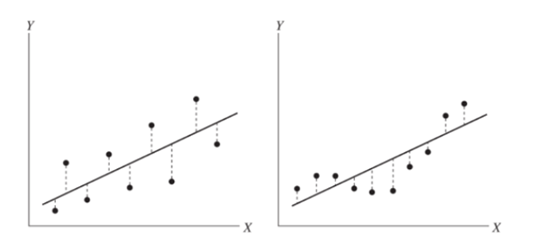
Fourth Quick Check 1
Check for autocorrelation with the Durbin-Watson.
Jump to long description

Slide 20
Fourth Quick Check 2
The DW statistic will always be in the range of 0 to 4. As a rule of thumb, a value close to 2 (e.g., between 1.50 and 2.50) indicates that there is no serial correlation. When the DW statistic approaches 4, the degree of negative serial correlation increases. When positive serial correlation exists, the value of DW approaches 0.
Durbin Watson Statistic
Rule of Thumb:
If DW(1) is between 1.5 and 2.5, you probably
have no 1st order serial correlation (autocorrelation).

Slide 21
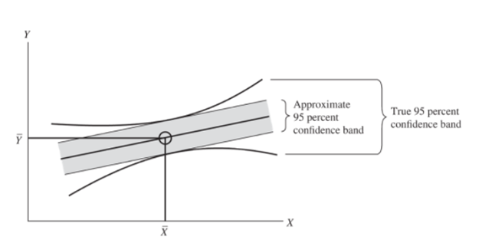
Figure 4.9 The Standard Error of the Estimate (The Standard Error of Regression)
The standard error of the estimate (SEE) can be used to generate approximate confidence intervals with relative ease.
Jump to long description

Slide 22
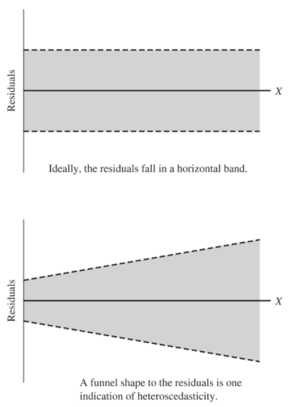
Figure 4.13 Heteroscedasticity
One of the assumptions of regression analysis is that the error terms in the population regression (εi) have a constant variance across all values of the independent variable (X). When this is true, the model is said to be homoscedastic, and if this assumption is violated, the model is termed heteroscedastic.
Jump to long description

Slide 23
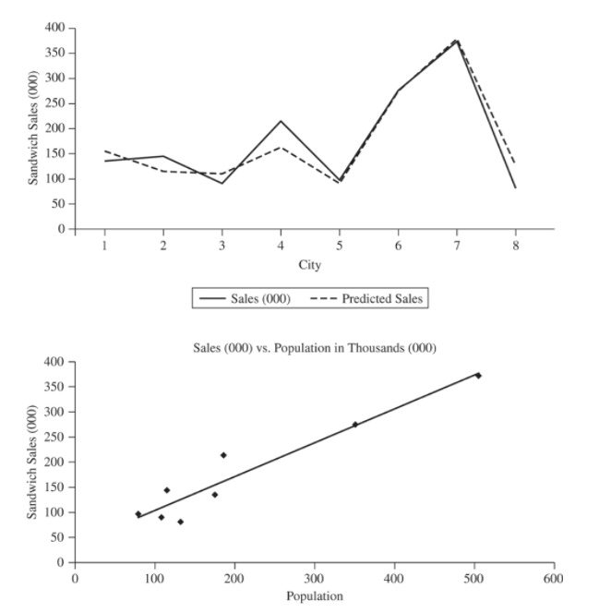
Figure 4.13 Cross- Sectional Regression
While most forecasting is based on time-series data, there are situations in which cross-sectional analysis is useful. In cross-sectional analysis, the data all pertain to one time period rather than a sequence of periods.
Jump to long description

Slide 24
Cross- Sectional Regression
While most forecasting is based on time-series data, there are situations in which cross-sectional analysis is useful. In cross-sectional analysis, the data all pertain to one time period rather than a sequence of periods.

Slide 25
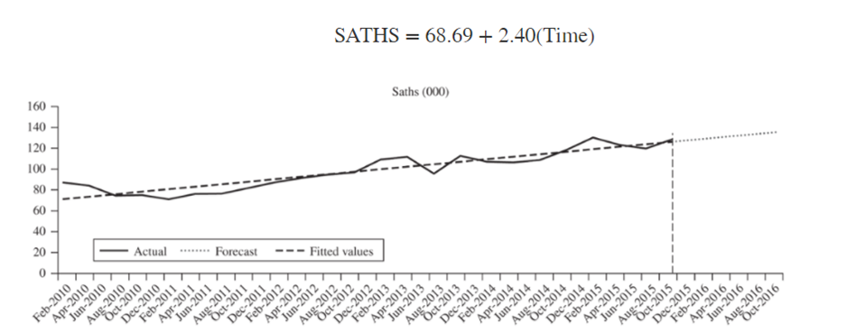
Figure 4.15
Jump to long description

Slide 26
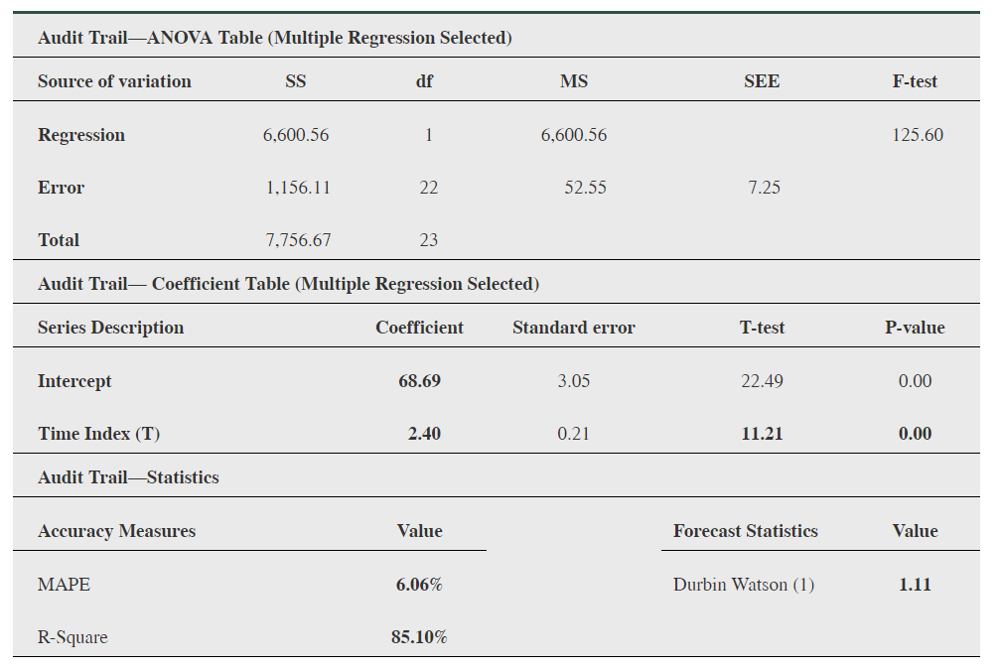
Table 4.15
Jump to long description

Slide 27
Trend Forecast
Date | Actual 2016 THS | THS Forecast | Error | Absolute Error | Absolute % Error
Feb-2016 | 134 | 128.40 | 5.60 | 5.60 | 4.18
May-2016 | 158 | 147.63 | 10.37 | 10.37 | 6.57
Aug-2016 | 144 | 132.39 | 11.61 | 11.61 | 8.06
Nov-2016 | 125 | 119.26 | 5.74 | 5.74 | 4.59
 |  |  |  | MAPE = | 5.85%

Slide 28
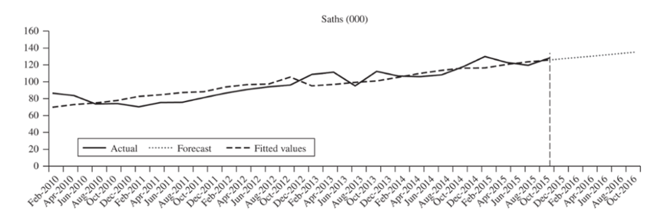
Figure 4.16
Seasonally adjusted total houses sold (000) = 6.29 + 0.01(DPI)
Jump to long description

Slide 29
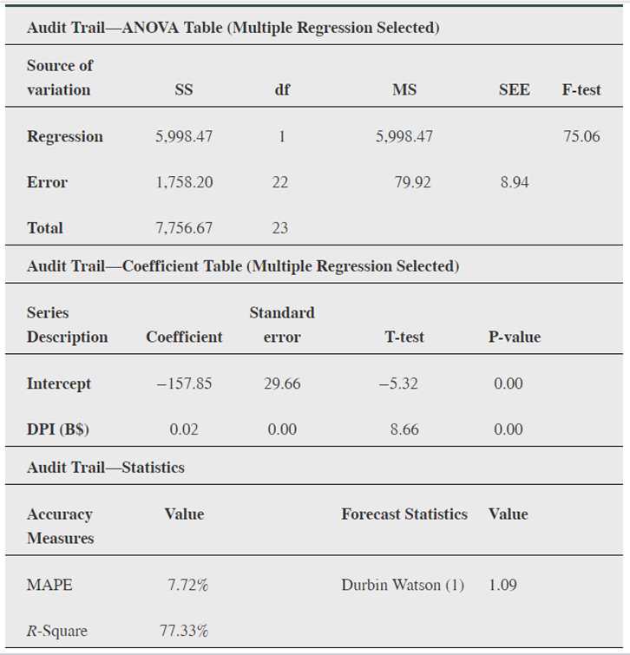
Table 4.16
Jump to long description

Slide 30
Causal Forecast
Date | Actual 2016 THS | THS Forecast | Error | Absolute Error | Absolute % Error
Feb-2016 | 134 | 128.200 | 5.800 | 5.800 | 4.328
May-2016 | 158 | 147.340 | 10.660 | 10.660 | 6.747
Aug-2016 | 144 | 132.100 | 11.900 | 11.900 | 8.264
Nov-2016 | 125 | 118.970 | 6.030 | 6.030 | 4.824
 |  |  |  | MAPE = | 6.04

Slide 31
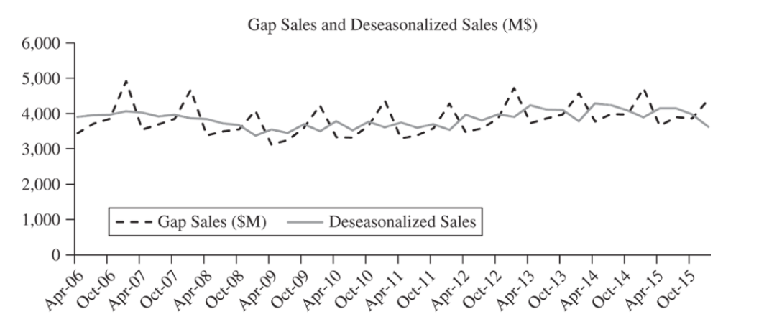
Intergrative Case: The Gap
Jump to long description

Slide 32
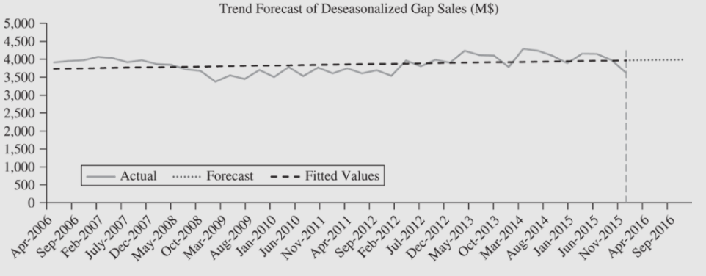
Trend Forecast: The Gap
Jump to long description

Slide 33
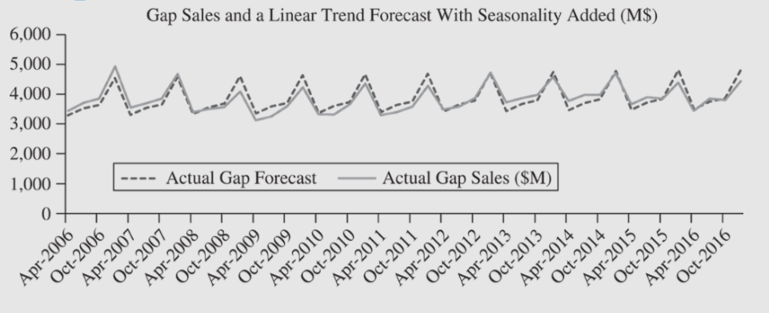
Linear Trend with Seasonality
Jump to long description

Slide 34
Appendix of Image Long Descriptions

Slide 35
Figure 4.1 - Appendix
The first scatterplot has a positive fairly linear trend. The second scatterplot shows a very consistent concave down curve. The third one shows all points in a nearly perfect line with the exception of one outlier. The last graph shows a cluster of points with the x value of 8, and one point far to the right and vertically greater than the others.
Jump to the image

Slide 36
Figure 4.3 A Trend Regression - Appendix
This is the same graph as the previous, but with the linear trend forecast shown as well as the actual data. The forecast fits the actual data nearly perfectly.
Jump to the image

Slide 37
Audit Report result from ForecastX - Appendix
Included in the table is the following:
Audit Trail - ANOVA Table (Trend (Linear) Regression Selected)
Regression
SS = 1,34,93,902.63, df = 1, MS = 1,34,93,902.63, Overall F-test = 571.28
Error
SS = 5,19,653.32, df = 22, MS = 23,620.61, SEE = 153.69
Total
SS = 1,40,13,555.95, df = 23
Audit Trail - Coefficient Table (Trend (Linear) Regression Selected
Intercept
Value = 11,042.86, Standard Error = 64.76, T-test = 170.53, P-value = 0.00
Slope
Value = 108.32, Standard Error = 4.53, T-test = 23.90, P-value = 0.00
Audit Trail - Statistics
Accuracy Measures
MAPE = 0.94%, R-Square = 96.29%
Forecast Statistics
Durbin Watson (1) = 1.03
Jump to the image

Slide 38
Data for a Causal Regression - Appendix
The jewelry store sales were cyclical, peaking each year around December with a smaller peak around Valentines Day. The general trend over time is slightly positive with sales growing from about 6 million in 2010 to about 7 or 8 million in 2016.
Jump to the image

Slide 39
Figure 4.5 Jewelry Sales Causal Regression - Appendix
The jewelry store sales were cyclical, peaking each year around December with a smaller peak around Valentines Day. The general trend over time is slightly positive with sales growing from about 6 million in 2010 to about 7 or 8 million in 2016.
Audit Trail - Coefficient Table (Multiple Regression Selected)
Intercept:
Coefficient –3,812.18, Standard error 5,766.40, T-test –0.66, P-Value 0.52
DPI:
Coefficient 0.91, Standard error 0.46, T-test 1.95, P-Value 0.06
Audit Trail - Statistics
Accuracy Value
MAPE 17.78%, R-Square 14.75%
Forecast Statistics Value
Durbin Watson (4) 0.04
Jump to the image

Slide 40
Figures 4.7 and 4.8 Seasonally Adjusted Jewelry Sales Model and Reseasonalized Forecast Values - Appendix
(Top left image) Time plot showing the deseasonalized sales and regression predictions for February 2010 to November 2015 along with the fitted values and forecast.
(Bottom left image) Time plot showing the jewelry store sales in millions of dollars from February 2010 to October 2016 along with fitted and forecasted values.
(Right image) Date with Forecast:
February 2016, 8,254.53, May 2016, 8,320.64, August 2016, 8,386.76, November 2016, 8,452.88
Audit Trail - ANOVA Table (Multiple Regression Selected)
Regression:
SS 49,16,436.99, df 1, MS 49,16,436.99, F-ratio 79.43
Error:
SS 13,61,670.56, df 22, MS 61,894,12, SEE 248.79
Total:
SS 62,78,107.55, df 23
Audit Trail - Coefficient Table (Multiple Regression Selected)
Intercept:
Coefficient 61.53, Standard Error 825.44, T-test 0.07, P-value 0.94
DPI (B$):
Coefficient 0.59, Standard Error 0.07, T-test 8.91, P-value 0.00
Audit Trail - Statistics
Accuracy Measures with Value
MAPE 2.82%, R-Square 78.31%
Forecast Statistics:
Durbin Watson (1)
Jump to the image

Slide 41
Fourth Quick Check 1 - Appendix
The first scatterplot shows points that consistently alternate between being above and below the regression line. Vertical lines are drawn between the points and the regression line. The second scatterplot shows a nonlinear relationship with three points above the regression line, then 5 points below the regression line, followed by 2 points above the regression line. Vertical lines are drawn between each point and the regression line.
Jump to the image

Slide 42
Figure 4.9 The Standard Error of the Estimate - Appendix
Also shown are two curves. One curve is above the upper limit and is concave up. The other curve is below the lower confidence limit and is concave down. This is the true 95% confidence band. Also shown is the fact that the regression line passes through the point x-bar, y-bar.
Jump to the image

Slide 43
Figure 4.13 Heteroscedasticity - Appendix
The first graph shows that the residuals will ideally fall uniformly around the x-axis, meaning that they will not exceed or go below specific y-values. The second graph shows residuals that are increasing in size as x increases. This makes a funnel shape, or fanning out as x increases, indicating heteroscedasticity.
Jump to the image

Slide 44
Figure 4.13 Cross- Sectional Regression - Appendix
The first graph displays city on the horizontal axis and is scaled from 1 to 8 and sandwich sales on the vertical axis and is scaled from 0 to 400,000. A line is drawn between the points along with a dashed line connecting the values of the predicted sales for each city. The second graph is a scatterplot with sandwich sales on the vertical axis and population (from 0 to 600) on the horizontal axis. The relationship is fairly strong, positive, and linear. There is a cluster of points around a population of 100 to 200 and sandwich sales around 50,000 to 200,000. There are two points that are towards the top right, one with a population of about 350 and sales of about 300 and one with a population of about 500,000 and sales of about 400,000.
Jump to the image

Slide 45
Figure 4.15 - Appendix
The fitted values and forecast are also shown. The fitted values are linear and model the positive trend.
Jump to the image

Slide 46
Table 4.15 - Appendix
Audit Trail- ANOVA Table (Multiple Regression Selected)
Regression:
SS 6,600.56, df 1, MS 6,600.56, F-test 125.60
Error:
SS 1,156.11, df 22, MS 52.555, SEE 7.25
Total
SS 7,756.67, df 23
Audit Trail - Coefficient Table (Multiple Regression Selected)
Intercept:
Coefficient 68.69, Standard error 3.05, T-test 22.49, P-value 0.00
Time Index (T):
Coefficient 2.40, Standard error 0.21, T-test 11.21, P-value 0.00
Audit Trail - Statistics
MAPE 6.06%, R-Square 85.10%
Durbin-Watson (1) 1.11
Jump to the image

Slide 47
Figure 4.16 - Appendix
The fitted values and forecast are also shown. The fitted values are not perfectly linear this time, but are not far from linear because the actual data is fairly linear.
Jump to the image

Slide 48
Table 4.16 - Appendix
Audit Trail - ANOVA Table (Multiple Regression Selected)
Regression:
SS 5,998.47, df 1, MS 5,998.47, F-test 75.06
Error:
SS 1,758.20, df 22, MS 79.92, SEE 8.94
Total:
SS 7.756.67, df 23
Audit Trail - Coefficient Table (Multiple Regression Selected)
Intercept:
Coefficient −157.85, Standard error 29.66, T-test −5.32, P-value 0.00
DPI (B$)
Coefficient 0.02, Standard error 0.00, T-test 8.6, P-value 0.00
Audit Trail - Statistics
MAPE 7.72%, R-Square 77.33%
Durbin Watson (1) 1.09
Jump to the image

Slide 49
Intergrative Case: The Gap - Appendix
Gap sales show seasonal variation, but fairly horizontal over time. The deseasonalized sales are considerably smoother, but still fairly horizontal (around 4 million).
Jump to the image

Slide 50
Trend Forecast: The Gap - Appendix
This is the same deseasonalized graph as the previous, but with the forecasted values included from November 2015 through September 2016. Also included are the fitted values.
Jump to the image

Slide 51
Linear Trend with Seasonality - Appendix
This graph shows the seasonal variation for the actual gap sales as well as the actual gap forecast, which follows the actual gap sales nearly perfectly.
Jump to the image

