Slide 1

Chapter 3
Extrapolation 1: Moving Averages and Exponential Smoothing
© 2019 McGraw-Hill Education. All rights reserved. Authorized only for instructor use in the classroom. No reproduction or further distribution permitted without the prior written consent of McGraw-Hill Education.
Notes:
1

Slide 2
THE NAÏVE METHOD
A starting point and benchmark
Where F_{t} is the forecast for time period t and
is the actual one period earlier.
Notes:
2
2

Slide 3
THE MOVING AVERAGE METHOD
A moving average is a series of numbers obtained by overlapping groups of two or more consecutive values in a time series.
The average is “moving” because an ever-new average is calculated by adding a more recent time series value to the group and dropping the oldest one.
Do you use moving averages?
Notes:
3
3

Slide 4
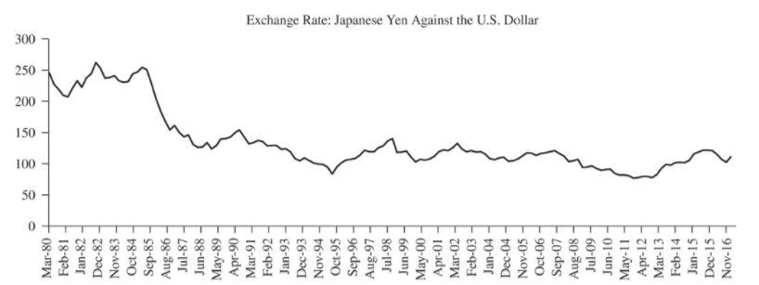
Figure 3.1 Dollar Yen Exchange Rate

Slide 5
Table 3.1
Date | Exchange Rate: Japanese Yen Against the US Dollar | Three Quarter Moving Average (MA3) | Forecast Based on MA3 | Five Quarter Moving Average (MA5) | Forecast Based on MA5
Mar-80 | 245.52 | NA | NA | NA | NA
Jun-80 | 227.27 | NA | NA | NA | NA
Sep-80 | 219.17 | 230.65 | NA | NA | NA
Dec-80 | 209.79 | 218.74 | 230.65 | NA | NA
Mar-81 | 207.73 | 212.23 | 218.74 | 221.89 | NA
Jun-81 | 221.45 | 212.99 | 212.23 | 217.08 | 221.89
Sep-81 | 233.40 | 220.86 | 212.99 | 218.31 | 217.08
Dec-81 | 223.13 | 225.99 | 220.86 | 219.10 | 218.31
Mar-82 | 238.09 | 231.54 | 225.99 | 224.76 | 219.10
Jun-82 | 244.35 | 235.19 | 231.54 | 232.08 | 224.76
Sep-82 | 262.49 | 248.31 | 235.19 | 240.29 | 232.08
Dec-82 | 253.79 | 253.54 | 248.31 | 244.37 | 240.29
Mar-83 | 237.39 | 251.22 | 253.54 | 247.22 | 244.37
Jun-83 | 238.59 | 243.26 | 251.22 | 247.32 | 247.22
Sep-83 | 241.59 | 239.19 | 243.26 | 246.77 | 247.32
Dec-83 | 233.26 | 237.81 | 239.19 | 240.92 | 246.77
The simple statistical method of moving averages may mimic some data better than a complicated mathematical function.
The choice of the interval for the moving average depends on the length of the underlying cycle or pattern in the original data.

Slide 6
Simple Exponential Smoothing
The simple exponential smoothing model can be written in the following manner:
Note: Moving Averages give equal weight to past values
while Smoothing gives more weight to recent observations.

Slide 7
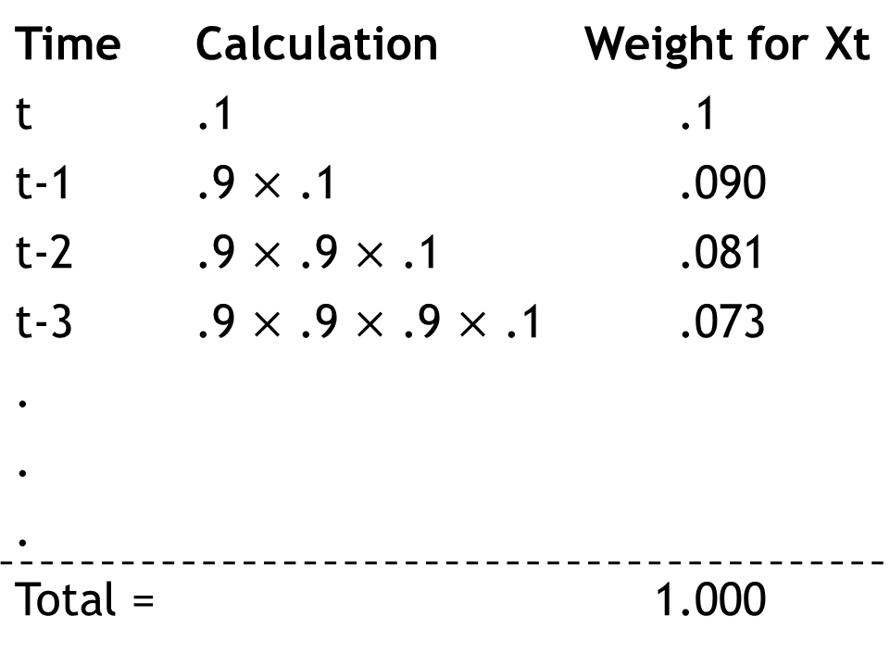
Weights for Alpha level smoothing = .1
Time | Calculation | Weight for Xt
t | .1 | .1
t-1 | .9 $×$ .1 | .090
t-2 | .9 $×$ .9 $×$ .1 | .081
t-3 | .9 $×$ .9 $×$ .9 $×$ .1 | .073
.
.
.
Total = |  | 1.000
α = .1
Regardless of the smoothing constant chosen, the weights will eventually sum to 1. Whether the sum of the weights converges on 1 quickly or slowly depends on the smoothing constant chosen.

Slide 8
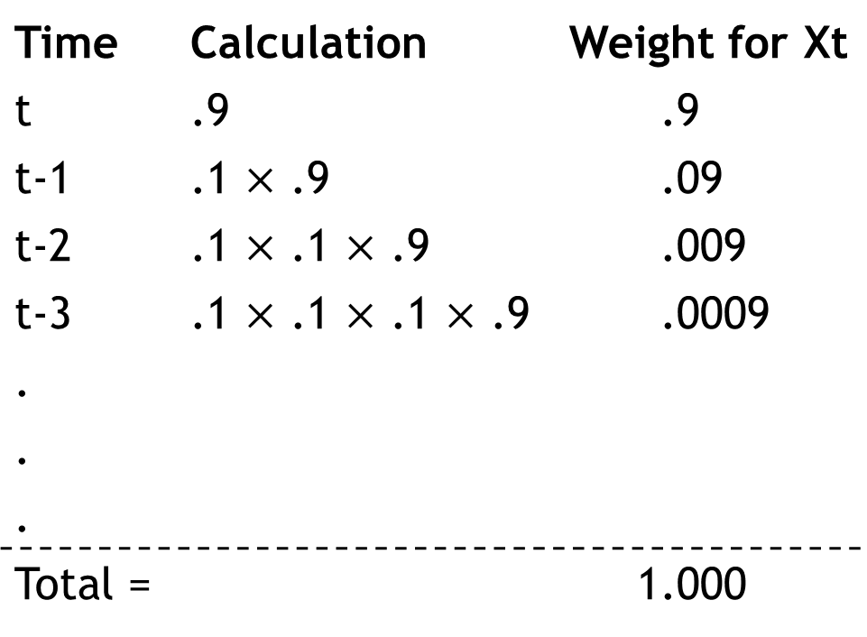
Weights for Alpha level smoothing = .9
Time | Calculation | Weight for Xt
t | .9 | .9
t-1 | .1 $×$ .9 | .09
t-2 | .1 $×$ .1 $×$ .9 | .009
t-3 | .1 $×$ .1 $×$ .1 $×$ .9 | .0009
.
.
.
Total = |  | 1.000
α = .9
Regardless of the smoothing constant chosen, the weights will eventually sum to 1. Whether the sum of the weights converges on 1 quickly or slowly depends on the smoothing constant chosen.
Similar to the Naïve Model if α equals .9

Slide 9
Holt’s Exponential Smoothing
Used for data exhibiting some trend over time
Is just as simple to apply as simple smoothing
Involves two smoothing factors, a simple smoothing factor and a trend smoothing factor
Notes:
9
9

Slide 10
Holt’s Exponential Smoothing:

Slide 11
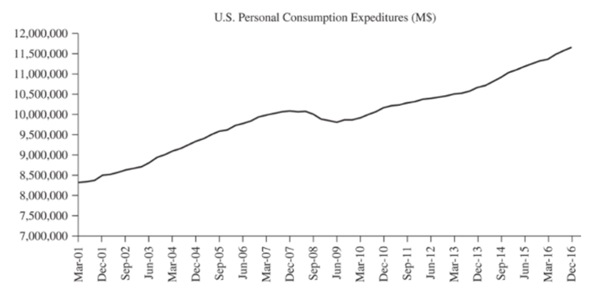
Figure 3.5
Notes:
11
11

Slide 12
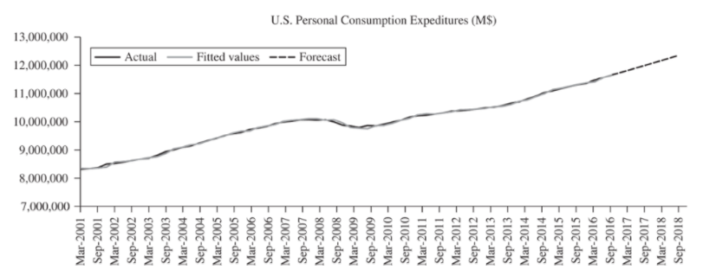
Figure 3.6
Holt’s two-parameter exponential smoothing method (called "Double Exponential Smoothing Holt" in ForecastXTM) is an extension of simple exponential smoothing; it adds a growth factor (or trend factor) to the smoothing equation as a way of adjusting for the trend.
In this case, alpha (the level constant) was 0.88 and gamma (the trend constant) was 0.68.

Slide 13
Holt Winter’s Exponential Smoothing 1
Adjusts for both trend and seasonality
Is just as simple to apply as simple smoothing
Involves the use of three smoothing parameters, a simple smoothing parameter, a trend smoothing parameter and a seasonality smoothing parameter
Notes:
13
13

Slide 14
Holt Winter’s Exponential Smoothing 2

Slide 15
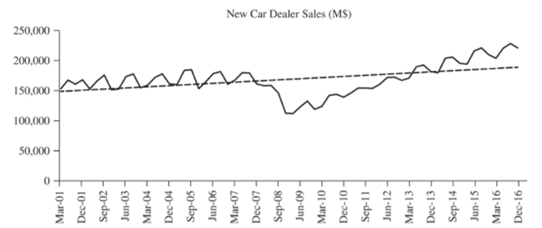
Figure 3.7
Notes:
15
15

Slide 16
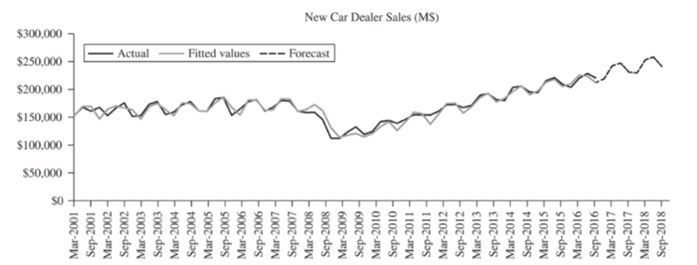
Figure 3.8
Notes:
16
16

Slide 17
The Seasonal Indices
Winters’ exponential smoothing provides forecasters with one additional piece of information that can be of significant value to a manager. As part of the calculation with an adjustment for seasonality, seasonal indices are calculated and displayed in most forecasting software. ForecastX™ produces seasonal indices with each Winters’ model.
Seasonal Indices | Value
Index 1 | 0.95
Index 2 | 1.04
Index 3 | 1.05
Index 4 | 0.96
Notes:
17
17

Slide 18
What is a Seasonal Index? 1
Q1 100
Q2 100
Q3 100
Q4 100
No Obvious Seasonal Pattern!
But note that total sales for the year = 400

Slide 19
What is a Seasonal Index? 2
Q1 125
Q2 75
Q3 125
Q4 75
There is a Seasonal Pattern !
Assume it repeats year after year.
Again, total sales for the year = 400

Slide 20
The Seasonal Indices are calculated from the Seasonal Factors.
What is a Seasonal Factor?
125/100 = 1.25 SF for Quarter 1
75/100 = 0.75 SF for Quarter 2
125/100 = 1.25 SF for Quarter 3
75/100 = 0.75 SF for Quarter 4

Slide 21
Finally, what is a Seasonal Index?
The Final Step:
Sum all the Quarter 1 Seasonal Factors and divide by the number of first quarter; this gives the Seasonal Index for Quarter 1.
Sum all the Quarter 2 Seasonal Factors and divide by the number of second quarters; this gives the Seasonal Index for Quarter 2.
And so on...

Slide 22
Interpreting the Seasonal Index? 1
Our Quarter 1 Seasonal Index was 1.25
This could be interpreted as saying that, on average, Quarter 1 is 125% of the average quarter.
This is an “above average” quarter.

Slide 23
Interpreting the Seasonal Index? 2
The Seasonal Index for Quarter 2 was 0.75
This could be interpreted as saying that:
Sales would be expected to take on a value of only 75% of the average quarter.
This is a “below average” quarter.

Slide 24
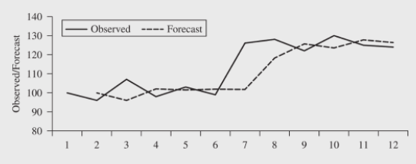
Adaptive Response Model

Slide 25
New Product Forecasting 1
S-Curves of Growth
S-Curves are also called
  Growth Models
  Saturation Models
  Substitution Models
  Diffusion Models

Slide 26
Life Cycles as S-Curves
The life cycles we associate with products are often related to technology life cycles; these cycles have four phases
  Slow growth in the embryonic stage
  Rapid growth
  Slowing growth in the mature phase
  Decline during the final phase

Slide 27
New Product Forecasting 2
S-Curve Models - Examples
The selection of an S-shaped trend model is a common step to model and forecast:
  The diffusion of innovations
  The penetration of a market (for example, with HDTV)
  Production situations
  Product life cycle situations

Slide 28
Growth Models
When manufacturers introduce an innovation such as HDTV to a population, initially only a small number of adopters buy it.
Gradually this process gathers momentum, the adoptions reach a peak and then decrease as Saturation is reached. (ForecastX uses “L” for the Saturation constant)
An idealized plot would look like:

Slide 29
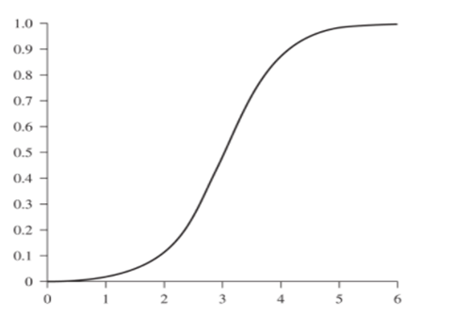
The S Curve – Figure 3.12

Slide 30
Using Growth Curves To Approximate Nonlinearity
Two S-Curve fitting techniques:
Gompertz Curve
Logistics Curve

Slide 31
Choosing The Correct Curve
Research has shown that models based on initial data are quite valid in later forecasts if the correct curve and upper limit have been identified.
In general:
  If it is harder to achieve a constant improvement as we approach the maximum value, the Gompertz Curve is the better choice. (HDTV?)
  If there are factors that assist in maintaining improvements then the Logistics Curve is the better choice. (cell phone? Network Effects)

Slide 32
Gompertz
Also called: law of mortality
Where:
L = upper limit of Y
e = Natural (or Naperian) number 2.718282
a and b = estimated coefficients describing the curve
The Gompertz curve ranges from zero to L as t varies from −∞ to +∞. The L is the “Maximum” value in the ForecastX dialog box.
“Harder to achieve a constant improvement” – No Network Effect

Slide 33
Logistics Model
Where:
L = upper limit of Y
e = Natural (or Naperian) number 2.718282
a and b = estimated coefficients describing the curve
“Factors assist in maintaining improvements” = Network Effect

Slide 34
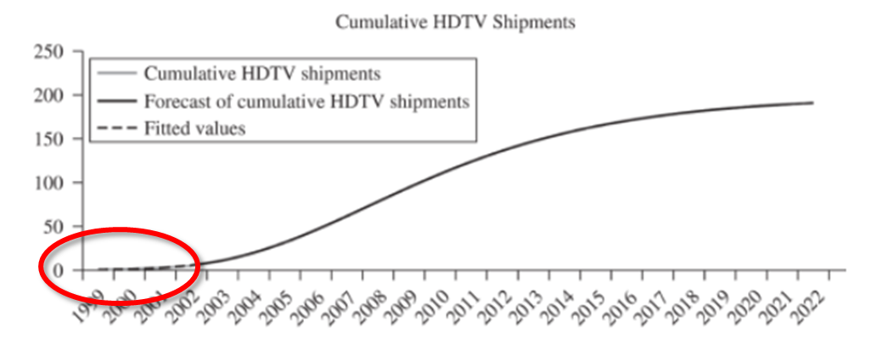
HDTV Introduction
Date | Cumulative HDTV Shipments (millions)
12/31/1999 | 0.12
12/31/2000 | 0.77
12/31/2001 | 2.23
12/31/2002 | 4.76

Slide 35
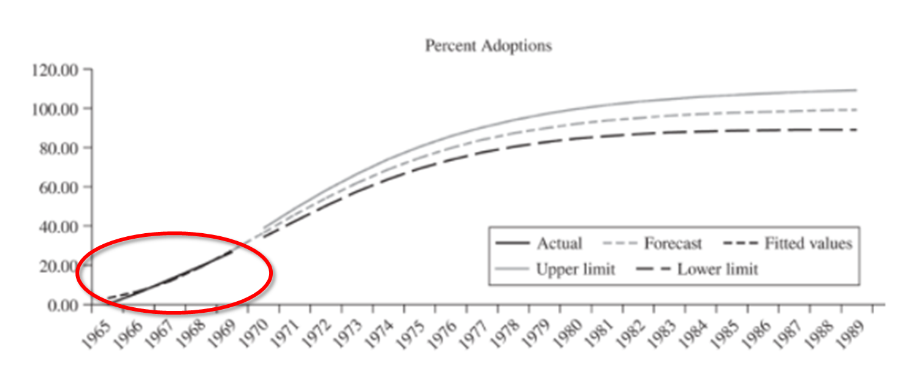
Gompertz Prediction – Figure 3.16

Slide 36
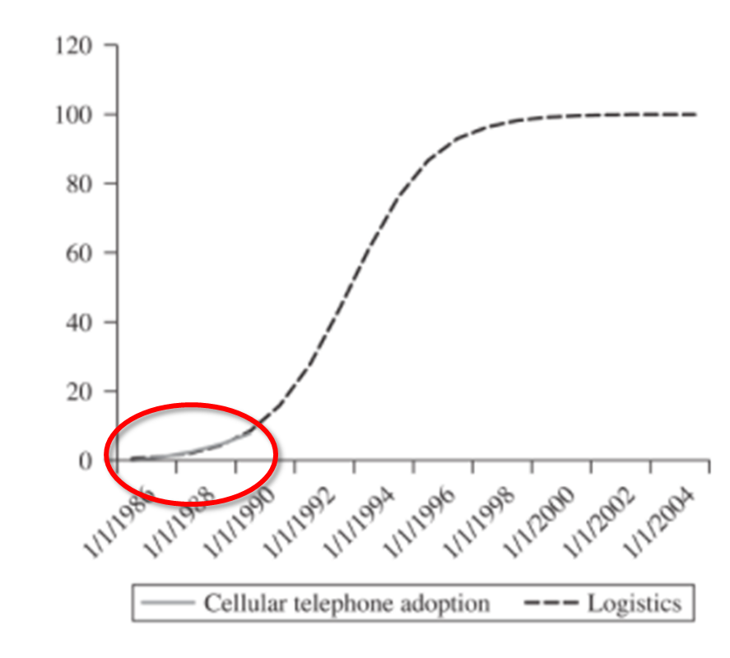
Logistics Curve _ Figure 3.17
Note: Probably includes a network characteristic.

Slide 37
The Bass Model – A Third S-Curve Model
Bass Model:
100’s of Applications-An Empirical Generalization
Widely Cited
Numerous Extensions
Published in Several Languages
Growing Software Applications

Slide 38
The Bass Model – A Third S-Curve Model
Where:
m=ultimate market potential
p=coefficient of innovation
q=coefficient of imitation
Y = number of previous buyers
S = Sales

Slide 39
Bass Model
Suggestions for Choosing p and q
People in collectivist cultures care more about what others think of them and seem to react accordingly. In countries with higher purchasing power, the p tends to be higher.
More disposable income makes it easier to adopt innovations; the p tends to be higher.
Products that exhibit significant network effects or require heavy investment in complimentary infrastructure (like television and the cellular telephone) will have higher values for q.

Slide 40
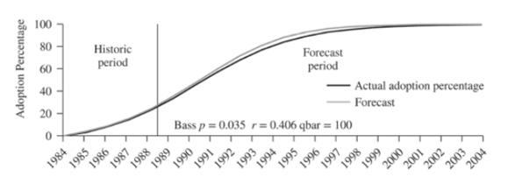
Bass Model – Figure 3.20

Slide 41
Event Models (events create new patterns)
The simple exponential smoothing model can be written in the following manner:
This becomes the default “underlying model” for the Event Model.

Slide 42
Event Models 1
The addition of “Events” to the exponential smoothing model allows the modeling of any management controlled event (and nonmanagement controlled events as well).
Event Flags are assigned to particular time periods.

Slide 43
Event Models 2
  Often used to determine the effects of special promotions.
  Since special promotions affect everything from revenue and inventory to the volume of business done, it is necessary to consider them in forecasts.
  Failure to describe events accurately could seriously degrade the accuracy of forecasts.
We calculate the lift factors associated with the event. An event index is built to identify when in the past events have occurred and when in the future they will occur.
A Promotional Calendar must be correct for the Event Modeling to work.

Slide 44
What could “events” be?
Scheduled promotions by your firm
Expected reactions by competing firms
Events that may (or may not) recur
  A competitor’s factory burns down
  September 11, 2001

Slide 45
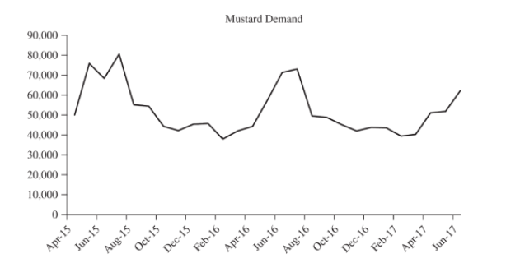
Event Model – Figure 3.21
Date | Mustard | Event Index
Apr-15 | 50,137 | 7
May-15 | 76,030 | 7
Jun-15 | 68,590 | 3
Jul-15 | 80,681 | 4
Aug-15 | 55,228 | 5
Sep-15 | 54,577 | 0
Oct-15 | 44,384 | 8
Nov-15 | 42,337 | 0
Dec-15 | 45,512 | 6
Jan-16 | 45,798 | 4
Feb-16 | 38,045 | 5
Mar-16 | 42,127 | 0
Apr-16 | 44,422 | 2
May-16 | 57,662 | 1
Jun-16 | 71,427 | 6
Jul-16 | 73,269 | 5
Aug-16 | 49,695 | 8
Sep-16 | 49,021 | 1
Oct-16 | 45,263 | 0
Nov-16 | 42,210 | 1
Dec-16 | 43,968 | 6
Jan-17 | 43,778 | 4
Legend:
0 = Nothing | 5 = Deload
1 = FSI | 6 = Light Load
2 = Thematics | 7 = FSI / Act Media
3 = Big Load | 8 = Cross Cpn
4 = After Load
FSI = free standing inserts. These are off-cents coupons distributed in newspapers
Thematics = Themed add campaign
Big Load = Large trade promotion - often a deep drop in the case price for the retailer
Deload = Month after effect of a “load”
Act Media = Radio, television, print add campaign
Cross Coupons = Cents off coupons placed directly on the packaging of other goods

Slide 46
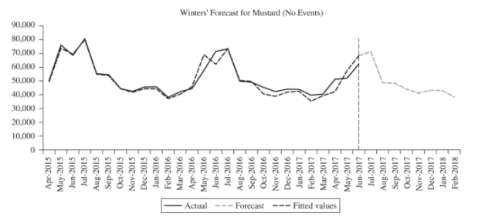
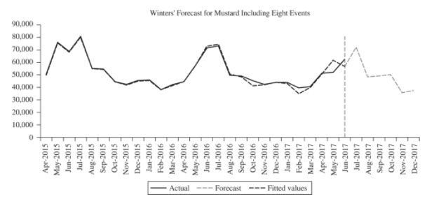
With and Without Events – Figures 3.22 and 3.23
MAPE = 5.18%
MAPE = 2.62%

Slide 47
Table 3.14
 | Winters’ Model | Winters’ Model with Event Indices
Historical MAPE | 5.18% | 2.62%
Level Smoothing Factor (alpha) | 0.05 | 0.20
Seasonal Smoothing Factor (beta) | 0.88 | 0.92
Trend Smoothing Factor (gamma) | 0.26 | 0.26
Event Index 1 | NA | 0.94
Event Index 2 | NA | 1.16
Event Index 3 | NA | 0.99
Event Index 4 | NA | 1.03
Event Index 5 | NA | 1.00
Event Index 6 | NA | 0.94
Event Index 7 | NA | 1.03
Event Index 8 | NA | 0.99
The addition of the events to the historical period caused a tighter fit between the actual mustard demand and predicted mustard demand. Using the knowledge of the planned company promotions for the next six months allows the forecaster to calculate a much better picture of predicted demand than the Winters’ model alone.

