Slide 1
JavaScript:
Introduction to Scripting

Slide 2
Introduction
JavaScript
Scripting language that facilitates a disciplined approach to designing computer programs that enhance the functionality and appearance of web pages.
Before you can run code examples with JavaScript on your computer, you may need to change your browser’s security settings.
IE7 prevents scripts on the local computer from running by default
FF2 enables JavaScript by default

Slide 3
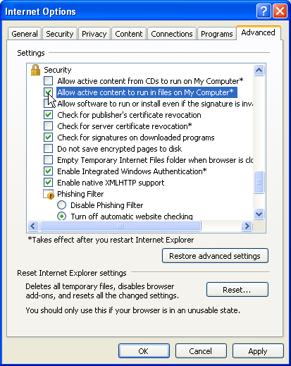

Slide 4
Simple Program: Displaying a Line of Text in a Web Page
Spacing displayed by a browser in a web page is determined by the XHTML elements used to format the page
Often, JavaScripts appear in the <head> section of the XHTML document
The browser interprets the contents of the <head> section first
The <script> tag indicates to the browser that the text that follows is part of a script. Attribute type specifies the scripting language used in the script—such as text/javascript

Slide 5
Simple Program: Displaying a Line of Text in a Web Page (Cont.)
A string of characters can be contained between double (") or single (') quotation marks
A string is sometimes called a character string, a message or a string literal

Slide 6
Simple Program: Displaying a Line of Text in a Web Page (Cont.)
The parentheses following the name of a method contain the arguments that the method requires to perform its task (or its action)
Every statement should end with a semicolon (also known as the statement terminator), although none is required by JavaScript
JavaScript is case sensitive
Not using the proper uppercase and lowercase letters is a syntax error

Slide 7
Simple Program: Displaying a Line of Text in a Web Page (Cont.)
The document object’s writeln method
Writes a line of XHTML text in the XHTML document
Does not guarantee that a corresponding line of text will appear in the XHTML document.
Text displayed is dependent on the contents of the string written, which is subsequently rendered by the browser.
Browser will interpret the XHTML elements as it normally does to render the final text in the document

Slide 8
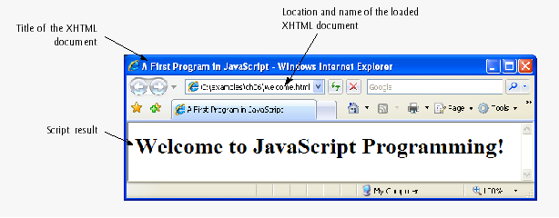
Specifies that we are using the JavaScript language
Script begins
Prevents older browsers that do not support scripting from displaying the text of the script
Writes an h1 welcome message in the XHTML document
XHTML comment delimiter, commented for correct interpretation by all browsers
Script ends

Slide 9
Modifying Our First Program
Method write displays a string like writeln, but does not position the output cursor in the XHTML document at the beginning of the next line after writing its argument
You cannot split a statement in the middle of a string. The + operator (called the “concatenation operator” when used in this manner) joins two strings together

Slide 10
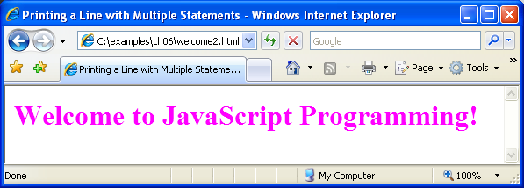
Two write statements create one line of XHTML text
Concatenation operator joins the string together, as it is split into multiple lines

Slide 11
Modifying Our First Program (Cont.)
Dialogs
Useful to display information in windows that “pop up” on the screen to grab the user’s attention
Typically used to display important messages to the user browsing the web page
Browser’s window object uses method alert to display an alert dialog
Method alert requires as its argument the string to be displayed

Slide 12
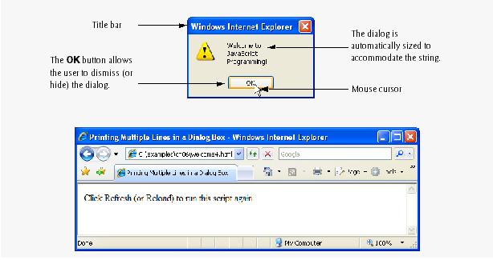
Creates a pop up box that alerts the welcome text to the user

Slide 13
Modifying Our First Program (Cont.)
When a backslash is encountered in a string of characters, the next character is combined with the backslash to form an escape sequence. The escape sequence \n is the newline character. It causes the cursor in the XHTML document to move to the beginning of the next line.

Slide 15
Obtaining User Input with prompt Dialogs
Declarations end with a semicolon (;) and can be split over several lines, with each variable in the declaration separated by a comma (forming a comma-separated list of variable names)
Several variables may be declared in one declaration or in multiple declarations.
Comments
A single-line comment begins with the characters // and terminates at the end of the line
Comments do not cause the browser to perform any action when the script is interpreted; rather, comments are ignored by the JavaScript interpreter
Multiline comments begin with delimiter /* and end with delimiter */
All text between the delimiters of the comment is ignored by the interpreter.

Slide 16
Obtaining User Input with prompt Dialogs (Cont.)
The window object’s prompt method displays a dialog into which the user can type a value.
The first argument is a message (called a prompt) that directs the user to take a specific action.
The optional second argument is the default string to display in the text field.
Script can then use the value that the user inputs.

Slide 17
Obtaining User Input with prompt Dialogs (Cont.)
The window object’s prompt method displays a dialog into which the user can type a value.
The first argument is a message (called a prompt) that directs the user to take a specific action.
The optional second argument is the default string to display in the text field.
Script can then use the value that the user inputs.

Slide 18
Declares a new variable
Sets the identifier of the variable to name
Inserts the value given to name into the XHTML text
Assigns the string entered by the user to the variable name

Slide 19
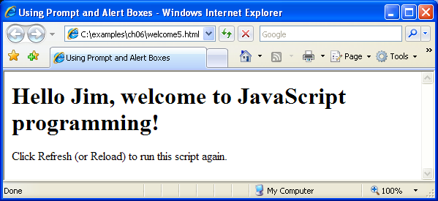

Slide 20
Assigns the first input from the user to the variable firstNumber
Assigns the second input from the user to the variable secondNumber
Converts the strings entered by the user into integers

Slide 21
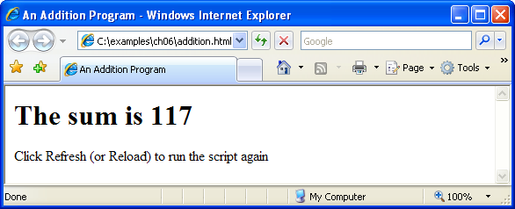

Slide 22
Arithmetic
The basic arithmetic operators (+, -, *, /, and %) are binary operators, because they each operate on two operands
JavaScript provides the remainder operator, %, which yields the remainder after division

Slide 23
Decision Making: Equality and Relational Operators
if statement allows a program to make a decision based on the truth or falsity of a condition
If the condition is met (i.e., the condition is true), the statement in the body of the if statement is executed
If the condition is not met (i.e., the condition is false), the statement in the body of the if statement is not executed
Conditions in if statements can be formed by using the equality operators and relational operators

Slide 25
Decision Making: Equality and Relational Operators (Cont.)
Date object
Used acquire the current local time
Create a new instance of an object by using the new operator followed by the type of the object, Date, and a pair of parentheses

Slide 26
Set variable now to a new Date object
Assigns hour to the value returned by the Date object’s getHours method
Conditional statement: checks whether the current value of hour is less than 12
This statement will execute only if the previous condition was true

Slide 27
Conditional statement: checks whether the current value of hour is greater than or equal to 12
If hour is 12 or greater (the previous condition was true), subtract 12 from the value and reassign it to hour
Conditional statement: checks whether the current value of hour is less than 6
Conditional statement: checks whether the current value of hour is greater than or equal to 6

Slide 28
