Slide 1

Introduction to Organic Chemistry
Dr. Shatha Alaqeel
Chem. 108

Slide 2
Leaning objectives:
By the end of this lecture the student will know:
What is Organic Chemistry?
How are organic compounds are made from indiviual elements?
Types of bond in organic compounds and their significance
Different methods of representing chemical bonding

Slide 3
What is organic chemistry?
Organic chemistry is the study of carbons / hydrogen containing compounds and their derivatives (containing other elements such as O, X and N).
organic chemistry also is the study of the chemistry of life.

Slide 4
Importance of organic compounds
DNA: the giant molecules that contain all the genetic information for a given species.
proteins: blood, muscle, and skin.
Enzymes: catalyze the reactions that occur in our bodies.
Petroleum: furnish the energy that sustains life.
Polymers: Cloths, cars, plastic.
Medicine

Slide 5
Chemical Bonds
The attractive force which holds together the constituent particles (atoms, ions or molecules) in chemical species is known as chemical bond.
Each bond is made up of two electrons
The electrons that participate in chemical bonds are the valence electrons, which are the electrons found in an atom's outermost shell.

Slide 6
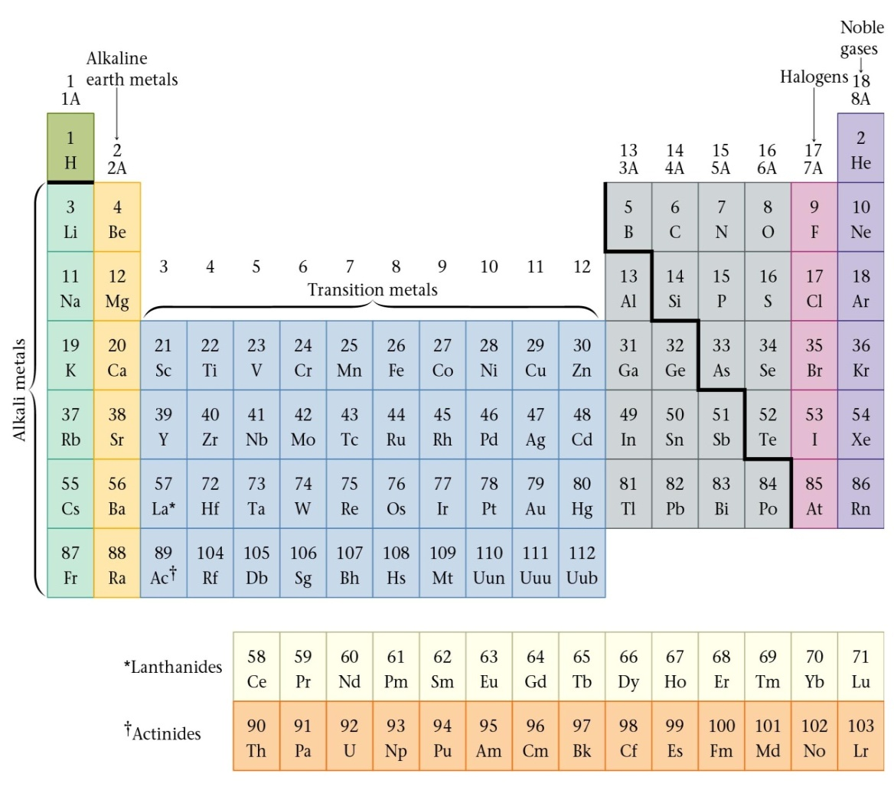
Review of Valence Electrons
Number of valence electrons of a main (A) group atom = Group number

Slide 7
Chemical Bonding
1. Ionic Bonds
2. Covalent Bonds
3. Coordinate Covalent Bonds

Slide 8
Ionic bond
Ionic compounds are formed when one atom gains a valence electron from a different atom, forming a negative ion (anion) and a positive ion (cation) respectively. The electrostatic force of attraction between oppositely charged ions constitutes the ionic bond. Therefore ionic bonds are usually between metals and nonmetals ; opposite ends of the periodic table.
When two atoms with large different electronegativity values

Slide 9
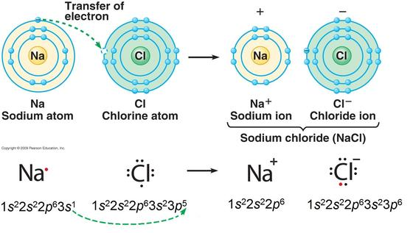
Sodium lets Chlorine use its valance electron

Slide 10
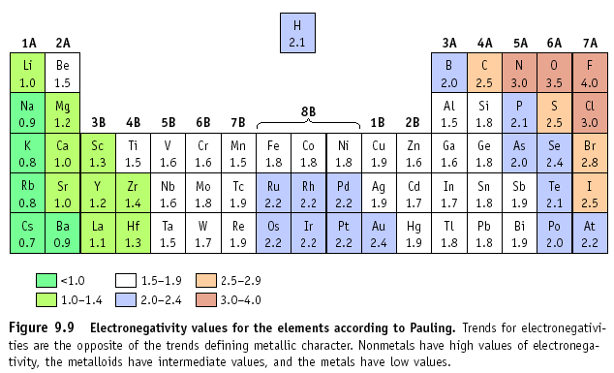
The type of bond can usually be calculated by finding the difference in electronegativity of the two atoms that are going together.

Slide 11
Covalent Bond
results when two or more atoms have similar electronegativities, lend to form bond by sharing electron pairs rather than completely transferring electrons.
A covalent bond is formed when two atoms share one or more electron pairs.
Covalent bonds form between two non-metal atoms.

Slide 12
Covalent Bonds:
1. single or multiple
A covalent bond in which one electron pair is shared by two atoms, represented in chemical formulas by one line or two vertical dots, as C–H or C:H.
A double covalent bond is where two pairs of electrons are shared between the atoms rather than just one pair, represented in chemical formulas by two lines or four vertical dots, as O=O or O::O .
A triple covalent bond is where three pairs of electrons are shared between the atoms rather than just one pair, represented in chemical formulas by three lines or sex vertical dots

Slide 13
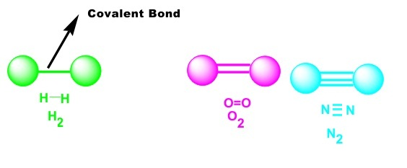
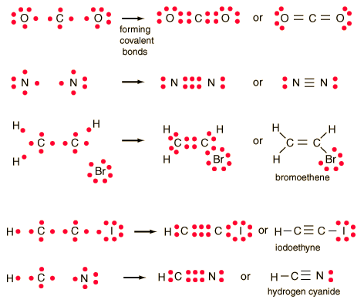

Slide 14
2. polar or non polar
Polar covalent bond
Covalent bonds can be formed not only between identical atoms but also between different atoms (C-H, C-Cl), Provided that the atoms do not differ too greatly in electronegativity. However, one of the atoms partially "pulls" the bonding electrons toward itself, creating an unequal sharing of those bonding electrons. the electron pair may not be shared equally between them. Alternatively, a partial charge, written as δ+ or δ – .
Non polar
If the bonding electrons are shared equally because both atoms have the same electronegativity.

Slide 15
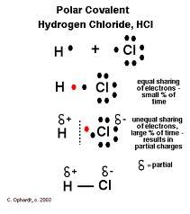
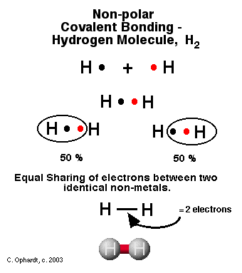
2. polar or non polar

Slide 16
Coordinate Covalent Bond
There are molecules in which one atom supplies both electrons to another atom in the formation of a covalent bond.
Ammonia Hydrogen ion Ammoniom ion
Lewis base Lewis acid
furnishes electron pair accepts electron pair
⊕

Slide 17
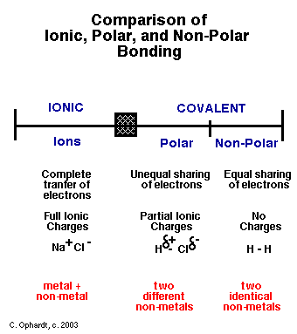
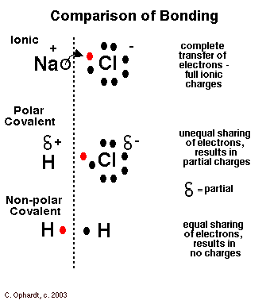

Slide 18
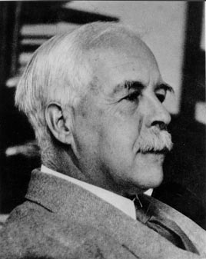
Chemical bonding in Molecules by Lewis (electron dot) structures
The symbol of the element is written first. This represents the nucleus of the element with all the inner electrons that do not take part in the bond formation.
The valence electrons (electrons in the OUTERMOST energy level ) are then written as dots or small cross marks around the symbol. They are spread in a pair on four sides of the symbol.
In case of ions the charge is shown with the symbol

Slide 19
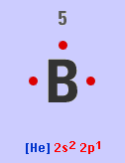
Examples:
B⁵ its electronic configuration is 1s² 2s² 2p¹;
so the outer energy level is 2, with 3 valence electrons These can be represented by Lewis structure.
      Used to show an element and the number of valence electrons.
      Q1:Draw Lewis structure for Cl

Slide 20
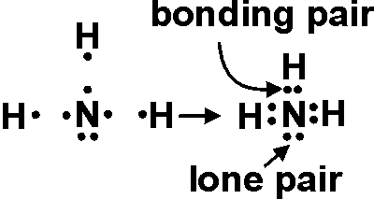
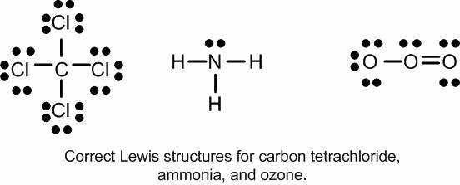
Types of valence electrons
Valence electrons of an atom which are shared with others are called BOND PAIRS and those are unshared are called LONE PAIRS (LP).

Slide 21
Covalence Numbers
How Many Bonds to an Atoms?
number of bonds = (full valence shell VS) – (number of valence electrons VE) (for a neutral atom)
Atoms | full number VS | number of VE | No.Typical bonds | No. Typical unbonds
H | 2 | 1 | 1 | 0
C | 8 | 4 | 4 | 0
N | 8 | 5 | 3 | 2
O | 8 | 6 | 2 | 4
F,Cl,Br,I | 8 | 7 | 1 | 6

Slide 22
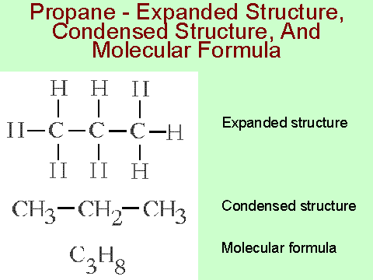
Condensed structural formulas

Slide 23
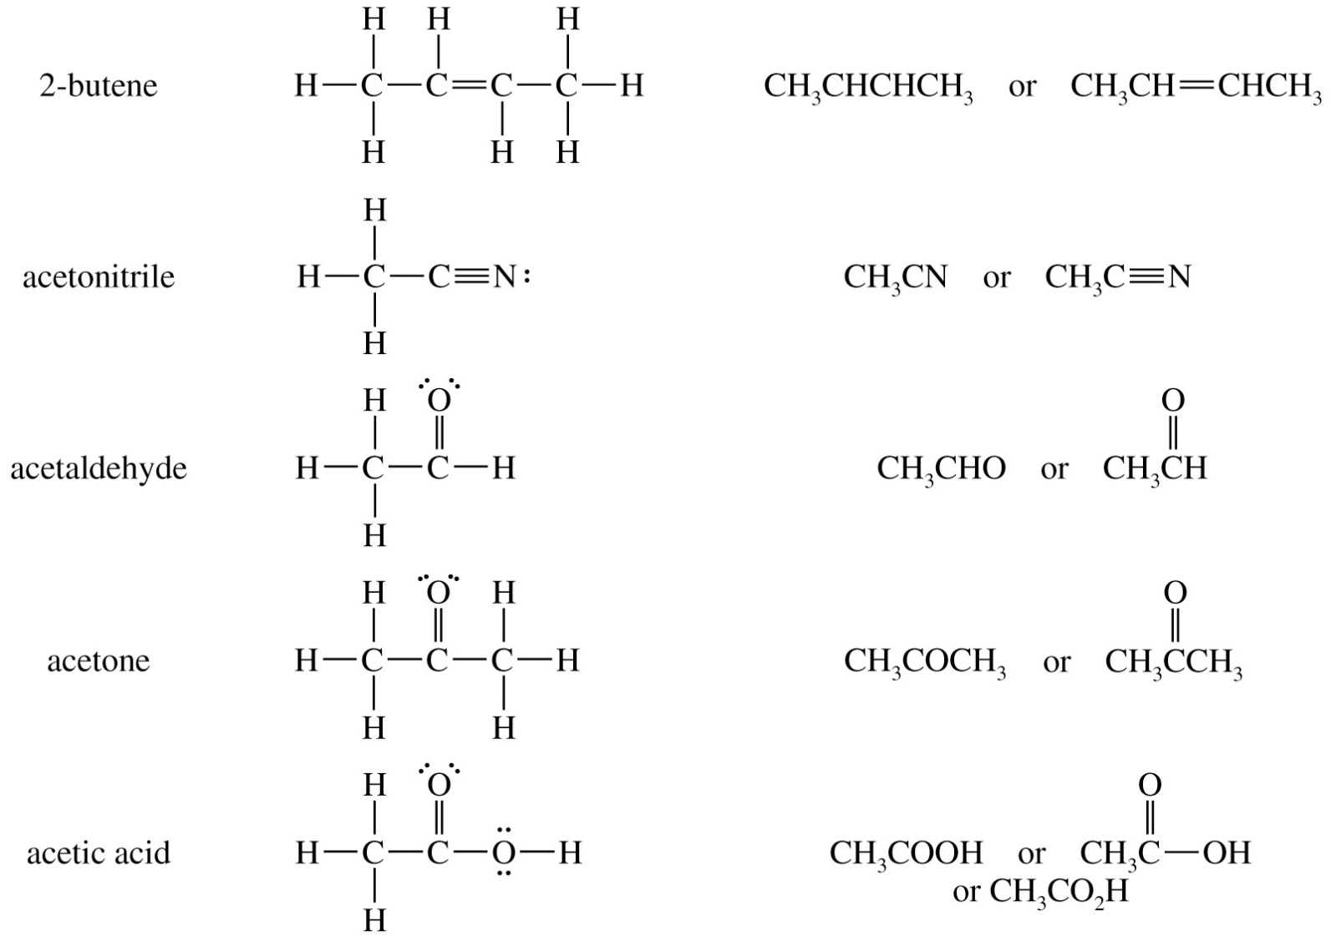

Slide 24
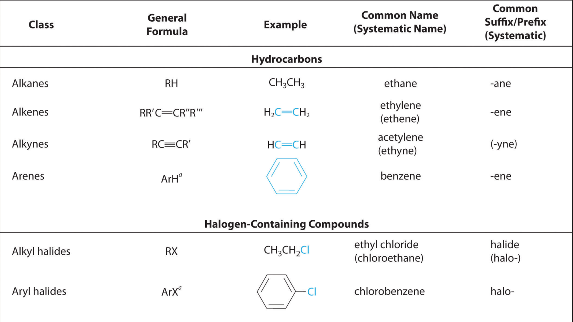
Functional Groups
Functional groups – is areactive portion of an organic molecule, an atom, or group of atoms that confers on the whole molecule its characteristic properties.

Slide 25
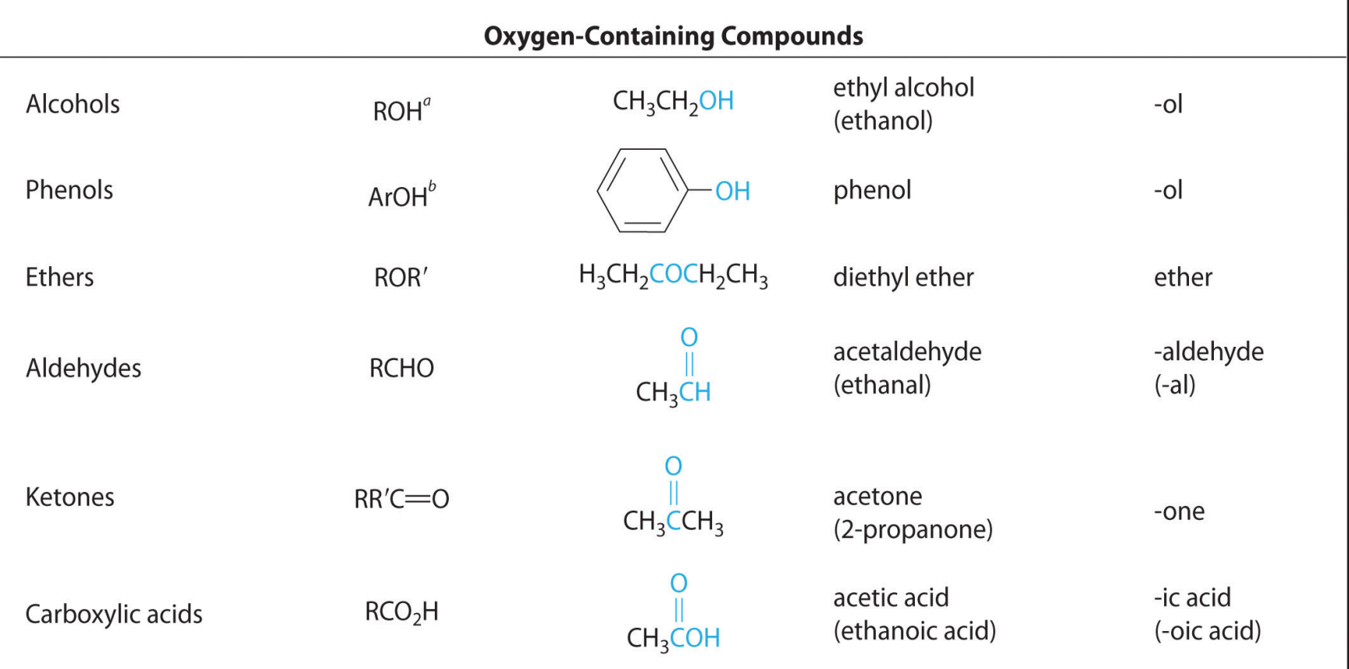

Slide 26
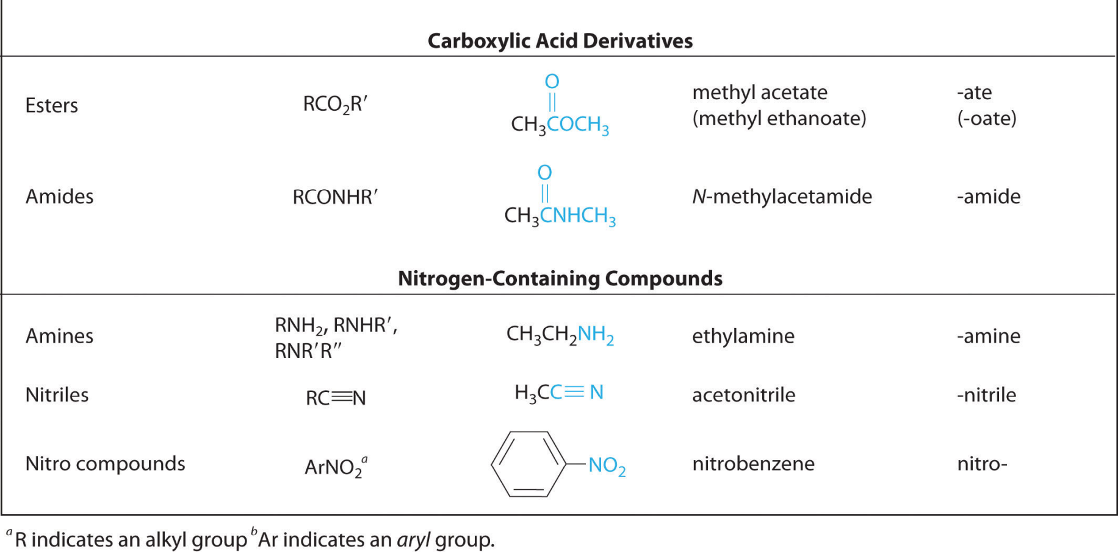

Slide 27
Thank You for your kind attention !
Questions?
Comments

