Slide 1
Introduction
King Saud University
College of Applied studies and Community Service
By: Nour Alhariqi
Edited: Elham Sunbu
1st semester 1439 - 1440

Slide 2
Outline
Communication system
Communication system model
Mode of Communication
Data Transmission Mode
Analog and digital communication system
Effectiveness of Communications System

Slide 3
Communications System
Communication is the sharing of information. Local , Over distance.
A Communication System is a combination of processes and the hardware used to accomplish the transfer of the Information.

Slide 4
Communications System Model

Slide 5
Communications System Model
Transmitter: process the message signal into a form suitable for transmission over the communication channel.
Communication channel: provide a pathway between the transmitter's output and the receiver's input.
Receiver: process the received signal to recover the appropriate message signal.

Slide 6
Mode of Communication
There are two basic mode of communication:
1- Broadcasting → single transmitter and numerous receiver.
2- Point to point communication → single transmitter and single receiver.
Broadcasting
Point to point

Slide 7
Data Transmission Mode
Data transmission between two devices can be:

Slide 8
Analog and Digital Data
Analog
Digital

Slide 9
Analog and Digital Data
Analog Data data takes on continues values.
E.g., human voice, weight, temperature values.
Digital Data data takes on discrete values.
E.g., text data

Slide 10
Analog and Digital Signals
There are two methods in transmitting a message signal over the communication channel: analog or digital

Slide 11
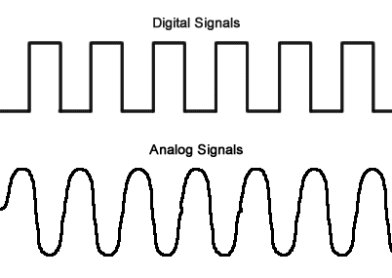
Analog and Digital Signals
Analog signal:
is a signal whose amplitude can take on any value in a continues range.
Digital signal:
is a signal whose amplitude can take on only a finite number of values.

Slide 12
Data and Signals

Slide 13
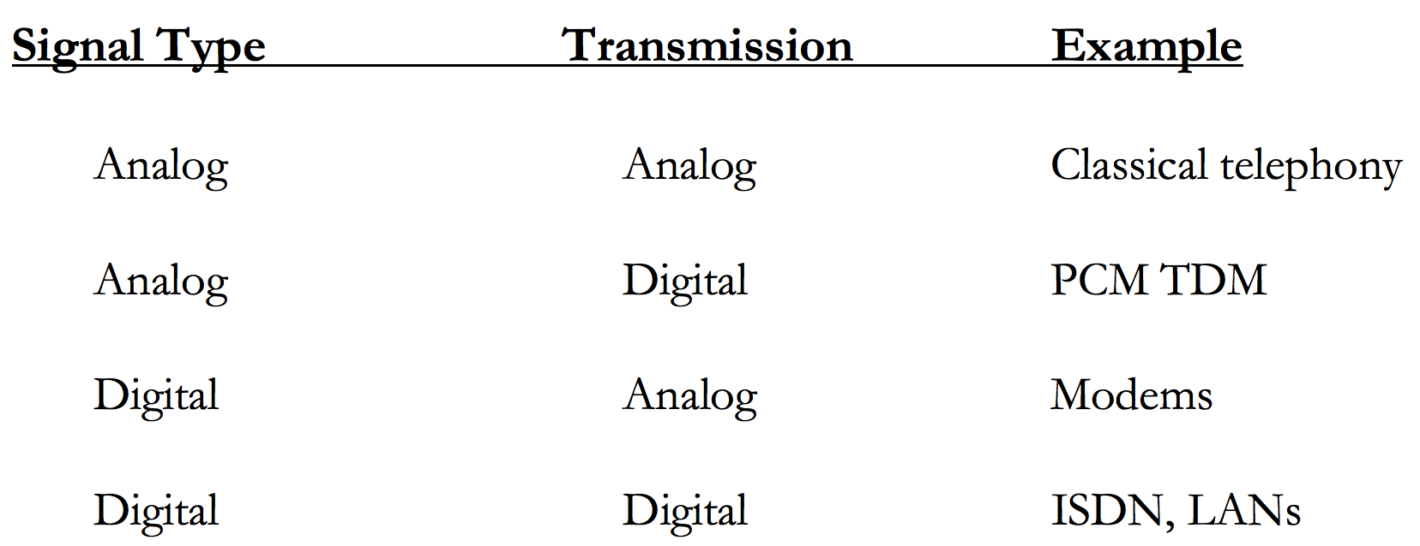
Data and Signals

Slide 14
Analog Communication System
Analog Communication is a communication method of conveying voice, data, image, signal or video information using a continuous signal.
Which varies in amplitude, phase, or some other property in proportion to that of a variable.

Slide 15
Analog Communication System
Notes:
- (Radio Frequency stage) The frequency used to carry a radio signal (radio station, TV channel, cellphone channel, etc.).
- The RF signals are converted to an intermediate stage for demodulation.

Slide 16
Analog Communication System
The transmitter block contains the modulator device.
The receiver block contains the demodulator device.
The modulator modulates a carrier wave (the electromagnetic wave) which has a frequency that is selected from an appropriate band in the radio spectrum.
Notes:
Modulation is the process of impressing a low-frequency information signal (baseband signal )onto a higher frequency carrier signal

Slide 17
Digital Communication System
Digital communication is a mode of communication where the information is encoded digitally as discreet signals and electronically transferred to the recipients.

Slide 18
Digital Communication System

Slide 19
Digital Communication System
Source Encoder: compresses the data into minimum number of bits. This process helps in effective utilization of the bandwidth.
Channel Encoder: The channel encoder, does the coding for error correction.
Digital Modulator: The signal to be transmitted is modulated here by a carrier.
Notes:
Source Encoder compresses the data into minimum number of bits. This process helps in effective utilization of the bandwidth. It removes the redundant bits (unnecessary excess bits, i.e., zeroes)
The channel encoder, does the coding for error correction. During the transmission of the signal, due to the noise in the channel, the signal may get altered and hence to avoid this, the channel encoder adds some redundant bits to the transmitted data. These are the error correcting bits

Slide 20
Digital Communication System
Channel Decoder: The channel decoder does some error corrections.
Source Decoder: The source decoder recreates the source output.
Notes:
Channel Decoder The channel decoder does some error corrections. The distortions which might occur during the transmission, are corrected by adding some redundant bits. This addition of bits helps in the complete recovery of the original signal.

Slide 22
Effectiveness of Communications System
The effectiveness of a communications system depends on four fundamental characteristics:
Delivery
Accuracy
Jitter
Timeliness

Slide 23
Effectiveness of Communications System
Delivery:
The system must deliver information to the correct receiver.
Information must be received by the intended device or user and only by that device or user.
Accuracy:
The system must deliver the information accurately.
Information that have been altered in transmission and left uncorrected are unusable.

Slide 24
Effectiveness of Data Communications System
Timeliness:
The system must deliver information in a timely manner.
Information delivered late are useless.
In the case of video and audio, timely delivery means :
delivering data in the same order as they are produced,
and without significant delay.
This kind of delivery is called real-time transmission.

Slide 25
Effectiveness of Data Communications System
Jitter:
Jitter refers to the variation in the packet arrival time.
It is the uneven delay in the delivery of audio or video packets.
For example, let us assume that video packets are sent every 3 ms. If some of the packets arrive with 3 ms delay and others with 4 ms delay, an uneven quality in the video is the result.

Slide 26
Any Question?

