Slide 1
College of Science,
Zoology Department

Slide 2
Teaching Strategy
A)- Description:
أ)- الوصف:
Course Designation | Zoo-109 | 109 حين | رقم المقرر ورمزه
Course Name | General Animal Biol. | بيولوجيا الحيوان العام | اسم المقرر
No. of Credits | 3 (2 + 1) | 3 ساعات (2 + 1) | عدد الوحدات الدراسية المعتمدة
Prerequisites | None | لا يوجد | متطلب سابق
Co-requisite Course | None | لا يوجد | متطلب مصاحب
B)- Assessments Timetable
ب)- الجدول الزمني لمهام التقويم
Assessment | Assessment tasks | Marks | Total marks
1 | 1st laboratory exam | 30/100 | 30 marks
2 | Final laboratory Exam
3 | 1st theoretical exam | 15/100 | 30 marks
4 | 2nd theoretical exam | 15/100
5 | Final theoretical Exam | 40/100 | 40 marks
 |  | 100/100 | 100 marks

Slide 3
إرشادات
الالتزام بالحضور في موعد المحاضرة
وضع مكبر الصوت والكاميرا وضع الاغلاق
رفع اليد للسؤال
عدم التغيب عن الامتحان الا لسبب قاهر مع الاثبات
عند التغيب عن اكثر من 25% من عدد المحاضرات بما فيها المعامل تحرم الطالبة من دخول الامتحان النهائي

Slide 4
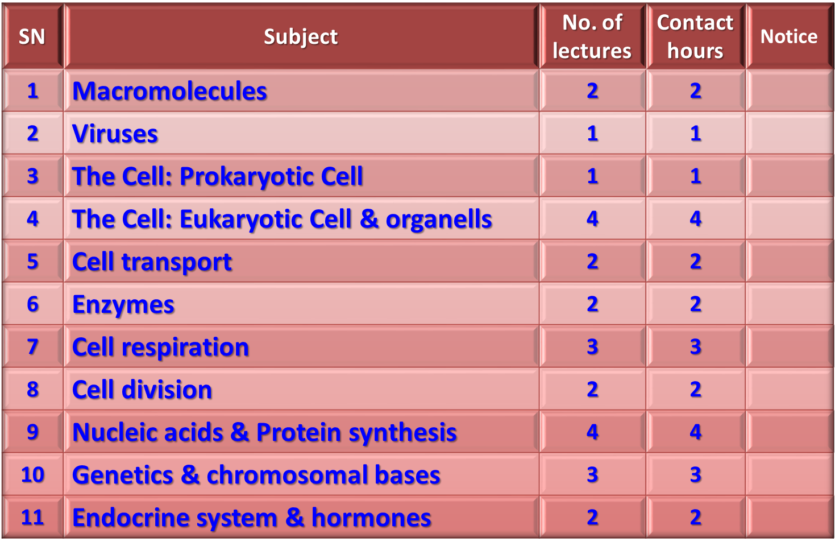
C)- Topics and teaching hours

Slide 5
D)- Knowledge to be acquired
Knowledge about the structure and properties of the living cell.
Knowledge about enzymes and there mode of action.
Knowledge about cellular respiration and energy production.
Knowledge about macromolecules and their types and importance.
Knowledge about DNA-RNA molecular bases and protein production
Knowledge about Mendel’s lows and genetic bases of inheritance
Knowledge about human endocrine system.

Slide 6
E)- Detailed Syllabus of Theoretical Zoo-109
Macromolecules:
Carbohydrates
Lipids
Proteins
Nucleic acids
Viruses
Prokaryotes
Bacteria & Archaea
Eukaryotes (Basics of cell Biology):
Cell types (plant & animal cell).
Cell organelles (animal cell)
Cellular transport (active & passive)
Enzymes and metabolic control

Slide 7
E)- Detailed Syllabus of Theoretical Zoo-109
Cellular respiration (production of ATP)
Cell division (cell cycle)
Mitotic division
Meiotic division (and sexual life cycle)
Molecular Biology (information codes and genes):
DNA and DNA-replication
RNA and RNA-transcription
From gene to protein (RNA translation)
Mendel and the gene idea:
First low of Mendel
Second low of Mendel
The genetic diseases, sex-linked disorders and mutations
The chromosomal bases of inheritance
Chemical signals in animals (endocrine system and hormonal regulation).

Slide 8
Campbell, N. A. and Reece, J. B. (2014). Biology (10th edition). Pearson Education. Inc. USA.

Slide 9
College of Science,
Zoology Department
General Animal Biology
(Zoo-109)
Zoology Department

