Slide 1
Industrial microbiology
CLS 416

Slide 2
Content:
Industrial microbiology.
Elements of industrial microbiology:
microorganisms, Environment(Fermenter)
Microbiological products:
Food Products: Bread,Yogurt, Single cell protein.
Enzyme production:
Pharmaceuticals: antibiotics, hormones, Vitamins
Production of pesticides.
Digestion of oil spills.

Slide 3
Industrial micrbiology
Successful exploitation of microbial activities on a large scale to manufacture useful substances for human consumption and economical benefits.
Mutant strains are most important to keep industrial fermentaation productive.
-Treatment with mutagens ( x-ray, U.V…)
-Gene amplification to force plasmid to reproduce faster.
Gene transfer and recombinant DNA.

Slide 4
Elements of Industrial mircrobiology
1- Microorganisims: Bacteria, yeasts, molds, viruses.
Must produce good amount of product
Rapid transport of nutrients
High metabolic rate
Short division time
Stable and non pathogenic

Slide 5
Elements of Industrial mircrobiology
2- Environment:
“Fermenter” provides the desired conditions:
Temperature (heating+cooling system)
PH (addition of acid or base)
Oxygen
Agitation (paddle wheels)

Slide 6
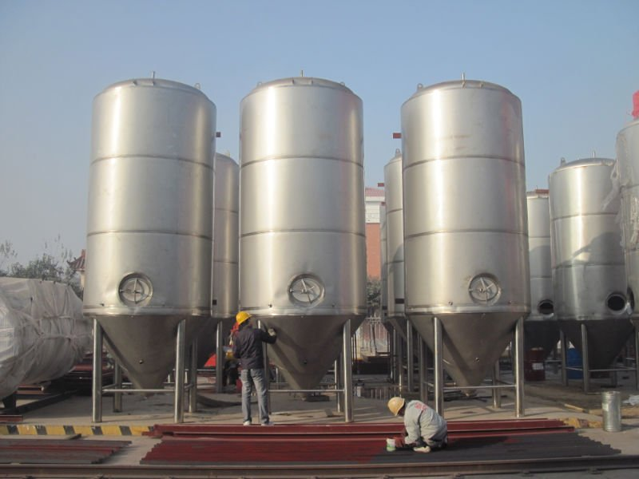
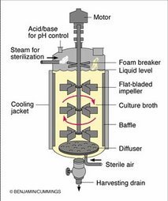
FERMENTERS

Slide 7
Types of fermenters
Batch culture fermenter
Continous culture fermenters
-More susceptible to contamination and
selection of mutants with increased growth rate.
-Give more products per unit time.

Slide 8
Microbiological products of food
Bread:
Saccaromyces cerevisiae (Brewers yeast)
Flour + salt +water→ CO₂+ ethanol
Yogurt:
Streptococcus thermophilus
Lactobacillus bulgaricus
Pasteurized milk → → Lactic acid + acetaldehyde+ other products
starter+bacteria 42ºC(8-10h)

Slide 9
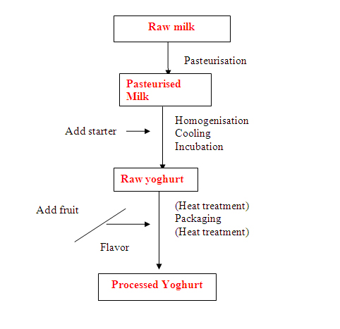
Yogurt Production

Slide 10
Microbiological products of food-------cont
Single cell proteins:
Growth of suitable microorganisms on a large scale
as a direct source of human food & animal feed.
hydrocarbons+mineral salts+m.o→→→ protein products
Saccaromyces cerevisiae (protein source)
Candida utilis (protein +vitamine)---40-50%f dry wt. is a.a
Pseudomonas sp.------69%of dry wt is essential a.a

Slide 11
Enzyme production:
Aspergillus sp., Penicillium sp., Rhizopus sp…..
Synthesize & extract large quantities of enzymes.
Amylase-----hydrolyse starch→dextrin+sugar
Invertase----sucrose→glucose+ levulose(inverted sugar)
Proteases refine hides, liquify glues, tenderize meat.
Pectinase digest pectin to manufacture linen,
to liquify fruit juice

Slide 12
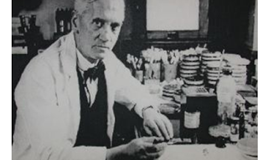
History of penicillin:
Sir Alexander Fleming observed that colonies of the bacterium Staphylococcus aureus could be destroyed by the mold Penicillium notatum, demonstrating antibacterial properties.()

Slide 13
History of Penicillin
The manufacturing process for Penicillin G Procaine was invented by Howard Florey (1898–1968) and Ernst Chain (1906–1979). Penicillin could now be sold as a drug. Fleming, Florey, and Chain shared the 1945 Nobel Prize for medicine for their work on penicillin.

Slide 14
Microbiological products of pharmaceuticals
Antibiotics:
Penicillins, tetracyclines, cephalosporins, erythromycin production yields 4 billion $/year.
-Streptomyces sp. tetracyclines, streptomycin
chloroamphenicol
-Penicillium notatum Penicillins (100 units)
Penicillium chrysogenum penicillins (100,000 units)
- Cephalosporium sp. cephalosporins

Slide 15
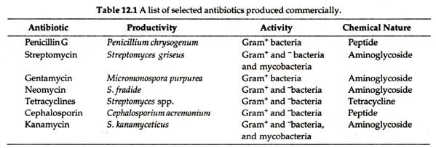

Slide 16
Synthesis of penicillin G
Penicillium chrysogenum+phenyl acetic acid→filtration
+ water+CHO+salt 8days
Crystals of penicillin G < ---chemical extraction
(99.9% pure)
Preparation of semi-synthetic penicillins:
Penicillin → → → → → Aminopenicillanic acid
(core molecule) remove benzyl group addition of side cain

Slide 17
Steps in Penicillin production

Slide 18
Steroid conversion:
microorganisms transform plant & animal steroids
into theraputically active forms:
Streptomyces lavendulae
Actinomycetes →→→
Rhizopus sp. →→→ Progesterone
Penicillium sp. →→
Aspergillus sp. →→
Steroids

Slide 19
Vitamin production
Pseudomonas dinitrificans→→B₁₂(cyanocobalamin)
Asbya gossypii→→B₂(riboflavin)
Acetobacter sp. →→Vit C (ascorbic acid)

Slide 20
Microbiological products of chemicals
Pesticides:
Bacillus thuringiensis
secretes an exo-enzyme
When injested by larvae of insects. The exo-enzymes
degrade hyaluronic acid that damage the digestive system and kills the larvae.
Secretes a toxin, when sprayed on larvae it would kill them.
Degradation of oil spills (pollutants)
Pseudomonas putida.

