Slide 1
Introduction Basic Immunology
Chapter one Types of immunity

Slide 2
Definition of Immunology
The branch of biomedicine concerned with:
the study of immunity
and the structure and function of the immune system

Slide 3
IMMUNITY
Definition of Immunity :
It means resistance of the body against foreign body .
Foreign body
1.Living body 2.non living body

Slide 4
Type of immunity
Acquired immunity (adaptive) | Natural immunity (innate)
specific | Non specific not directed to certain Ag
From time of exposure to certain Ag | From beginning of life
Cells → T & B lymphocytes . | Cells → macrophage (M Ø) Natural killer (NK)
Antibody Lymphokine | Humeral factor ( soluble factor ) Lysozyme _ complement _ cytokine - Acute phase protein
There are memory Cell → ↑ improve resistance | Excessive exposure to Ag No memory cell → No improve to resistance

Slide 5
1 - age : Young & old age →lower natural immunity Best immunity → after puberty 2- Nutritional factor : Good diet contain all vitamins & minerals produce good minerals immunity . While deficiency of vitamin & minerals in area of poverty → low immunity 3- Infidel varation 4- Race vidual variations : or breed or species 5- Stress (physical , Emotional ) Where stress stimulate adrenal gland to secrete glucocorticoids . w affect he immunity .
Factors affecting natural immunty

Slide 6
6- Hormonal Factors :
e.g. cortisone inhibit the immunity
Hormonal disturbance Affect immunity .
7- Drugs:
e.g. anticancer drugs
antibiotic

Slide 7
2nd interior factor The chemical barrier
1- lysozymes ..
A* originated from mucous membrane .
B* present in all body fluid except urine and sweat and C.S.F.
C* nature : protein .
D* function : in all body fluid it contains lysozyme: an enzyme that kill the gram positive bacteria.
~ they cause lyses to the peptidoglycan ( wall of the bacteria or viral envelope).

Slide 8
2- Acute phase protein
A* originated from the liver.
B* present in blood.
C* nature : its group of proteins produce by hepatic cells in low level in healthy body.
D* function : in case of infection , macrophage ingest bacteria secrete cytokines ώ activate hepatic cell to secrete large amount of acute phase protein to the circulation (100 times) which bind to CHO of some bacteria e.g. pneumococci.
Acute phase protein has opsonic effect .
E* psonization : coating of m.o and make it palatable to phagocytosis.
APP activate complement cascade which cause lysis to m.o. *
*Diagnosis of bacterial disease: ώ accompanied with high level of APP(CRP).

Slide 9
3- complement..
A*originated from liver and MØ (some factor).
B*present in serum.
C*nature : 21 protein molecules.
D*present in circulative in an in active form and activated during infection cascade activation ( in serial).
E* function : lysis of the Ag-Ab immune complex.
4-cytokines..
A*nature : protein in nature.
B*originated interleukin 1 and IL.6 from macrophage during infection.
C*function: they go to the hypothalamus which contain the center of body temperature (heat regulatory center) for induction of fever ( unfavorable to the m.o).

Slide 10
*they go to the liver to increase the production of acute phase protein.
*they go to the bone marrow to produce neutrophile neutrophilia . and also go to the T and B lymphocytes to increase the immune response

Slide 11
5-interferons..
They are protein molecules.
A*Gama interferon's : - interferon's.
*origination: from any infected body cell.
Againt any m.o especially virus.
*function: has antiviral effect and called immune IF.
Activate mø , .NK , IL-1 & TL2 & antibody production.
B* beta IF from b-lymphocytes and called.
C*alpha IF from leukocytes and called leukocyte .IF

Slide 12
Antibody | Interferon
-after 14 days from infection | -24 – 72 hour from infection
- from B lymphocytes | - from all cells
- specific | -Non specific
- still a long time | -Still for 24- 72 hour

Slide 13
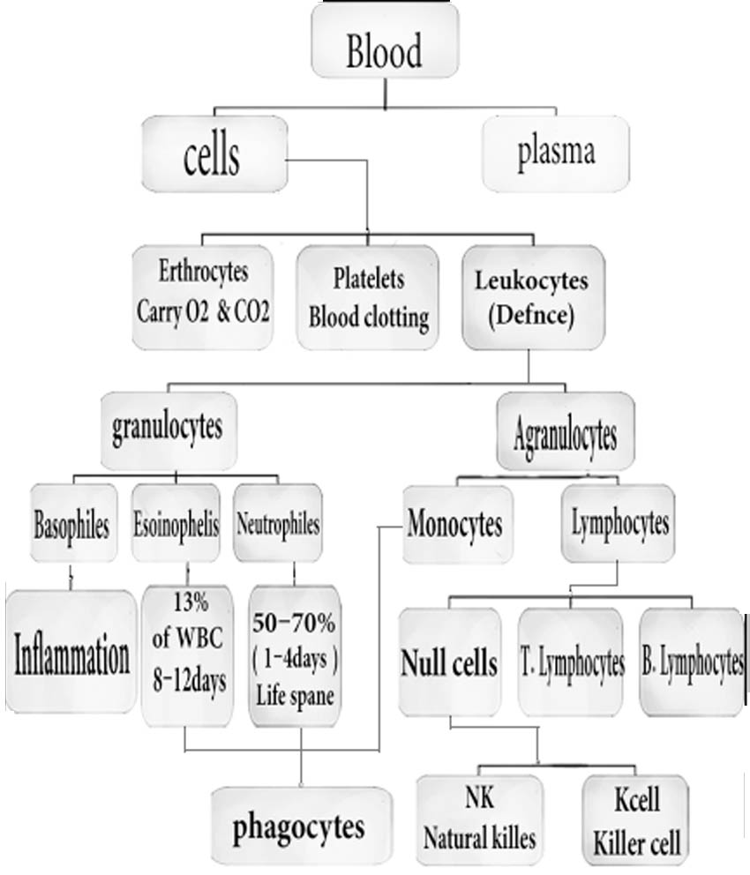
The cellular barrier
(2nd line of defence)

Slide 14
1- phagocytes
a- Macrophage
-Big
-Eater
Most largest blood cell. *
* Promonocytes are produced in the bone marrow
Then, become → Monocytes in the blood
Then, converted into macrophage in tissue (maturation) of monocyte to macrophage

Slide 15
2- Fixed macrophage
In epidermis called langerhans cell *
* In lung called alveolar macrophage.
* In centrol Nervous system called microglia
* Liver called küpffer΄s cell.
* Bone called osteoplast

Slide 16
3- Wandering m.ø → monocytes.
* It is long liver, depend on mitochondria for energy & are best in attacking dead cells & pathogens.
* Play rale in natural & acquired immunity
Function: phagocytosis & secretory function

