Slide 1
Illustrations

Slide 2
Artwork
traditional pasteup method
or the
electronic pasteup method.
In the traditional pasteup method, you simply leave space for the art. Before reproducing the copy on a duplicating machine, you paste the artwork in place. In an electronic pasteup, you will have the entire document on disk and can make a copy or copies from the printer.

Slide 3
There are 3 purposes for an illustration::
To give a general impression.:
pie chart
bar chart (sectional bar chart, dual bar chart)
pictogram
To show detailed information.:
Algorathim
Table
To show the structure and working of a system.:
chart
organizational chart
map
photo
Read the deatails of each chart from pgs 112-125

Slide 4
Examples

Slide 5
Pie Chart

Slide 6
Bar Chart

Slide 7
Sectional Bar Chart

Slide 8
 | A | B | C | D
Category 1 | 5 | 3 | 5 | 2
Category 2 | 4 | 6 | 0 | 1
Category 3 | 1 | 1 | 5 | 7
Table

Slide 9
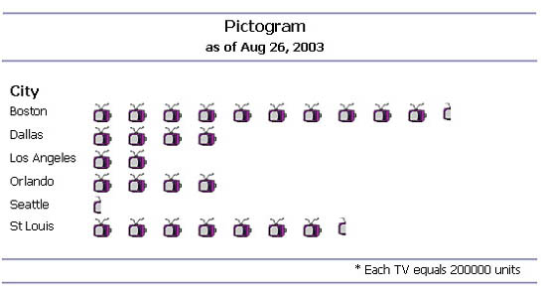
Pictogram

Slide 10
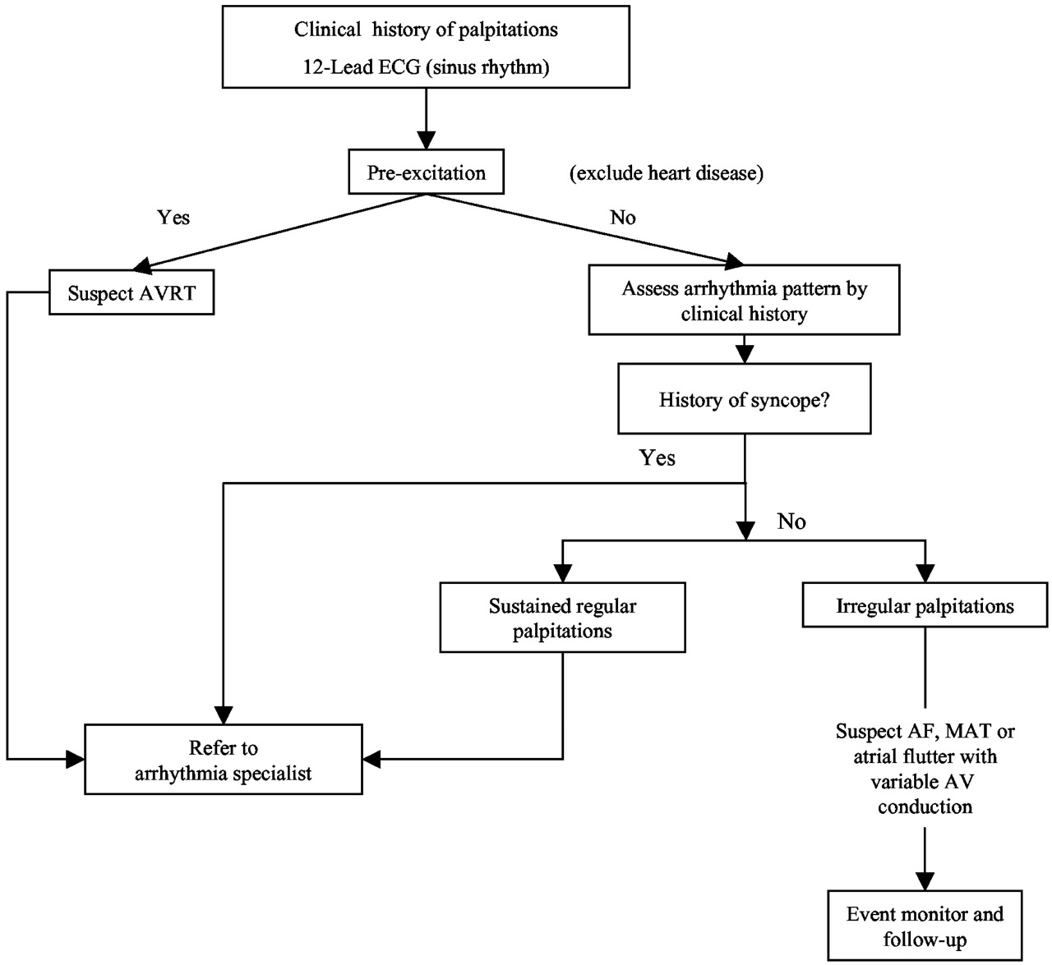
Algorithm

Slide 11
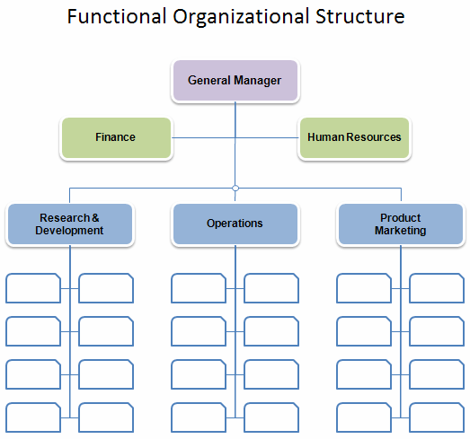
Organizational Chart

