Slide 1
hydrolysis of glycogen and determination of glucose

Slide 2
- Objective:
To examine the polysaccharide nature of glycogen and show that hydrolysis increases the number of reducing groups.

Slide 3
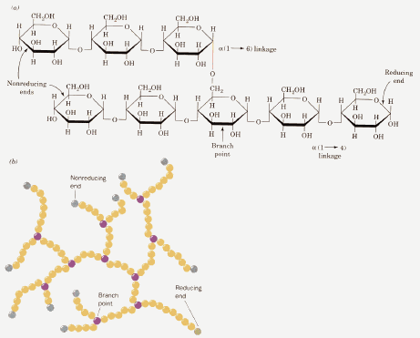
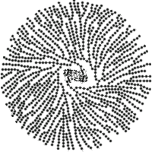
Introduction:
The structure of the glycogen molecule is fan-like; with long chains of glucose residues linked by 1, 4-glycosidic bonds, with 1, 6- links at the branch points.
So, the whole glycogen molecule has only one free reducing end, where the C1 of a glucose residue is free (exposed).

Slide 4
Thus the glycogen molecule is essentially non-reducing.
Hydrolysis converts glycogen from a non-reducing substance into reducing substances.
Hydrolysis of the glycogen molecule with acid results in splitting of all its glyosidic bonds giving only glucose molecules as the product.
Enzymes are more specific in the bond type they split.

Slide 5
Thus salivary amylase (α-amylase) will randomly split only 1, 4- glycosidic bonds and produce a mixture of products consisting of glucose, maltose and malttriose molecules.
The increase in the number of reducing groups is determined using 3, 5-dinitrosalicylic acid (DNS) in lkaline solution.

Slide 6
Theory
Several reagents can be used to assay reducing sugars such as 3, 5 dinitrosalicylic acid in one of the compounds.
In alkaline solution it is reduced to 3-amino-5- nitro salicylic acid, which is orange-red.
Absorbance is determined at 540 nm.

Slide 7
Acidic hydrolysis of glycogen
H2O |  | DNS reagent | 0.05 mol/l phosphate buffer | 1.2 mol/l NaOH | Time of hydrolysis (min) |  | 2 mol/l HCl | 0.05 mol/l PS buffer | Diluted glycogen | Tubes
5.5 | Boiling water bath for 10 min Cool down | 2 | 0.5 | 1 ml | 0 | -- | 0.6 | --- | 0.4 | 1
5.5 |  | 2 | 0.5 | 1 ml | 4 min | Boiling water bath in intervals of 4 min | 0.6 | --- | 0.4 | 2
5.5 |  | 2 | 0.5 | 1ml | 8 min |  | 0.6 | --- | 0.4 | 3
5.5 |  | 2 | 0.5 | 1 ml | 12 min |  | 0.6 | --- | 0.4 | 4
5.5 |  | 2 | 0.5 | 1 ml | 16 min |  | 0.6 | --- | 0.4 | 5
5.5 |  | 2 | 0.5 | 1 ml | 20 min |  | 0.6 | --- | 0.4 | 6
5.5 |  | 2 | 0.5 | 1 ml | 24 min |  | 0.6 | --- | 0.4 | 7
5.5 |  | 2 | 0.5 | 1 ml | 28 min |  | 0.6 | --- | 0.4 | 8
5.5 |  | 2 | 0.5 | 1 ml | 40 min |  | 0.6 | --- | 0.4 | 9
5.5 |  | 2 | 0.5 | 1 ml | 0 | -- | 0.6 | 0.4 | --- | Blank
Mix well ( total volume 10 ml in each tube) Read the absorbance at 540 nm against the blank sample (tube 10)

Slide 8
- Result:
Tubes | Time (min) | Abs (nm) | Hydrolysis %
2 | 4
3 | 8
4 | 12
5 | 16
6 | 20
7 | 24
9 | 28
10 | 40
Hydrolysis %= Abs x 100
Example:
Abs = 0.123
Hydrolysis % = 0.123 x 100 = 12.3

Slide 9
- Result:

Slide 10
Thank you

