Slide 1
How to handle your stress
Dr.Noor AL-Modihesh
Psychiatrist, lecturer.
Department of Psychiatry
KKUH

Slide 2
Lecture outline
Department divisions & population it serves.
What is stress ?
What makes you stressed?
Steps to help.

Slide 3
Psychiatry department
Grand floor, has both in-patient & out-patient service.
Covers ER cases, other wards referrals & PCC ones.
Qualified staff from North America & UK
Had Canadian accreditation this year.

Slide 4
What is stress?
we feel we have too much to do and too much on our minds, or other people are making unreasonable demands on us, or we are dealing with situations that we do not have control over.
It is NOT a medical diagnosis !
BUT can proceed to Anxiety or Depression

Slide 5
What causes stress?
There is change
Lack of control
It is not always harmful ! Sometimes necessary to achieve

Slide 6
How do I know if I'm under sever stress ?
Your body reaction ( ms cramps, sleep problems, headaches….
Your feeling ( depressed, dreaded from future, lack of interest, irritable, neglected
Your behavior ( decisions, concentration, avoidance,,,

Slide 7
What's the best way to handle pressure?
Plan every day
Relaaaaaaaaax
Manage your time ( noon or night, make list, vary tasks,,,
Act positively ( change scene, talk about achievement ,,
Develop an absorbing hobby or interest
Make time for your friends

Slide 8
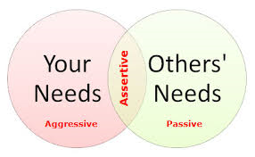
Practice being straightforward and assertive in communicating with others.
If you find yourself in conflict with another person, try to find solutions which are positive for them as well as for you.

Slide 9
Try to accept things you can’t change
Learn relaxation
Acknowledging your problems
Sleep
Healthy eating
Physical activity

Slide 10
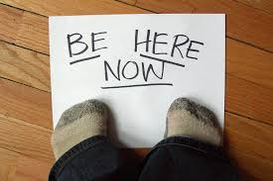
Mindfulness
is an approach to wellbeing that involves accepting life and living ‘in the moment’. This includes paying attention to the present moment and taking time to see what is happening around you in a nonjudgmental way

