Slide 1
Hair Health & Conditioners
Lauren Thaman Hodges
Associate Director
Procter & Gamble

Slide 2
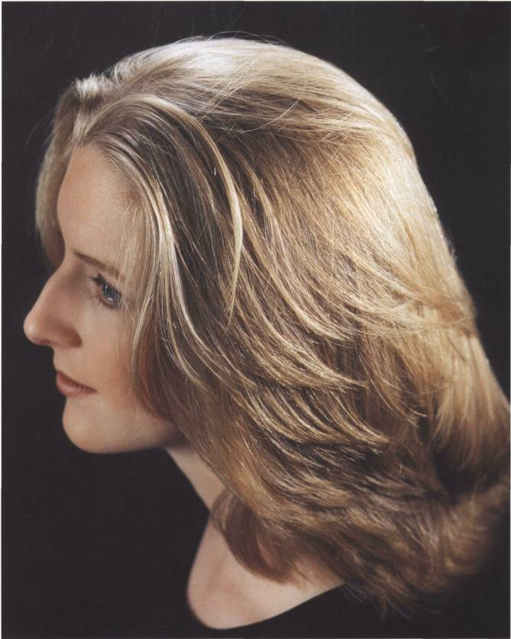
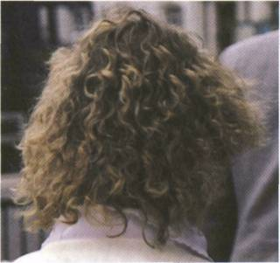
Patient Hair Health Concerns
Common Symptoms of Unhealthy Hair
Dull—lacking shine
Thin, limp
Dry, Frizzy
Brittle, Weak
Lifeless -- lacking resiliency and body
2

Slide 3
Causes of Cosmetic Hair Disorders
Common Causes of Unhealthy Hair
Medical vitamin deficiency, thyroid imbalance, hormonal changes, etc.
Aging graying, thinning, loss of pigment
Non-medical result of damage

Slide 4
Hair Health and Conditioners
Hair Physical Changes to Aging
Mechanism of Non-medical hair health issues --i.e. Damage
Use of Conditioner to improve cosmetic appearance of medical and non-medical hair health issues
    How Conditioners Work
    Benefits of Conditioning
4. P&G Proprietary Conditioner Technology

Slide 5
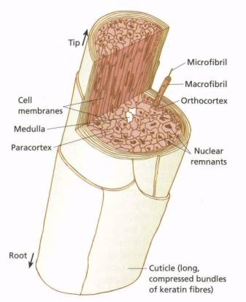
Hair Health
Anatomy of the Hair Shaft
Cortex provides the hair’s tensile strength
Cuticle layers bind the cortex bundles together
Cuticle layers protect cortex fibers from friction and mechanical damage
Cuticle responsible for surface properties of hair: shine, smoothness
5

Slide 6
Aging Effects on Hair Health
Melanin Loss | Increased UV damage susceptibility Reduced Shine
Development of Medulla | Hollow space increases hair stiffness Lack of fibers reduces tensile strength
Falling Sebum production (~50% by age 50) | Increased Dryness Loss of lubricity
Changes in Hair growth cycle | Thinning, loss of volume Diameter, fiber quality may also decline
Color Treating | Increase in damage susceptibility
6

Slide 7
Hair Damage
Progression of Hair Damage
Uplifted Cuticle
loss of cuticle
layer by layer
exposes cortex
split ends
hair breaks
Slight
Moderate
Severe

Slide 8
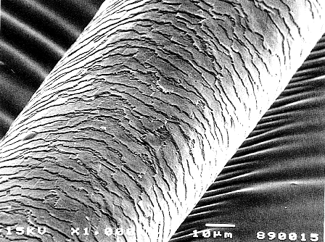
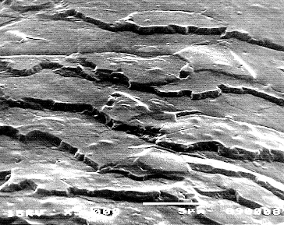
First Damage Symptom – Lack Shine
Good Cuticle Alignment/No Cuticle Lifting
→ Smooth Texture, Shine Reflection
Poor Cuticle Alignment
→ Light is scattered, shine diminished

Slide 9
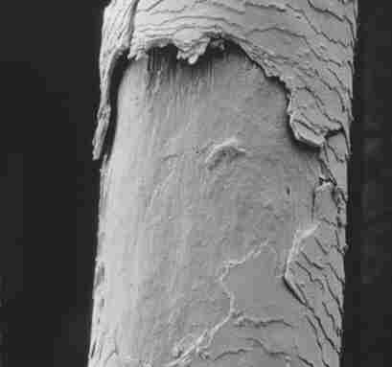
Hair Damage
Progression of Hair Damage
Uplifted Cuticle
loss of cuticle
layer by layer
exposes cortex
split ends
hair breaks
Slight
Moderate
Severe

Slide 10
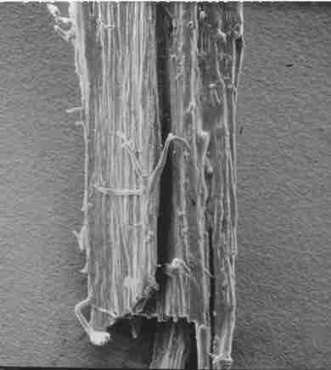
Hair Damage
Progression of Hair Damage
Uplifted Cuticle
loss of cuticle
layer by layer
exposes cortex
split ends
hair breaks
Slight
Moderate
Severe

Slide 11
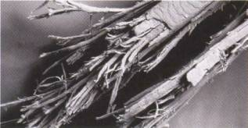
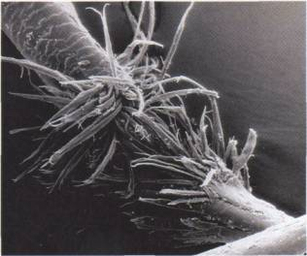
Hair Damage
Progression of Hair Damage
Uplifted Cuticle
loss of cuticle
layer by layer
exposes cortex
split ends
hair breaks
Slight
Moderate
Severe

Slide 12
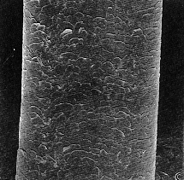
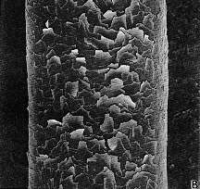
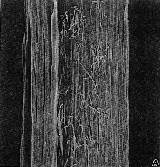
Hair Damage
Damage Occurs Over Time
Hair Damage typically occurs over a long time
Many consumers don’t notice damage until the cortex has already been destroyed
Root
Middle
Tip

Slide 13
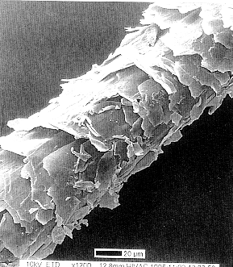
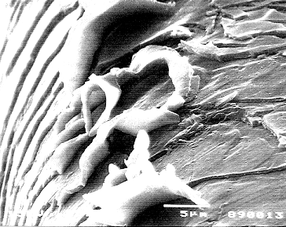
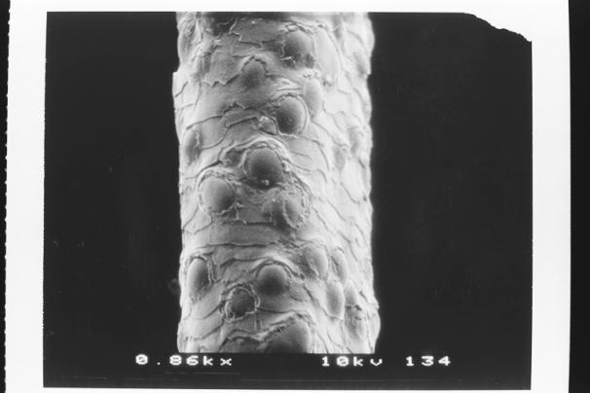
Hair Damage
Excess perming
Sources of Hair Damage
chemical
type of damage:
mechanical
UV
Protein degradation leads to other damage types
thermal
Back combing
Bubble Hair
13

Slide 14
Hair Damage
Healthy Hair = Healthy Cuticle
Shiny
Strong
Smooth
Silky
Full of Body
Soft

Slide 15
Conditioners
Definition:
The process of applying materials to the hair, both inside and outside, which provide:
a protective coating → prevent cuticle damage
retain moisture → improve flexibility, resilience
provide lubrication → improve smoothness and shine
Disperse static → reduce frizz

Slide 16
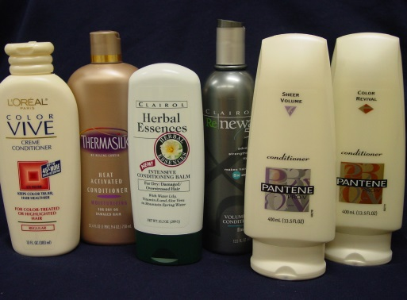
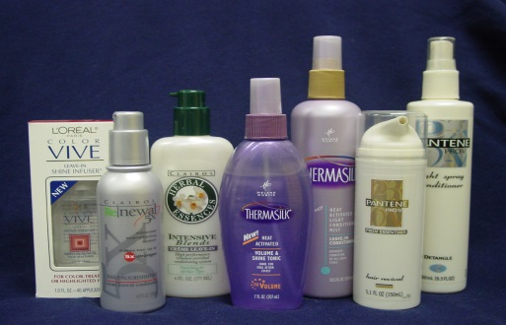
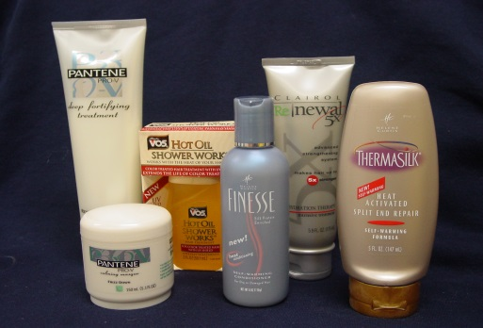
Types of Conditioners
Type
Purpose
Rinse-off (Traditional)
Leave-in or Rinse-free
Intensive Treatment
Used just after washing, provides a daily dose of damage protection, and help improve or maintain hair quality.
Used anytime during the day to provide damage protection, and help improve or maintain hair quality.
A high conditioning product to help restore the quality of very dry, damaged hair.

Slide 17
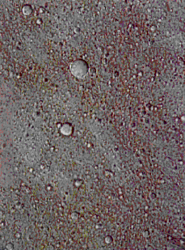
How Do Conditioners Work?
A combination of conditioning materials is blended together to deliver the intended level of conditioning.
Conditioning Material C
Conditioning Material A
The types and amount of conditioning materials and determines the total level of conditioning delivered.
Conditioning Material B

Slide 18
Conditioner Ingredients
Silicone Dimethicone, cyclomethicone, cyclopentacyloxane | Smooth hair feel, reduce friction, easier combing
Cationic Polymers Polyquaternium 10, Hydrolyzed protein, Keratin Amino Acids | Positively charged and attracted preferentially to areas of damage. Fortify damaged areas, can add volume.
Oil Emollients Mineral oil, Glycerine, Propylene Glycol, Natural Oils | Moisturize hair and make softer
Fatty Alcohols and Acids Cety alcohol, stearyl alcohol | Smooth hair feel and improved moisture retention
Quats/Amines Quaternium, Stearmidepropyl dimethylamine, Ditallowmethyl Ammonium Chloride | Makes hair easier to comb, charge dispersal helps reduce static
Pro B Vitamins Panthenol, Panthethine, panthenyl ehtyl ether | Optimize hair growth environment Humectants, moisture retention
19

Slide 19
Figure 4.15 Part of a keratin molecule with aspartic acid (asp), lysine (lys), and glutamic acid (glu) in the ionic forms they assume at pH 4 to 6.

Slide 20
One function of a conditioner then is to supply positively charged ions to neutralize the negative charge. Most conditioners do this with ionic substances in which one or more amino groups is electrically positive:
Your hair ceases to be charged once these amino compounds bind to it with ionic bonds.

Slide 21
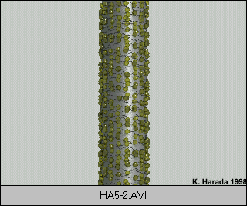
How Do Conditioners Work?
The conditioning materials are dispersed as very small droplets.
When the conditioner is applied to the hair, the droplets stick to the hair surface.

Slide 22
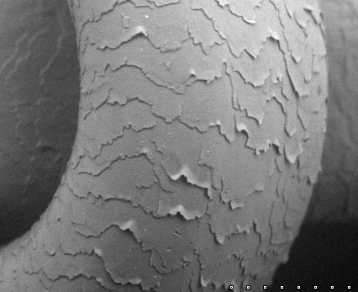
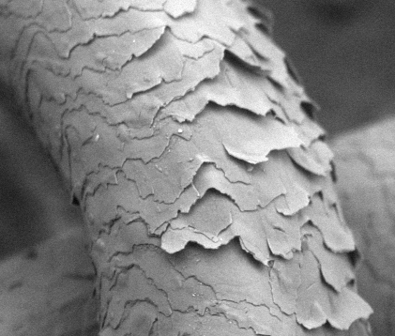
Conditioning Benefits:
Flexibility, Resilience, Body, Strength
Knot w/ Smooth Cuticle
Knot w/ Uplifted Cuticle
Conditioned hair
Non-conditioned hair

Slide 23
Q conditioner
R/
Stearyl dimehtyl benzyl NH4CL 35
Cetyl alcohol 25
Mineral oil 5
Water 935

Slide 24
Acid Conditioner
R/Cetyl Alcohol 15
SLS 0.5
Citric Acid 2
Water 82.5

Slide 25
Procedure:
In a porcelain dish, melt cetyl alcohol over water bath (75-80ºC).
Dissolve SLS and citric acid in water , heat on the same heater.
Add 2 to 1 gradually, with gentle stirring (to avoid incorporation of air) until a stable cream is formed.
Continue stirring until cooling, and then add perfume at 35ºC

Slide 26
Smoothing Benefits of Silicone
Conditioned with Silicone
Unconditioned
20μm
Very rough hair surface
Sharp, well-defined cuticle edges
Very smooth hair surface
Silicone visible under cuticle edges

Slide 27
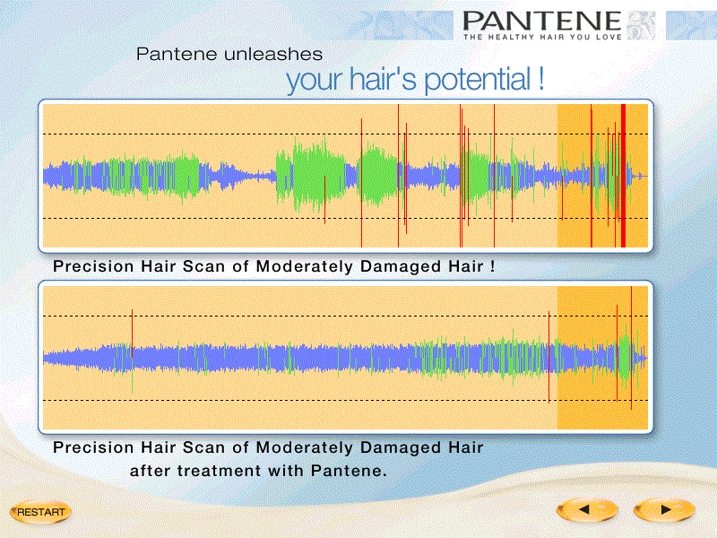
Conditioning Benefits:
Smoothness, Silkiness
Reduced Surface Friction
→Improved silky, soft feel
→prevention of mechanical damage to cuticle
25

Slide 28
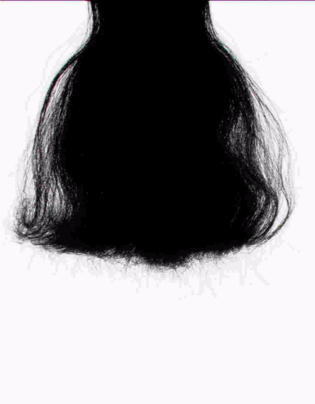
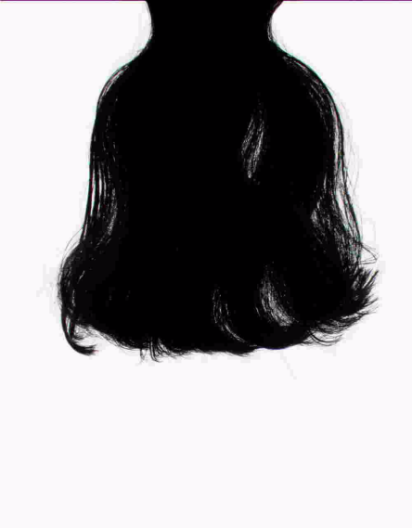
Conditioning Benefits:
Frizz, Flyaway Control
Poor
Conditioning
Moderate
Conditioning
Excellent
Conditioning
Frizz control via
Cuticle Smoothing
Static Charge Dispersal

Slide 29
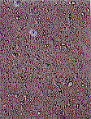
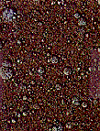
P&G Superior Conditioning Technology
BEST SALON
COMPETITION
OURS
Proprietary Gel Network Technology:
→Smaller particle sizes →More consistent coverage
→Higher levels of materials →Hair not weighed down

Slide 30
P&G Superior Conditioning Technology
28

Slide 31
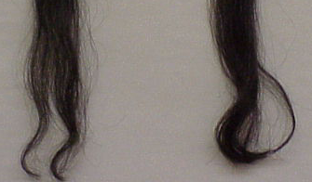
P&G Superior Conditioning Technology
Hair Condition after Wash & Wear Testing*
Competitor has lost 6X more hair (by weight) vs. P&G
P&G hair rated:
→thicker
less frizzy
healthier
Competitive Volumizing System
P&G Volumizing System
*After 16 cycles of:
Wash→ Condition→ Detangling→Wet & Dry Blow Dry→ Combing
Weighed and Visually Graded by Panelists
29

Slide 32
Hair Health and Conditioners: Key Take Away for Patients
Damage and medical hair health symptoms are very similar
Damage you see now actually began months or years ago
  Reduce damage by reducing friction
  Avoid double processing
Prevent Damage by frequent conditioner use
Improve cosmetic appearance of damaged and unhealthy hair by using conditioner

