Slide 1
Global Problems

Slide 2
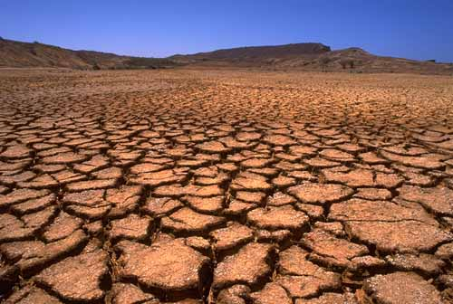
Drought

Slide 3
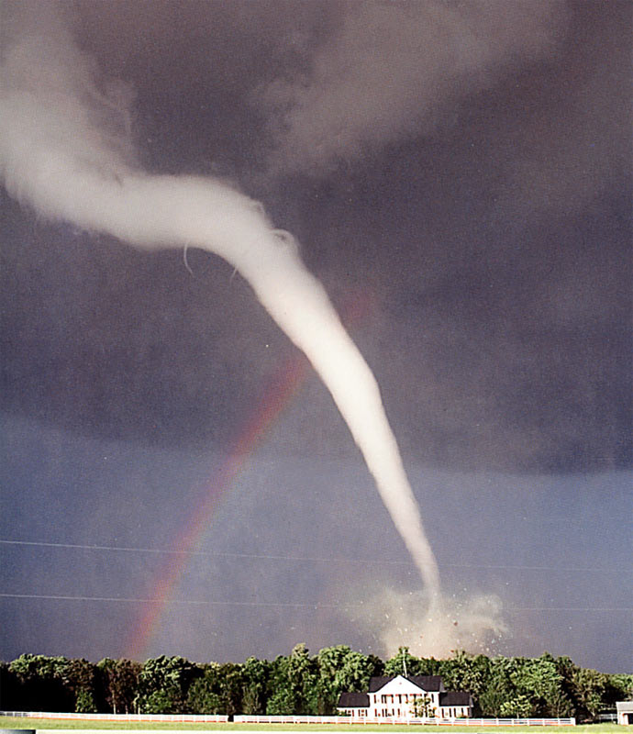
Tornadoes

Slide 4
Hurricanes: Are hundreds of miles wide.
Form only over warm ocean water.
Last for days and sometimes well over a week.
Produce rain and flooding in addition to powerful winds.
Are independent, self-sustaining storm systems.
Have winds ranging from 74 to about 200 mph

Slide 5
tornadoes: Are rarely over a mile wide
Usually form over land
Usually last minutes, rarely a few hours
Cause damage via wind and debris
Are dependent on a large storm to develop and keep going
Have winds ranging from 65 to about 300 mph
Often have a condensation funnel.

Slide 6
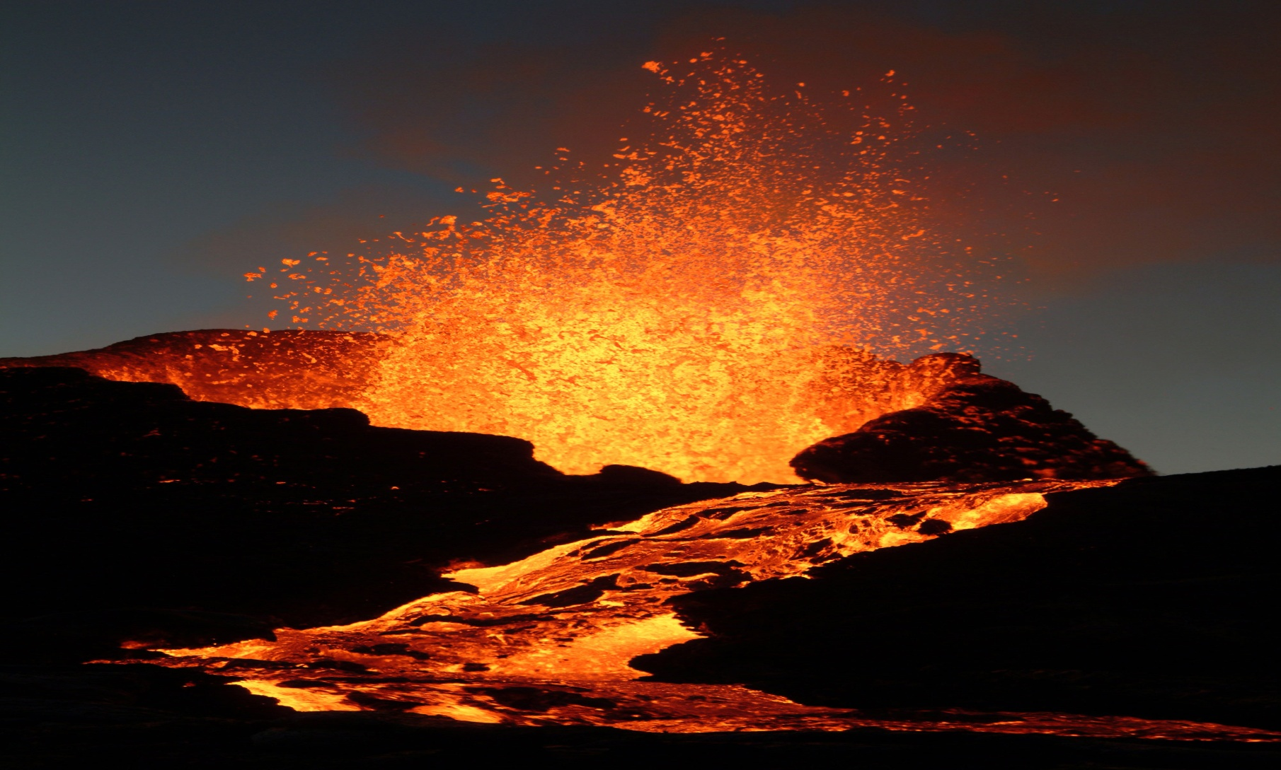
Volcanoes

Slide 7
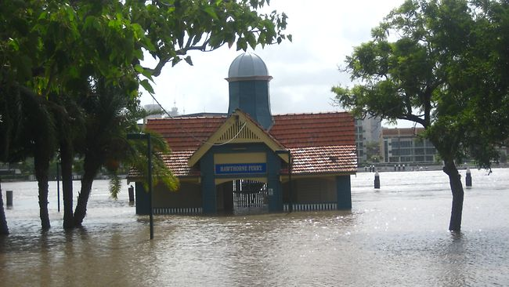
Floods

